Slide 1


SAP DESIGN PHASE · AI-AUGMENTED · BUILT FOR REUSE
Designveave
Process Design Platform
Capture the workshop. Structure the design.
Reuse what you've solved. Let the agent do the routine.
Xveave technologies pvt ltd

Slide 2
WHAT MAKES AN SAP DESIGN PHASE IMPACTFUL
Four things a design phase must get right
01
Reuse proven design
02
Expert time on what's unique
Start from patterns already solved — across your rollouts and past programs — instead of authoring every process from a blank page.
Automate the routine so your consultants spend their hours on the processes that actually differentiate your business.
03
See the design take shape
04
Review in logical units
Track progress by process area and requirement — real status, not "we're about 50% done."
The business reviews design as it's built, in digestible pieces — not a 300-page document dropped at the end.
Designveave · Process Design Platform
02

Slide 3
WHEN THE DESIGN PHASE FALLS SHORT
The cost shows up later — and compounds
47% of failed projects trace back to inaccurate requirements
COST TO FIX A REQUIREMENTS ERROR, BY PHASE
The single biggest controllable cause of failure sits in the design phase — before a line of code exists. PMI, Pulse of the Profession
Relative to fixing it in the requirements phase (1×) — log scale
29–1,500×
Large IT projects deliver 56% less value, run 45% over budget
What survives poor design isn't the plan — it's a diminished version of it. McKinsey & Univ. of Oxford, 5,400+ projects
21–78×
S/4HANA reality: only 8% finish on schedule
60%+ exceed budget; 65% find severe quality deficiencies after go-live — root cause: program setup and conceptual preparation. Horváth S/4HANA Study, 2025
7–16×
3–8×
A defect found after delivery costs up to 100× more
1×
…than finding and fixing it during requirements and design. Boehm & Basili, IEEE Computer, 2001
Requirements
Design
Build
Test
Operations
The design phase runs weeks. The real cost runs for years.
Source: NASA / INCOSE — Haskins, Stecklein et al., “Error Cost Escalation Through the Project Life Cycle,” 2004. Bar heights on a logarithmic scale (upper bound of each range).
Sources: NASA/INCOSE 2004 (NTRS 20100036670) · Boehm & Basili, IEEE Computer, Jan 2001 · PMI Pulse of the Profession, Requirements Management, 2014 · McKinsey & Company / Univ. of Oxford, 2012 · Horváth, Business Transformation Unlocked, 2025
Designveave · Process Design Platform
03

Slide 4
WHY IT PAYS OFF INSIDE YOUR PRACTICE
Four ways it changes your delivery economics
01
More throughput per consultant
02
Protect fixed-price margin
A faster design phase means each consultant delivers more engagements a year — the same team, more billable projects, higher utilisation.
Design rework is where fixed-price margin quietly disappears. Catching design gaps early — before build — keeps the profit in the project.
03
Leverage past senior scarcity
04
Consistent quality across teams
Junior consultants deliver senior-quality design when the AI and a proven repository carry the expertise — less dependence on scarce architects.
Every consultant works the same structured way, so design quality doesn’t swing with who’s staffed — fewer weak deliverables to catch and rework later.
Designveave · Process Design Platform
02

Slide 5
THE COMPOUNDING ADVANTAGE
Every engagement makes the next one faster
✦
Your repository grows with every project
✦
Reuse across clients becomes a moat
Each engagement adds proven design your consultants draw from — the next rollout starts from everything the last one solved.
The fifth project starts from the first four — accumulated design IP a competitor starting from scratch cannot match.
✦
Knowledge stays in the firm
✦
Not a tool — an intelligence layer
Design expertise is captured in the platform — it doesn't walk out the door when a consultant rolls off or leaves.
Find-similar surfaces the solution, config and RICEF your firm already proved — the moment a matching requirement appears. Your accumulated design working on every new engagement, not sitting in an archive.
The more you deliver, the sharper your edge — and the same platform is a differentiator you can put in front of clients.
Designveave · Process Design Platform

Slide 6
THE DESIGN PHASE, REBUILT
Same phase — a fundamentally different shape
Every stage of the design phase runs on one platform — and AI runs underneath all of them, turning build-work into verify-work.
→
→
→
→
01
02
03
04
05
Repository
start
Workshop
capture
Structured
BPD
Continuous
review
Final
deliverable
✦ AI THROUGHOUT
build repository · refine notes · propose changes · find similar & reuse · generate tests & authorizations · classify minutes
AI isn't a step in the flow — it's the layer every stage runs on.
Designveave · Process Design Platform
04

Slide 7
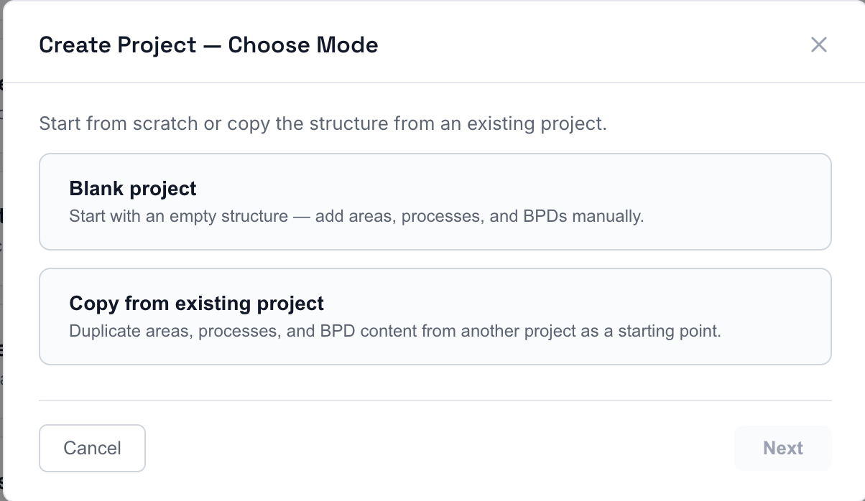
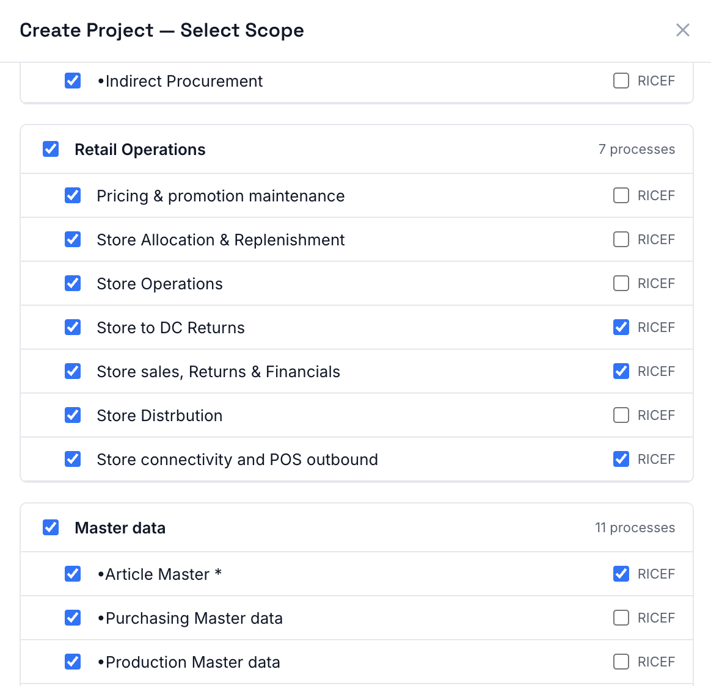
REUSE — START FROM THE REPOSITORY
A new rollout starts from the last one
1 · CHOOSE MODE
2 · SELECT SCOPE
CREATE PROJECT · CHOOSE MODE
CREATE PROJECT · SELECT SCOPE
Create a project by copying an existing one — then choose exactly what carries over: whole areas, individual processes, and their RICEF. The next rollout starts from proven structure, not an empty page.
WHY IT MATTERS Your next rollout doesn't start from zero — it starts from everything the last one proved.
Designveave · Process Design Platform
05

Slide 8
ZOOM IN — A SINGLE WORKSHOP
One workshop, before & after
TODAY
WITH DESIGNVEAVE
–
Notes scattered — margins, notebooks, laptops
✦
Notes captured live, tagged in context
–
Hours of post-workshop typing and sorting
✦
AI drafts cascading proposals immediately
–
Days waiting on email-based review
✦
Consultant reviews & accepts in real time
–
Rework cycles on the sticky points
✦
Per-requirement review can start same day
Workshop → reviewable design: days
Workshop → reviewable design: hours
Designveave · Process Design Platform
06

Slide 9
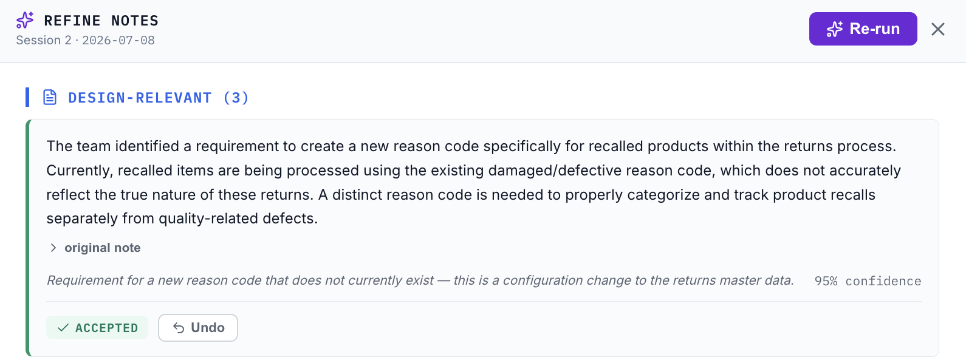
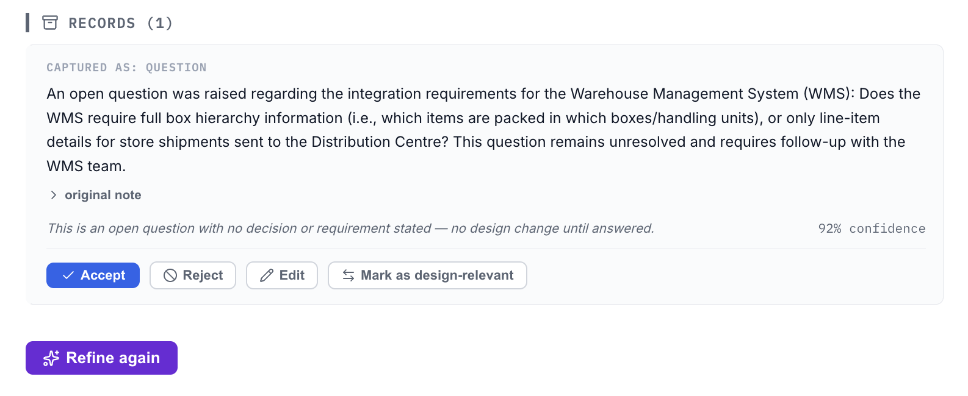
CLASSIFIED BY DESIGN IMPACT
It knows what changes the design — and what doesn't
NOTE 1 · CHANGES THE DESIGN — ACCEPTED
REFINE NOTES · DESIGN-RELEVANT
Every workshop note is rewritten into clean, structured language and classified by its design impact — with the reasoning and a confidence score shown. Nothing is filed silently: the consultant accepts, rejects, edits, or reclassifies.
NOTE 2 · A QUESTION — NO DESIGN CHANGE
REFINE NOTES · RECORDS
WHY IT MATTERS An open question never becomes a design decision by accident — and every call the AI makes is shown with its reasoning, for a person to confirm.
Designveave · Process Design Platform
07

Slide 10
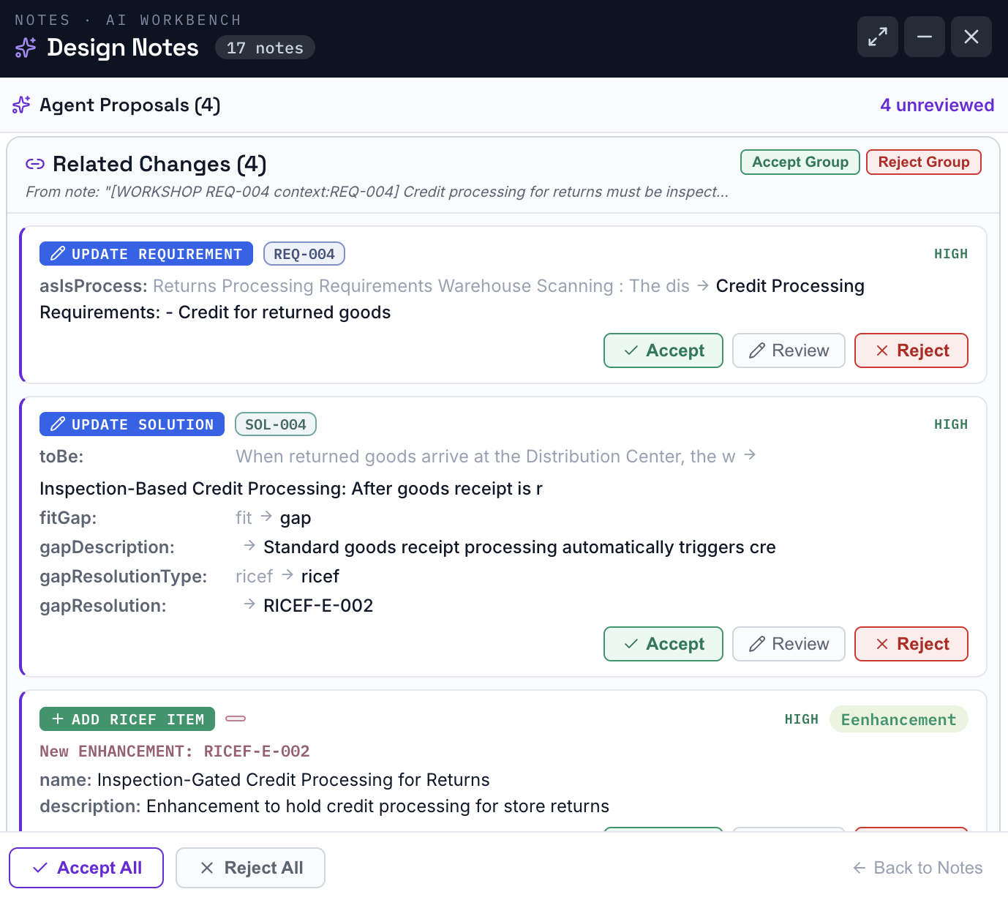
AI THROUGHOUT
The agent does the routine — consultants verify
✦
Refine notes
Shorthand → clean, structured input.
✦
Generate Process diagram using business language
Describe the process and let the app build/modify the process diagram
✦
Agent proposals
Reads notes, drafts changes to accept.
✦
Find-similar reuse
Pulls solution + config + RICEF across projects.
✦
Test-case generation
Drawn from the structured requirements.
✦
Authorization matrix
Roles → activities → t-codes / Fiori apps.
Designveave · Process Design Platform
08

Slide 11
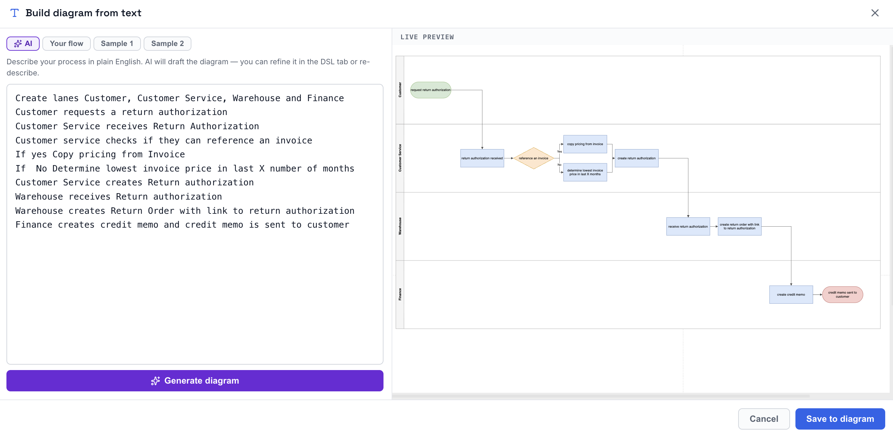
AI assisted process diagram generation
Business language to Process diagram
Explain the process in business language
And let the app build a process diagram
Create process diagram using business language
Build process diagram
—
Create new process flow using
business language
—
Edit a generated process flow as needed
—
View before/after and make a prudent call
Designveave · Process Design Platform
09

Slide 12
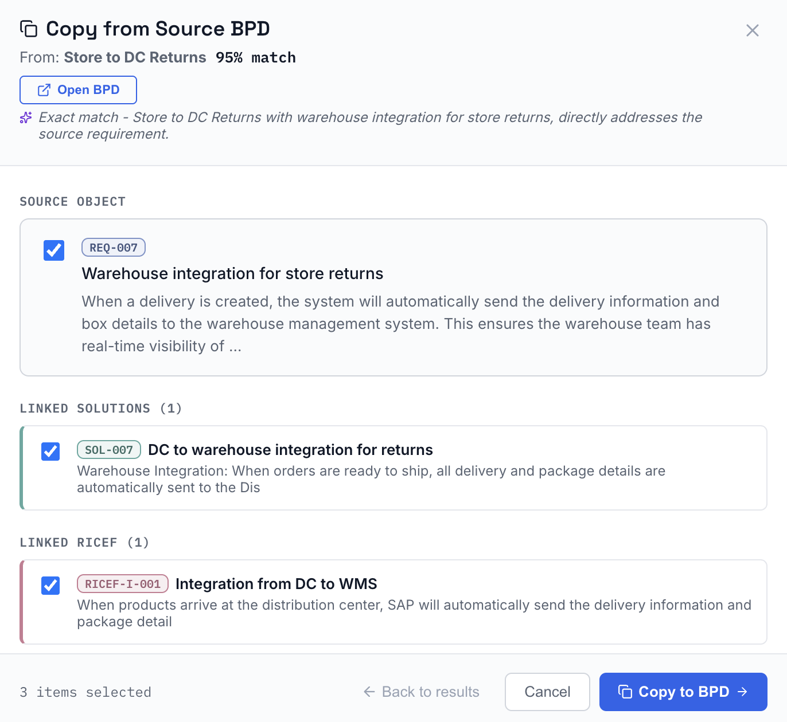
REUSE — START FROM PROVEN DESIGN
FIND SIMILAR · COPY FROM SOURCE BPD
Someone already solved this
A new requirement matches design proven on another rollout or program. Designveave finds it and pulls the whole cascade — solution, configuration and RICEF — across projects.
REUSE AT EVERY LEVEL
—
A full best-practice project
—
A subset — phases or modules
—
An entire area of prior work
—
A single process within an area
—
One requirement + its cascade
Designveave · Process Design Platform
09

Slide 13
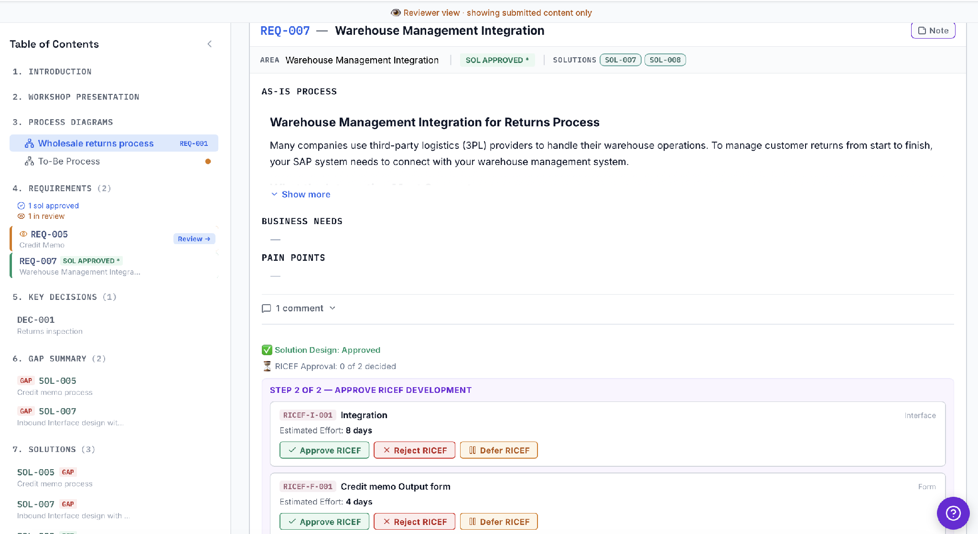
CONTINUOUS REVIEW
The business reviews the design as it's built
BPD · REVIEW & APPROVE
Instead of a 300-page document dropped at the end — reviewed in a rush when the team is already overwhelmed — the business sees the design take shape and approves it in logical units, the moment each piece is ready.
Real understanding at sign-off — not a rushed rubber-stamp.
Designveave · Process Design Platform
10

Slide 14
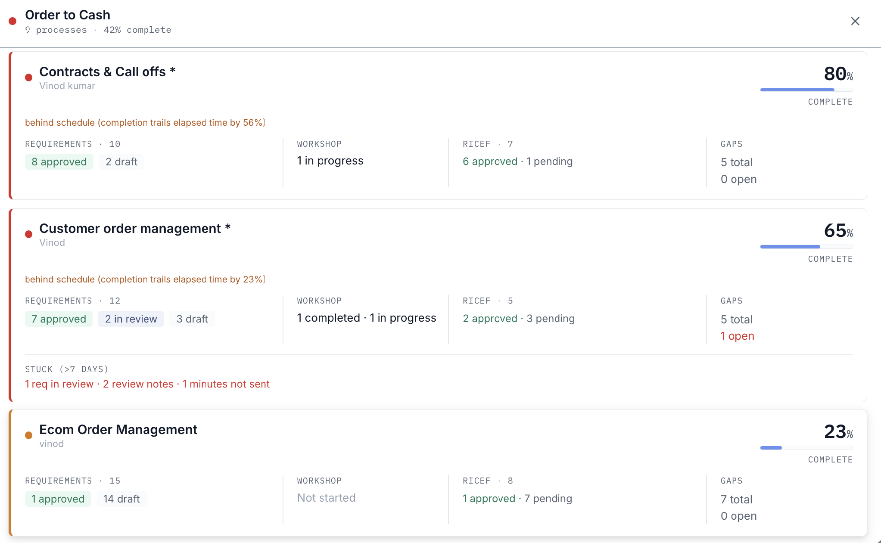
VISIBILITY
Progress you can see
PROJECT DASHBOARD · PROGRESS
No more "we're about 50% done." Every requirement carries a status; every solution, config and RICEF links back to the requirement it serves. Leadership sees where each design stands — by process area, by BPD, by element — and where the effort is going.
From "consultant says 50%" to evidence you can act on.
Designveave · Process Design Platform
11

Slide 15
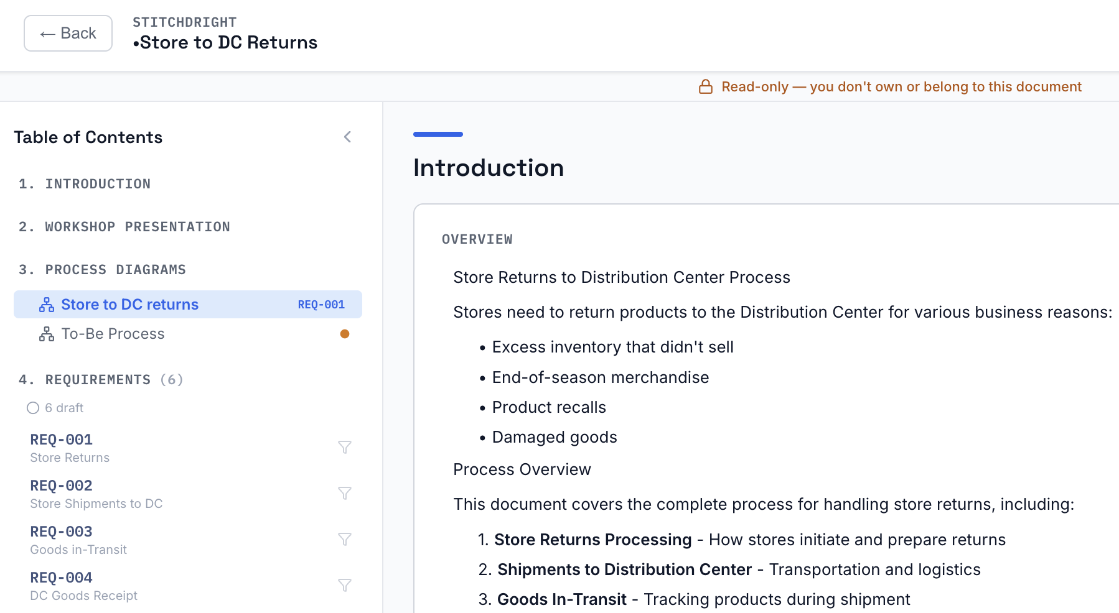
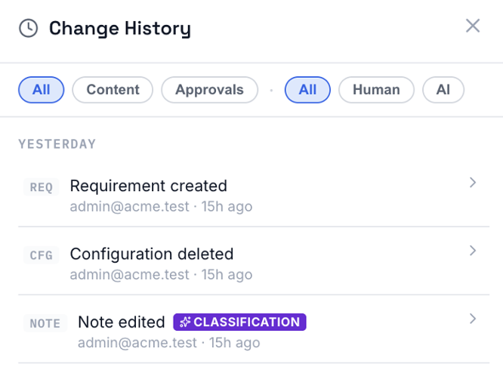
GOVERNANCE — ACCESS & AUDIT
Who can see what — and a record of every change
Design is commercial-in-confidence and contractually binding. Access is scoped to the role — and every change to it is evidence, not memory.
ADMIN · ROLES & ACCESS
BPD · AUDIT LOG · CHANGE HISTORY
ROLE-BASED ACCESS Consultants, reviewers, admins and business owners each see what their role needs — no more. A customer reviewing their design doesn't get your whole repository.
EVERY CHANGE, ATTRIBUTED Who changed it, when, what it was before — and whether a person or the agent made
the change. Approvals carry their own trail.
WHY IT MATTERS Two years post go-live, “why was it built this way?” has an answer — with a name and a date against it.
Designveave · Process Design Platform
12

Slide 16
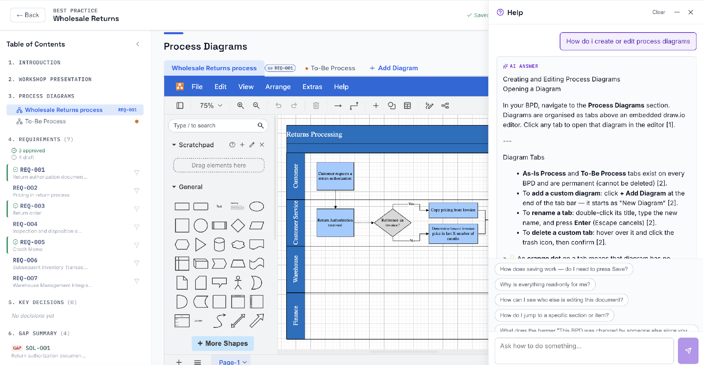
ADOPTION — AI HELP BUILT IN
Built-in AI help to navigate the application
BPD · IN-APP AI HELP
There's no training programme to organise. Help lives inside the product — ask a question in plain English and get step-by-step, click-through guidance for any part of the application, in context, at the moment it's needed.
Designveave · Process Design Platform
13

Slide 17
THE OUTCOME
A design phase that finishes on time — and holds up
✦
Finishes on time
✦
The business understood it
Faster authoring and continuous review mean the phase ends on schedule, not in emergency mode.
Reviewed in logical units as it was built — real sign-off, not a rushed rubber-stamp.
✦
Build starts on solid ground
✦
Knowledge stays with the program
Specs written from sound design, fewer gaps waiting to surface in testing.
Captured in a reusable repository — it doesn't walk out when consultants roll off.
The design phase, made productive for both the SI and the customer.
Xveave technologies pvt ltd

