Slide 1


Login App REACT - ExpRESS -MonGOOSE
BY
Vinod Nagaraj

Slide 2

ABOUT ME
Vinod Nagaraj
Employer: Cognizant
Technical Skill: React,Javascript,Java,Spring MVC
Gmail:vinodnlee@gmail.com
Git Account: https://github.com/vinodnlee

Slide 3
AGENDA
React JS
Virtual DOM
State and props
Component life cycle
Express JS
Middle ware
Router
Mongoose JS
Object Document Model
API related to CRUD Operation

Slide 4



Browser
REACT UI
POST/GET request
EXPRESS
Service request
NODE SERVER
Process Login/SignUp
MONGO
DB
PASSPORT
LOCAL STRATEGY
MONGOOSE
DB Driver
Decode/Encode Pay Load
BCRYPT
Encode/Decode password
JSON WEB TOKEN
WORK FLOW

Slide 5

REACT

Slide 6







REACT History
+
=
APPLICATIONS :

Slide 7
REACT
UI Components
Virtual DOM
Immutable
Data
Can be Used in Other Framework
Abstracts away the DOM and does all the operations on the VD before updating real DOM
Data move in one direction

Slide 8
REACT DIFFING ALGORITHM
A
A
B
C
B
C
D
E
F
D
E
F
G
H
G
H
Depth Frist Search
Breadth First Search

Slide 9
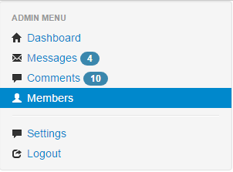



sample UI
HEADER Component
SIDE MENU Component
Article Component
FOOTER
Component

Slide 10
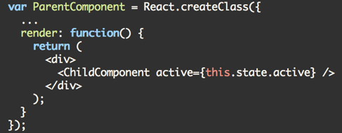
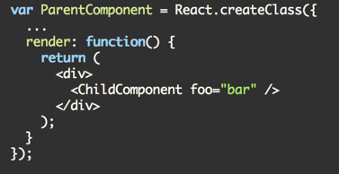


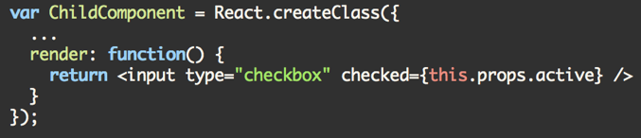
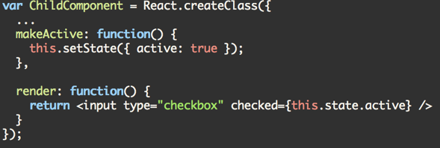
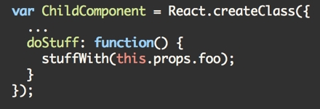
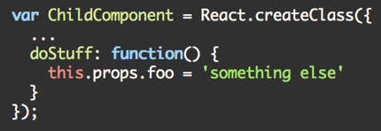

REACT STATE And PROPS
State can become props
Data handed from parent to child
Props are immutable
State is mutable

Slide 11
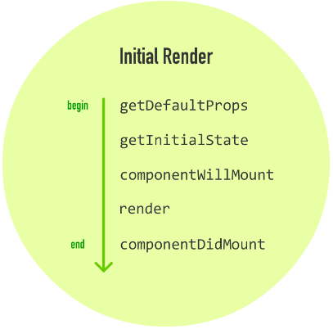
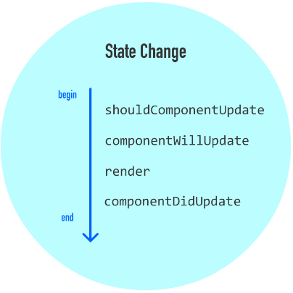
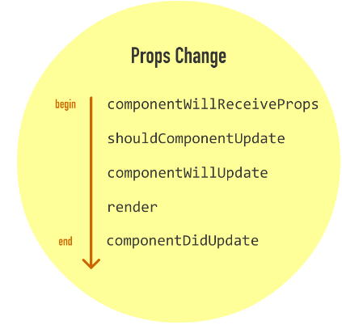
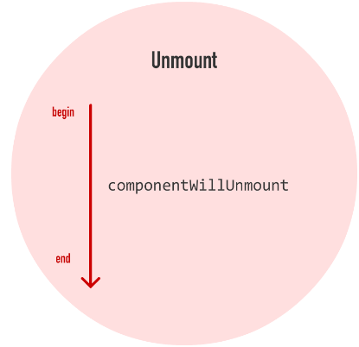
React LIFE CYCLE

Slide 12

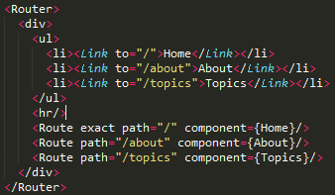
REACT ROUTER

Slide 13
EXPRESS

Slide 14

Browser
React
Node JS
Get/Post
Express
Webserver
Components
Mongo DB
Server Side
User
Interactions
Minimal open source web frame work for Node.js.
Uses MVC Concepts
Fast Access to I/O due to Node.
Single threaded and asynchronous servicing the request.
Express

Slide 15

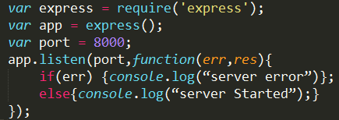
Express Server Config:
app.listen(port, [host], [backlog], [callback]])
Argument | Description
port | a port number on which the server should accept incoming requests
host | Name of the domain. You need to set it when you deploy your apps to the cloud.
backlog | The maximum number of queued pending connections. The default is 511.
callback | An asynchronous function that is called when the server starts listening for requests.
Express Server

Slide 16
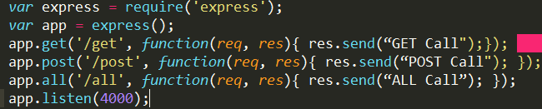
Express HTTP Config:
app.METHOD(PATH, HANDLER)
METHOD (get, set, put, delete). An alternate method called all exists that executes independent of the request type.
Path is the route at which the request will run.
Handler is a callback function that executes when a matching request type is found on the relevant route.
Express HTTP

Slide 17
Request is received by server
Multiple Middleware
Function execute
Express
Route handler
Response object after middleware processing is sent to client
Multiple Middleware
Function execute
Functions that are invoked before request handler is made.
app.use(function(req, res, next){});
app.post(‘/upload’,auth.isAuthenticated(),Controller.upload)
Express MIDDLE WARE

Slide 18
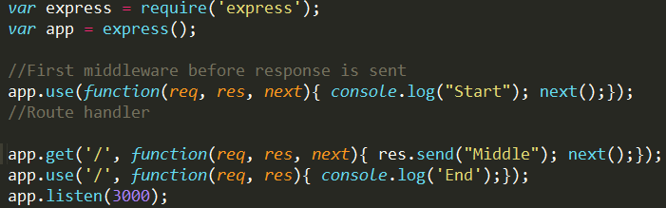
Express 3.Example:
Express MIDDLE WARE EXAMPLE

Slide 19
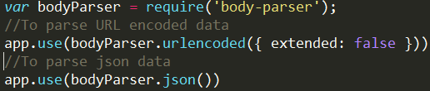
BODY-PARSER
parses the body of requests which have payloads attached to them.
Express THIRD PARTY MIDDLE WARE

Slide 20
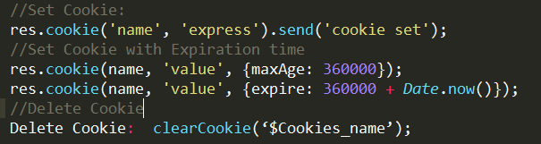
COOKIE-PARSER
parses cookies attached to the client request object
Express Cookie Parser

Slide 21
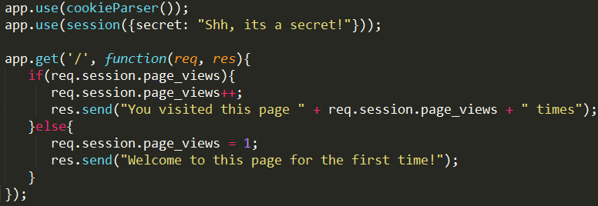
HTTP is stateless, in order to associate a request to any other request, need to store user data between HTTP requests.
creating the session,
setting the session cookie
creating the session object in req object.
Express THIRD PARTY Express

Slide 22
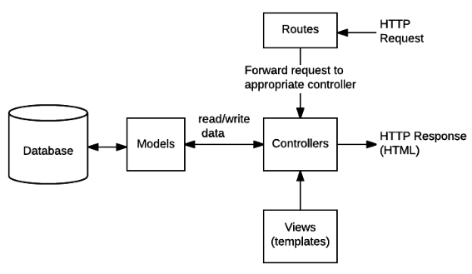
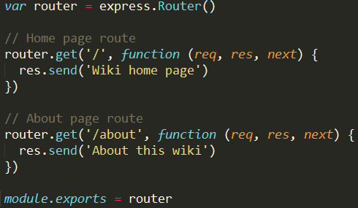


"Routes" to forward the supported requests to the appropriate controller functions
Express Routing

Slide 23
MONGOOSE

Slide 24

Mongoose is used for document Modeling in Node interacting with Mongo DB.
Establish connection to mongo DB:
MONGOOSE

Slide 25
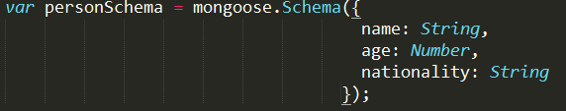
Create a Model:
Two step process:
1. Create schema
2. Assign schema to model
The above code defines the schema for a person and is used to create a mongoose Model Person.
MONGOOSE MODEL

Slide 26
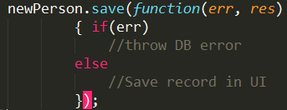
Saving documents in DB
save() function accepts a callback as argument, This callback has 2 arguments, error and response
Example
MONGOOSE SAVE

Slide 27


Model.find(conditions, callback)
Model.findById(id, callback)
Model.findOne(conditions, callback)
Above function finds all the documents matching the fields in conditions object.
Example: fetch all the documents from the persons collection.
Fetch all documents where feild name is “Test” and age is 20.
MONGOOSE RETRIEVING DOCUMENTS

Slide 28
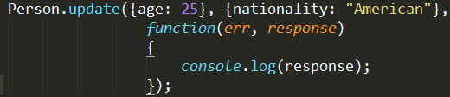
Model.update(condition, updates, callback)
Model.findOneAndUpdate(condition, updates, callback)
Model.findByIdAndUpdate(id, updates, callback)
This function takes a conditions and an updates object as input and applies the changes to all the documents matching the conditions in the collection.
Example: Update all the documents from the persons collection.
MONGOOSE UpDATE

Slide 29
Model.remove(condition, [callback])
Model.findOneAndRemove(condition, [callback])
Model.findByIdAndRemove(id, [callback])
This function takes a conditions and removes all documents matching the conditions
Example: delete all the documents from the persons collection.
MONGOOSE DELETE

Slide 30








Validate Login
Linked in User
passport.
authenticate(‘linkedin’');
Linked In
Account
Client ID /Secret
passport.
authenticate('twitter');
Twitter
User
Twitter
Account
Consumer key /Secret
Google
User
passport.
authenticate(google');
Google
Account
Client ID /Secret
Face Book User
passport.
authenticate(‘facebook');
Face Book
Account
Client ID /Secret
3rd party
Application
Passport JS
Call Back Url
PASSPORT JS

Slide 31

JSON WEB Token

Slide 32

standard since the information is transmitted via JSON
work across different programming languages:
self-contained
passed around easily.
JSON WEB TOKENS

Slide 33




Http Request No Web Token
Bank Transaction
Bank Transaction
Https Request with JSON Web Token
Http Request No Web Token
USE OF JSON WEB TOKENS

Slide 34

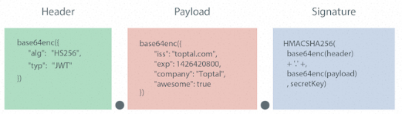
JSON Web Tokens (JWT)
JSON WEB TOKENS

Slide 35


Thank YOU

