Slide 1
Serverless Compute Proposal
Proof of Concept and Future Enhancements
Created by: Vinod Pandey
Date: March 23, 2025
Objective: Demonstrate a scalable, efficient serverless compute solution

Slide 2
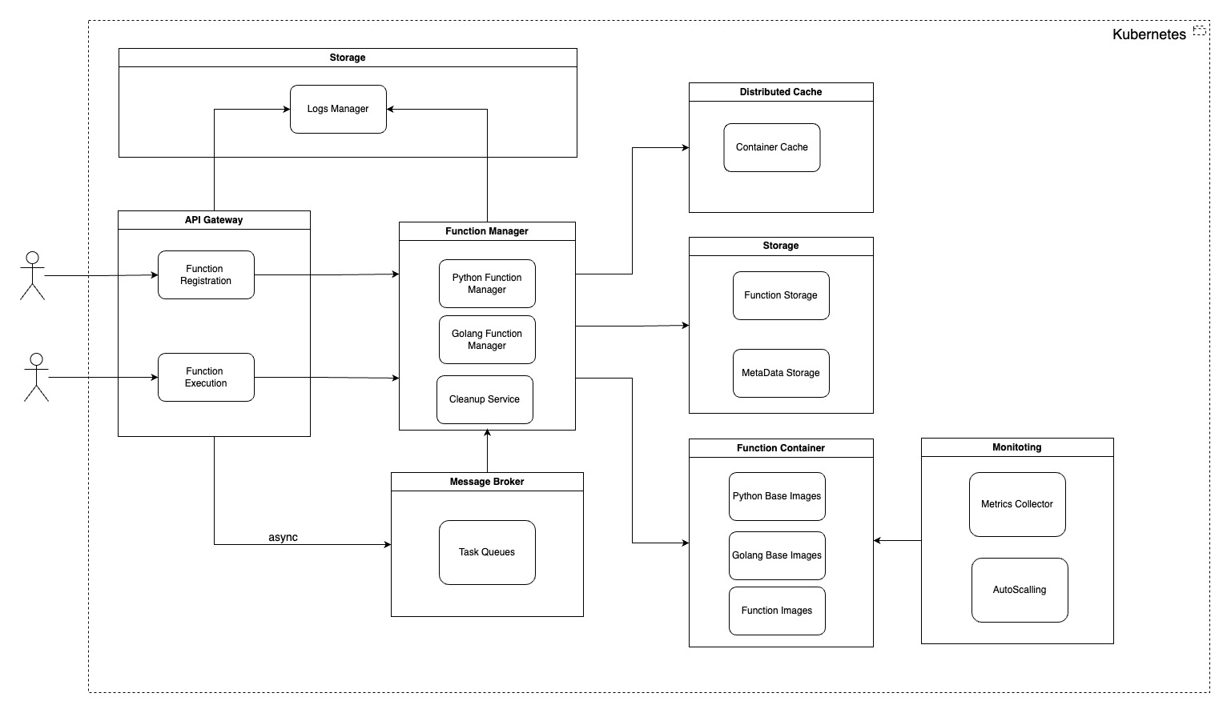
High-Level Architecture

Slide 3
High-Level Architecture
API Gateway
Entry point for function registration, execution and other feature
Function Manager
Orchestrates function lifecycle (Python support)
Function Container
Executes functions in isolated containers
Storage
Manages logs, function code, and metadata
Distributed Cach
Optimizes container reuse
Message Broker
Handles async function execution requests
Monitoring
Tracks metrics and enables autoscaling
Kubernetes
Orchestrates all components

Slide 4
API Gateway
Purpose: Single entry point for client interactions
POC Role:
Handles HTTP requests for function registration and execution
Routes to Function Manager synchronously
Future Enhancements:
Add authentication and authorization
Rate limiting and throttling

Slide 5
Function Manager
Purpose: Manages function lifecycle and execution
POC Role:
Supports Python functions
Includes Cleanup Service for container TTL (15 mins)
Integrates with storage and cache
Future Enhancements:
Add support for more languages (e.g., Golang, Node.js, Java) and multiple versions
Dynamic load balancing across replicas
Enhanced error handling and retries
Add support for List functions, Get function details and Download function code
Support for function metadata e.g. environment variable, concurrency and required resources (memory)
Function version management

Slide 6
Function Container
Purpose: Executes functions in isolated environments
POC Role:
Uses Python 3.11 Base Image
Creates Function Images dynamically
Cached for 15 minutes by Cleanup Service
Future Enhancements:
Prebuilt images for additional languages and multiple versions
Container optimization (e.g., smaller base images)
Base images for specific use-cases e.g. AI/ML, Data Processing etc.

Slide 7
Storage
Purpose: Persists function code, logs, and metadata
POC Role:
Log Manager: Stores execution logs
Function Storage: Holds function ZIPs
Future Enhancements:
Distributed storage (e.g., S3, MinIO)
Log aggregation and search (e.g., ELK)
Function Metadata

Slide 8
Distributed Cache
Purpose: Optimizes container reuse
POC Role:
Container Cache: Stores warm containers (15-min TTL)
Reduces cold start latency
Future Enhancements:
External distributed cache (e.g., Redis) for multi-instance sync
Cache eviction policies (e.g., LRU)
Cache size optimization

Slide 9
Message Broker
Purpose: Enables asynchronous function execution
POC Role:
None
Future Enhancements:
Use Task Queues (RabbitMQ) for async tasks
Decouple Function Manager from Function Container
Priority queues for critical tasks
Queue monitoring and alerting (use for Auto-scaling)

Slide 10
Monitoring
Purpose: Tracks system health and performance
POC Role:
None
Future Enhancements:
Metrics Collector: Gathers execution metrics
Auto-Scaling: Scales based on load (future-ready)
Integrate Prometheus for metrics
Grafana dashboards for visualization
KEDA for event-driven scaling

Slide 11
Kubernetes
Purpose: Orchestrates all components
POC Role:
Manages container lifecycle via Minikube
Deploys and restarts API Gateway and Function Manager pods
Future Enhancements:
Migrate to EKS
Multi-node cluster for production
Horizontal Pod Autoscaling (HPA)

Slide 12
POC Implementation Phases
Version 1
Docker compose used for API Gateway and Function Manager applications
Function code is in memory
Version 2
API Gateway and Function Manager applications managed by Minikube
Function code and logs are persisted on pod file system (delete on each pod restart)
Version 3
API Gateway and Function Manager applications managed by Minikube (PVC enabled)
Function code and logs are persisted on local file system (via minikube mount)
Function container (python) creation and virtual environment setup at cold start
Function containers are managed in local cache
Version 4 (Submitted)
API Gateway and Function Manager applications managed by Minikube (PVC enabled and resource optimization)
Function code and logs are persisted on local file system (via minikube mount)
Function container creation (using Python base images with built-in virtual environment) at cold start
Function containers are managed in local cache
Container cleanup service added
Performance improvement by 60-65%

Slide 13
Thank You!!!

