Slide 1
Serverless Compute Design Proposal
Prepared by:- Vinod Pandey
Date:- 6th April 2025

Slide 2
Agenda
High-Level Architecture Overview
Deep Dive: API Gateway
Deep Dive: Serverless Compute
Deep Dive: Monitoring & Observability
Deployment/Execution Flow: General-Purpose Functions
Deployment/Execution Flow: AI/ML Workload Functions
Design Considerations
References

Slide 3
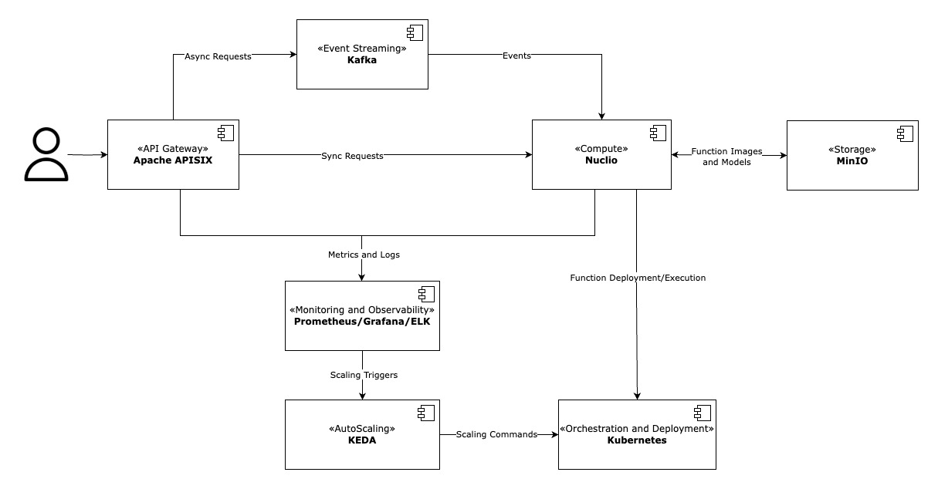
High Level Design

Slide 4
High Level Design
API Gateway (Apache APISIX)
Dynamic routing configuration, high performance and scalability, multi-protocol support
Extensible through plugins (authentication, caching, security, monitoring etc.)
Future ready AI Gateway
Compute (Nuclio)
Serverless framework with ultra low-latency and high performance
Seamless integration with Kubernetes
In-built auto-scaling, multi-language support and AI/ML ready
Orchestration and Deployment (Kubernetes)
Highly Scalable & Resilient Orchestration
Ecosystem Integration & Extensibility (Helm, KEDA, Prometheus etc.)
Can manage containerized serverless workloads, ensuring scalability, availability, and deployment automation
Event Streaming (Kafka)
Scalable & distributed messaging for async request processing
High throughput & low latency event streaming for AI/ML serverless workload
Durable & fault-tolerant event storage

Slide 5
High Level Design
Monitoring and Observability (Prometheus, Grafana and ELK)
Prometheus collects and stores real-time metrics for monitoring and auto-scaling
Grafana provides rich visualization and alerting for performance and system health
Centralized logging stack (Elasticsearch, Logstash, Kibana) for real-time log aggregation, search, and analysis
Storage (MinIO)
High performance S3-compatible open-source object storage
Ideal for cloud-native apps, deployable in Kubernetes for scalable and high-availability storage
Supports replication, server-side encryption, versioning, and data lifecycle management
Event-driven Autoscaling (KEDA)
Event-driven auto-scaling and supports multiple event source (Kafka, Prometheus etc.)
Seamless integration with Kubernetes (extension of HPA) and Nuclio
Low overhead and lightweight

Slide 6
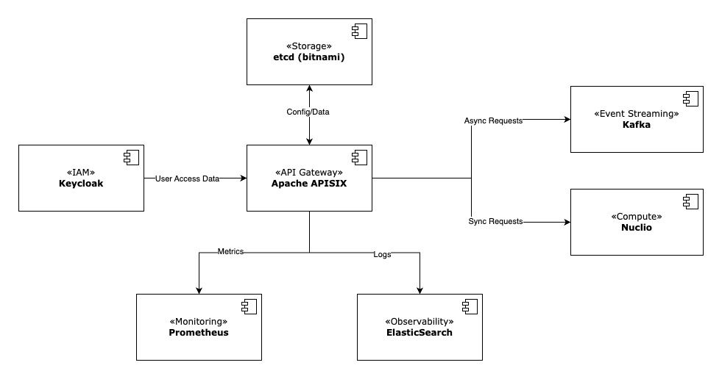
API Gateway

Slide 7
API Gateway: Apache APISIX
APISIX is an open-source API Gateway for managing API traffic, routing, security, rate-limiting and monitoring.
It acts as the entry point for API requests and integrates with various backend services and tools to ensure scalability, security, and real-time performance in a serverless architecture.
Request Flow:-
Incoming API requests are first authenticated by Keycloak using JWT or OAuth2 protocols. This ensures that only valid requests, with proper authentication and authorization, are allowed to access the backend services.
Once validated, valid requests are routed to Nuclio for serverless execution. Nuclio handles both synchronous function invocations (real-time responses) and event-driven functions triggered by events, enabling scalability and flexibility for serverless compute operations.
For non-blocking operations, asynchronous events are published to Kafka. Kafka facilitates decoupled, distributed event-driven architecture, enabling reliable, scalable processing of tasks.
Frequently accessed data, such as session data, route mappings, and API responses, are stored in in-built cache for quick retrieval. This improves API performance and reduces backend load. Cache also handles rate-limiting, ensuring fair usage across users and preventing abuse by managing request quotas.
Etcd (bitnami) is used for storing persistent data such as route configurations, request logs etc. It provides horizontal scalability and fault tolerance, ensuring that the system can handle high-volume requests.
API performance metrics, including request rates, response times, and success/failure statistics, are collected and analyzed by Prometheus. This allows real-time monitoring ensuring that the API Gateway and backend services are operating optimally.
All logs and traces are sent to ElasticSearch (via Logstash) for centralized storage and real-time indexing. This enables efficient search, analysis, and visualization of API requests and system errors, helping quickly identify and resolve issues in production environments.

Slide 8
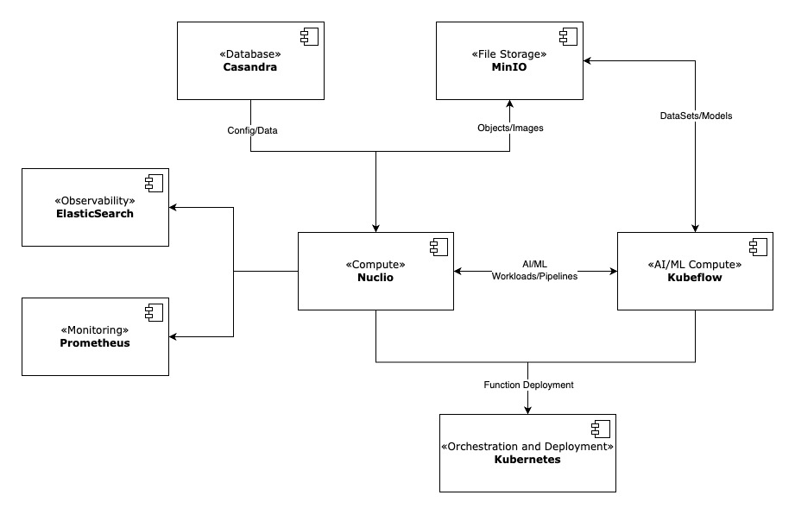
Serverless Compute

Slide 9
Serverless Compute: Nuclio
Nuclio is a high-performance open-source "serverless" framework focused on data, I/O, and compute intensive workloads.
Deploys functions as Kubernetes pods, supports in-built autoscaling, and manages execution efficiently without additional operational overhead.
Request Flow:-
Functions are deployed on Kubernetes, with Nuclio managing function containers, scaling, and execution.
Deployment configurations (resources, triggers, environment variables) are transformed into Kubernetes manifests.
For AI/ML workloads, Nuclio interacts with Kubeflow to trigger model training and inference pipelines.
Kubeflow enhances serverless design by providing a scalable and automated framework for AI/ML workloads, seamlessly integrating with serverless compute functions.
Frequently accessed function results and function meta data are stored in in-built cache to enhance performance.
Cassandra is used for storing function metadata, AI/ML pipeline metadata, and execution logs and metric (for billing needs).
MinIO serves as an object storage backend for function code/binaries, function container images, temporary build artifacts, and AI/ML models.
Functions handling large file processing can also retrieve and store objects in MinIO.
Nuclio exports function execution metrics (latency, throughput, error rates) to Prometheus.
Function execution logs are forwarded to Elasticsearch (via Logstash) for centralized logging and troubleshooting.

Slide 10
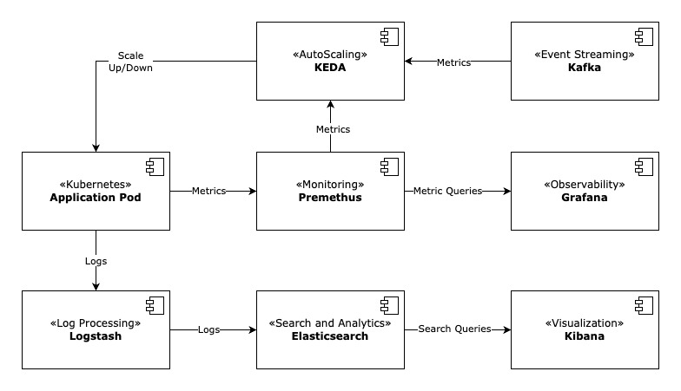
Monitoring & Observability

Slide 11
Monitoring & Observability: Prometheus, Grafana and ELK
Application Pods (APISIX, Nuclio and Function Pods)
Run inside Kubernetes pods and send logs to standard output (stdout / stderr)
Expose metrics via /metrics endpoint (via Prometheus client libraries)
Metrics Flow: Prometheus + Grafana
Prometheus scrapes metrics from application pods at regular intervals
It stores time-series data using its built-in TSDB
Grafana connects to Prometheus to visualize real-time and historical metrics via dashboards
Grafana also enable alerting based on metric thresholds (CPU usage, latency, error rate, etc.)
Logs Flow: ELK Stack
Logstash collects logs from application pods using agents like Filebeat
Logstash parses and transforms logs and then push into Elasticsearch for indexing and storage
Kibana queries Elasticsearch to visualize logs and supports filtering, searching, and log analysis
Auto-Scaling: KEDA (Kubernetes Event-Driven Autoscaler)
KEDA uses metrics from Prometheus and Kafka as triggers and evaluates the load on a deployment
Based on defined thresholds, KEDA scales pods up or down

Slide 12
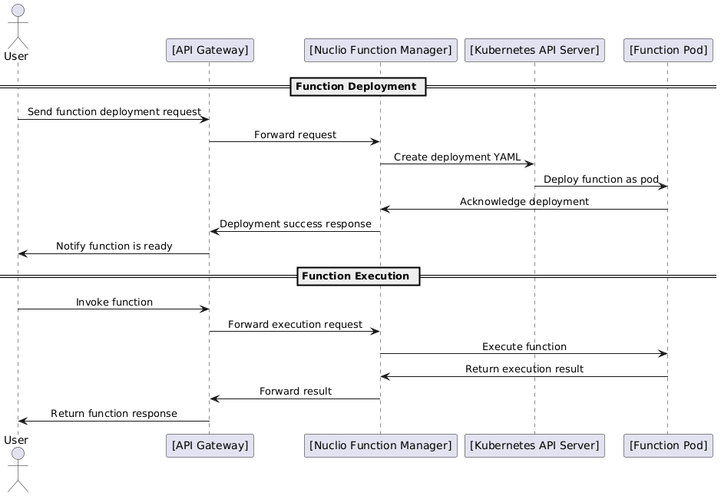
General Purpose Function

Slide 13
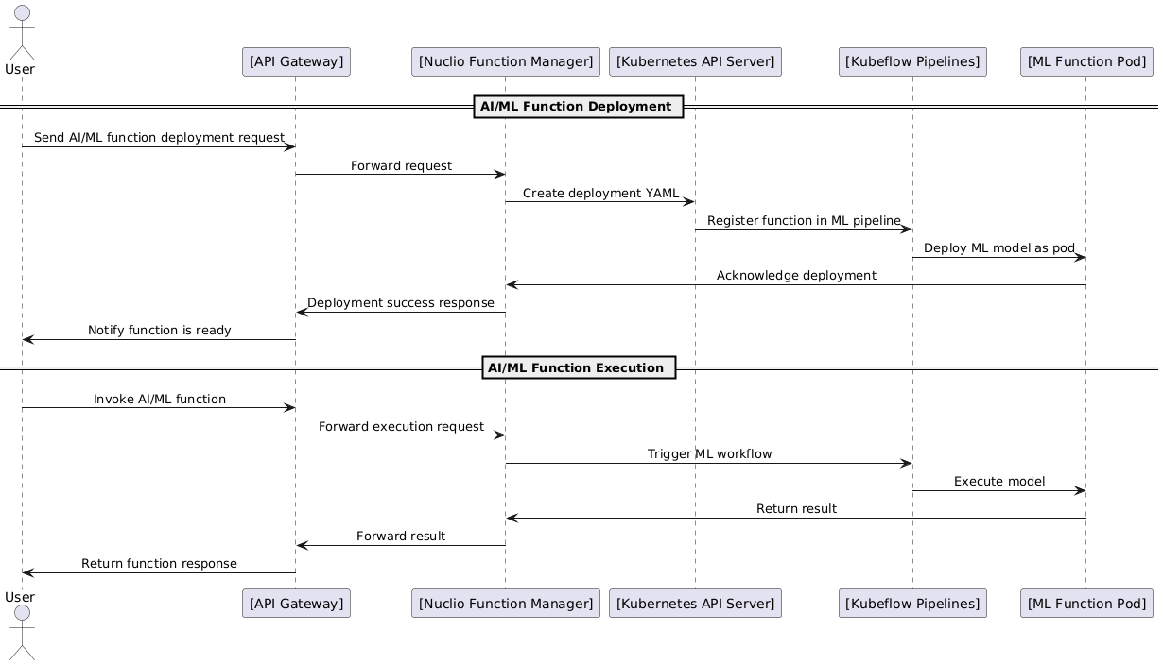
AI/ML Workload Function

Slide 14
Design Considerations
If the serverless solution is planned for a specific cloud provider, cloud-native services like identity management, API gateway, and NoSQL databases can be used instead of Keycloak, APISIX, and Cassandra, provided they meet the requirements of the serverless design. This can simplify integration, enhance scalability, and reduce operational overhead.
GitLab Pipeline or GitLab Actions can automate the CI/CD process for serverless function deployment. Upon code push, the pipeline can build, test, and package the function, then deploy it to Kubernetes via Nuclio.
The Promtail + Loki + Grafana stack can be a cost-effective alternative to the ELK stack, offering efficient log aggregation and visualization. However, it comes with a trade-off in advanced search and indexing capabilities.
KEDA auto-scaling is preferred over Nuclio’s built-in auto-scaling as it offers greater flexibility and true event-driven scaling. It supports a broader range of event sources (Kafka, Prometheus, etc.), allowing precise control over function scaling based on real-time demand. Additionally, KEDA seamlessly integrates with Kubernetes HPA, ensuring efficient resource utilization across diverse workloads.
To enhance temporary file processing for AI/ML workloads, Ceph distributed file system can be integrated in the future. It offers scalability, high availability, and fault tolerance, making it suitable for efficiently managing temporary artifacts while ensuring data durability and seamless scaling.

Slide 15
References
Apache APISIX
https://apisix.apache.org/
https://apisix.apache.org/blog/2025/02/24/apisix-ai-gateway-features/
Nuclio
https://github.com/nuclio/nuclio
https://theburningmonk.com/2019/04/comparing-nuclio-and-aws-lambda/
Kubeflow
https://www.kubeflow.org/
https://www.iguazio.com/blog/orchestrating-ml-pipelines-scale-kubeflow/

