Slide 1
Retrieving Data Using Http

Slide 2






Web Server
Web Browser
index.html
index.html
JavaScript
JavaScript
(http://mysite/api/products/5)
Web Service
Response
D_{D}at_{B}a

Slide 3

Module Overview
Observables and Reactive Extensions
Sending an Http Request Exception Handling Subscribing to an Observable

Slide 4
Application Architecture
Welcome Component
index.html
App Component
Product List Component
Star Component
Product Detail Component
Product Data Service

Slide 5
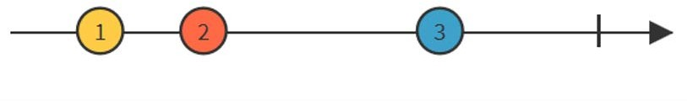
Observables and Reactive Extensions
Help manage asynchronous data
Treat events as a collection
- An array whose items arrive asynchronously over time
Are a proposed feature for ES 2016 Use Reactive Extensions (RxJS) Are used within Angular

Slide 6

Observable Operators
Methods on observables that compose new observables
Transform the source observable in some way
Process each value as it is emitted Examples: map, filter, take, merge, …

Slide 7
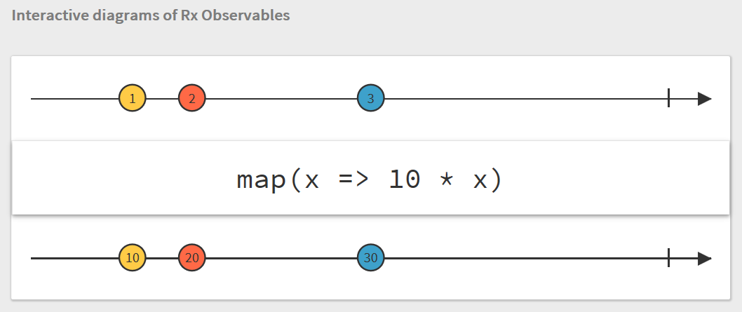
Observables

Slide 8
Promise vs Observable
Promise
Provides a single future value
Not lazy Not cancellable
Observable
Emits multiple values over time Lazy
Cancellable
Supports map, filter, reduce and similar operators

Slide 9
Application Architecture
Welcome Component
index.html
App Component
Product List Component
Star Component
Product Detail Component
Product Data Service

Slide 10
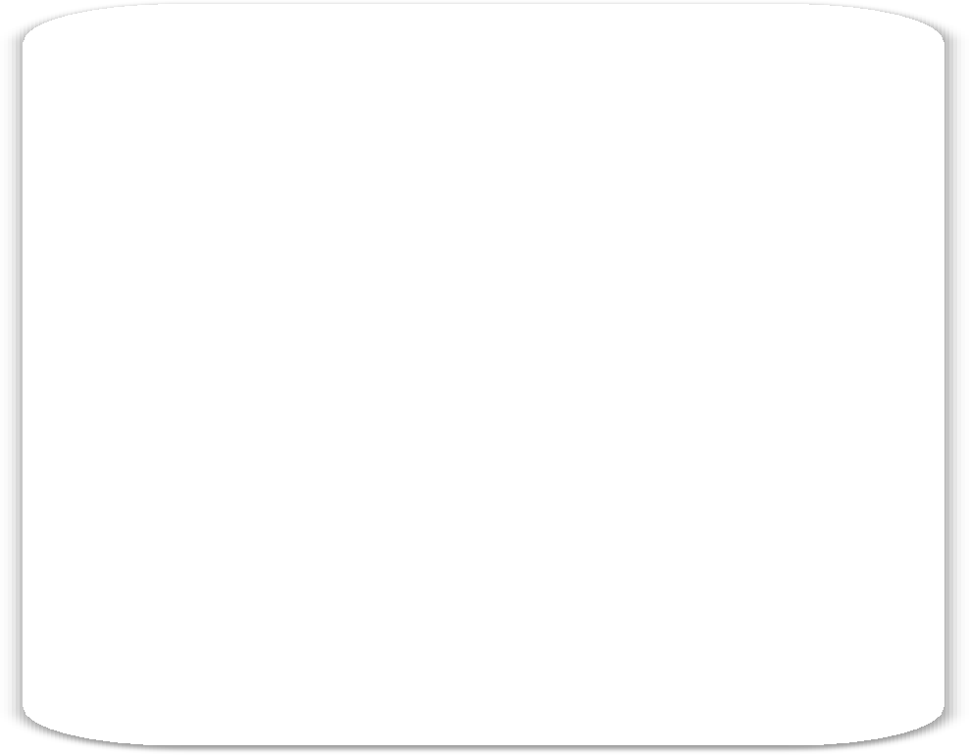

Sending an Http Request
Product Data Service
Get Response | Http Service | GET
 |  | Response
Web Server

Slide 11
Sending an Http Request
product.service.ts
...
import { HttpClient } from '@angular/common/http';
@Injectable()
export class ProductService {
private _productUrl = 'www.myWebService.com/api/products';
constructor(private _http: HttpClient) { } getProducts() {
return this._http.get(this._productUrl);
}
}

Slide 12
Registering the Http Service Provider
app.module.ts
...
import { HttpClientModule } from '@angular/common/http';
@NgModule({ imports: [
BrowserModule, FormsModule, HttpClientModule ],
declarations: [ AppComponent, ProductListComponent, ConvertToSpacesPipe, StarComponent ],
bootstrap: [ AppComponent ]
})
export class AppModule { }

Slide 13
HttpClientModule
BrowserModule
FormsModule
AppModule
AppComponent
ProductList - Component
ConvertToSpaces Pipe
StarComponent
Imports Exports Declarations Providers Bootstrap

Slide 14
Sending an Http Request
product.service.ts
...
import { HttpClient } from '@angular/common/http';
@Injectable()
export class ProductService {
private _productUrl = 'www.myWebService.com/api/products';
constructor(private _http: HttpClient) { } getProducts() {
return this._http.get(this._productUrl);
}
}

Slide 15
Sending an Http Request
product.service.ts
...
import { HttpClient } from '@angular/common/http';
@Injectable()
export class ProductService {
private _productUrl = 'www.myWebService.com/api/products';
constructor(private _http: HttpClient) { } getProducts() {
return this._http.get<IProduct[]>(this._productUrl);
}
}

Slide 16
Sending an Http Request
product.service.ts
...
import { HttpClient } from '@angular/common/http'; import { Observable } from 'rxjs/Observable';
@Injectable()
export class ProductService {
private _productUrl = 'www.myWebService.com/api/products';
constructor(private _http: HttpClient) { } getProducts(): Observable<IProduct[]> {
return this._http.get<IProduct[]>(this._productUrl);
}
}

Slide 17
Exception Handling
product.service.ts
...
import { HttpClient, HttpErrorResponse } from '@angular/common/http'; import { Observable } from 'rxjs/Observable';
import 'rxjs/add/operator/catch'; import 'rxjs/add/operator/do';
...
getProducts(): Observable<IProduct[]> {
return this._http.get<IProduct[]>(this._productUrl)
.do(data => console.log('All: ' + JSON.stringify(data)))
.catch(this.handleError);
}
private handleError(err: HttpErrorResponse) {
}

Slide 18
Subscribing to an Observable
x.then(valueFn, errorFn) x.subscribe(valueFn, errorFn) x.subscribe(valueFn, errorFn, completeFn)
//Promise
//Observable
//Observable
let sub = x.subscribe(valueFn, errorFn, completeFn)
product-list.component.ts
ngOnInit(): void { this._productService.getProducts()
.subscribe(products => this.products = products, error => this.errorMessage = <any>error);
}

Slide 19

Http Checklist: Setup
Add HttpClientModule to the imports array of one of the application's Angular Modules

Slide 20
Http Checklist: Service
Import what we need
Define a dependency for the http client service
Use a constructor parameter
Create a method for each http request Call the desired http method, such as get
Pass in the Url
Use generics to specify the returned type Add error handling

Slide 21
Http Checklist: Subscribing
Call the subscribe method of the returned observable
Provide a function to handle an emitted item
- Normally assigns a property to the returned JSON object
Provide an error function to handle any returned errors

Slide 22
Summary
Observables and Reactive Extensions
Sending an Http Request Exception Handling Subscribing to an Observable

Slide 23

Learning More
Pluralsight Courses
"Angular: Reactive Forms"
  Http and CRUD
"Play by Play: Angular 2/RxJS/HTTP and RESTful Services with John Papa and Dan Wahlin"
  RxJS and Observables

Slide 24
Application Architecture
Welcome Component
index.html
App Component
Product List Component
Star Component
Product Detail Component
Product Data Service

