Slide 1
Navigation and Routing Basics

Slide 3

Module Overview
How Does Routing Work?
Configuring Routes Tying Routes to Actions Placing the Views

Slide 4
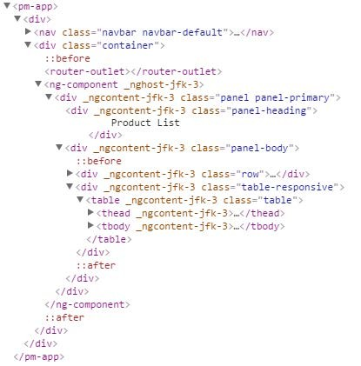
How Routing Works
Configure a route for each component
Define options/actions
Tie a route to each option/action Activate the route based on user action
Activating a route displays the component's view

Slide 5
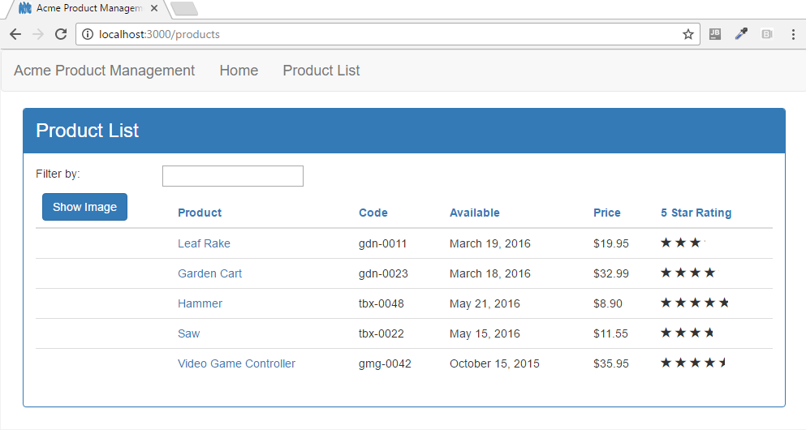
How Routing Works
<a r ou t e rL i nk=" / p r odu c ts">P roduc t L i s t < / a>
{ pa t h : 'p r oduc t s ' , c ompon e n t: P r oduc t L i s tCompon e n t }
product-list.component.ts
impo r t { Componen t } f rom '@angu la r /co re ' ;
< rou te r - ou t le t>< / r ou t e r - ou t le t >
@Componen t ({ temp la teUr l
} )
: ' . /p roduc t - l is t .componen t .h tm l '
expo r t c lass Produc tL is tComponen t { }

Slide 6
'products', ProductListComponent
'products/:id', ProductDetailComponent
'welcome', WelcomeComponent

Slide 7
Configuring Routes
app.module.ts
...
import { RouterModule } from '@angular/router';
@NgModule({ imports: [
BrowserModule, FormsModule, HttpClientModule, RouterModule
],
declarations: [
...
],
bootstrap: [ AppComponent ]
})
export class AppModule { }

Slide 8
Configuring Routes
app.module.ts
...
import { RouterModule } from '@angular/router';
@NgModule({ imports: [
BrowserModule, FormsModule, HttpClientModule, RouterModule.forRoot([])
],
declarations: [
...
],
bootstrap: [ AppComponent ]
})
export class AppModule { }

Slide 9
Configuring Routes
app.module.ts
...
import { RouterModule } from '@angular/router';
@NgModule({ imports: [
BrowserModule, FormsModule, HttpClientModule,
RouterModule.forRoot([], { useHash: true })
],
declarations: [
...
],
bootstrap: [ AppComponent ]
})
export class AppModule { }

Slide 10

 |  | Configuring Routes
[
{ | path: | 'products', component: ProductListComponent },
{ | path: | 'products/:id', component: ProductDetailComponent },
{ | path: | 'welcome', component: WelcomeComponent },
{ path: '', redirectTo: 'welcome', pathMatch: 'full' }, { path: '**', component: PageNotFoundComponent } ]

Slide 11

Navigating the Application Routes
Menu option, link, image or button that activates a route
Typing the Url in the address bar / bookmark
The browser's forward or back buttons

Slide 12
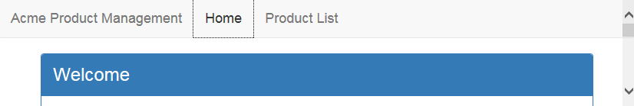
Tying Routes to Actions

Slide 13
Tying Routes to Actions
app.component.ts
...
@Component({
selector: 'pm-root', template: `
<ul class='nav navbar-nav'>
<li><a>Home</a></li>
<li><a>Product List</a></li>
</ul>
`
})

Slide 14
Tying Routes to Actions
app.component.ts
...
@Component({
selector: 'pm-root', template: `
<ul class='nav navbar-nav'>
<li><a [routerLink]="['/welcome']">Home</a></li>
<li><a [routerLink]="['/products']">Product List</a></li>
</ul>
`
})

Slide 15
Placing the Views
app.component.ts
...
@Component({
selector: 'pm-root', template: `
<ul class='nav navbar-nav'>
<li><a [routerLink]="['/welcome']">Home</a></li>
<li><a [routerLink]="['/products']">Product List</a></li>
</ul>
<router-outlet></router-outlet>
`
})

Slide 16
How Routing Works
<a [ r ou t e r L ink ] =" [ ' /p r oduc t s ' ] ">P rodu c t L i s t < / a>
{ pa t h : 'p r oduc t s ' , c ompon e n t: P r oduc t L i s tCompon e n t }
product-list.component.ts
impo r t { Componen t } f rom '@angu la r /co re ' ;
< rou te r - ou t le t>< / r ou t e r - ou t le t >
@Componen t ({ temp la teUr l
} )
: ' . /p roduc t - l is t .componen t .h tm l '
expo r t c lass Produc tL is tComponen t { }

Slide 17
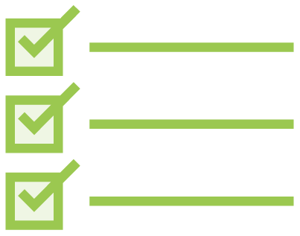
Checklist: Displaying Components
Nest-able components
Define a selector
Nest in another component
No route
Routed components
No selector
Configure routes
Tie routes to actions

Slide 18
Checklist: Doing Routing
Configure routes
Tie routes to actions Place the view

Slide 19
Routing Checklist: Configuring Routes
Define the base element
Add RouterModule
Add each route (RouterModule.forRoot)
Order matters
path: Url segment for the route
No leading slash
'' for default route
'**' for wildcard route
component
Not string name; not enclosed in quotes

Slide 20
Routing Checklist: Tying Routes to Actions
Add the RouterLink directive as an attribute
Clickable element
Enclose in square brackets
Bind to a link parameters array
First element is the path
All other elements are route parameters

Slide 21
Routing Checklist: Placing the View
Add the RouterOutlet directive
Identifies where to display the routed component's view
Specified in the host component's template

Slide 22
Summary
How Does Routing Work?
Configuring Routes Tying Routes to Actions Placing the Views

Slide 23
Application Architecture
Welcome Component
index.html
App Component
Product List Component
Star Component
Product Detail Component
Product Data Service

Slide 24
Application Architecture
Welcome Component
index.html
App Component
Product List Component
Star Component
Product Detail Component
Product Data Service

