Slide 1
Services and Dependency Injection

Slide 2
Service
A class with a focused purpose. Used for features that:
Are independent from any particular component
Provide shared data or logic across components
Encapsulate external interactions

Slide 3
Module Overview
How Does It Work?
Building a Service Registering the Service Injecting the Service

Slide 4

How Does It Work?
Service
export class myService {}
Component
let svc = new myService();
svc

Slide 5
Dependency Injection
A coding pattern in which a class receives the instances of objects it needs (called dependencies) from an external source rather than creating them itself.

Slide 6
Building a Service
Import what we need
Define the metadata with a decorator
Create the service class

Slide 7
Building a Service
product.service.ts
import { Injectable } from '@angular/core'
@Injectable()
export class ProductService {
getProducts(): IProduct[] {
}
}

Slide 8
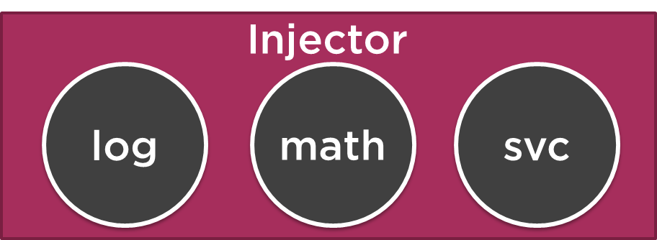
Registering a Service
Register a provider
Code that can create or return a service
Typically the service class itself
Define in component OR Angular module metadata
Registered in component:
Injectable to component AND its children
Registered in Angular module:
Injectable everywhere in the application

Slide 9
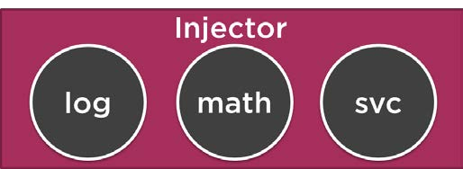

Application Architecture
Welcome Component
index.html
App Component
Product List Component
Star Component
Product Detail Component
Product Data Service

Slide 10
Registering a Provider
app.component.ts
...
import { ProductService } from './products/product.service';
@Component({ selector: 'pm-root', template: `
<div><h1>{{pageTitle}}</h1>
<pm-products></pm-products>
</div>
`,
providers: [ProductService]
})
export class AppComponent { }

Slide 11


Injecting the Service
Injector
log
math
svc
Service
export class myService {}
Component
constructor(private _myService) {}

Slide 12
Injecting the Service
product-list.component.ts
...
@Component({
selector: 'pm-products',
templateUrl: './product-list.component.html'
})
export class ProductListComponent {
constructor() {
}
}

Slide 13
Injecting the Service
product-list.component.ts
...
import { ProductService } from './product.service';
@Component({
selector: 'pm-products',
templateUrl: './product-list.component.html'
})
export class ProductListComponent { private _productService;
constructor(productService: ProductService) {
_productService = productService;
}
}

Slide 14
Injecting the Service
product-list.component.ts
...
import { ProductService } from './product.service';
@Component({
selector: 'pm-products',
templateUrl: './product-list.component.html'
})
export class ProductListComponent {
constructor(private _productService: ProductService) {
}
}

Slide 15
Summary
How Does It Work?
Building a Service Registering the Service Injecting the Service

Slide 16
Application Architecture
Welcome Component
index.html
App Component
Product List Component
Star Component
Product Detail Component
Product Data Service

