Slide 1
User Guide
GOP - Grihasoft Automation Tool – Dictionary Check

Slide 2
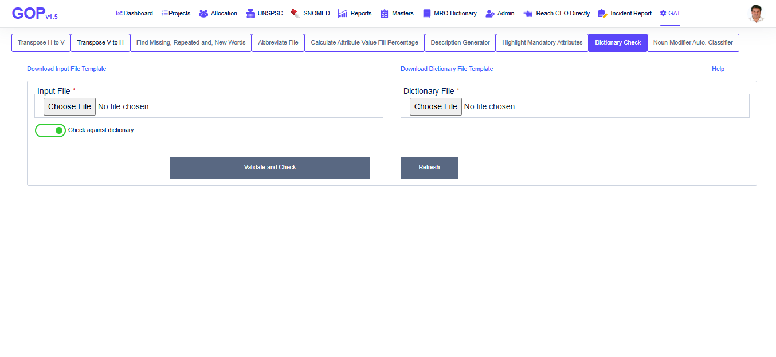
GAT- Check Input File against Dictionary
The ‘Dictionary Check’ tool is developed to check the input file with dictionary.
Open GOP application by following the link https://gop.Grihasoft.com
Click on GAT main menu and select ‘Dictionary Check’ tab of GAT module

Slide 3
GAT- Check Input File against Dictionary
To upload the data to the tool, click on ‘Download Input File Template’ link and fill-up the input file data in this format. Save the file.
If input file data has to be checked against dictionary, then click on ‘Download Dictionary File Template’ link and fill-up the dictionary file data in this format. Save the file.
Upload both the files, Input file and Dictionary file.
Click on ‘Validate and Check’ button to check the data from this input file.
After successful upload of file(s), input format check will be applied, this should be same as template format.
If input file row has attributes not matching to attributes from dictionary, then application writes the input file row with dictionary row to the second worksheet of input file

Slide 4
GAT- Check Input File against Dictionary
Application first checks the Noun and Modifier from input file exists in dictionary or not. If not, it writes that unmatched noun and modifier to the second worksheet of input file. The same way, application checks all the attributes from input file matches to the attributes in dictionary, if not, it writes the input file row and dictionary row to the second worksheet of input file. Saves this file as output file.
Following types of errors are checked by this tool,
Input row must have unique attribute names.
Input row should not have any intermediate blank attribute.
For each noun-modifier, attribute names must be unique (vertically).
Attributes must be same for all input items of a noun-modifier and this order should match to the order of attributes in dictionary.

