Slide 1
User Guide
GOP - MRO Dictionary

Slide 2
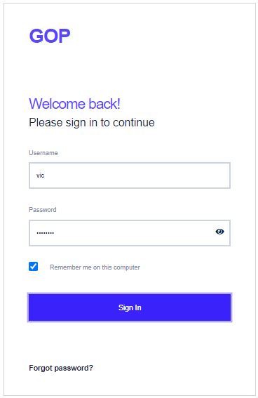
GOP - MRO Dictionary module usage
Step 1- Login to GOP application
Open GOP application by typing the URL address as received from application administrator in the address bar of the browser.
Login to the GOP application by using the credentials provided by application administrator. If you don’t have credentials, you can contact to Project Manager
Enter User Name and Password. User Name is case insensitive and password is case sensitive
If you forgot password, click on ‘Forgot Password’ link to get the password reset link to your mailbox
To avoid frequent entry of credentials, check “remember me on this computer” option, if you are the single user of this computer.

Slide 3
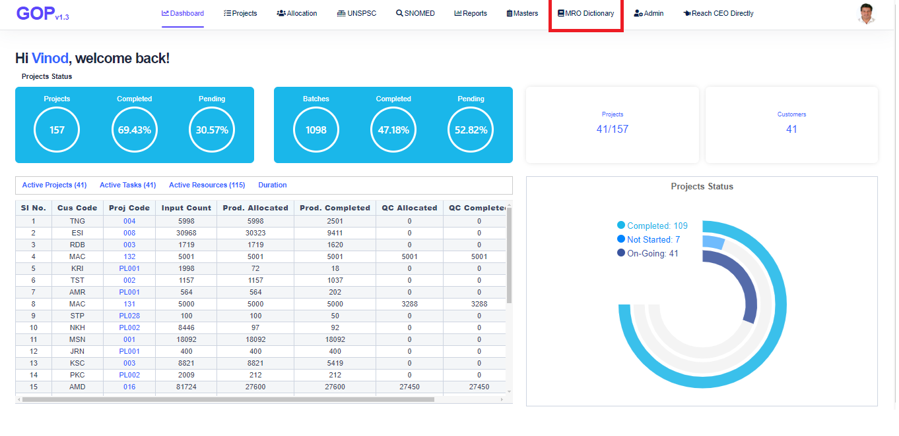
Open MRO Dictionary module
GOP - MRO Dictionary module usage
After login, GOP application screen will open. Click on ‘MRO Dictionary’ menu in top menu panel.
If this menu is not available, please contact Project Manager / Application administrator to get the access of this menu.

Slide 4
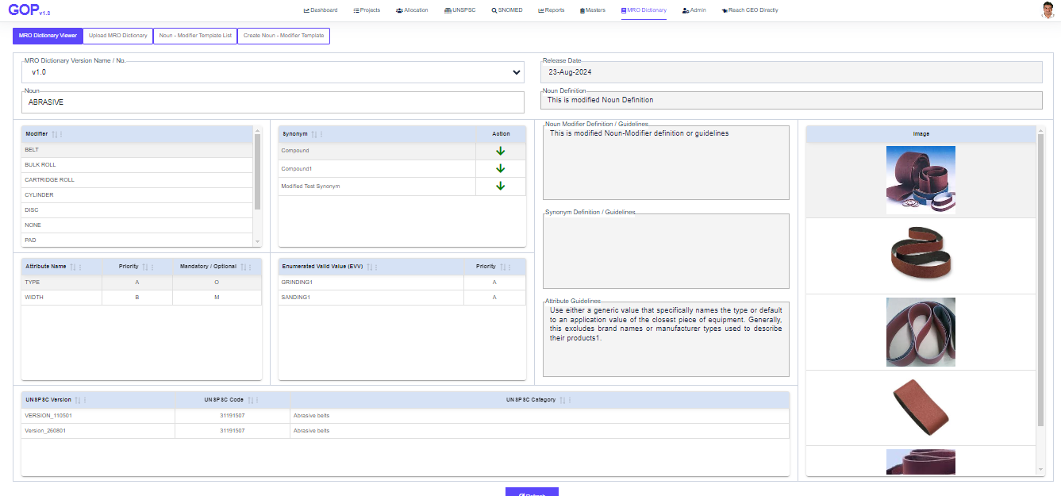
MRO Dictionary Viewer
GOP - MRO Dictionary module usage
Select the MRO Dictionary Version
Select the Noun, Application displays the list of all modifiers and the list of all synonyms for the selected noun
Select the Modifier. Application displays the Attributes of selected Noun and Modifier with definition of Noun-Modifier, Modifier Guidelines, UNSPSC Categories linked to this noun-modifier
Application displays the images of selected noun and modifier
Click on Synonym down-arrow, application displays the synonym as noun and it displays the modifiers / synonyms of selected synonym

Slide 5
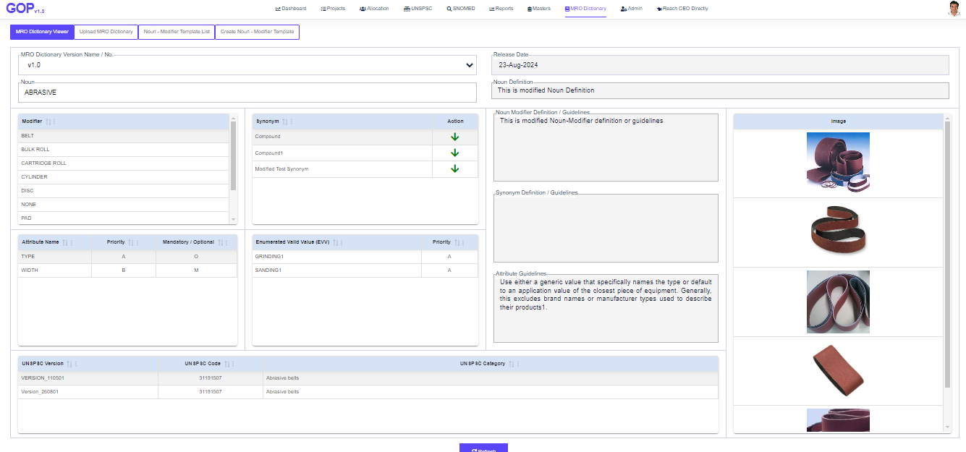
MRO Dictionary Viewer
GOP - MRO Dictionary module usage
Select the Attribute to get the enumerated valid values (EVVs), Attribute Definition/Guidelines
Select synonym, to get the synonym definition / guidelines
If you click ‘Action’ column from synonym, application displays all the details of that synonym as noun

Slide 6
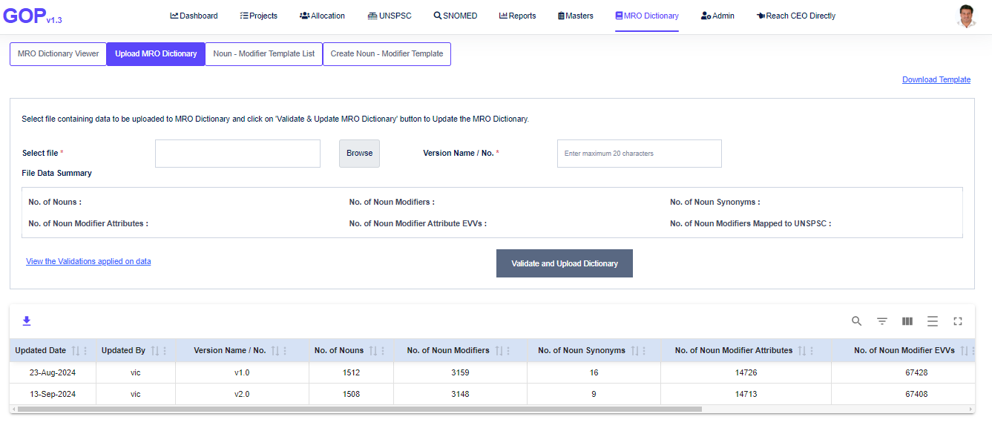
GOP - MRO Dictionary module usage
Upload MRO Dictionary
To upload MRO Dictionary data, download the template by clicking on Download Template hyperlink from the top right corner of the page
Prepare the data in template format. Ensure that you are preparing the data by following all the validations from the ‘View the validation applied on data’
To upload the data, select the file, enter unique Version Name / No.
Application shows the summary of all the from file on page. Ensure that, this is correct as per selected file.
Click on Validate and Upload Dictionary button to upload all the data from the file
Application shows the progress of each step and right mark on completion of the step successfully
On successful upload of the data, application shows all the details in below table, click on ‘Download Data’ button to download all the details of selected Version.
To delete all the details of selected version, click on Delete button from the table

Slide 7
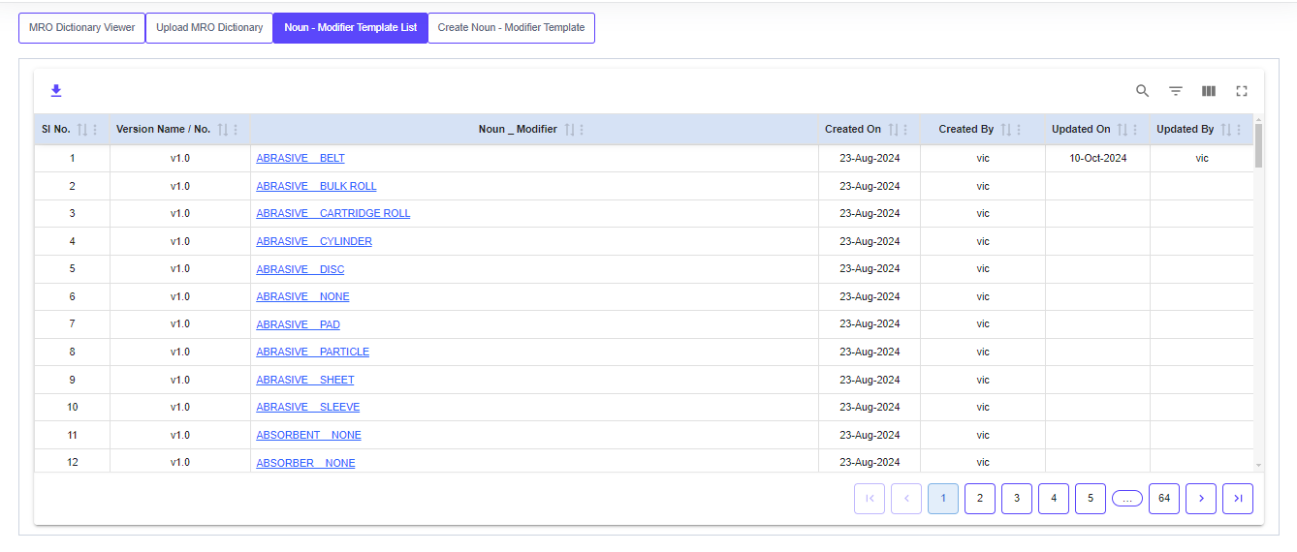
GOP - MRO Dictionary module usage
Noun-Modifier Template List
Click on Noun-Modifier Template List tab to view the list of all Noun-Modifier templates from all the versions
Application shows the Sl. No., Version Name / No., Noun-Modifier, Created Date, Created By, Updated On, Updated By columns
Application has the provision to export all the details to csv format
Application has the option to search / filter / hide the column details. Also you can view the page in full-screen
Click on any column header to sort the details in ascending / descending order

Slide 8
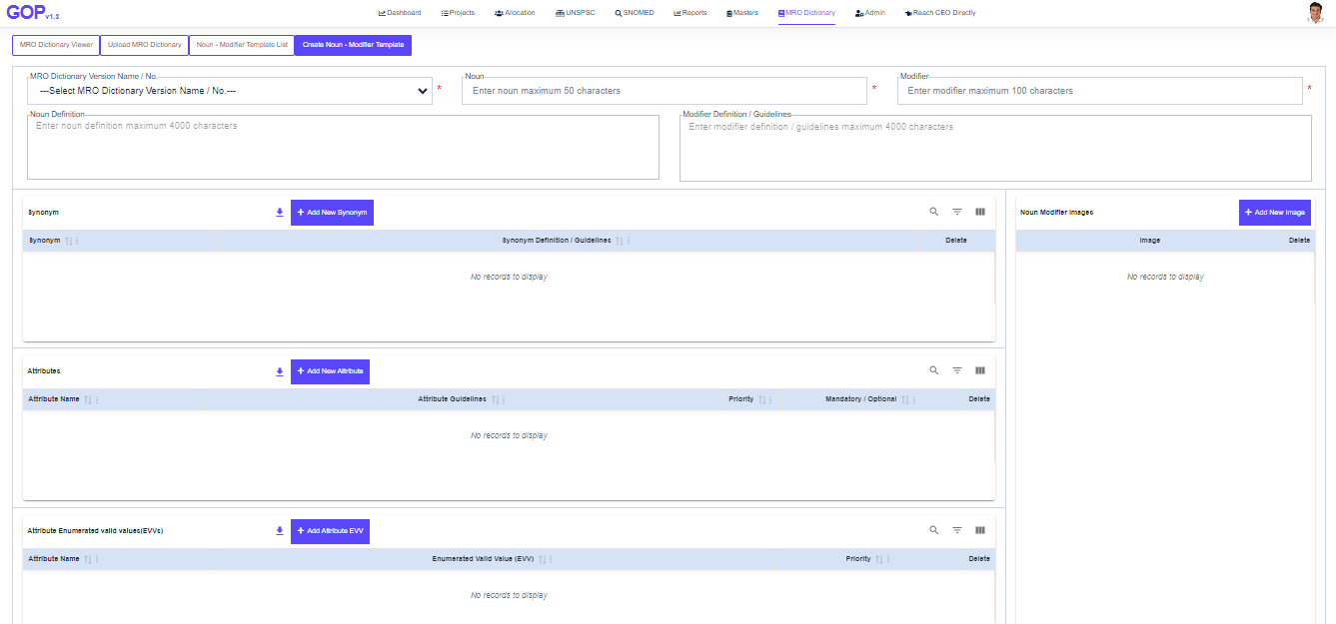
GOP - MRO Dictionary module usage
Create Noun-Modifier Template
Application has option to create a template which will have all details as dictionary viewer
To Create a template, enter all the details and click on Save button
MRO Dictionary Version Name / No., Noun, Modifier are mandatory field values to enter
Each synonym for the noun must be unique
Each attribute for the selected noun-modifier must be unique
Each Value for the selected attribute must be unique
The UNSPSC Version for each Noun-Modifier must be unique

Slide 9
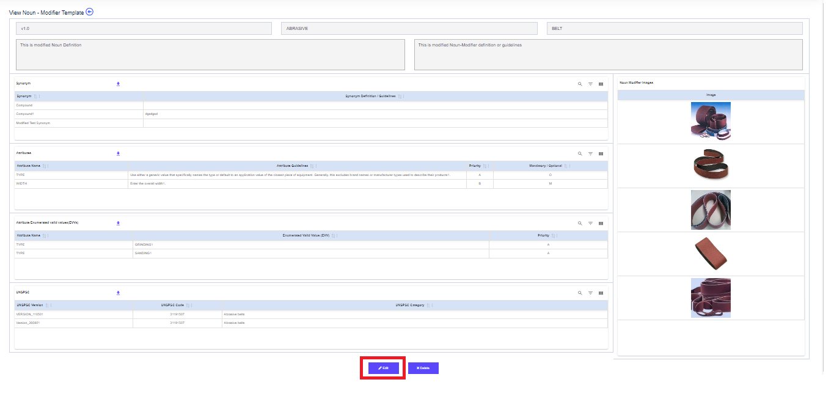
GOP - MRO Dictionary module usage
Edit Noun-Modifier Template
Application has option to edit a template which will have all details as dictionary viewer
To edit any Noun-Modifier details, click on Noun-Modifier hyperlink from Noun-Modifier Template List page. Application displays all the details of selected Noun-Modifier in View Noun-Modifier template page. Click on Edit button to edit the details
On click of Edit button, application displays all the details of selected noun-modifier in edit page.
Edit the required details and click on save button to save all the details

Slide 10
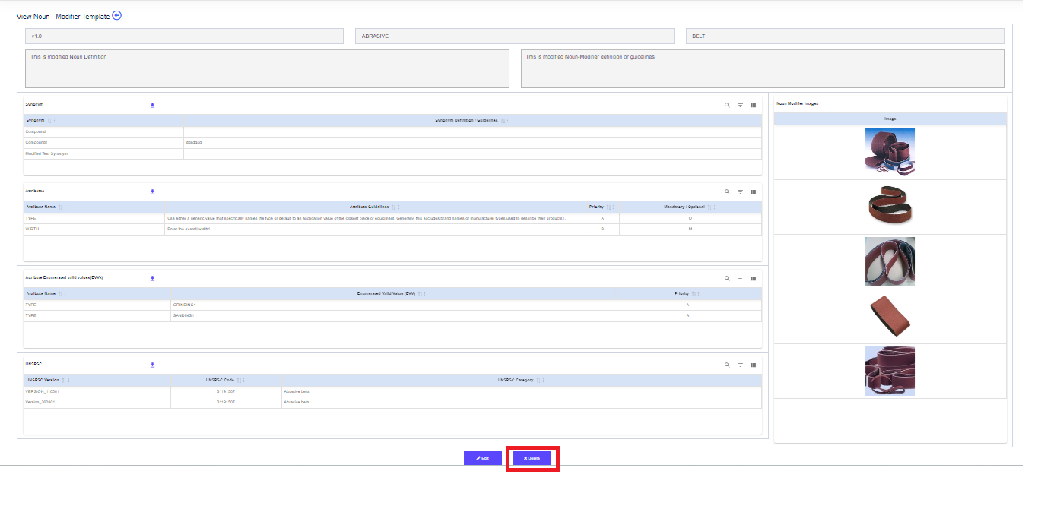
GOP - MRO Dictionary module usage
Delete Noun-Modifier Template
Application has option to delete a template which will have all details as dictionary viewer
To delete any Noun-Modifier details, click on Noun-Modifier hyperlink from Noun-Modifier Template List page. Application displays all the details of selected Noun-Modifier in View Noun-Modifier template page.
On click of Delete button, application displays the confirmation message to delete all the details of selected noun-modifier.
Click on ‘Yes’ button to delete all the details of selected noun-modifier
Click on ‘No’ button to cancel the delete operation

