Slide 1
User Guide
GOP - Marketing

Slide 2
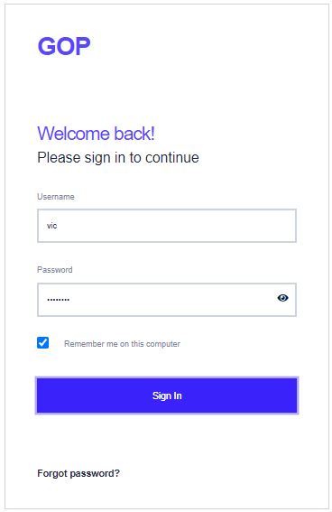
GOP - Marketing module usage
Step 1- Login to GOP application
Open GOP application by typing the URL address as received from application administrator in the address bar of the browser.
Login to the GOP application by using the credentials provided by application administrator. If you don’t have credentials, you can contact to Project Manager
Enter User Name and Password. User Name is case insensitive and password is case sensitive
If you forgot password, click on ‘Forgot Password’ link to get the password reset link to your mailbox
To avoid frequent entry of credentials, check “remember me on this computer” option, if you are the single user of this computer.

Slide 3
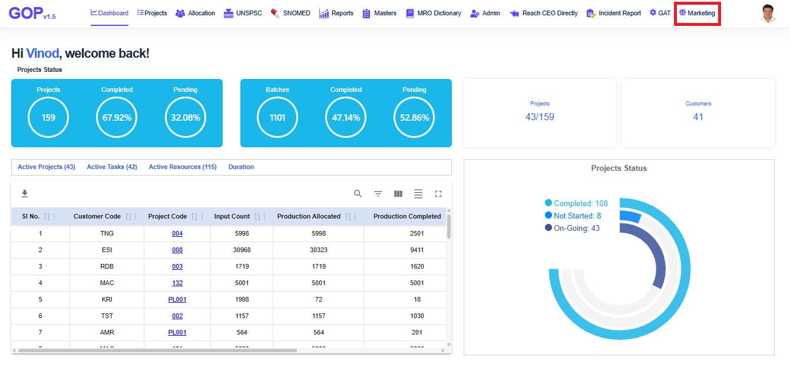
Open Marketing module
GOP - Marketing module usage
After login, GOP application screen will open. Click on ‘Marketing’ menu in top menu panel.
If this menu is not available, please contact Project Manager / Application administrator to get the access of this menu.

Slide 4
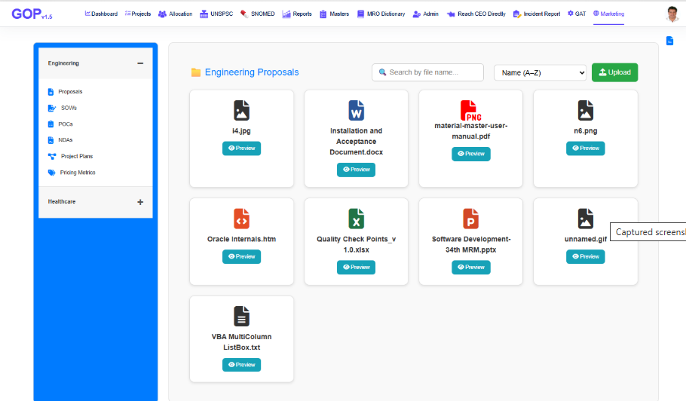
Engineering Proposals
GOP – Marketing module usage
Select the Engineering menu panel and click on ‘Proposals’ menu
Application shows all the documents uploaded as Engineering Proposals
User can search for any uploaded document, by typing document file name in search box.
User can sort the list of documents based on File Name and Uploaded on date in ascending / descending order

Slide 5
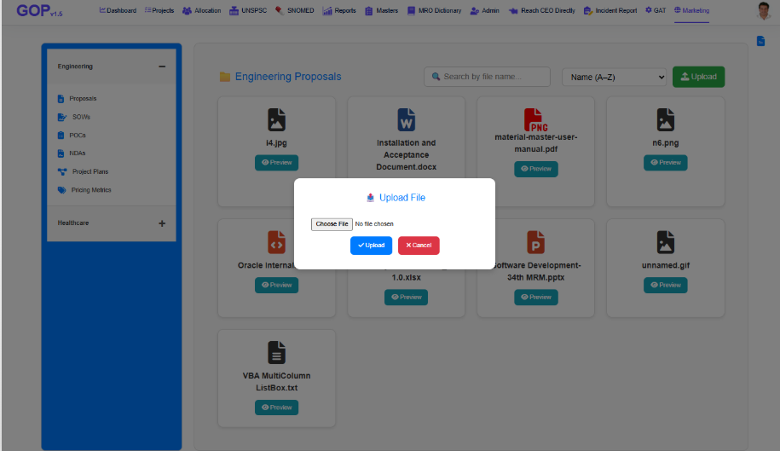
Uploading New document
GOP – Marketing module usage
Click on “Upload” button, application shows the upload popup as in screenshot
Choose the file which you want to upload and click on “Upload” button
Application uploads the selected file and displays success message, if it is uploaded successfully
All file names must be unique
On successful upload, application displays the selected file in list of files
If any error, application displays it

Slide 6
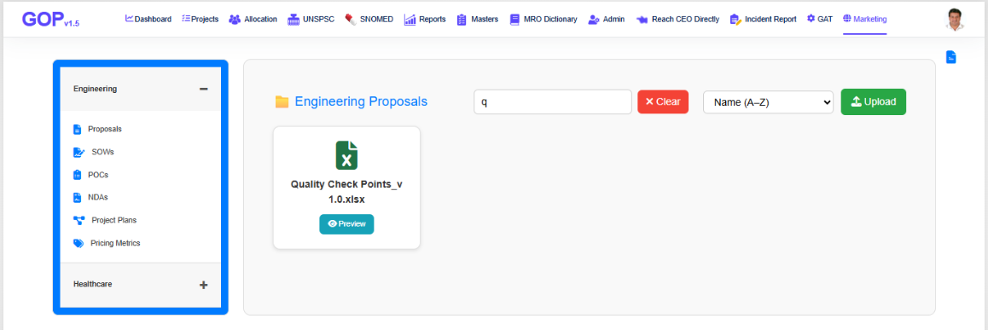
Search for any document
GOP – Marketing module usage
To search any document, user should know few characters from file name and it’s type like it is a Proposal / SOW / POC / NDA / Pricing Metrics / Project Plan
Type few characters from file name in search text box and application filters the files having search characters in file name
To clear filter, click on clear button

Slide 7
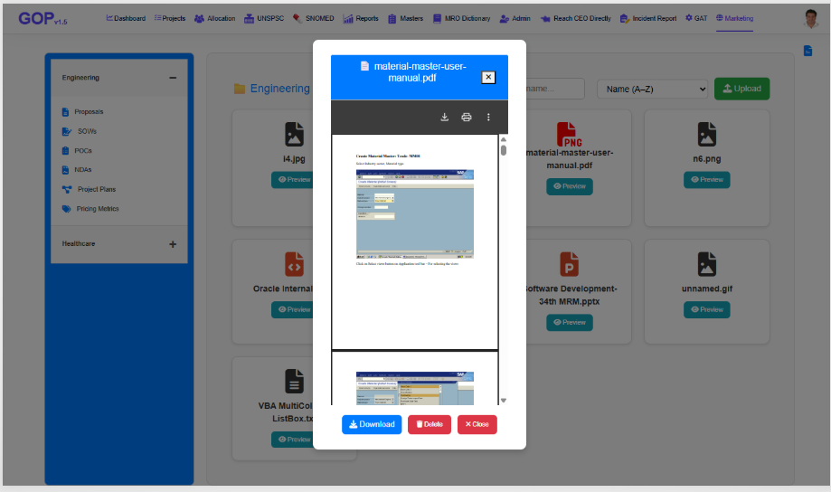
Preview a document
GOP – Marketing module usage
To preview a document, click on Preview button of the selected document
Application shows the preview of contents from the file
User can download the file by clicking the download button in Preview window
User can delete the unwanted document by clicking the Delete button

Slide 8
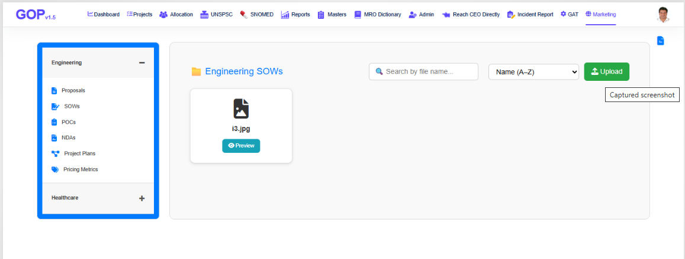
Other Document Types
GOP – Marketing module usage
To manage other type of documents like SOWs / POCs / NDAs / Project Plans / Pricing Metrics, user can select the respective menu option from the respective domain
Other features such as Search, Sort and, Upload are all same like Engineering Proposals as explained in previous slides
All these features are same for Healthcare domain too

