Slide 1
User Guide
SNOMED Searcher

Slide 2
What is SNOMED-CT?
The Systematized Nomenclature of Medicine - Clinical Terms (SNOMED - CT) is a systematic, computer-processable collection of medical terms, in human and veterinary medicine, to provide codes, terms, synonyms and definitions which cover anatomy, diseases, findings, procedures, microorganisms, substances, etc. It allows a consistent way to index, store, retrieve, and aggregate medical data across specialties and sites of care

Slide 3
Benefits of SNOMED - CT
There are many benefits of using SNOMED CT in Electronic Health Records including:
Health information can be shared consistently within and across healthcare settings.
Data can be organized, queried, and analyzed for the benefit of the individual and institution.
The risk of different interpretations of the record between different healthcare settings can be reduced.
Updated twice a year to help users keep pace with the advances of healthcare terminology and add to the scope of coverage.

Slide 4
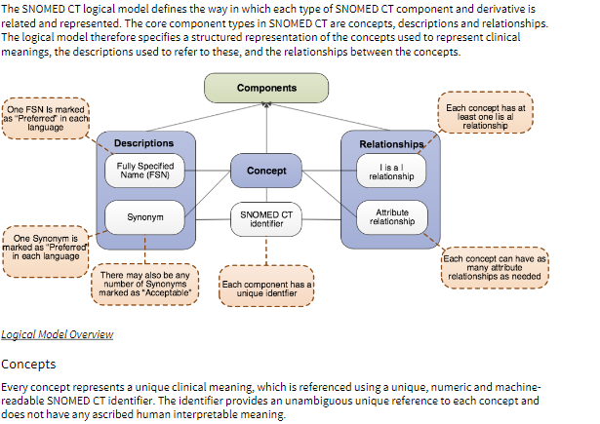

Slide 5
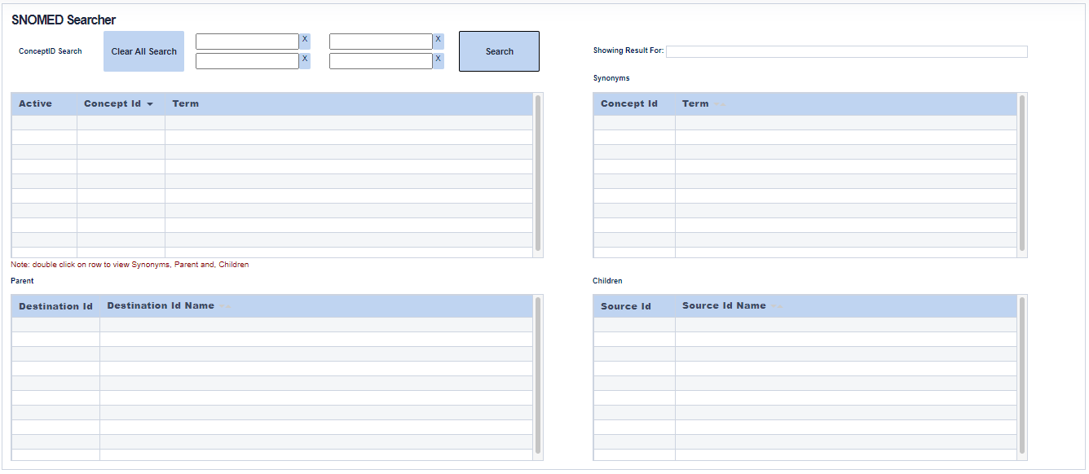

Slide 6
How to use SNOMED – CT Searcher
Click on SNOMED menu at the top. Application shows the SNOMED Searcher page.
Enter Concept term you would like to search and click on Search button. Optionally, you can enter up to 4 different search terms and click on Search button
Application shows the active concept terms with concept id with no. of concepts matching the search term(s)
Double click on row to view synonyms, Parents and, children of any concept with no. of rows matching for each.
Clear all the search results by clicking on “Clear All Search” button on left top

