Slide 1
User Guide
UNSPSC Searcher

Slide 2
What is UNSPSC?
UNSPSC refers to United Nations Standard Products and Services Code. It is an open standard and taxonomy of products and services and also a practical business tool

Slide 3
Define: Open Standard?
Publicly available specifications for solving a certain problem.
Not proprietary
Available to all to read and implement
No royalty or license fees for usage
No restrictions on sharing codes with trading partners
No lock-in to one commercial solution
Do not discriminate or favour; level, neutral playing field.
Participation in development is open and transparent.
Decisions are made on a consensus basis.
Not to be confused with “open source” software.

Slide 4
Define: Taxonomy?
A system of classification, in this case, of
Products and services bought and sold.
A hierarchical tree structure, which enables “drill down” and “roll up” analysis.
A practical tool, responsive to user needs.
Use in Enterprise Resource Planning, e-Commerce, Business Intelligence systems.

Slide 5
UNSPSC Design:
Hierarchical 4-level tree structure: Segment, Family, Class and Commodity
Note: “Commodity” is not defined as bulk materials but in the Broader sense as any article of commerce including capital Equipment, high-value products, and professional services.
Category titles are unambiguous and mutually exclusive
Products appear in only one category; categories each have only had one parent.
Products are grouped according to dominate usage in world market.

Slide 6
UNSPSC Components:
UNSPSC Code: 8 digits, e.g. 44103103.
Title: natural language text up to 120 characters long, e.g. “Toner”.
Definition: free form text gives concise explanation.
Business Function: 2-digit codes for Rental or Lease, Maintenance or Repair, Manufacturer, Wholesale, Retail, Recycle, Installation (optional to use).

Slide 7
UNSPSC Code Structure:
Segment 44000000 Office Equipment and Accessories and Supplies.
Family 44100000 Office machines and their supplies and accessories.
Class 44103100 Printer and facsimile and photocopier supplies.
Commodity 44103103 Toner.

Slide 8
UNSPSC Segments:
The 55 Segments are arranged in a logical sequence that
Reflects how value is progressively added to products.
Raw Materials=>Industrial Equipment=>Components and Supplies=>End Use Products=> Services.
Raw Materials[Segments 10-15],Industrial Eqipment[Segments 20-27],Components And Supplies[Segments 30-41],End Use Products[Segments 42-60],Services[Segments 70-94].
Family, Class and Commodity codes are arbitrary, and
Reflect no logical sequence.

Slide 9
How to Implement UNSPSC?
Classify products: enter the appropriate 8-digit UNSPSC Code against each item in your system.
Store the UNSPSC Titles in a look-up table.
If a code for your product does not exist, temporarily use the parent category and submit a request for a new code.

Slide 10
Advantages of UNSPSC:
Segments exist for:
Raw materials
Industrial equipment
Components and supplies
End-use products
Services
Comprehensive: over 20,000 categories.
Responsive to the marketplace.

Slide 11
How to Use UNSPSC Searcher?
Step1: Click on ‘Search UNSPSC’ option of UNSPSC submodule. Application creates a new tab ‘Search UNSPSC’ and it opens UNSPSC Searcher page in this tab. Select the version from which you want to search the code and category. Application displays the latest version as the default version.
Lock the version by clicking on ‘Lock’ checkbox.
You can use shortcut keys to access all controls.

Slide 12
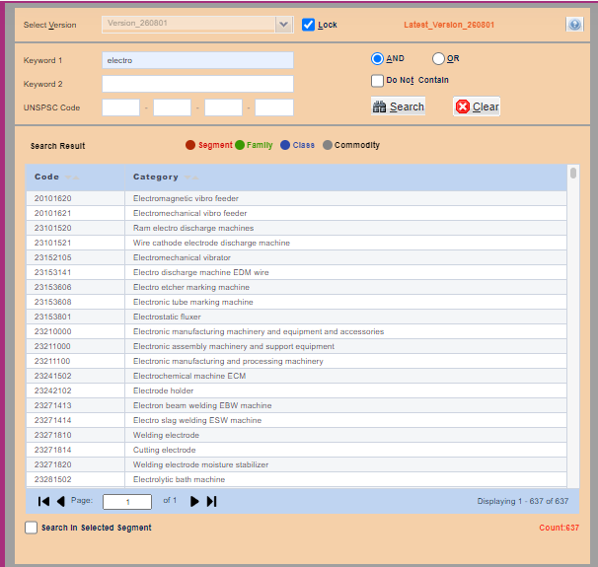
Step2: Type Keyword1 or Keyword2 then select the operations in which you like [AND, OR, DO NOT CONTAIN] as well and hit Search button or Enter to retrieve the results in Search Results screen. Which is showed below. Application shows the count of no. of rows, satisfying the search criteria.

Slide 13
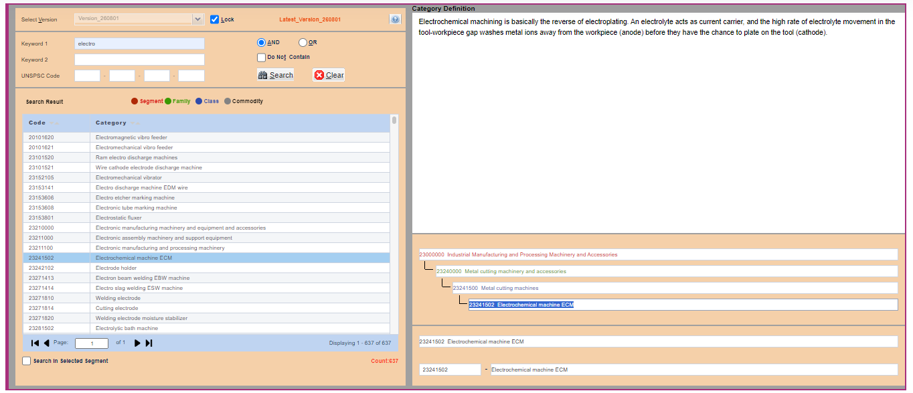
In the above screen you can find Segment, Family, Class, and Commodity in Search Results screen with coloured data. So that you can easily find the category of Search Results.

Slide 14
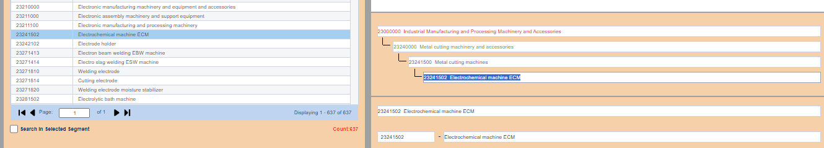
Step3: After selecting particular data in Search Results screen. It’ll show the Hierarchy for each Selected Item which is showed in above picture.

Slide 15
Screen Shot for Griha UNSPSC Searcher. If you click on any of Segment, Family, Class, or commodity – application shows selected code and category, code, Category in the bottom text fields.

Slide 16
List of Shortcut Keys to Access UNSPSC Searcher:
Alt+V → Select Version
Alt+L → Lock Version
Alt+H → Keyword1
Alt+I → Keyword2
Alt+B → Code1
Alt+X → Code2
Alt+Y → Code3
Alt+Z → Code4
Alt+S → Search
Alt+C → Clear

Slide 17
List of Shortcut Keys to Access UNSPSC Searcher:
Alt + A → AND
Alt + O → OR
Alt + T → Do Not Contain
Alt + J → Segment
Alt + K → Family
Alt + M → Class
Alt + N → Commodity
Alt + P → Code Category
Alt + Q → Code
Alt + G → Category

Slide 18
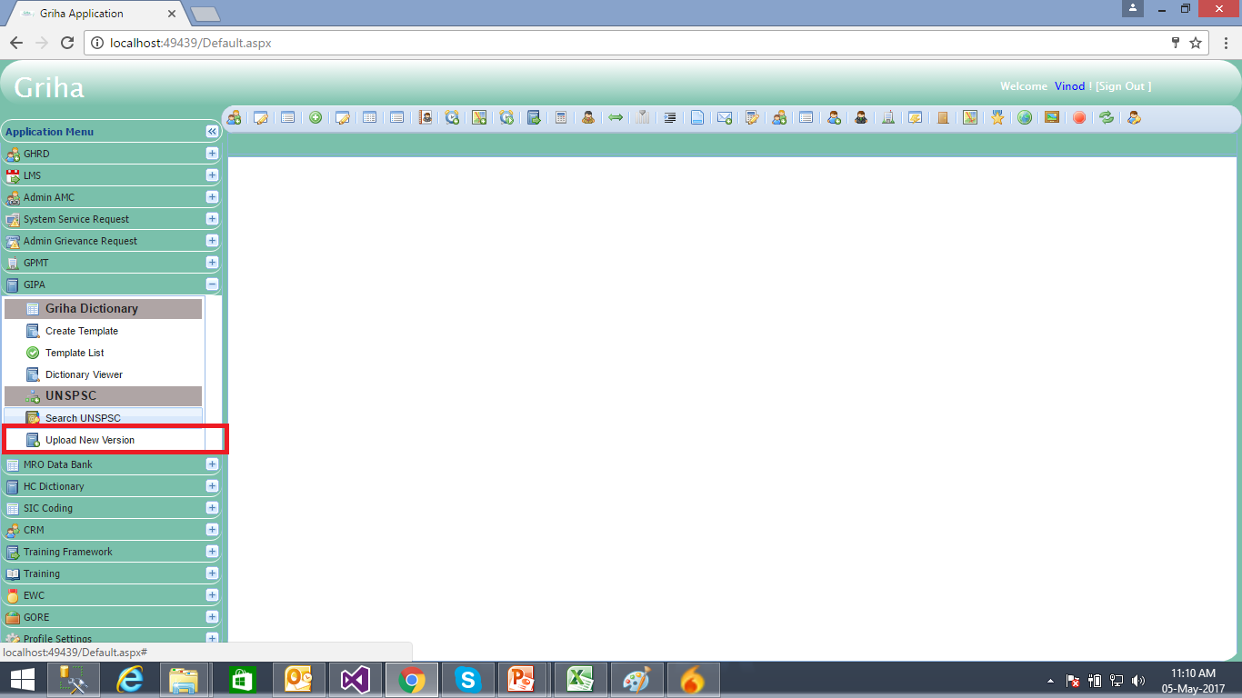
Upload New Version - UNSPSC
This menu will be available for managers and application administrator.
Click on ‘Upload New Version’ menu option on left hand side of application.

Slide 19
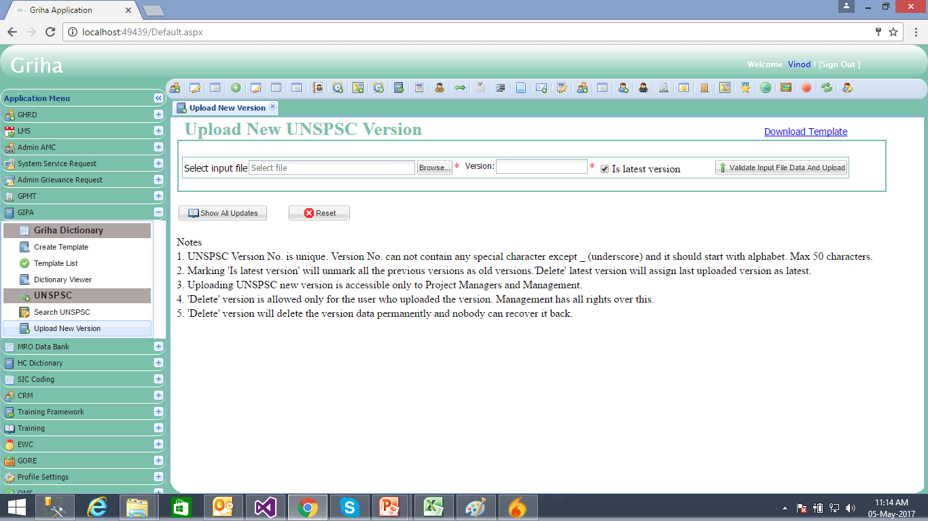
Upload New Version - UNSPSC
After clicking ‘Upload New Version’ menu option of UNSPSC, application opens a new page. Please read the ‘Notes’ in the page to upload the data successfully.
Download the input file data template by clicking on ‘Download Template’ hyperlink. Application downloads the template in excel format.
Prepare the data in this format of template.
Enter Version No. and check ‘Is Latest Version’ checkbox if you are uploading latest version else check it OFF

Slide 20
Upload New Version - UNSPSC
Click on ‘Validate Input File and Upload’ button, to check the input file for errors and upload it to the server.
This step will take some time until the data is uploaded successfully to the server. Application shows the message after successful upload.
Click on ‘Show All Updates’ button to show all ‘UNSPSC active versions’ uploaded till date

