Slide 1

Final Project Case Study in Finance - House Rooms Classification
Rachapudi, Vinod
CSCI E-89 Deep Learning, Fall 2023
Harvard University Extension School
Prof. Zoran B. Djordjević
@Vinod Rachapudi

Slide 2
Introduction
In FinTech Mortgage business investment (Mortgage Portfolio) decisions are made based on a house and its rooms.
Therefore, having the ability to classify the rooms of a house to identify the type of room such as Dining Room vs Bed Room vs et al enables these investment decisions.
The code in this project helps with binary classification of Dining Room vs Bed Room by using
Convolutional Neural Networks in Part 1
Pre-trained Convolutional Neural Network VGG16 in Part 2 and
Pre-trained Convolutional Neural Networks - Xception in Part 3
@Your Name

Slide 3
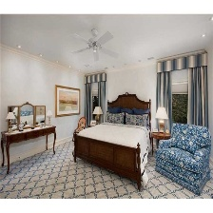

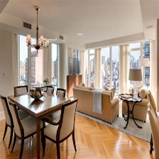

Downloading the Data
The Data is downloaded from Kaggle https://www.kaggle.com/datasets/robinreni/house-rooms-image-dataset/data
This Kaggle Data set has 1248 bedroom pictures and 1158 dining room pictures

Slide 4
Splitting of Data into Training, Validation & Test DataSets
This Kaggle Data set has 1248 bedroom pictures and 1158 dining room pictures
Total training bedroom images: 500
Total training diningroom images: 500
Total validation bedroom images: 300
Total validation diningroom images: 300
Total test bedroom images: 448
Total test diningroom images: 358

Slide 5
Part 1 - Convolutional Neural Networks

Slide 6
Conv Neural Network
Model: "sequential"
_________________________________________________________________
Layer (type) Output Shape Param #
=================================================================
conv2d (Conv2D) (None, 148, 148, 32) 896
max_pooling2d (MaxPooling2 (None, 74, 74, 32) 0
D)
conv2d_1 (Conv2D) (None, 72, 72, 64) 18496
max_pooling2d_1 (MaxPoolin (None, 36, 36, 64) 0
g2D)
conv2d_2 (Conv2D) (None, 34, 34, 128) 73856
max_pooling2d_2 (MaxPoolin (None, 17, 17, 128) 0
g2D)
conv2d_3 (Conv2D) (None, 15, 15, 128) 147584
max_pooling2d_3 (MaxPoolin (None, 7, 7, 128) 0
g2D)
flatten (Flatten) (None, 6272) 0
dense (Dense) (None, 512) 3211776
dense_1 (Dense) (None, 1) 513
=================================================================
Total params: 3453121 (13.17 MB)
Trainable params: 3453121 (13.17 MB)
Non-trainable params: 0 (0.00 Byte)

Slide 7
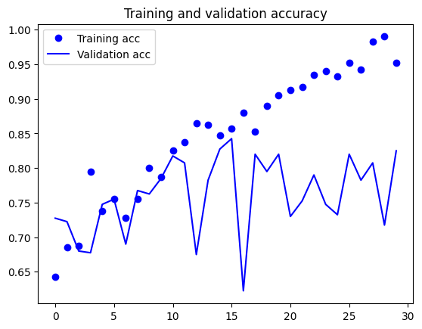
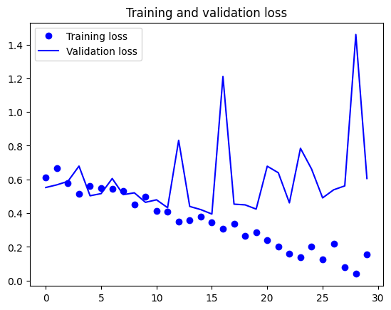
Validation Accuracy is at 82.5%
Epoch 30/30
20/20 [==============================] - 3s 136ms/step - loss: 0.1534 - acc: 0.9525 - val_loss: 0.6058 - val_acc: 0.8250

Slide 8
Added the L1 Regularizer (0.0001) on the Dense Layer
Model: "sequential_1"
_________________________________________________________________
Layer (type) Output Shape Param #
=================================================================
conv2d_4 (Conv2D) (None, 148, 148, 32) 896
max_pooling2d_4 (MaxPoolin (None, 74, 74, 32) 0
g2D)
conv2d_5 (Conv2D) (None, 72, 72, 64) 18496
max_pooling2d_5 (MaxPoolin (None, 36, 36, 64) 0
g2D)
conv2d_6 (Conv2D) (None, 34, 34, 128) 73856
max_pooling2d_6 (MaxPoolin (None, 17, 17, 128) 0
g2D)
conv2d_7 (Conv2D) (None, 15, 15, 128) 147584
max_pooling2d_7 (MaxPoolin (None, 7, 7, 128) 0
g2D)
flatten_1 (Flatten) (None, 6272) 0
dense_2 (Dense) (None, 512) 3211776
dense_3 (Dense) (None, 1) 513
=================================================================
Total params: 3453121 (13.17 MB)
Trainable params: 3453121 (13.17 MB)
Non-trainable params: 0 (0.00 Byte)
_____________________________________

Slide 9
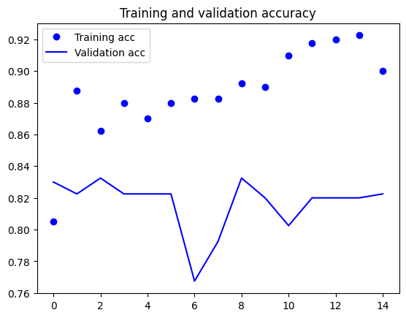
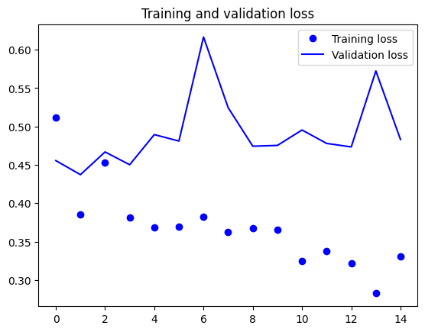
Regularization does not help 82.5% vs 82.2%
Epoch 15/15
20/20 [==============================] - 3s 132ms/step - loss: 0.3307 - acc: 0.9000 - val_loss: 0.4830 - val_acc: 0.8225

Slide 10
Replacing with Separable Conv2D
Model: "model"
__________________________________________________________________________________________________
Layer (type) Output Shape Param # Connected to
==================================================================================================
input_1 (InputLayer) [(None, 150, 150, 3)] 0 []
rescaling (Rescaling) (None, 150, 150, 3) 0 ['input_1[0][0]']
conv2d_8 (Conv2D) (None, 146, 146, 32) 2400 ['rescaling[0][0]']
batch_normalization (Batch (None, 146, 146, 32) 128 ['conv2d_8[0][0]']
Normalization)
activation (Activation) (None, 146, 146, 32) 0 ['batch_normalization[0][0]']
separable_conv2d (Separabl (None, 146, 146, 32) 1312 ['activation[0][0]']
eConv2D)
batch_normalization_1 (Bat (None, 146, 146, 32) 128 ['separable_conv2d[0][0]']
chNormalization)
activation_1 (Activation) (None, 146, 146, 32) 0 ['batch_normalization_1[0][0]'
]
separable_conv2d_1 (Separa (None, 146, 146, 32) 1312 ['activation_1[0][0]']
bleConv2D)
max_pooling2d_8 (MaxPoolin (None, 73, 73, 32) 0 ['separable_conv2d_1[0][0]']
g2D)
batch_normalization_2 (Bat (None, 73, 73, 32) 128 ['max_pooling2d_8[0][0]']
chNormalization)
activation_2 (Activation) (None, 73, 73, 32) 0 ['batch_normalization_2[0][0]'
]
separable_conv2d_2 (Separa (None, 73, 73, 64) 2336 ['activation_2[0][0]']
bleConv2D)
batch_normalization_3 (Bat (None, 73, 73, 64) 256 ['separable_conv2d_2[0][0]']
chNormalization)
activation_3 (Activation) (None, 73, 73, 64) 0 ['batch_normalization_3[0][0]'
]
separable_conv2d_3 (Separa (None, 73, 73, 64) 4672 ['activation_3[0][0]']
bleConv2D)
max_pooling2d_9 (MaxPoolin (None, 37, 37, 64) 0 ['separable_conv2d_3[0][0]']
g2D)
batch_normalization_4 (Bat (None, 37, 37, 64) 256 ['max_pooling2d_9[0][0]']
chNormalization)
activation_4 (Activation) (None, 37, 37, 64) 0 ['batch_normalization_4[0][0]'
]
separable_conv2d_4 (Separa (None, 37, 37, 128) 8768 ['activation_4[0][0]']
bleConv2D)
batch_normalization_5 (Bat (None, 37, 37, 128) 512 ['separable_conv2d_4[0][0]']
chNormalization)
activation_5 (Activation) (None, 37, 37, 128) 0 ['batch_normalization_5[0][0]'
]
separable_conv2d_5 (Separa (None, 37, 37, 128) 17536 ['activation_5[0][0]']
bleConv2D)
max_pooling2d_10 (MaxPooli (None, 19, 19, 128) 0 ['separable_conv2d_5[0][0]']
ng2D)
batch_normalization_6 (Bat (None, 19, 19, 128) 512 ['max_pooling2d_10[0][0]']
chNormalization)
activation_6 (Activation) (None, 19, 19, 128) 0 ['batch_normalization_6[0][0]'
]
separable_conv2d_6 (Separa (None, 19, 19, 256) 33920 ['activation_6[0][0]']
bleConv2D)
batch_normalization_7 (Bat (None, 19, 19, 256) 1024 ['separable_conv2d_6[0][0]']
chNormalization)
activation_7 (Activation) (None, 19, 19, 256) 0 ['batch_normalization_7[0][0]'
]
separable_conv2d_7 (Separa (None, 19, 19, 256) 67840 ['activation_7[0][0]']
bleConv2D)
max_pooling2d_11 (MaxPooli (None, 10, 10, 256) 0 ['separable_conv2d_7[0][0]']
ng2D)
batch_normalization_8 (Bat (None, 10, 10, 256) 1024 ['max_pooling2d_11[0][0]']
chNormalization)
activation_8 (Activation) (None, 10, 10, 256) 0 ['batch_normalization_8[0][0]'
]
separable_conv2d_8 (Separa (None, 10, 10, 512) 133376 ['activation_8[0][0]']
bleConv2D)
batch_normalization_9 (Bat (None, 10, 10, 512) 2048 ['separable_conv2d_8[0][0]']
chNormalization)
activation_9 (Activation) (None, 10, 10, 512) 0 ['batch_normalization_9[0][0]'
]
separable_conv2d_9 (Separa (None, 10, 10, 512) 266752 ['activation_9[0][0]']
bleConv2D)
max_pooling2d_12 (MaxPooli (None, 5, 5, 512) 0 ['separable_conv2d_9[0][0]']
ng2D)
conv2d_13 (Conv2D) (None, 5, 5, 512) 131072 ['max_pooling2d_11[0][0]']
add (Add) (None, 5, 5, 512) 0 ['max_pooling2d_12[0][0]',
'conv2d_13[0][0]']
global_average_pooling2d ( (None, 512) 0 ['add[0][0]']
GlobalAveragePooling2D)
dropout (Dropout) (None, 512) 0 ['global_average_pooling2d[0][
0]']
dense_4 (Dense) (None, 1) 513 ['dropout[0][0]']
==================================================================================================
Total params: 677825 (2.59 MB)
Trainable params: 674817 (2.57 MB)
Non-trainable params: 3008 (11.75 KB)

Slide 11
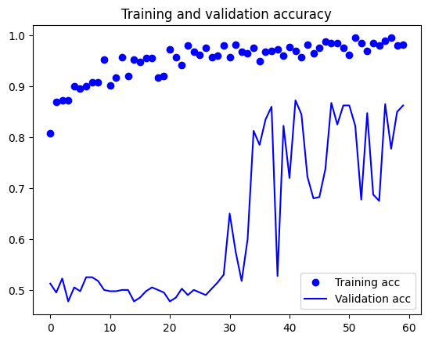
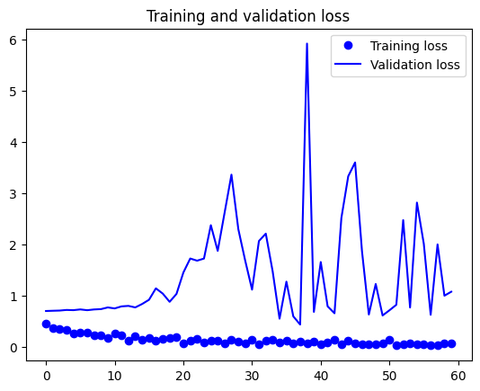
The validation accuracy went up to 86.25% with the SeparableConv2D replacement from the original (only Conv2D withOUT regularization) 82.5%
Epoch 60/60
20/20 [==============================] - 3s 131ms/step - loss: 0.0567 - acc: 0.9825 - val_loss: 1.0717 - val_acc: 0.8625
This shows that Separable CONV2D leads to ~4% increase in accuracy which is a big deal. There is still some overfitting.
The of Trainable params decreased to 674,817 from the original
Trainable params: 3,453,121 - which is good as with fewer parameters we are getting a 4% accuracy lift.

Slide 12
Part 2 - Pre-trained Convolutional Neural Networks - VGG16

Slide 13
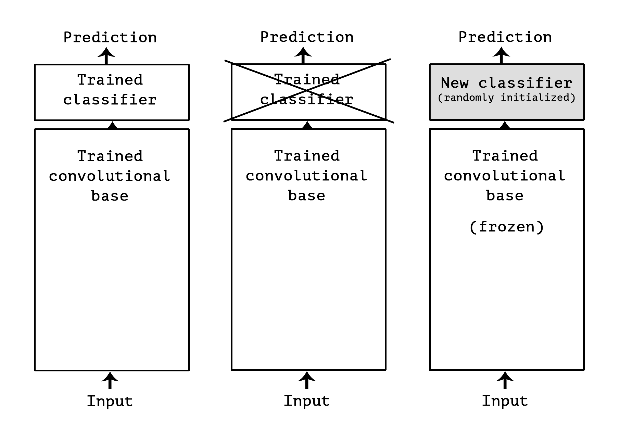
Pre-trained Convolutional Neural Network VGG16
Model: "vgg16"
_________________________________________________________________
Layer (type) Output Shape Param #
=================================================================
input_1 (InputLayer) [(None, 150, 150, 3)] 0
block1_conv1 (Conv2D) (None, 150, 150, 64) 1792
block1_conv2 (Conv2D) (None, 150, 150, 64) 36928
block1_pool (MaxPooling2D) (None, 75, 75, 64) 0
block2_conv1 (Conv2D) (None, 75, 75, 128) 73856
block2_conv2 (Conv2D) (None, 75, 75, 128) 147584
block2_pool (MaxPooling2D) (None, 37, 37, 128) 0
block3_conv1 (Conv2D) (None, 37, 37, 256) 295168
block3_conv2 (Conv2D) (None, 37, 37, 256) 590080
block3_conv3 (Conv2D) (None, 37, 37, 256) 590080
block3_pool (MaxPooling2D) (None, 18, 18, 256) 0
block4_conv1 (Conv2D) (None, 18, 18, 512) 1180160
block4_conv2 (Conv2D) (None, 18, 18, 512) 2359808
block4_conv3 (Conv2D) (None, 18, 18, 512) 2359808
block4_pool (MaxPooling2D) (None, 9, 9, 512) 0
block5_conv1 (Conv2D) (None, 9, 9, 512) 2359808
block5_conv2 (Conv2D) (None, 9, 9, 512) 2359808
block5_conv3 (Conv2D) (None, 9, 9, 512) 2359808
block5_pool (MaxPooling2D) (None, 4, 4, 512) 0
=================================================================
Total params: 14714688 (56.13 MB)
Trainable params: 14714688 (56.13 MB)
Non-trainable params: 0 (0.00 Byte)

Slide 14
Densely-connected classifier
from keras import models
from keras import layers
from keras import optimizers
model = models.Sequential()
model.add(layers.Dense(256, activation='relu', input_dim=4 * 4 * 512))
model.add(layers.Dropout(0.5))
model.add(layers.Dense(1, activation='sigmoid'))
model.compile(optimizer=optimizers.RMSprop(lr=2e-5),
loss='binary_crossentropy',
metrics=['acc'])
history = model.fit(train_features, train_labels,
epochs=30,
batch_size=20,
validation_data=(validation_features, validation_labels))

Slide 15
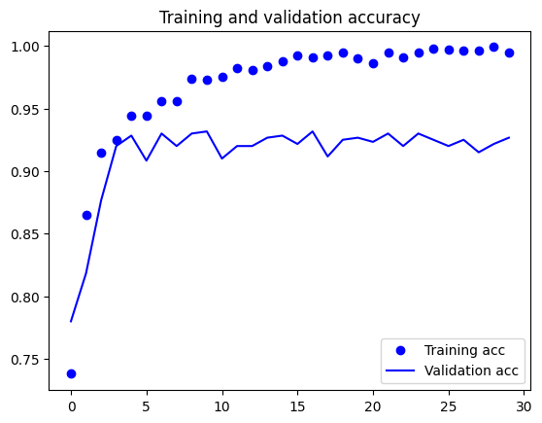
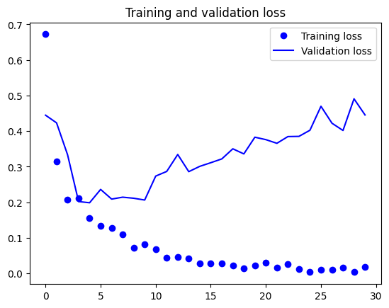
Validation Accuracy 92.67%
Epoch 30/30
50/50 [==============================] - 0s 8ms/step - loss: 0.0191 - acc: 0.9950 - val_loss: 0.4455 - val_acc: 0.9267

Slide 16
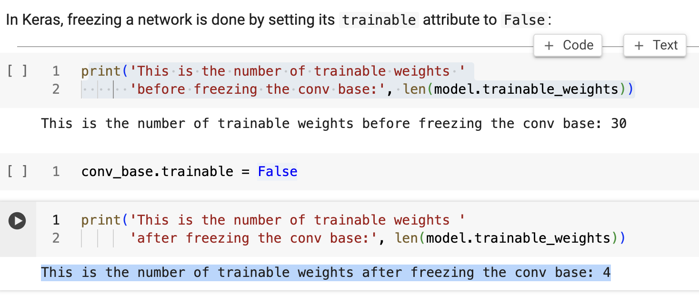
Building the VGG16 and layering the dense layers and then freezing them
Model: "sequential_1"
_________________________________________________________________
Layer (type) Output Shape Param #
=================================================================
vgg16 (Functional) (None, 4, 4, 512) 14714688
flatten (Flatten) (None, 8192) 0
dense_2 (Dense) (None, 256) 2097408
dense_3 (Dense) (None, 1) 257
=================================================================
Total params: 16812353 (64.13 MB)
Trainable params: 16812353 (64.13 MB)
Non-trainable params: 0 (0.00 Byte)

Slide 17
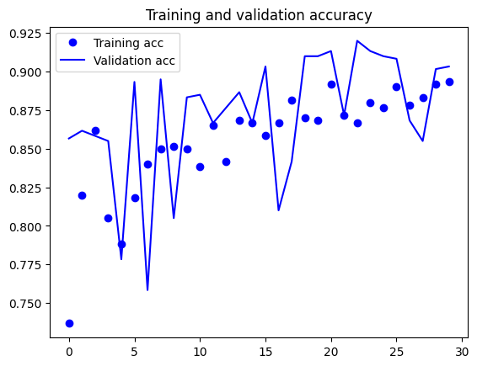
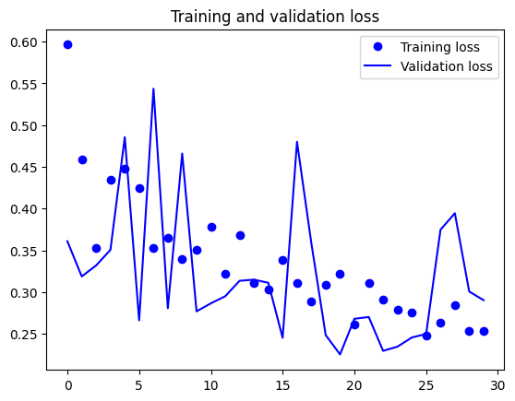
Validation Accuracy is at 90.33%
Epoch 30/30
30/30 - 12s - loss: 0.2539 - acc: 0.8933 - val_loss: 0.2903 - val_acc: 0.9033 - 12s/epoch - 411ms/step

Slide 18
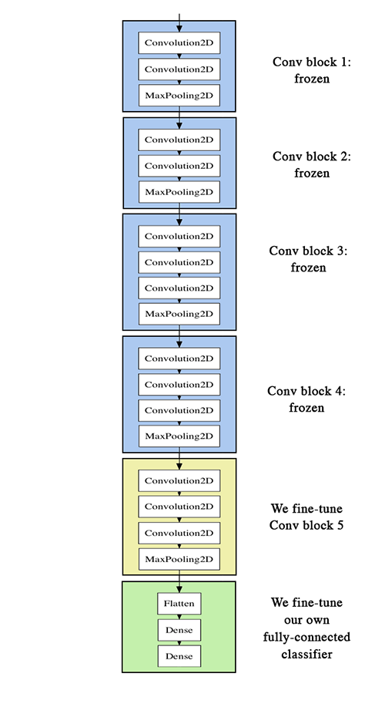
Fine-Tuning
Model: "vgg16"
_________________________________________________________________
Layer (type) Output Shape Param #
=================================================================
input_1 (InputLayer) [(None, 150, 150, 3)] 0
block1_conv1 (Conv2D) (None, 150, 150, 64) 1792
block1_conv2 (Conv2D) (None, 150, 150, 64) 36928
block1_pool (MaxPooling2D) (None, 75, 75, 64) 0
block2_conv1 (Conv2D) (None, 75, 75, 128) 73856
block2_conv2 (Conv2D) (None, 75, 75, 128) 147584
block2_pool (MaxPooling2D) (None, 37, 37, 128) 0
block3_conv1 (Conv2D) (None, 37, 37, 256) 295168
block3_conv2 (Conv2D) (None, 37, 37, 256) 590080
block3_conv3 (Conv2D) (None, 37, 37, 256) 590080
block3_pool (MaxPooling2D) (None, 18, 18, 256) 0
block4_conv1 (Conv2D) (None, 18, 18, 512) 1180160
block4_conv2 (Conv2D) (None, 18, 18, 512) 2359808
block4_conv3 (Conv2D) (None, 18, 18, 512) 2359808
block4_pool (MaxPooling2D) (None, 9, 9, 512) 0
block5_conv1 (Conv2D) (None, 9, 9, 512) 2359808
block5_conv2 (Conv2D) (None, 9, 9, 512) 2359808
block5_conv3 (Conv2D) (None, 9, 9, 512) 2359808
block5_pool (MaxPooling2D) (None, 4, 4, 512) 0
=================================================================
Total params: 14714688 (56.13 MB)
Trainable params: 0 (0.00 Byte)
Non-trainable params: 14714688 (56.13 MB)

Slide 19
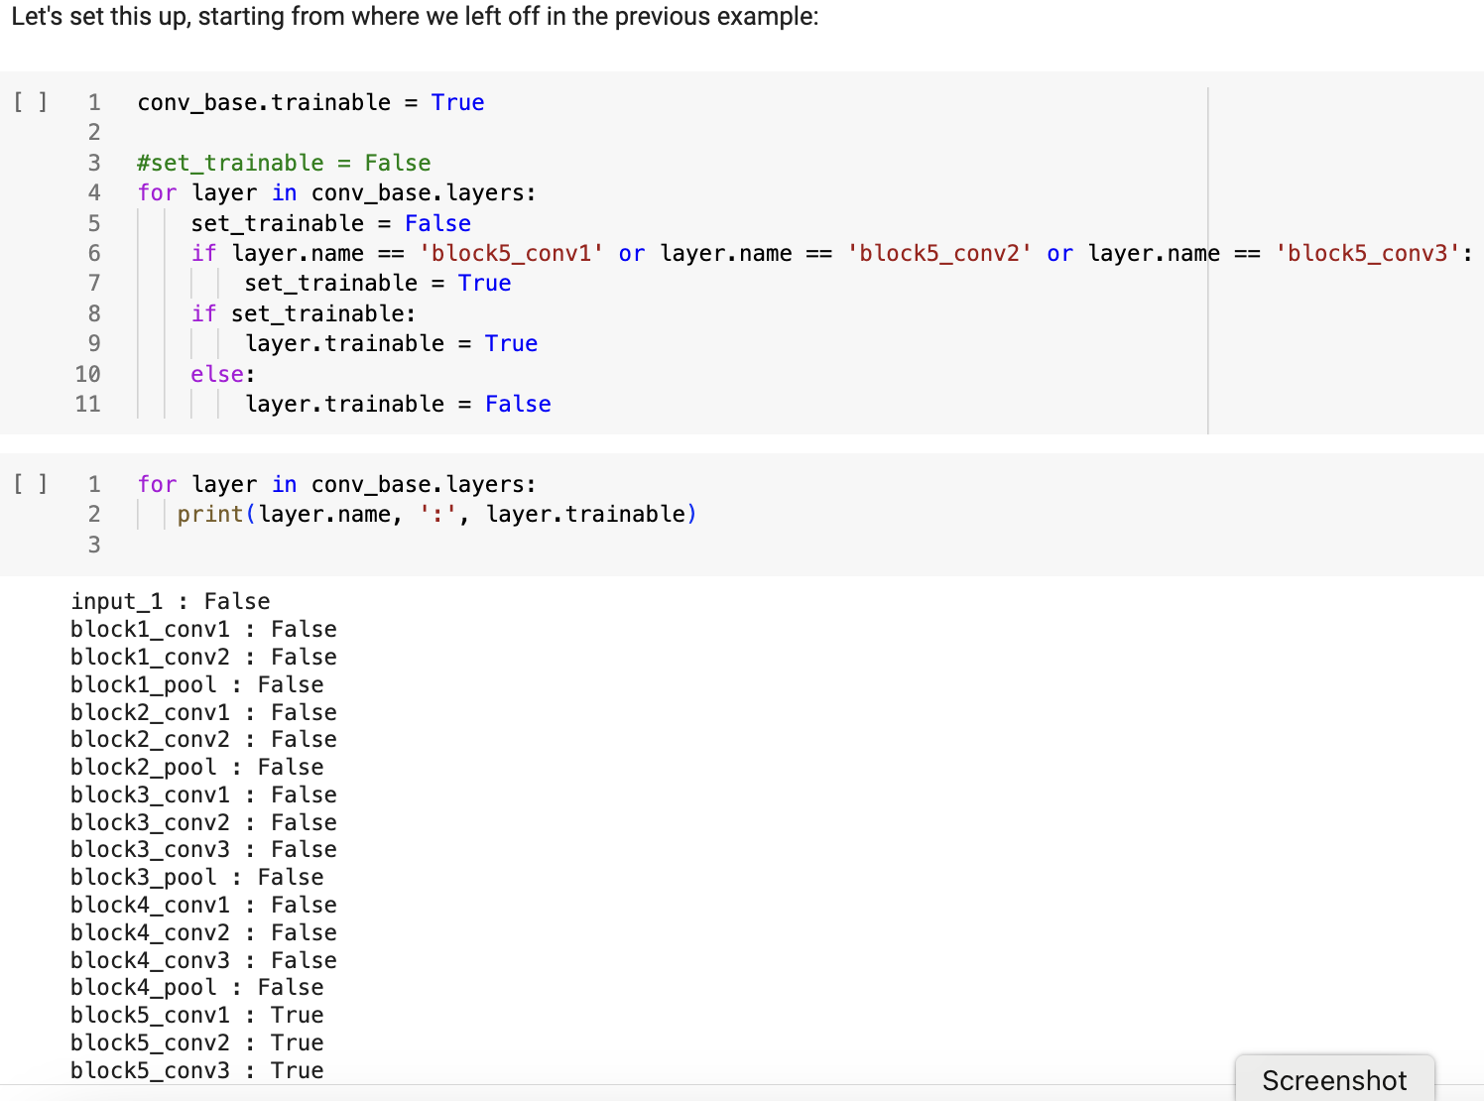
Fine-tune the last 3 convolutional layers

Slide 20
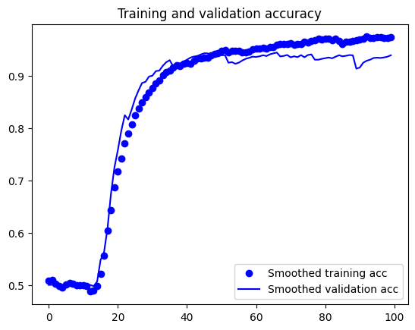
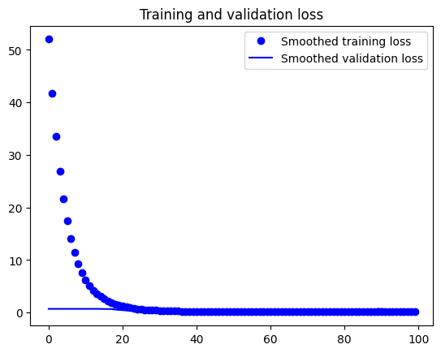
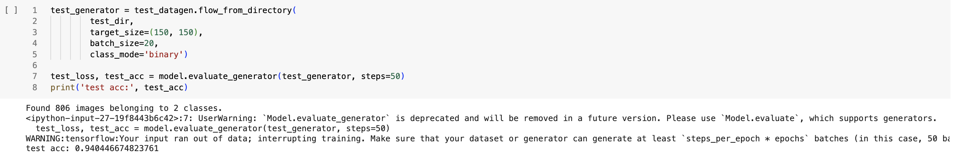
Test Accuracy 94.04% & Validation Accuracy 95%
Epoch 100/100
30/30 [==============================] - 6s 217ms/step - loss: 0.0695 - acc: 0.9767 - val_loss: 0.5351 - val_acc: 0.9500

Slide 21
Part 3 - Pre-trained Convolutional Neural Networks - Xception

Slide 22
Pretrained Convolutional Neural Networks - Xception
Model: "xception"
__________________________________________________________________________________________________
Layer (type) Output Shape Param # Connected to
==================================================================================================
input_1 (InputLayer) [(None, 299, 299, 3)] 0 []
block1_conv1 (Conv2D) (None, 149, 149, 32) 864 ['input_1[0][0]']
block1_conv1_bn (BatchNorm (None, 149, 149, 32) 128 ['block1_conv1[0][0]']
alization)
block1_conv1_act (Activati (None, 149, 149, 32) 0 ['block1_conv1_bn[0][0]']
on)
block1_conv2 (Conv2D) (None, 147, 147, 64) 18432 ['block1_conv1_act[0][0]']
block1_conv2_bn (BatchNorm (None, 147, 147, 64) 256 ['block1_conv2[0][0]']
alization)
block1_conv2_act (Activati (None, 147, 147, 64) 0 ['block1_conv2_bn[0][0]']
on)
block2_sepconv1 (Separable (None, 147, 147, 128) 8768 ['block1_conv2_act[0][0]']
Conv2D)
block2_sepconv1_bn (BatchN (None, 147, 147, 128) 512 ['block2_sepconv1[0][0]']
ormalization)
block2_sepconv2_act (Activ (None, 147, 147, 128) 0 ['block2_sepconv1_bn[0][0]']
ation)
…..
block14_sepconv1_act (Acti (None, 10, 10, 1536) 0 ['block14_sepconv1_bn[0][0]']
vation)
block14_sepconv2 (Separabl (None, 10, 10, 2048) 3159552 ['block14_sepconv1_act[0][0]']
eConv2D)
block14_sepconv2_bn (Batch (None, 10, 10, 2048) 8192 ['block14_sepconv2[0][0]']
Normalization)
block14_sepconv2_act (Acti (None, 10, 10, 2048) 0 ['block14_sepconv2_bn[0][0]']
vation)
==================================================================================================
Total params: 20861480 (79.58 MB)
Trainable params: 20806952 (79.37 MB)
Non-trainable params: 54528 (213.00 KB)
__________________________________________________________________________________________________

Slide 23
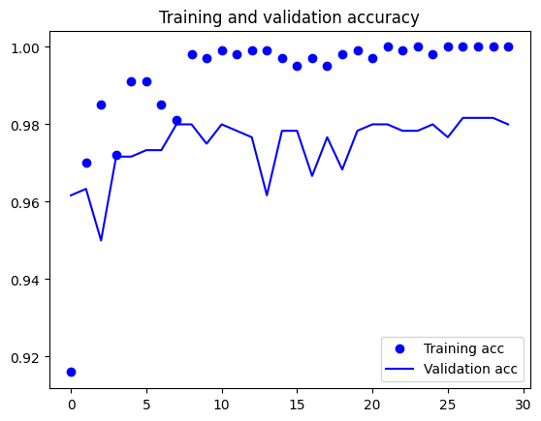
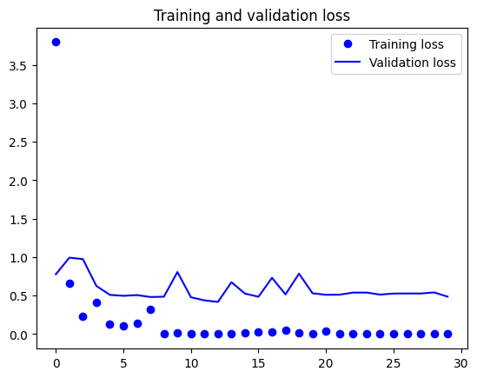
Validation Accuracy 98%
Epoch 30/30
50/50 [==============================] - 1s 19ms/step - loss: 1.7528e-04 - acc: 1.0000 - val_loss: 0.4869 - val_acc: 0.9800

Slide 24
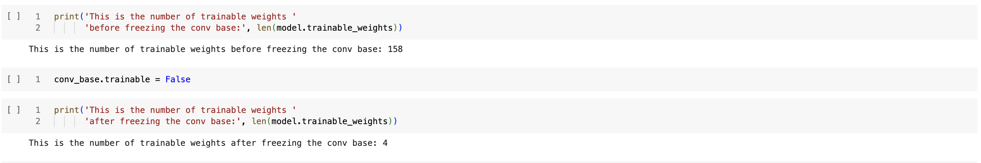
Building the Exception and layering the dense layers and then freezing them
Model: "sequential_1"
_________________________________________________________________
Layer (type) Output Shape Param #
=================================================================
xception (Functional) (None, 10, 10, 2048) 20861480
flatten (Flatten) (None, 204800) 0
dense_2 (Dense) (None, 256) 52429056
dense_3 (Dense) (None, 1) 257
=================================================================
Total params: 73290793 (279.58 MB)
Trainable params: 73236265 (279.37 MB)
Non-trainable params: 54528 (213.00 KB)
_________________________________________________________________

Slide 25
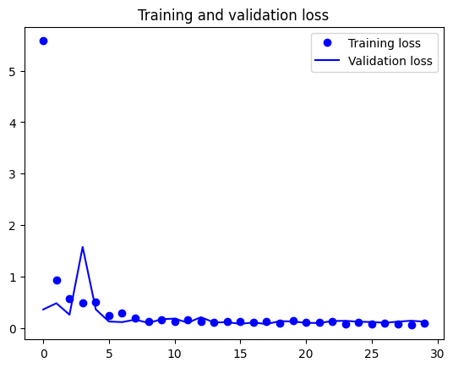
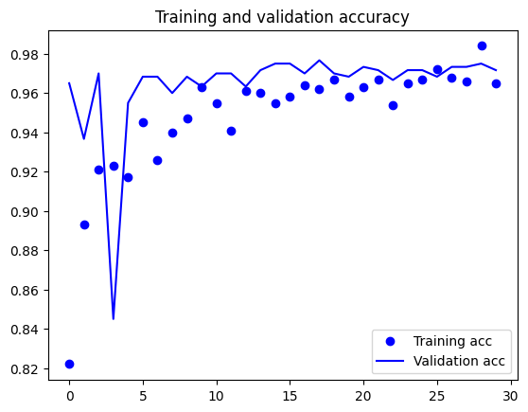
Validation Accuracy 97.17%
Epoch 30/30
50/50 - 29s - loss: 0.0867 - acc: 0.9650 - val_loss: 0.1237 - val_acc: 0.9717 - 29s/epoch - 575ms/step

Slide 26
Fine Tuning
Model: "xception"
__________________________________________________________________________________________________
Layer (type) Output Shape Param # Connected to
==================================================================================================
input_1 (InputLayer) [(None, 299, 299, 3)] 0 []
block1_conv1 (Conv2D) (None, 149, 149, 32) 864 ['input_1[0][0]']
block1_conv1_bn (BatchNorm (None, 149, 149, 32) 128 ['block1_conv1[0][0]']
alization)
block1_conv1_act (Activati (None, 149, 149, 32) 0 ['block1_conv1_bn[0][0]']
on)
block1_conv2 (Conv2D) (None, 147, 147, 64) 18432 ['block1_conv1_act[0][0]']
block1_conv2_bn (BatchNorm (None, 147, 147, 64) 256 ['block1_conv2[0][0]']
alization)
block1_conv2_act (Activati (None, 147, 147, 64) 0 ['block1_conv2_bn[0][0]']
on)
….
block14_sepconv2 (Separabl (None, 10, 10, 2048) 3159552 ['block14_sepconv1_act[0][0]']
eConv2D)
block14_sepconv2_bn (Batch (None, 10, 10, 2048) 8192 ['block14_sepconv2[0][0]']
Normalization)
block14_sepconv2_act (Acti (None, 10, 10, 2048) 0 ['block14_sepconv2_bn[0][0]']
vation)
==================================================================================================
Total params: 20861480 (79.58 MB)
Trainable params: 0 (0.00 Byte)
Non-trainable params: 20861480 (79.58 MB)
__________________________________________________________________________________________________

Slide 27
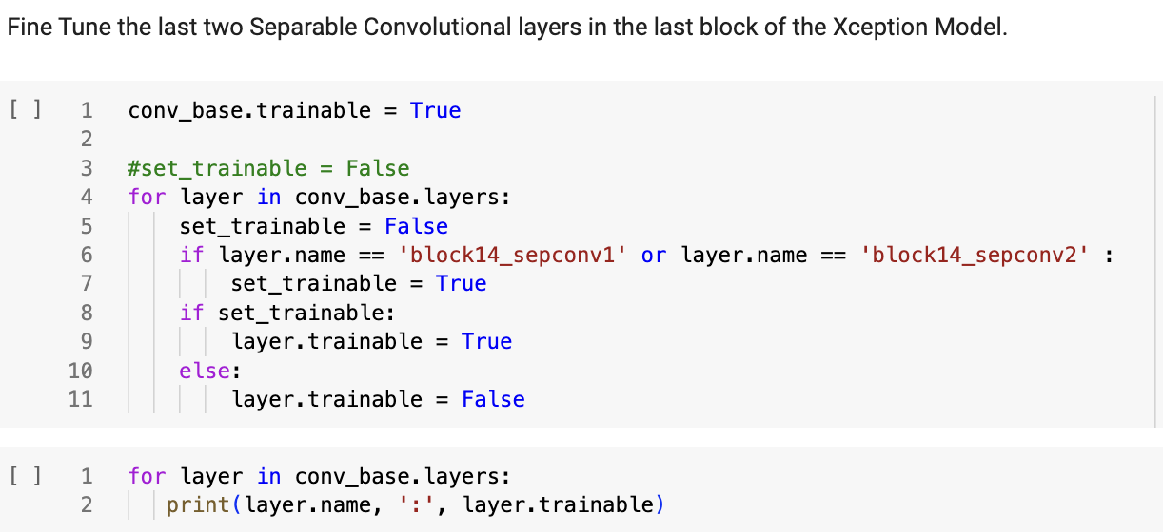
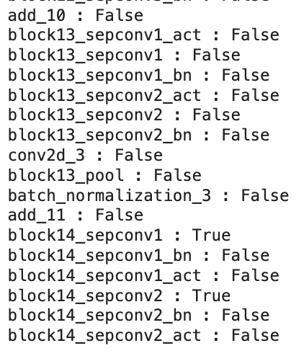
Fine Tune the last 2 Separable Conv. Layers

Slide 28
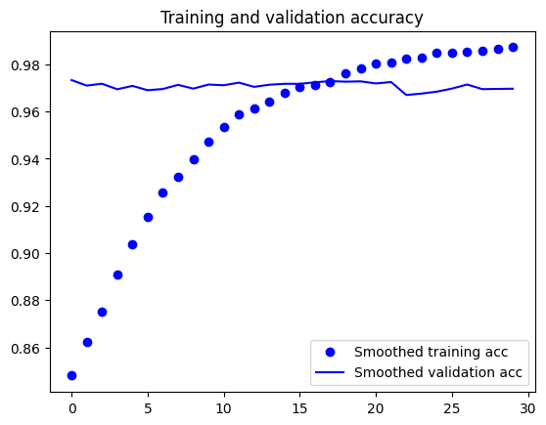
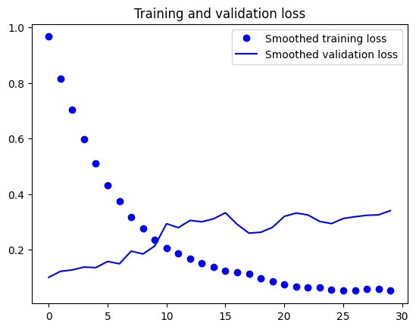
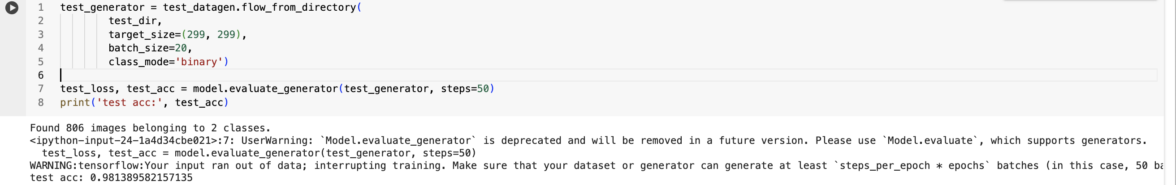
Accuracy is extremely high with Xception model and fine tuning it at 98.13% vs that of VGG16 at 94.04%
Epoch 30/30
50/50 [==============================] - 31s 628ms/step - loss: 0.0295 - acc: 0.9900 - val_loss: 0.4008 - val_acc: 0.9700

Slide 29
YouTube URLs, Last Page
Two minute (short): https://youtu.be/uqDYF-L85D8
15 minutes (long): https://youtu.be/GPKKnFPIraM
@Your Name

