Slide 1
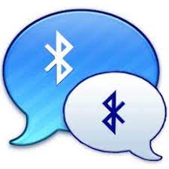
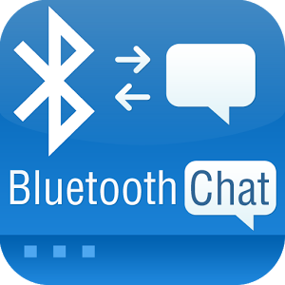
Project on Android Bluetooth Chat
Name-Vinod Singh Airy
B.Tech-CSE-C-V-Sem
Roll No-73
University Roll No-1018635
Class Co-ordinator Mr. Inderjeet kumar

Slide 2
About Project
The Android Bluetooth Chat messenger application is a two-way, sending and receiving, text chat program for phones.
These devices are largely used in open and closed spaces and everywhere as in street or in crowded places.
The Bluetooth Chat messenger does not require a GMS or Wi-Fi connection, all it need is two Bluetooth Chat app in range of 50 feet of each other

Slide 3
REASON FOR DEVELOPING BLUETOOTH CHAT APP SYSTEM
No Internet or Wi-Fi required
No server required
Easily handled technology
This Bluetooth Chat application allow you to see others Bluetooth Chat application users around ,ping any of them and start chatting via Bluetooth.

Slide 4
OBJECTIVES
Two way text messaging.
Develop and Implement chatting system without use of server and internet.
Create an Bluetooth Chat Application to provide a consistent UI to interact with the system.
Better use of mobile phones to use this technology.

Slide 5
SYSTEM REQUIREMENTS
HARDWARE REQUIREMENT
HP . The specification of the system is given as Intel(R)Core(TM) i5-1035G1 CPU
1.50GHz 1.19 GHz/10 GEN/18GB RAM/1TBHD/INTEGRATED GRAPHICS/15”FHD AG
SCREEN
SOFTWARE REQUIREMENT
Windows 10 Home Single Language, Version: - 2004, OS Build: - 19041.572
Android Studio is used for developing this application.

Slide 6
To Allow Two Way Text CHAT OVER BLUETOOTH IN ANDROID
Get Bluetooth Service
BluetoothAdapter Class
isEnable() Method
Discover Bluetooth
Check for Enable Devices
Pairing Devices
Read and Write Date

Slide 7
Tools Used
Android Studio: Android Studio is the official integrated development environment (IDE) for Android application development. It is based on the IntelliJ IDEA, a Java integrated development environment for software, and incorporates its code editing and developer tools.
SDK Tools: SDK stands for software development kit or devkit for short. It’s a set of software tools and programs used by developers to create applications for specific platforms. SDK tools will include a range of things, including libraries, documentation, code samples, processes, and guides that developers can use and integrate into their own apps. SDKs are designed to be used for specific platforms or programming languages.

Slide 8
FUNCTIONALITIES
Scanning for other Bluetooth devices.
Querying the local Bluetooth adapter for paired Bluetooth devices.
Establishing RFCOMM channel or sockets.
Connecting to remote devices.
Transferring data over Bluetooth.
Displaying paired devices.
Chatting over the mobile through Bluetooth connectivity.

Slide 9
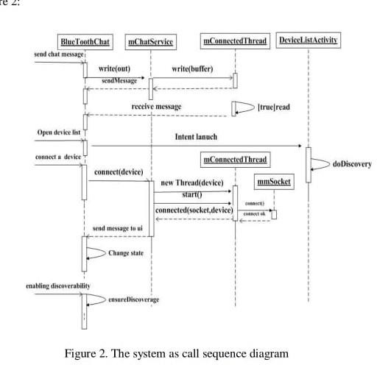
E-R diagram

Slide 10
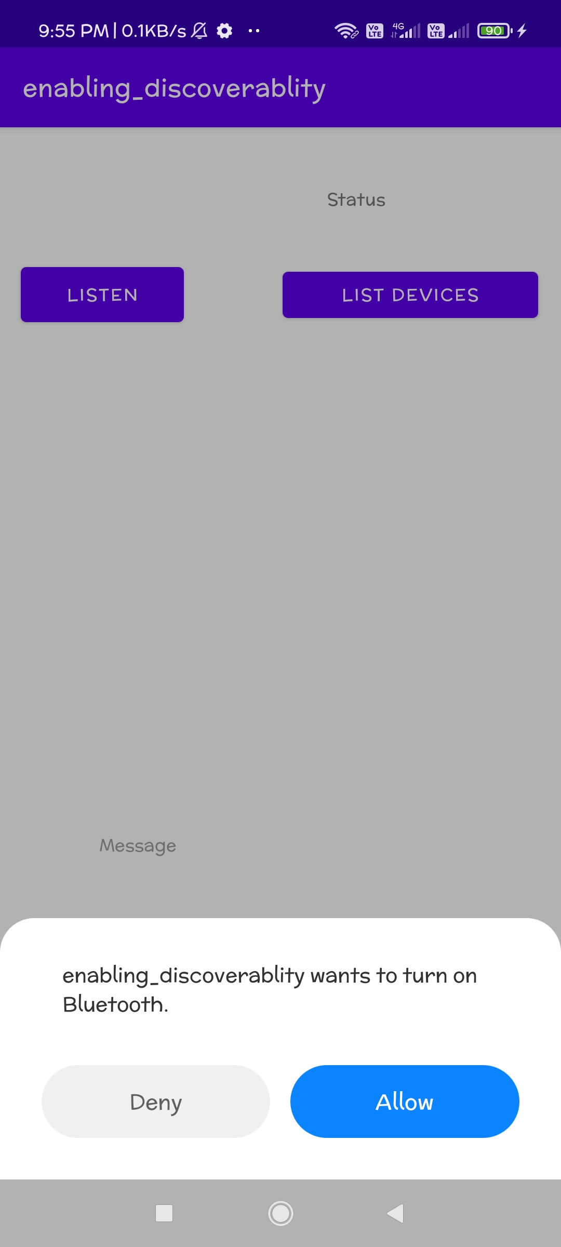
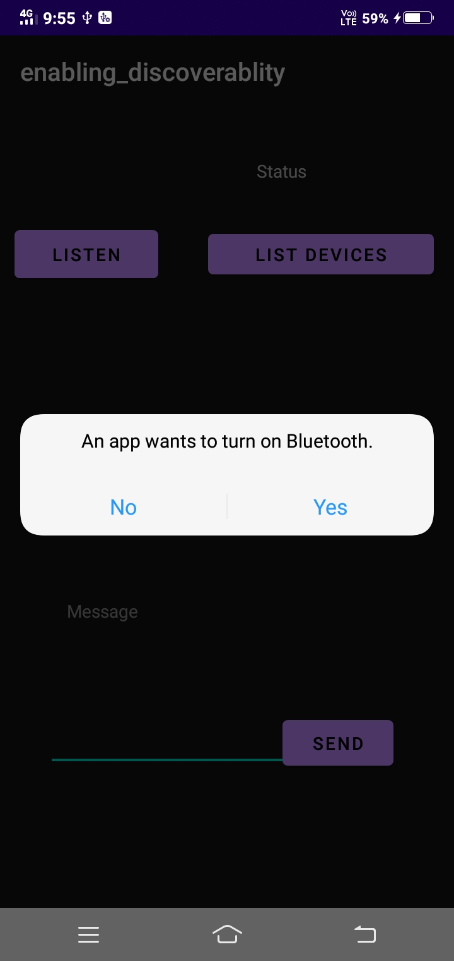
SCREENSHOT OF APP
Turing on Bluetooth and open app

Slide 11
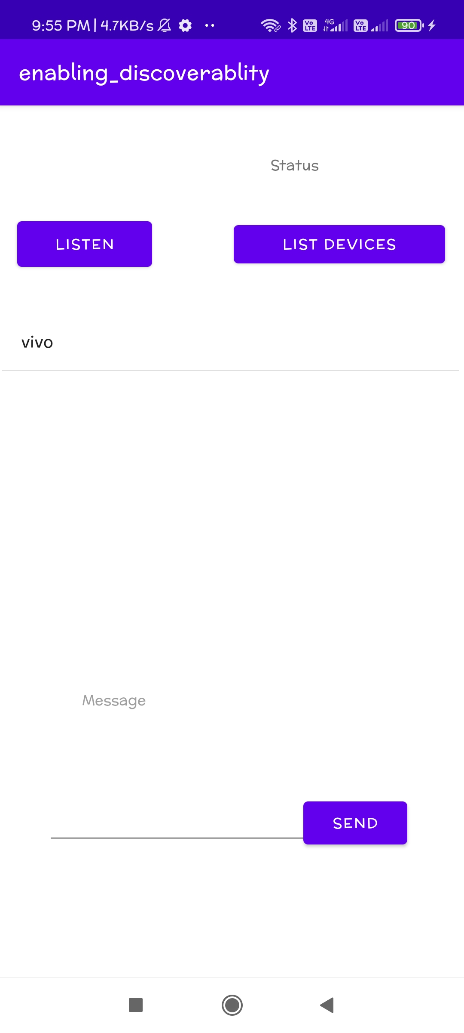
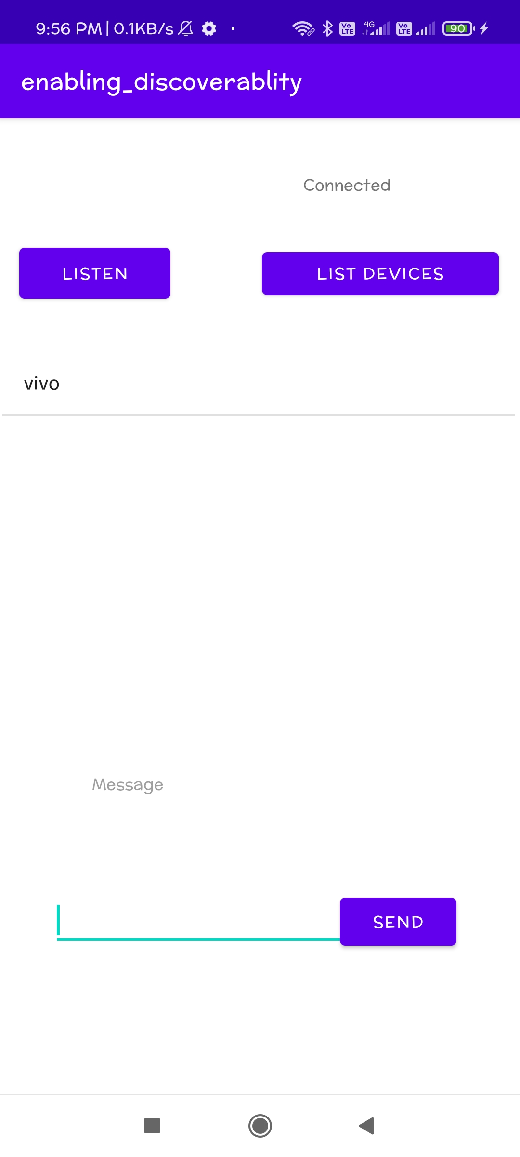
List of paired and available devices Choose device and device connected

Slide 12

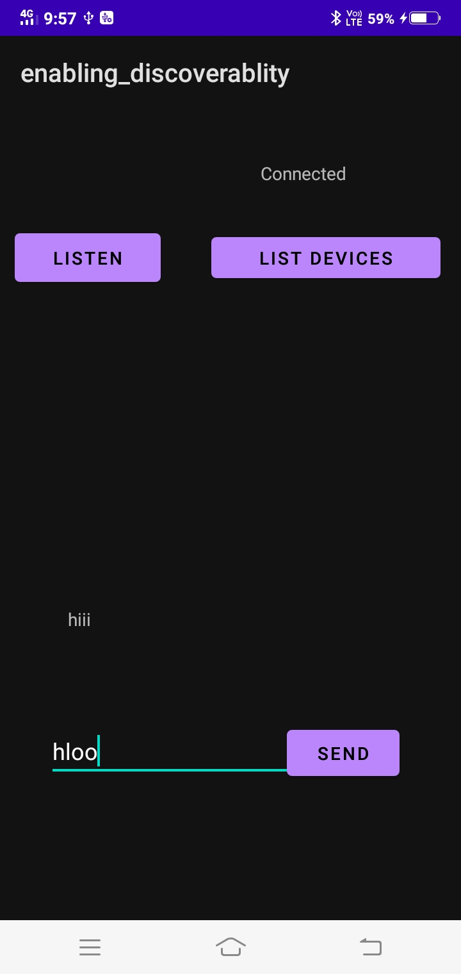
Connected device and chatting

Slide 13
ADVANTAGES
Bluetooth Chat App does not require Wi-Fi or internet.
The processing and battery power it requires in order to operate is very low.
It is very easy since anyone can figure out how to set up a connection and sync two devices to ease.
This technology is free for use and charges to be paid

Slide 14
CONCLUSION
The messenger application using Bluetooth technology was successfully completed in Windows platform and in Android platform.
Bluetooth consumes low power as compared to Wi-fi technology and on the other hand Wi-fi has a range of almost ten times to that of Bluetooth. In order to account for the limitations in range, we can incorporate Wi-fi communication in our application.
The goal of this is to create an Android application Blue Chat. This application would take the advantage of the wide spread of the Android operating system via varieties of devices. It is concerned with solving some problems of communicating freely, securely, silently and within small range. It is great for making new friends in a library or chatting up someone in crowded places. The application paves the ground for more Bluetooth applications.

Slide 15
REFERENCES
Thompson T.J.& Balakumar C(2020),Bluetooth Application Programming with Java APIs,(4th ed.)
Economou, D. (2021). Development platforms for mobile applications: Status and trends. IEEE, 28(1), 77-86.

Slide 16
THANK YOU

