Slide 1

IBM’s Cloud Platform
Codename: BlueMix
Deployment of Node.js app with Cloudant
Vinod Singh – Senior Architect
IBM Global Technology Services

Slide 2
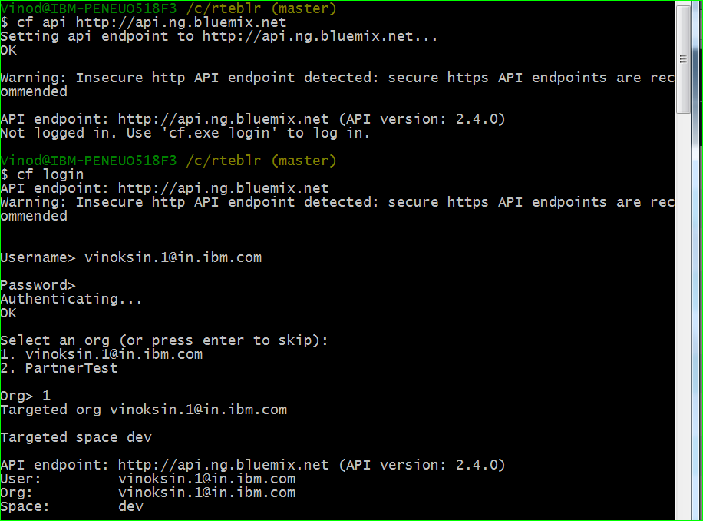
Deployment of Node.js with Cloudant – Steps 1-3
STEP 1
STEP 2
STEP 3

Slide 3
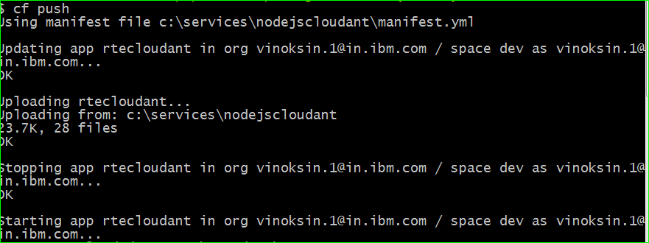
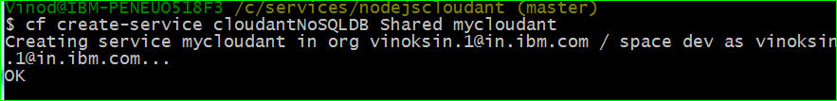

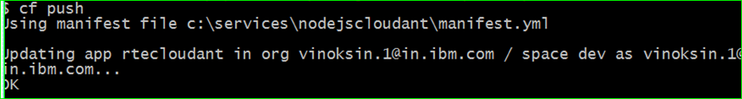
Deployment of Node.js with Cloudant – Step 4 - 7
STEP 4
STEP 5
STEP 6
STEP 7

