Slide 1

IBM’s Cloud Platform
Codename: BlueMix
Deployment of Java App on Bluemix
Vinod Singh – Senior Architect
IBM Global Technology Services

Slide 2
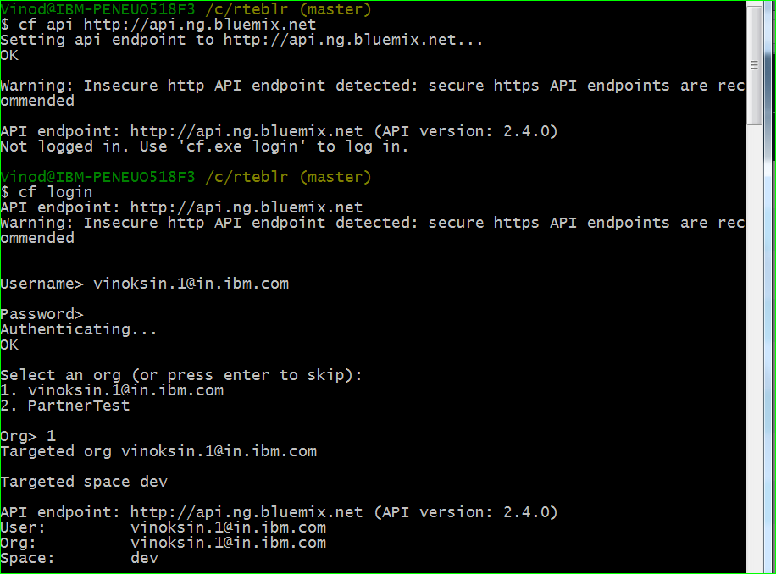
JAVA App deploying on Bluemix – Steps 1-3
STEP 1
STEP 2
STEP 3 (Optional)

Slide 3
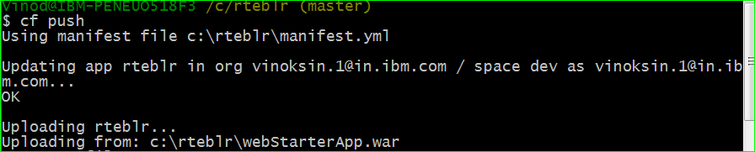
JAVA App deploying on Bluemix – Step 4
STEP 4

