Slide 1

Test Driven Development
Notes:
Congratulations; you’ve just taken the first step to upgrade to Hadoop, the most powerful BIG Data technology to ever exist. We assure you the best learning experience.
Lets get started.

Slide 2
{ Session Objective }
Introduction
What is TDD
Test First
Introduction to Mocha Testing Framework
Creating your first test
Making Sure you fail test
Getting your test pass
Application setup using gulp

Slide 3
{ What is Testing}
Testing is a process of executing a program or application with the intent of finding the software bugs. It can also be stated as the process of validating and verifying that a software program or application or product: Meets the business and technical requirements that guided it's design and development.

Slide 4
{ Test Driven Development }
What is Unit Test?
A unit test focuses on a single “unit of code” – usually a function in an object or module. By making the test specific to a single function, the test should be simple, quick to write, and quick to run. This means you can have many unit tests, and more unit tests means more bugs caught. They are especially helpful if you need to change your code, as you can safely do so and trust that any other code will not break.
You don’t have to use any specific syntax for unit tests – in fact, you can even write unit tests with plain JavaScript
var name= ‘Jhon’;
if(name == “Jhon”) {
throw new Error('User name should not equal to Jhon');
}
But as you can see, it’s not so easy to read, so you should definitely use an actual testing tool like Mocha or Jasmine.

Slide 5
{ Test Driven Development }
TDD or Test-Driven Development is a process for when you write and run your tests. Following it makes it possible to have a very high test-coverage. Test-coverage refers to the percentage of your code that is tested automatically, so a higher number is better.
The TDD process consists of the following steps:
Start by writing a test
Run the test and any other tests
Write the minimum amount of code required to make the test pass
Run the tests to check the new test passes
Code Refractor

Slide 6
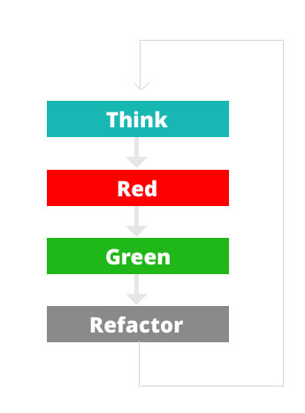
{ Test Driven Development }

Slide 7




{ Test Driven Development }

Slide 8
{ Behavior Driven Development }
BDD – Behavior-Driven Development – is perhaps the biggest source of confusion. When applied to automated testing, BDD is a set of best practices for writing great tests. BDD can, and should be, used together with TDD and unit testing methods.
BDD suggests to test behaviors, so instead of thinking of how the code is implemented, we spend a moment thinking of what the scenario is. Typically you phrase BDD tests in the form of “it should do something”.

Slide 9
{ Conclusion }
Unit Testing gives you the what. Test-Driven Development gives you the when. Behavior Driven-Development gives you the how. Although you can use each individually, you should combine them for best results as they complement each other very nicely.

Slide 10
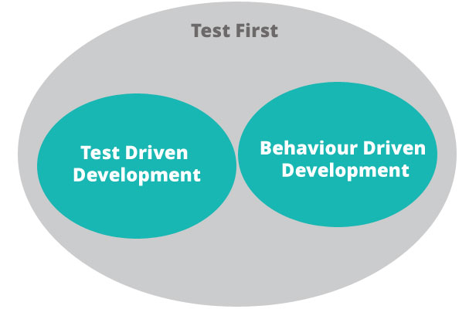
{ Test First }

Slide 11
{ Javascript Frameworks }
Jasmine
Jasmine is an open source testing framework for JavaScript. It aims to run on any JavaScript-enabled platform, to not intrude on the application nor the IDE, and to have easy-to-read syntax
Mocha
Mocha is a feature-rich JavaScript test framework running on Node.js and in the browser, making asynchronous testing simple and fun. Mocha tests run serially, allowing for flexible and accurate reporting, while mapping uncaught exceptions to the correct test cases.

Slide 12
{ Setup local Application }
Setup a local environment
Create package.json
Install Gulp
Create bower.json
Install Bower
Install bootstrap using bower
Install angular using bower
Install mocha
Examples

Slide 13
{ Setup local Application }
Create a gulpfile
Create a server
Sync your code with browser
Run your gulp task
Create your test folder
Create a **spec.js
Install Mocha
Run test
Examples and Exercises

Slide 14
{ Run a Test }
Create an element in JavaScript With TDD Approch
Bind Click Event
Install Karma
Run Karma
Test your test in Firefox, Internet Explorer and chrome

Slide 15
{ Gulp File }
var gulp = require('gulp');
var browserSync = require('browser-sync');
var karma = require('karma').Server;
gulp.task("test-server", function(){
browserSync.init({
notify:false,
port:8000,
server:{
baseDir:["test"],
routes:{
'/bower_components':'bower_components'
}
}
})
})

Slide 16
{ Gulp File }
gulp.task("karma-serve", function(){
karma.start({
configFile:__dirname + '/karma.conf.js',
singleRun:false
})
})
gulp.task('watch', function() {
gulp.watch(['application/**/*.*']).on('change', browserSync.reload);
})
gulp.task('default', ['karma-serve','watch'])

Slide 17
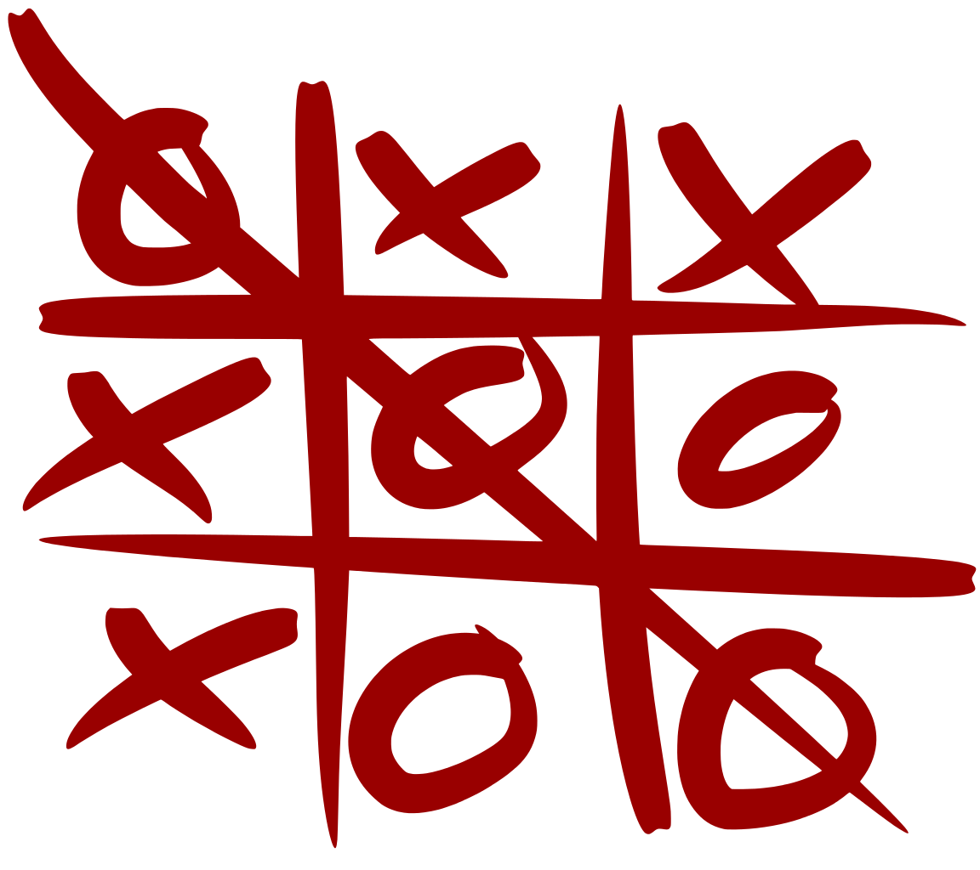
{ Assignment }
Design a Tic Tac Toe game and test it

Slide 18

Questions

Slide 19
Notes:
See you in the next lesson. Thank you.

