Slide 1

TurboID Project
DATA ANALYSIS 10/17

Slide 2
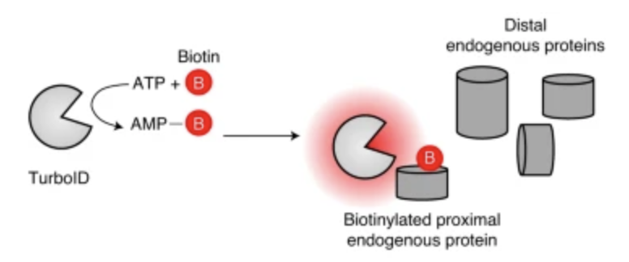
TurboID
proximity labelling enzyme (engineered biotin ligase)
uses ATP to convert biotin into biotin–AMP, a reactive intermediate that covalently labels proximal proteins
covalent tagging is performed in living cells and allows for enrichment and identification by mass spectrometry
has higher activity than previously described biotin ligase–related proximity labeling methods, labelling time 10 min. in cell culture
Goal: subcellular proteomic mapping
Downside: can exhibit biotinylation activity before addition of exogenous biotin, high activity and high biotin affinity can cause cellular toxicity
Cho et al. (2020)
Notes:
https://www.nature.com/articles/s41596-020-0399-0
can exhibit biotinylation activity before addition of exogenous biotin because it can utilize endogenous biotin present in some cell types and organisms, high activity and high biotin affinity can cause cellular toxicity

Slide 3
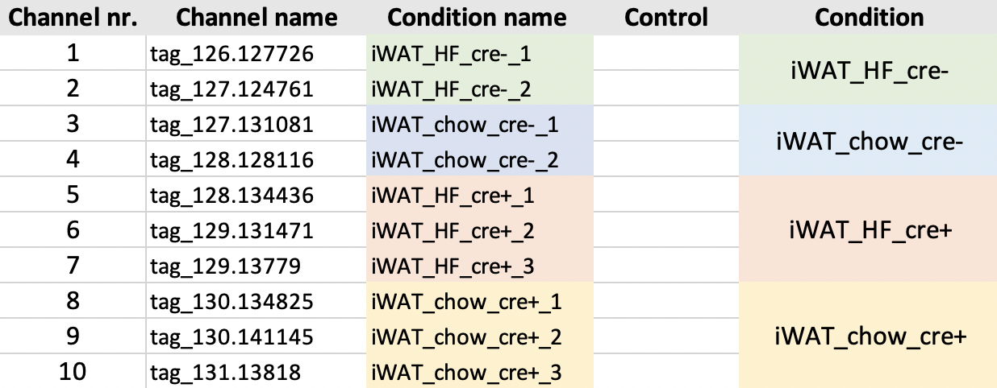
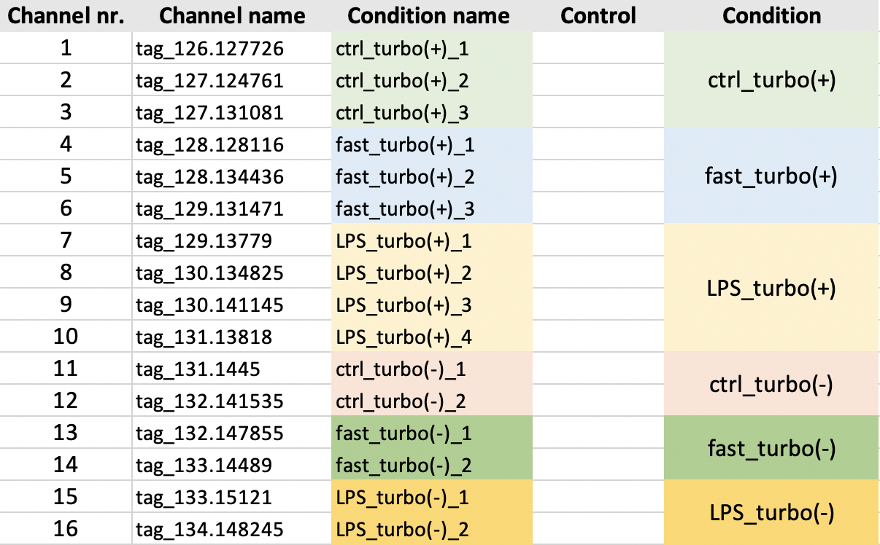
Experimental Setup
Total of 7 files (4 x 10 plex, 3 x 16 plex)
Example layout 10 plex:
Example layout 16 plex:
Notes:
https://www.nature.com/articles/s41596-020-0399-0

Slide 4


Analysis Overview
raw mass spectrometry data searched against a database of known proteins
Filter:
Remove non unique peptides
Remove not fully tryptic peptides
Allowed number of missed cleavage sites: 1
Min 1 or 2 peptides per protein
Peptide SI per protein
are summed
(=summed protein SI)
Raw file
Filtering based on cre+ replicates
AND
Normalisation
Processed file
Calculate Ratios
Experimental sample/negative control
Annotate proteins
Using TP and FP lists
ROC-based analysis
Establish optimal cutoffs per ratio
Determine biotinylated proteins
Report proteins that pass cutoff

Slide 5
TP and FP lists
Lists of TP and FP proteins generated on basis of annotation from UNIPROT
TP list includes proteins expected to be biotinylated
Endoplasmic Reticulum,
Rough Endoplasmic Reticulum
Golgi
Secreted
Extracellular space
FP list includes proteins not expected to be biotinylated
Cytoskeleton
Removed Proteins that have SignalP annotation
TP list: 3436 Proteins
FP list: 4353 Proteins
Notes:
Signal peptides control protein secretion and translocation
Proteins annotated as TP are removed from FP list

Slide 6
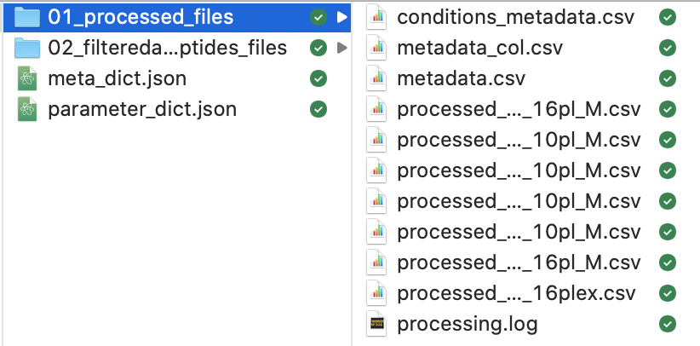
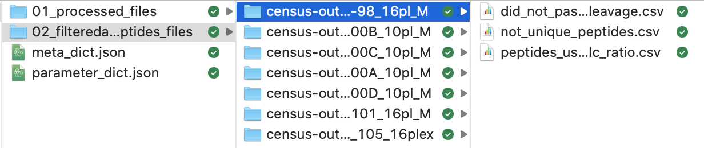
Processed Files Results
The same analysis was performed twice:
At least 1 peptide per protein (7_files_turbo_id_1pepperprotein)
At least 2 peptides per protein (7_files_turbo_id_2pepperprotein)
Both folders have following structure:
Processed files:
Filtered out peptides per file:

Slide 7
For each processed file…

Slide 8
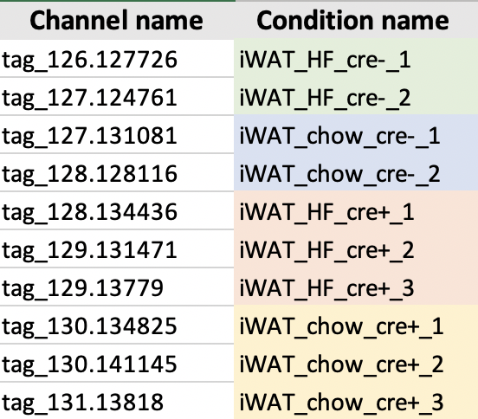
Update column names
Label channels according to provided condition information
Conditions: iWAT_HF, iWAT_chow
Negative control sample: cre-
Experimental sample: cre+
Example EV1-100A:

Slide 9
Remove Keratins
Remove proteins containing ”Keratin” in name
Keratin contamination caused through handling of samples

Slide 10
Filtering of cre+ replicates
Filtering is performed based on the experimental sample replicates for each condition
At least one pair (any 2 channels) out of the 3 or 4 cre+ channels should have a min raw signal intensity sum >= 10000 and a coefficient of variation <= 0.5
Example:
4000 | 6000 | 5
1500000 | 5000 | 6000
1 ) and 2) sum: pass, cv: pass
1 ) and 3) sum: not pass, cv: not pass
2 ) and 3) sum: not pass, cv: not pass
= at least one pair passed so this uniport ID passes
1 ) and 2) sum: pass, cv: not pass
1 ) and 3) sum: pass, cv: not pass
2 ) and 3) sum: pass, cv: pass
= at least one pair passed so this uniport ID passes
Notes:
From question

Slide 11
Preparation of ratios and annotation of proteins
1) Calculate Ratios per condition (experimental sample/negative control sample)
2) Annotate Proteins as TP or FP (depending in which list they are in)
ratio_iWAT_HF_cre+_1
ratio_iWAT_HF_cre+_2
ratio_iWAT_HF_cre+_3
iWAT_HF_cre-1
iWAT_HF_cre-_2
ratio_iWAT_HF_cre+_1/iWAT_HF_cre-1
ratio_iWAT_HF_cre+_1/iWAT_HF_cre-_2
ratio_iWAT_HF_cre+_2/iWAT_HF_cre-_1
ratio_iWAT_HF_cre+_2/iWAT_HF_cre-_2
ratio_iWAT_HF_cre+_3/iWAT_HF_cre-_1
ratio_iWAT_HF_cre+_3/iWAT_HF_cre-_2
Notes:
From question

Slide 12
For each calculated ratio…

Slide 13
Approach to determine the final proteome lists
receiver operating characteristic (ROC)-based analysis
with use of curated lists of true-positive (TP) and false-positive (FP) proteins
allows to establish optimal cutoffs
cutoffs maximize the TP proteins and minimize FP proteins in the final lists
Cho et al. (2020)
Notes:
From question

Slide 14
Determine biotinylated proteins
Normalize
Normalize ratio by the median ratio of proteins that are labelled as FP
Rank
Rank ratios in descending order
Calculate TPR & FPR
Calculate TP rate (TPR) and the FP rate (FPR) (= fraction of detected TP and FP proteins above the cutoff)
Plot (ROC)
Plot TPR and FPR (ROC) to determine how well the experiment enriched TP over FP proteins
Calculate TPR-FPR
calculate TPR-FPR
Find optimal cutoff ratio
find cutoff ratio which has the highest value for TPR-FPR (= the optimal cutoff ratio)
Plot TPR-FPR
Plot log2 ratio and TPR-FPR (see line-plot – cutoff will be the highest point)
Cho et al. (2020)
Notes:
From question

Slide 15
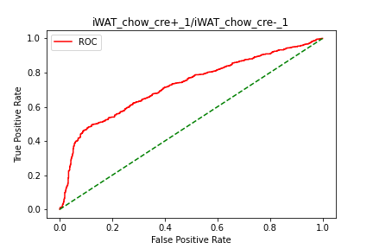
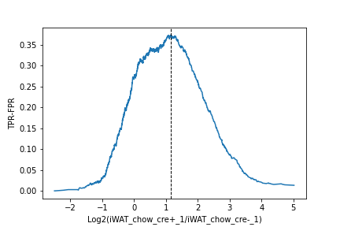
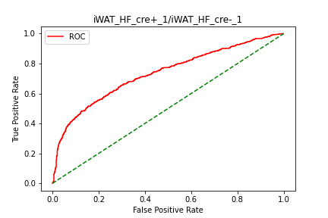
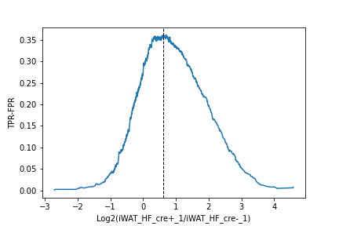
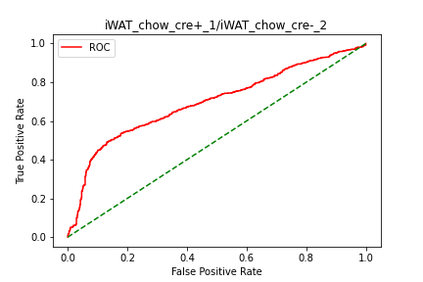
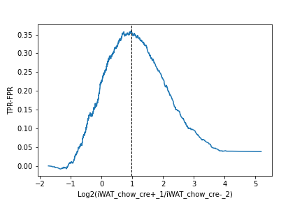

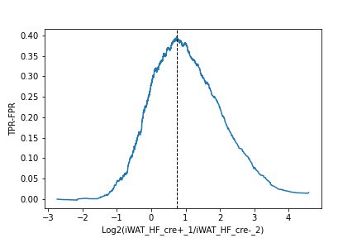
Example EV1-100A
1.14
0.62
0.96
0.74
Proteins above the determined TMT ratio cutoff are considered to be biotinylated proteins
Proteins below the cutoff are considered to be likely nonspecific binders

Slide 16
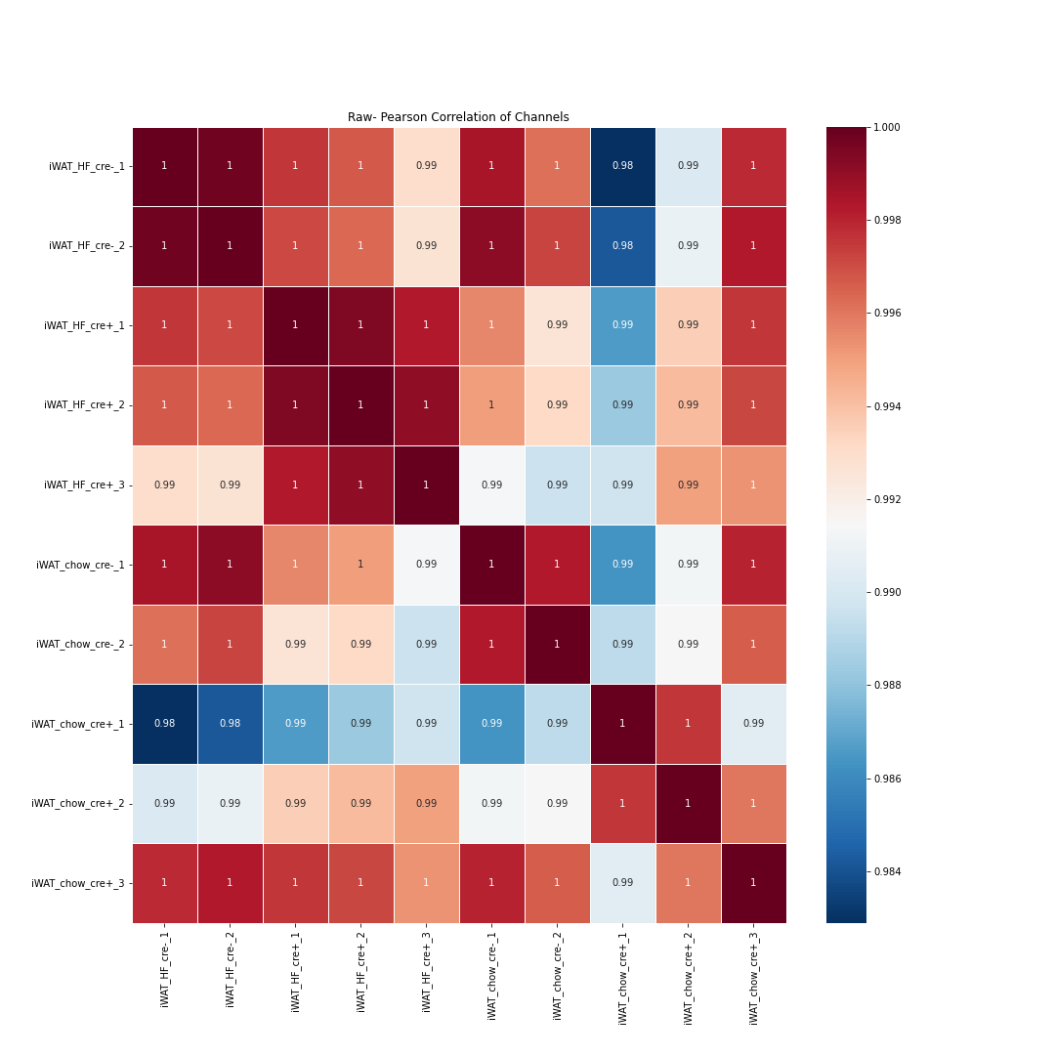
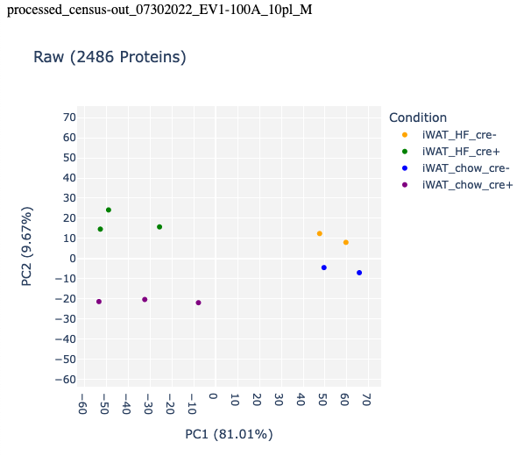
Raw Data 100A

Slide 17
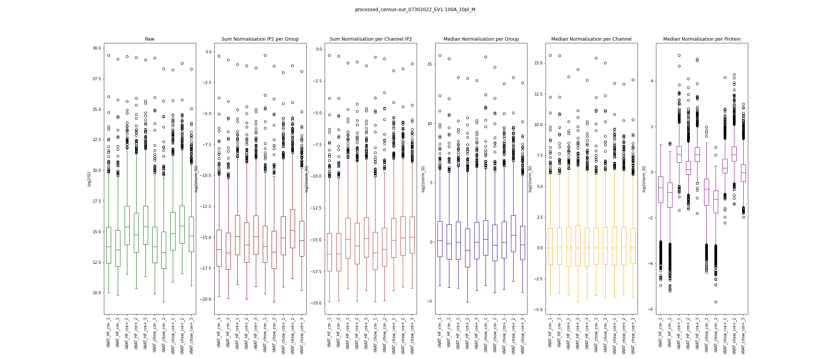
Normalisation

Slide 18
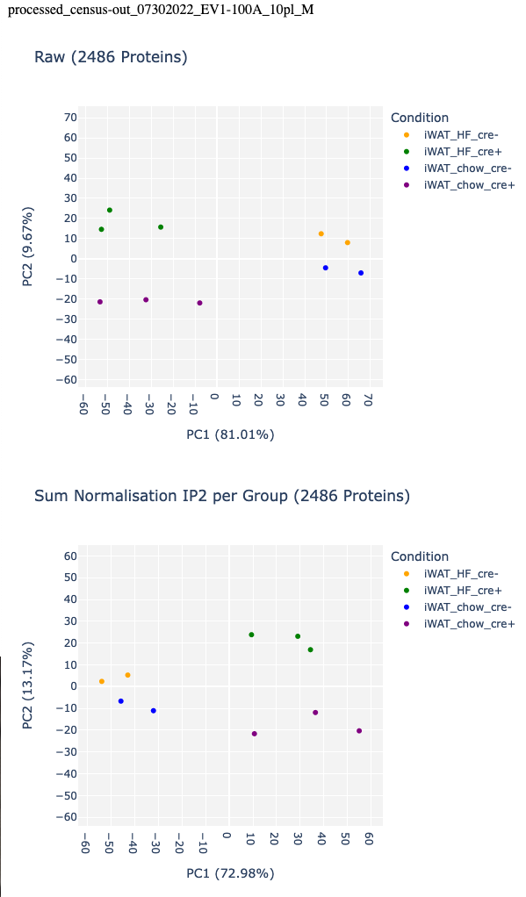
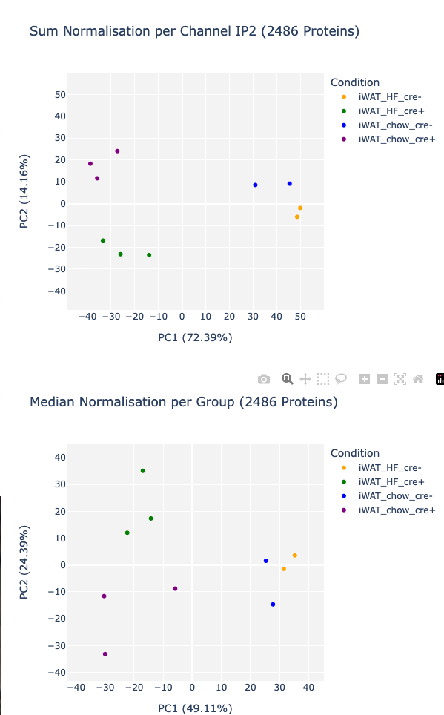
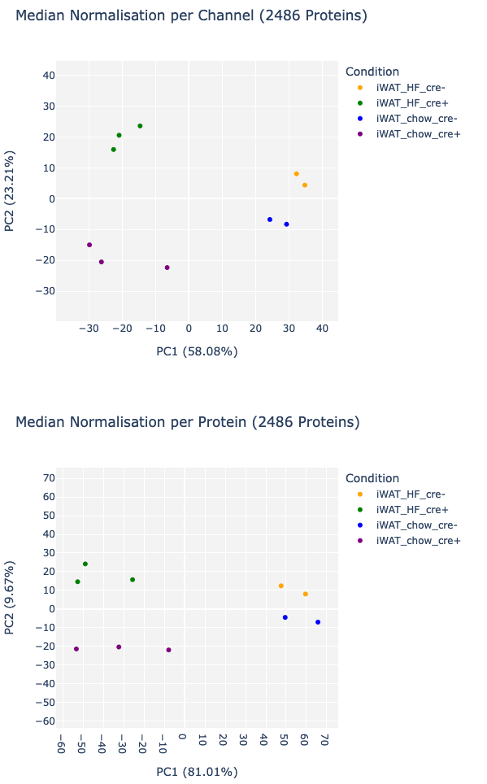
Normalisation

Slide 19
Normalisation
Normalization is needed to ensure that differences in intensities are indeed due to differential expression
Normalization is necessary before any analysis which involves within or between sample comparisons of intensities
The point of normalization is to change your observations so that they can be described as a normal distribution
Normalization changes the shape of the distribution of our data
Median normalisation: samples will have a median of 0
Normalization by TurboID?

Slide 20
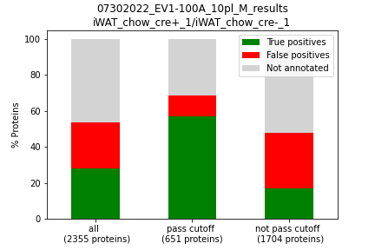
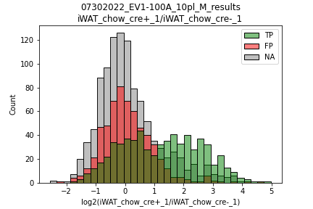
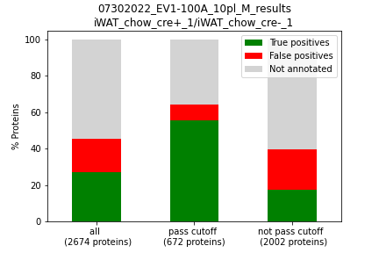
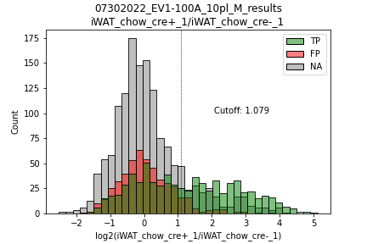
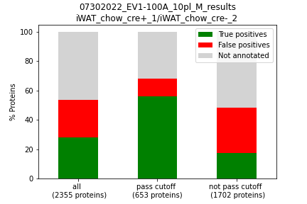
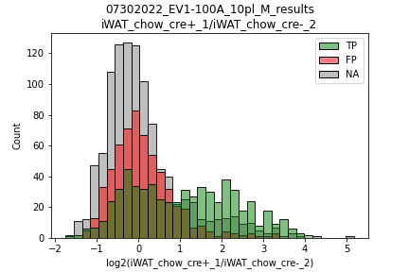
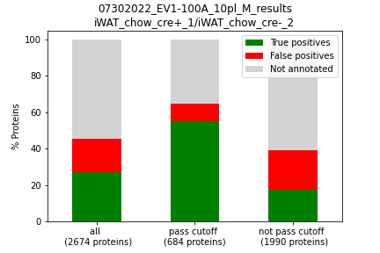
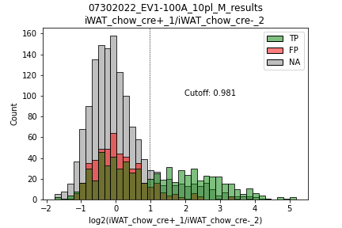
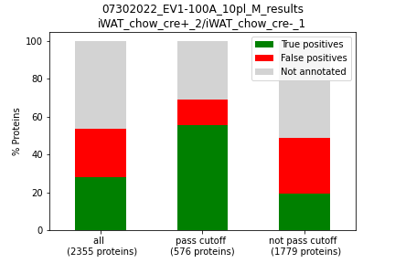
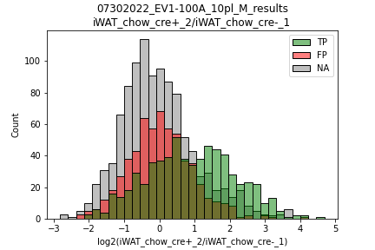

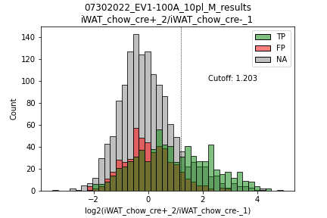
Old results
New results

Slide 21
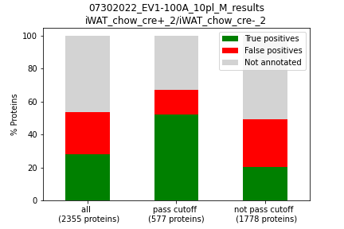
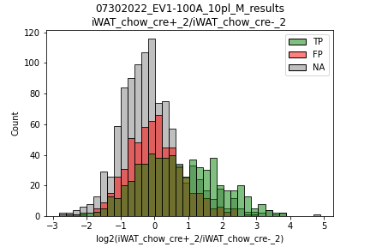
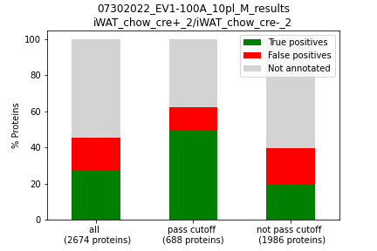
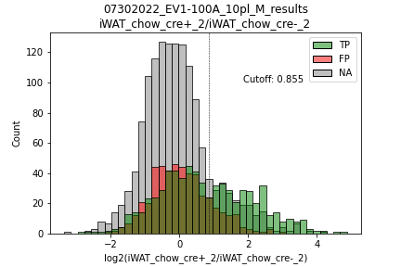
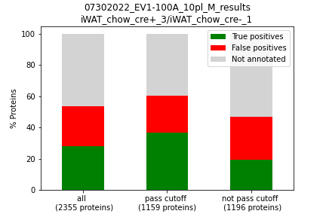
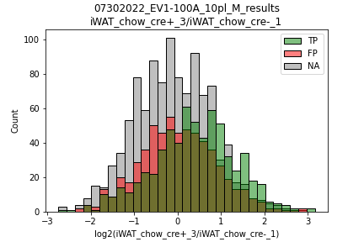
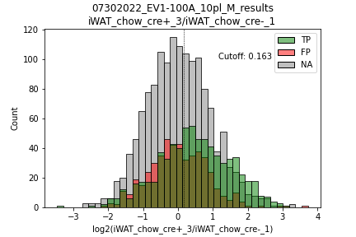
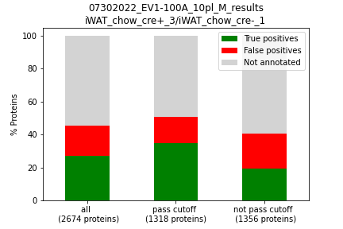
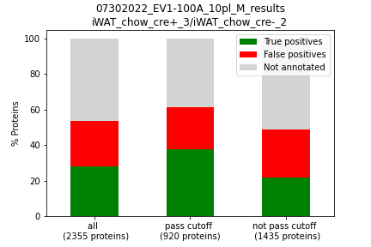
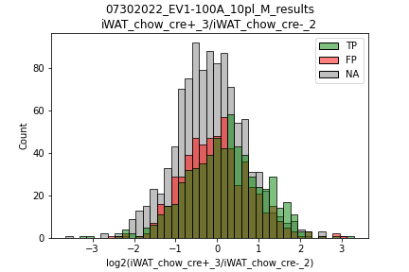
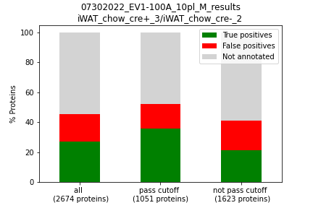
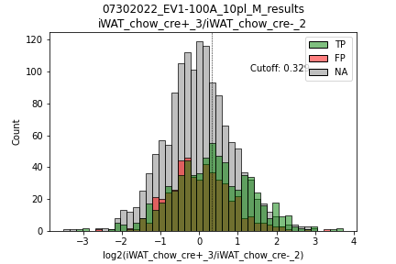
Old results
New results

Slide 22
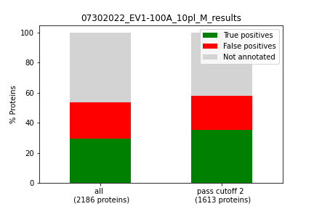
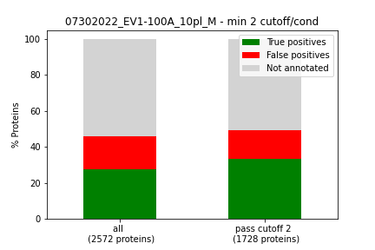
2 Cutoff pass
At least 2 different experimental replicates ratos need to pass

Slide 23
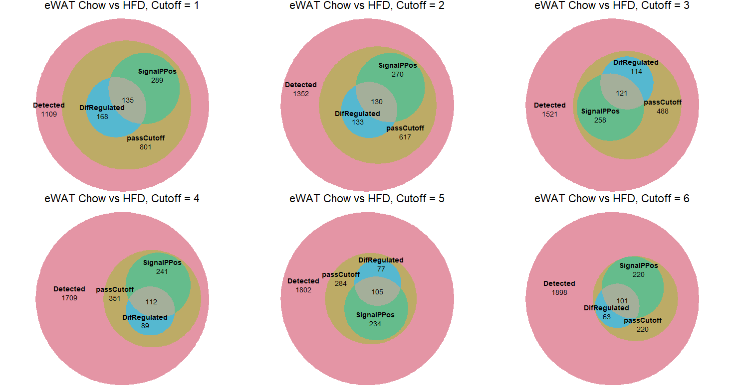
Corey

Slide 24
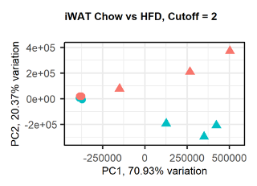
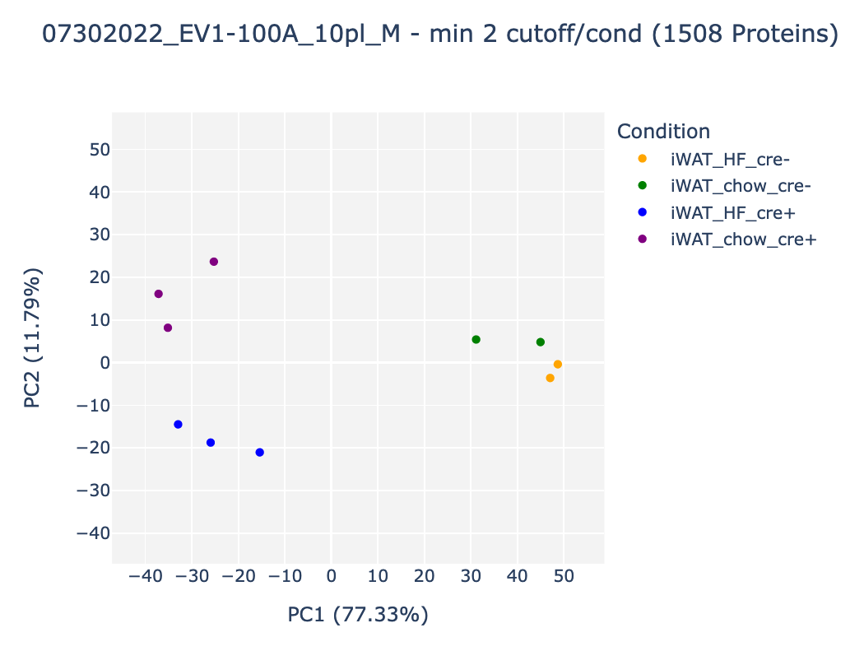
2 cutoff pass PCA

