Slide 1
TurboID

Slide 2
Analysis optimization
Improvement of folder structure and separation of tissue and serum samples
Description word document is now README.pdf
Improvement of FP list: Mitomatrix Proteins from Supplementary S1 published by Rhee et al. 2013 (as suggested by Alice Ting)
Improvement of TP list: Removal of Golgi and Extracellular space terms
Fixed pass_cutoff_result column (second filtering step based on min 2 replicates that pass cutoffs)
Volcano plot data (logFC and p-values) is now added to final protein list table for reference
Notes:
From question

Slide 3
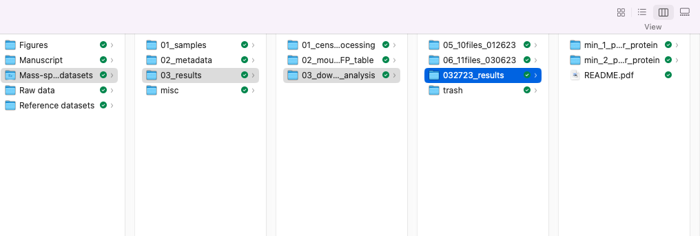
Location of new results
Old result folders for comparison
Dropbox:
https://www.dropbox.com/home/TurboID%20manuscript/Mass-spectrometry%20datasets/03_results/03_downstream_analysis/032723_results
New result folder
Other folders that were recently in this location can be found in trash and can be used for comparison with new results
Notes:
From question

Slide 4
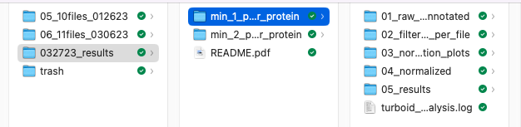
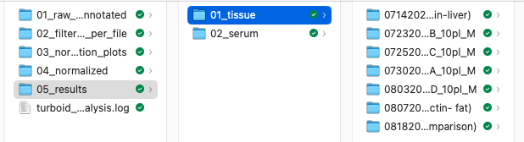
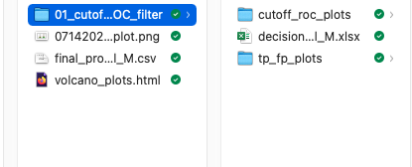
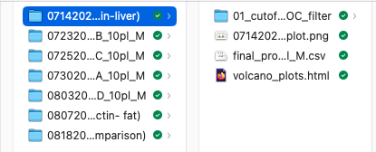
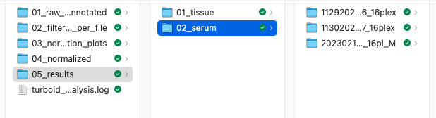
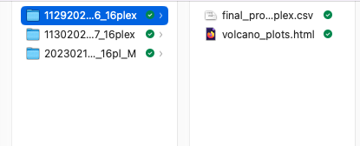
New folder structure
Min 1 peptide per protein = all proteins quantified
Min 2 peptides per protein = only proteins that had a min of 2 peptides quantified, more strict
01: Human readable files, annotated and keratins removed (raw signal intensity (SI))
02: for each file filtered results as well as proteins that were filtered out for reference
03: normalization plots for reference
04: normalized SI per experiment
05: results for serum and tissue
.log: log file of analysis pipeline
README.pdf contains details about the pipeline
TISSUE files
All cutoff ROC relevant plots as well as huge excel sheet holding all information before subset to final protein table
Final protein table
SERUM files
Final protein table
Notes:
From question

Slide 5
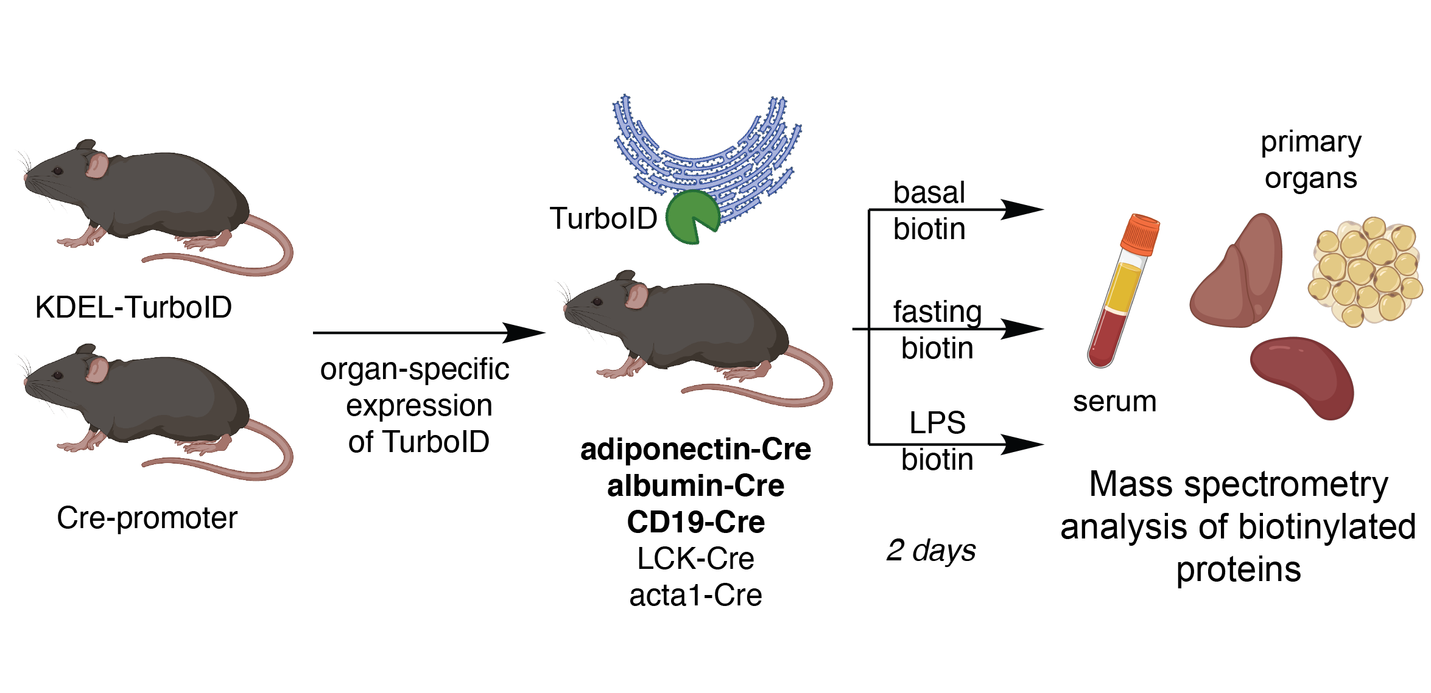
Experiment set up #1
Cell-type specific profiling of secreted and ER-resident proteins under different stress conditions [4 x 16plex TMT + serum]

Slide 6
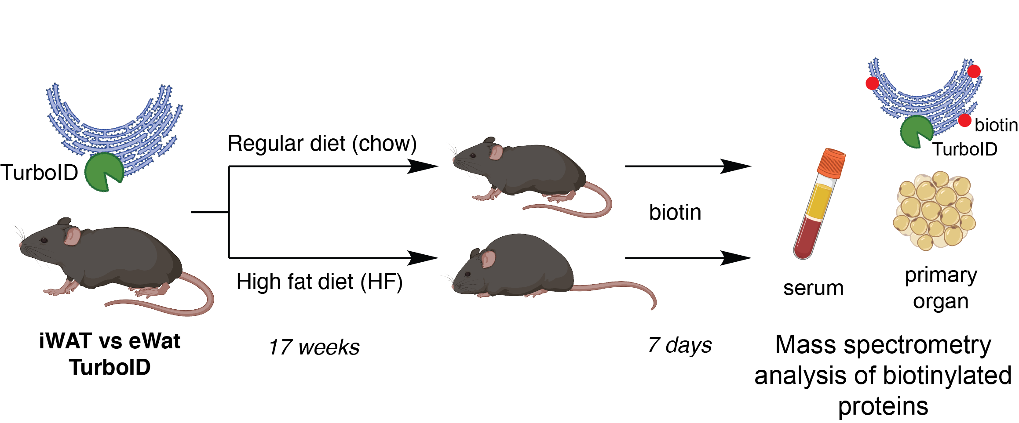
Experiment set up #2
Profiling of secreted and ER-resident proteins in distinct white adipose tissues under different dietary conditions [4 x 10plex TMT + serum]
Notes:
inguinal WAT(iWAT), and epididymal WAT (eWAT)

Slide 7
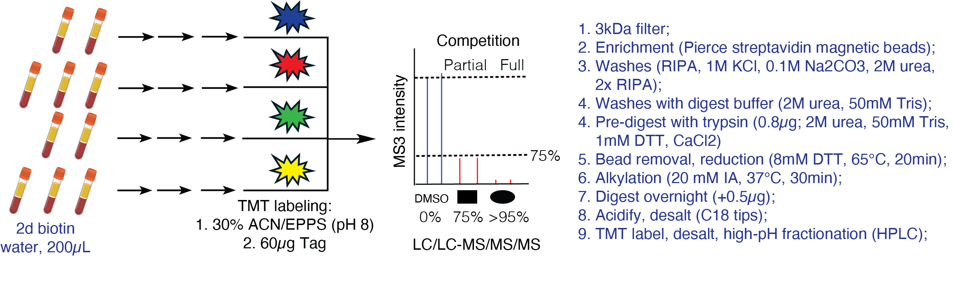
MS sample processing: Serum
Notes:
300
250 >25%
230 >50%

Slide 8


Analysis Overview
Mass-spec data searched against database of known proteins
Peptide filtering:
Remove non unique peptides
Remove not fully tryptic peptides
Allowed number of missed cleavage sites: 1
Min 1 | 2 peptides per protein
Peptide SI per protein
are summed
(=summed protein SI)
Raw file
1
2
Processed file
Calculate Ratios
Experimental sample/negative control
Annotate proteins
Using TP and FP lists
cre+ replicates filtering
&
Normalization
ROC-based analysis
Establish optimal cutoffs per ratio
Filtering based on pass/not pass cutoff
Determine biotinylated proteins
Report proteins that pass cutoff
3
4

Slide 9
Filtering of cre+ replicates
1
Filtering is performed based on the experimental sample replicates for each condition
At least one pair (any 2 channels) out of all cre+ channels should have a min raw signal intensity sum >= 10000 and a coefficient of variation <= 0.5
Notes:
From question

Slide 10
Median Normalization
1
Normalization is performed for cre+ channels
Per cre+ channel TP proteins with 2+ peptides are used to calculate the median per channel
normalization factors are calculated by dividing (median of cre+ channel medians)/(median cre+ channel)
each cre+ channel is then multiplied with the corresponding normalization factor
Notes:
From question

Slide 11
TP and FP lists
2
TP list includes proteins expected to be biotinylated
annotation based on ”Subcellular localization” column from UNIPROT:
Endoplasmic Reticulum,
Rough Endoplasmic Reticulum
Golgi
Secreted
Extracellular space
FP list includes proteins not expected to be biotinylated
annotation based on Supplementary S1 published by Rhee et al. 2013
Mitomatrix proteins
TP list: 2806 Proteins
FP list: 435 Proteins
Notes:
Signal peptides control protein secretion and translocation
Proteins annotated as TP are removed from FP list

Slide 12
Ratios
2
Calculate Ratios per condition (experimental sample/negative control sample)
ratio_iWAT_HF_cre+_1
ratio_iWAT_HF_cre+_2
ratio_iWAT_HF_cre+_3
iWAT_HF_cre-1
iWAT_HF_cre-_2
ratio_iWAT_HF_cre+_1/iWAT_HF_cre-1
ratio_iWAT_HF_cre+_1/iWAT_HF_cre-_2
ratio_iWAT_HF_cre+_2/iWAT_HF_cre-_1
ratio_iWAT_HF_cre+_2/iWAT_HF_cre-_2
ratio_iWAT_HF_cre+_3/iWAT_HF_cre-_1
ratio_iWAT_HF_cre+_3/iWAT_HF_cre-_2
Notes:
From question

Slide 13
Final proteome lists
3
receiver operating characteristic (ROC)-based analysis
with use of curated lists of true-positive (TP) and false-positive (FP) proteins
allows to establish optimal cutoffs
cutoffs maximize the TP proteins and minimize FP proteins in the final lists
Cho et al. (2020)
Notes:
From question

Slide 14
Determine biotinylated proteins
3
Normalize
Normalize ratio by the median ratio of proteins that are labelled as FP
Rank
Rank ratios in descending order
Calculate TPR & FPR
Calculate TP rate (TPR) and the FP rate (FPR) (= fraction of detected TP and FP proteins above the cutoff)
Plot (ROC)
Plot TPR and FPR (ROC) to determine how well the experiment enriched TP over FP proteins
Calculate TPR-FPR
calculate TPR-FPR
Find optimal cutoff ratio
find cutoff ratio which has the highest value for TPR-FPR (= the optimal cutoff ratio)
Plot TPR-FPR
Plot log2 ratio and TPR-FPR (see line-plot – cutoff will be the highest point)
Cho et al. (2020)
Notes:
From question

Slide 15
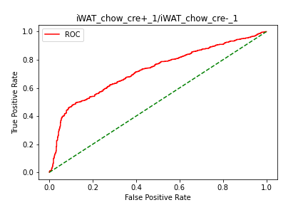
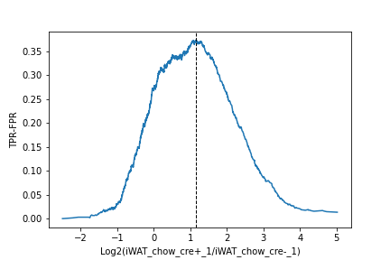
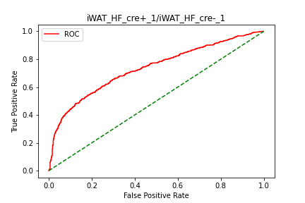
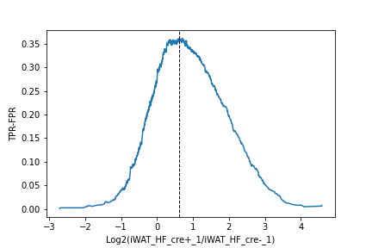
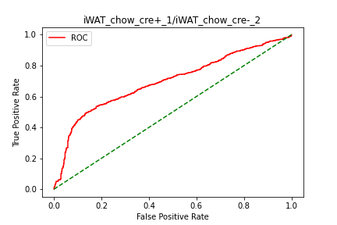
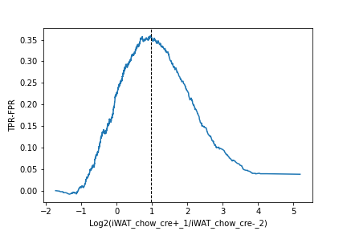

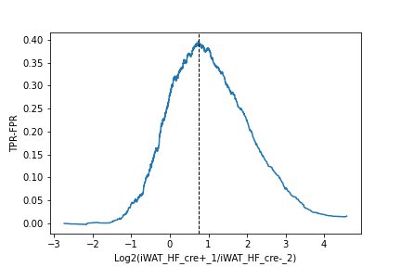
Example
3
1.14
0.62
0.96
0.74
Proteins above the determined TMT ratio cutoff are considered to be biotinylated proteins
Proteins below the cutoff are considered to be likely nonspecific binders

Slide 16
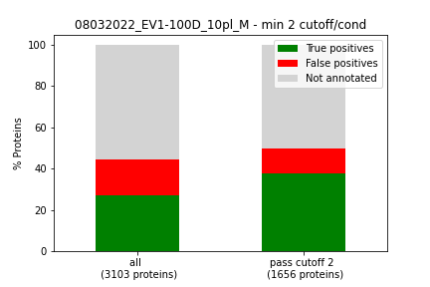
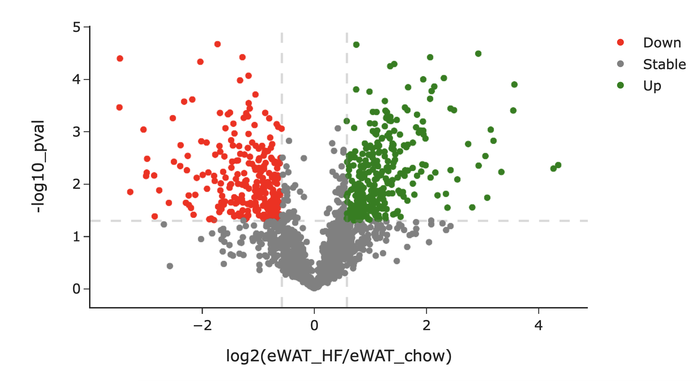
Second filtering step
4
We filter out proteins where at least one condition passes the ratio cutoff with 2 different cre+ replicates and create barplots to see how the amount of TP and FP proteins changes after the ROC cutoff analysis
Then investigate up/down regulated proteins in this filtered subset
Notes:
From question

Slide 17
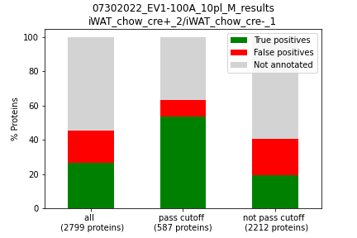
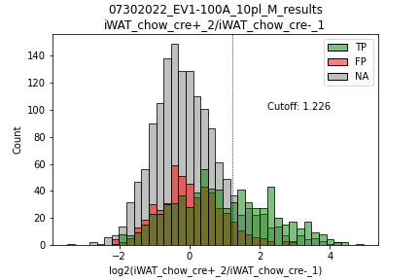
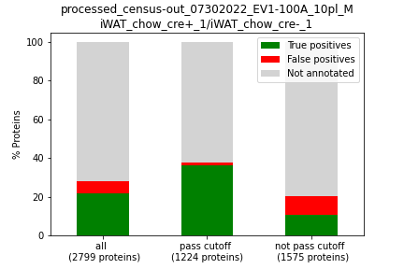
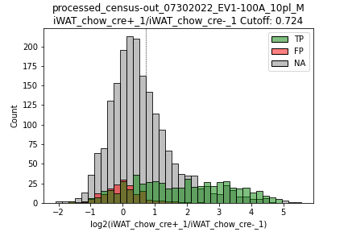
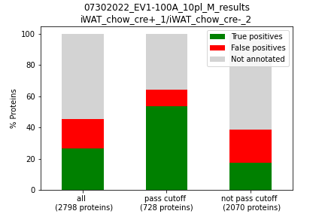
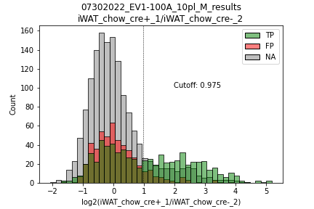
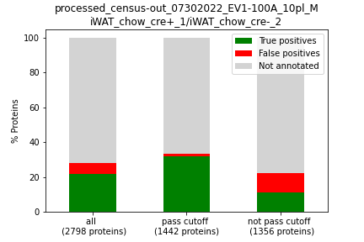
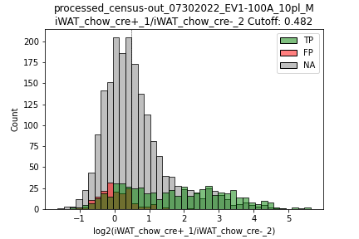
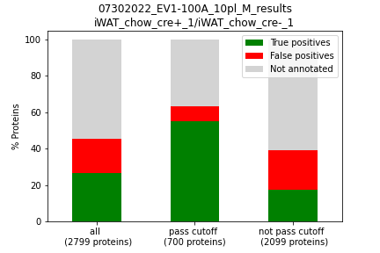
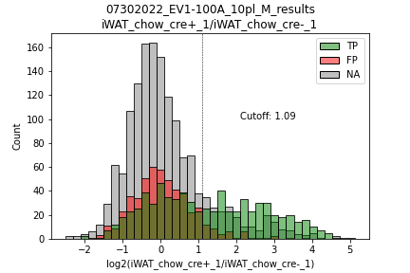
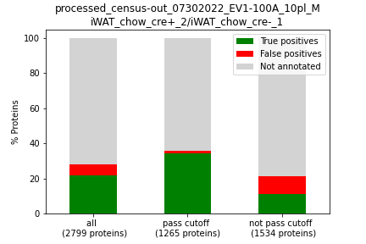
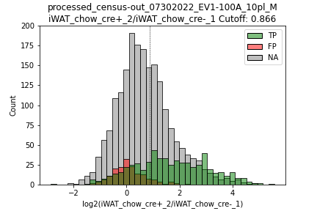
Old results
New results
Example file EV1-100A,
chow condition, 1 pep per protein
Changing the lists lowers the cutoff value in general and allows more proteins to pass
Folder: 05_10_files_012623
Folder: 032723_results

Slide 18
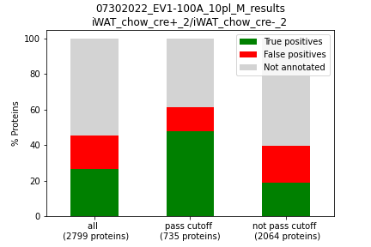
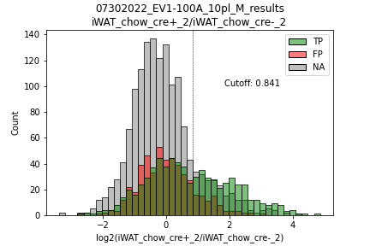
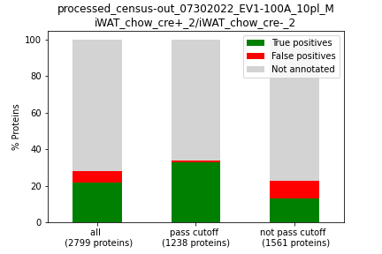
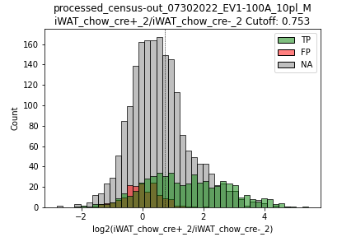
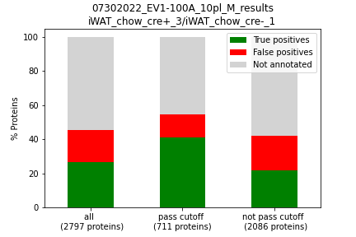
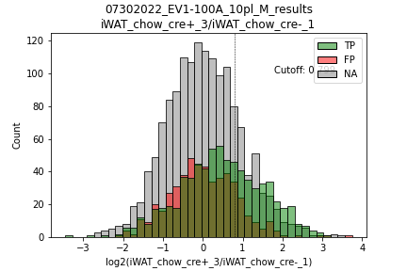
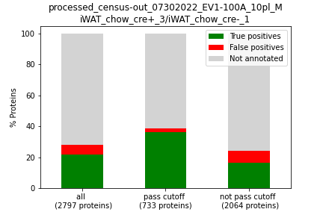
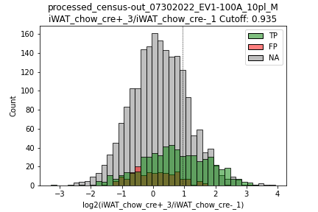
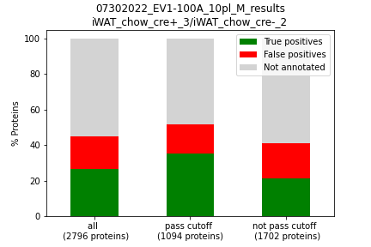
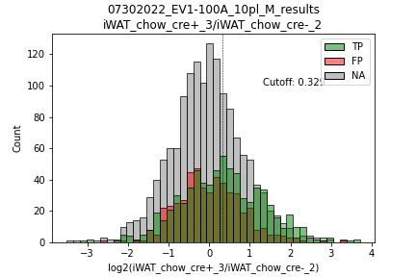
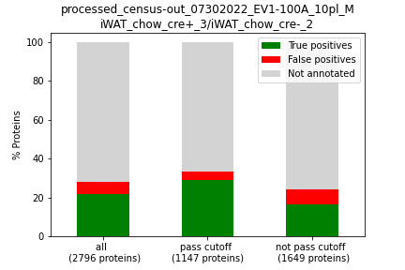
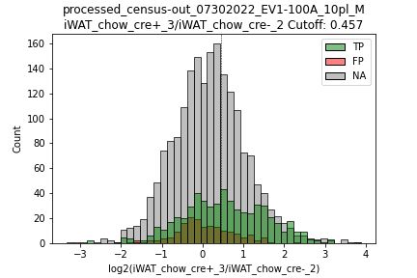
Old results
New results
Conclusion: Improvement of lists leads to more proteins passing cutoff
→ for 3/1 and 3/2 – cutoff value went up, but also more proteins pass cutoff
Folder: 05_10_files_012623
Folder: 032723_results

Slide 19

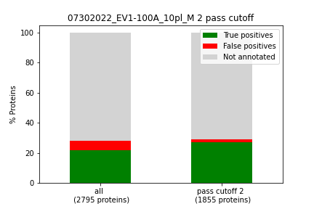
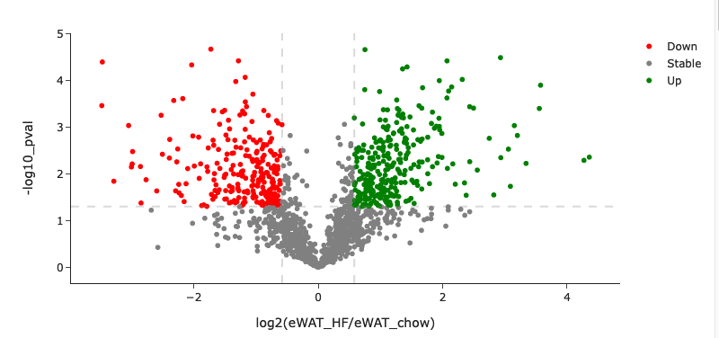
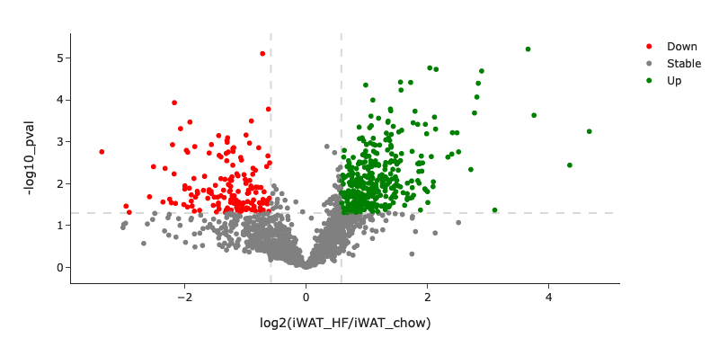
Old results
New results
Folder: 05_10_files_012623
Folder: 032723_results
This filtering step was wrong and was improved
leptin
leptin

Slide 20
Thank you!

