Slide 1
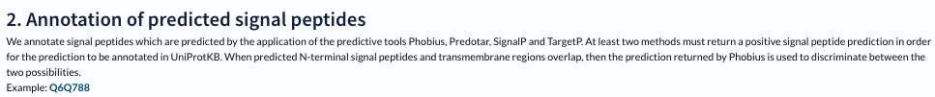
Notes from mini meeting 05.17.23
Go term analysis with significant up/down proteins - implement in python using goatools
Using Full mouse genome
Using experiment specific reference list (before ROC)
Improve color intensity and naming in volcano plots, save them as svg
Add labels in html volcano plot for top up and down regulated proteins
Create and save Heatmap (same as volcano plot)
Save PCA plots as svg
Create filter on final list for easier search in excel sheets
Discuss TP lists (still open)

Slide 2
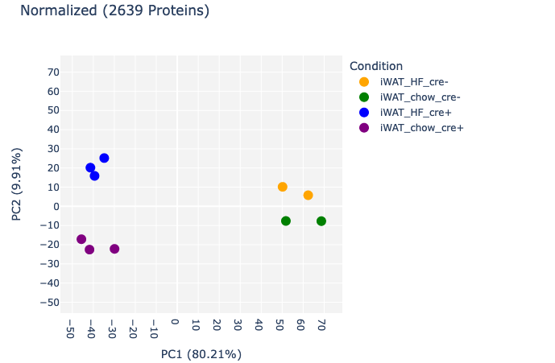
PCA plots
Increased size of symbols
Saved as svg

Slide 3
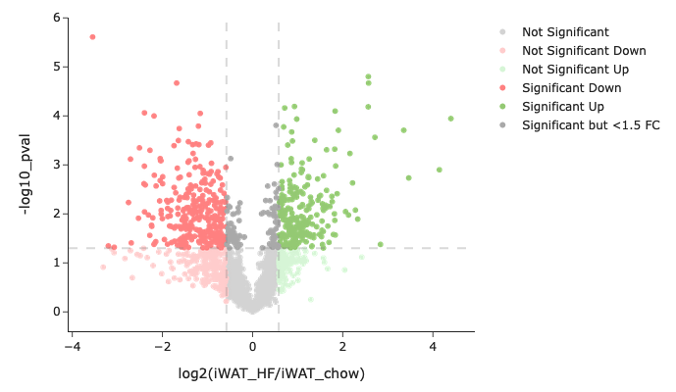
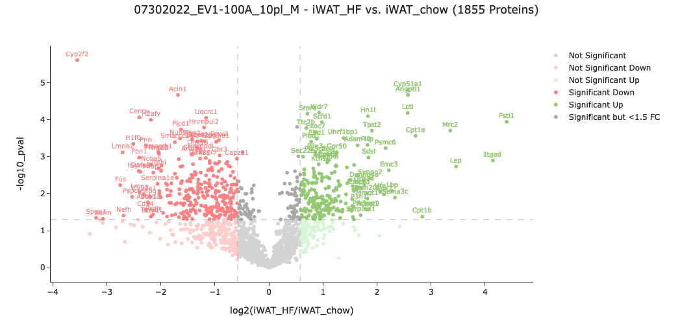
Volcano plots
Slightly changed colors
Html file: added top labels
Saved as svg: without labels

Slide 4
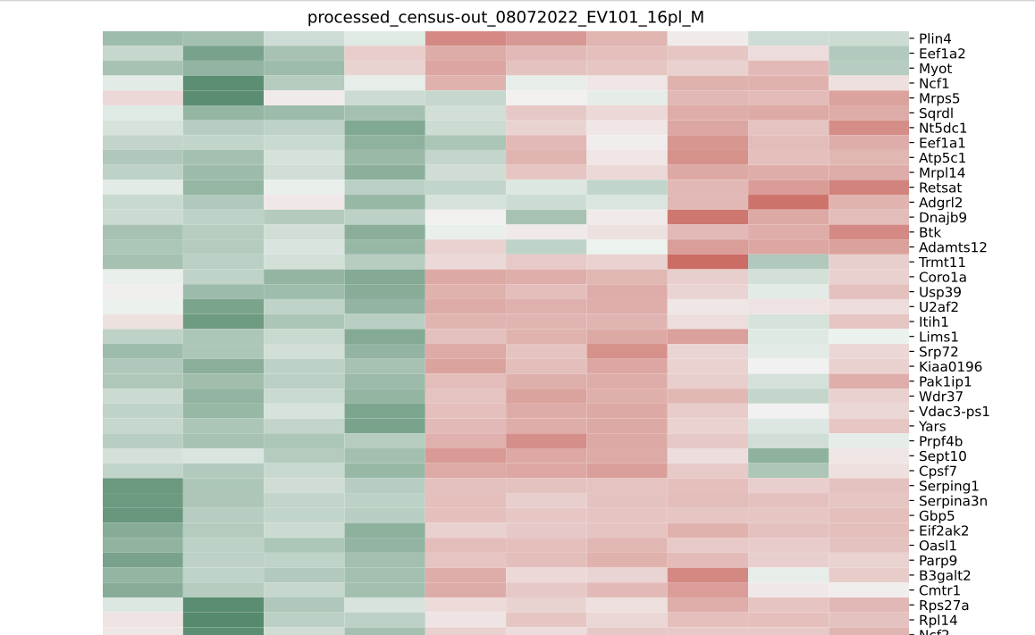
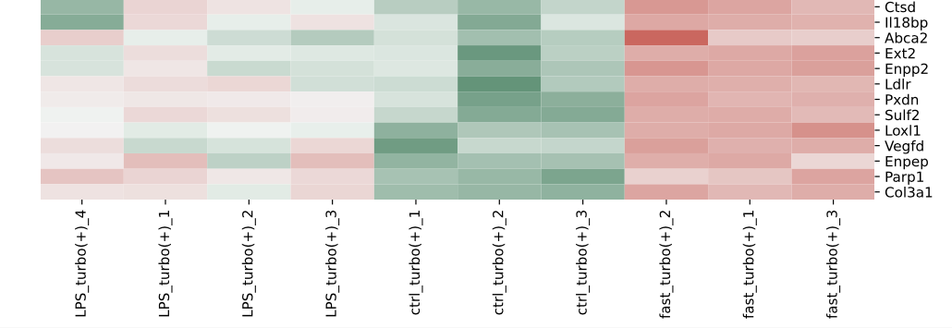
Heatmaps
Using top proteins
Pdf can be searched
Z-score
Replicates visible
Can be compared with volcano plots
Z-score: statistical measurement that describes a value's relationship to the mean of a group of values, Z-score is measured in terms of standard deviations from the mean. If a Z-score is 0, it indicates that the data point's score is identical to the mean score

Slide 5
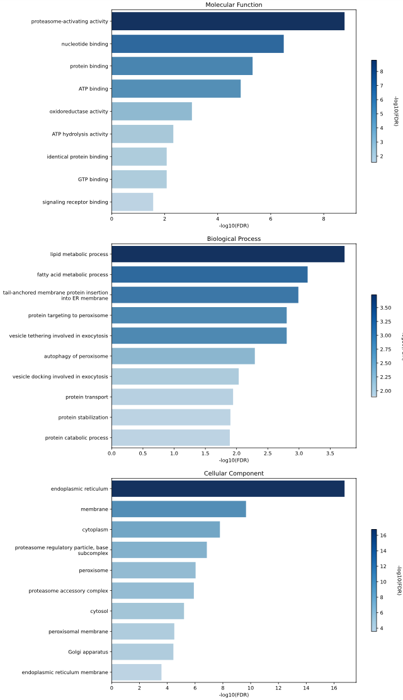
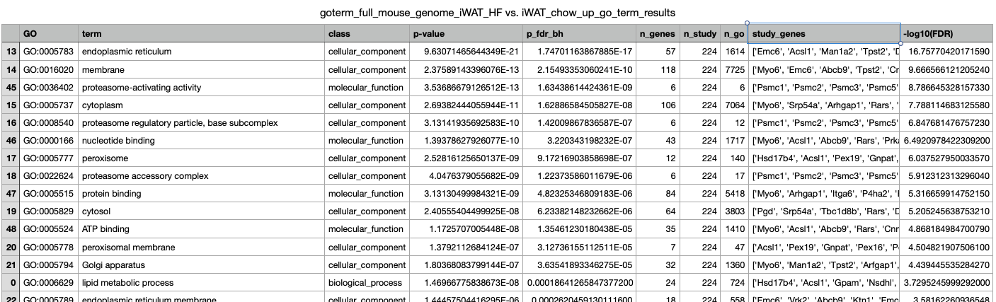
Example GOterm analysis
Molecular function
Gene Ontology Enrichment Analysis (GOEA) was performed using GOATOOLS.
Table
Biological process
Background gene set: all mouse protein-coding genes OR experiment specific genes
GOEA analysis was performed on the significant up or down regulated proteins (mapped to gene IDs). Enriched ontologies with a Benjamini-Hochberg-corrected p-value less than 0.05 were retained and top 10 terms were plotted.
Cellular Component
Notes:
GO ontologies and annotations were downloaded using the goatools.base.download go basic obo and goatools.base.download ncbi associations functions. Ontologies were then loaded in using the goatools.obo parser.GODag function. Mouse GO associations were then selected and stored as a list of named tuples using the call ‘taxids = [9606]’ in the goatools.anno.genetogo_reader.Gene2GoReader function.

Slide 6
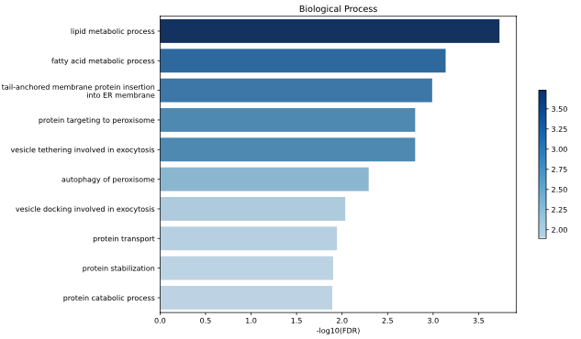
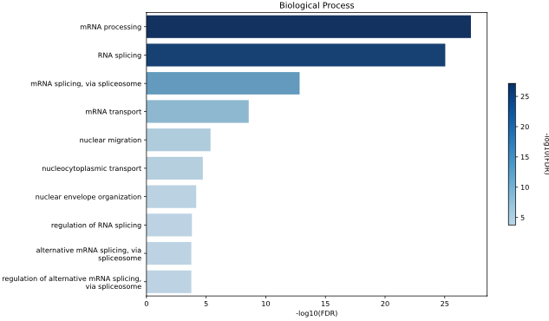
Example GOterm analysis 100A
Still working on it, need to improve uniprot to gene id mapping
Using full mouse genome
iWAT_HF vs. iWAT_chow
DOWN
UP

Slide 7
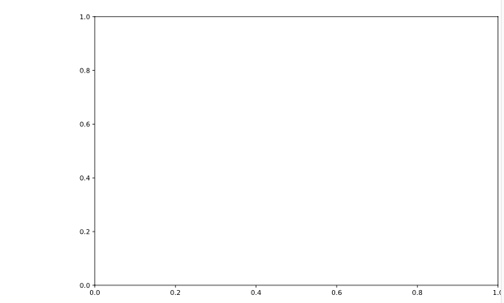
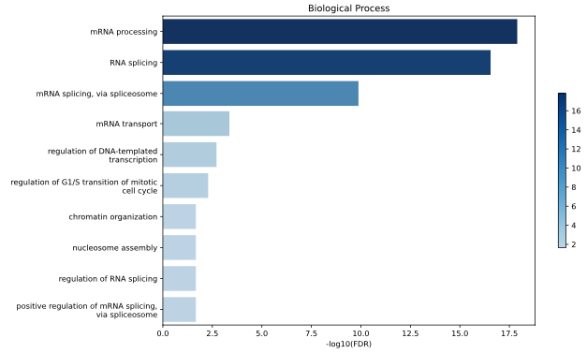
Example GOterm analysis 100A
Still working on it, need to improve uniprot to gene id mapping
Using experiment reference list (before ROC)
iWAT_HF vs. iWAT_chow
DOWN
UP
Nothing passed FDR <0.05

Slide 8
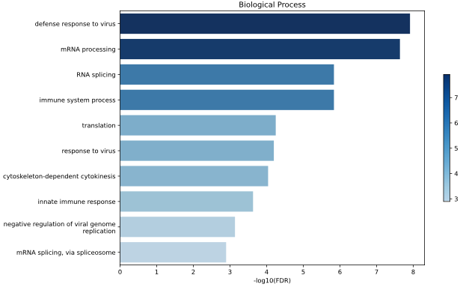
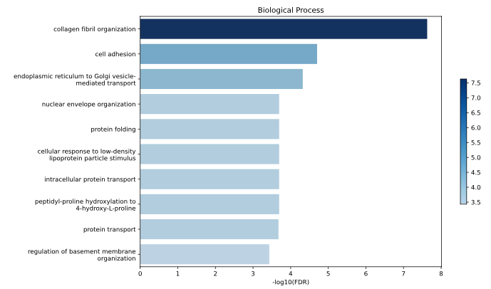
Example GOterm analysis 101
Still working on it, need to improve uniprot to gene id mapping
Using full mouse genome
UP
LPS vs ctrl
DOWN

Slide 9
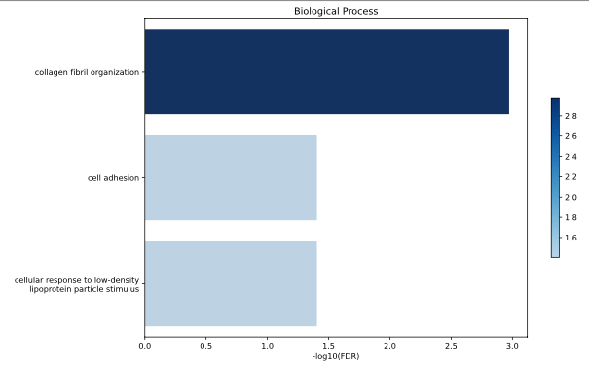
Example GOterm analysis 100A
Still working on it, need to improve uniprot to gene id mapping
Using experiment reference list (before ROC)
UP
LPS vs ctrl
DOWN
Nothing passed FDR <0.05

Slide 10
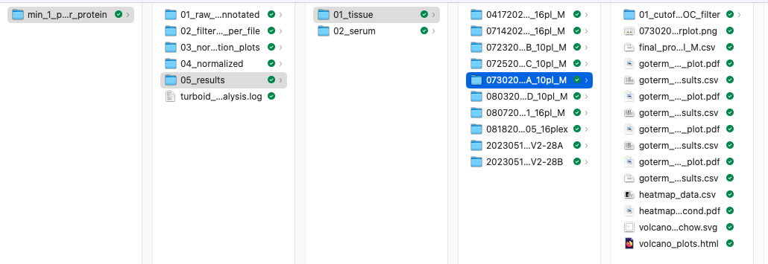
Where you can find the new plots
Still working on it, need to improve uniprot to gene id mapping for go term analysis will then send email to everyone

Slide 11
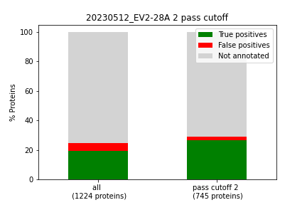
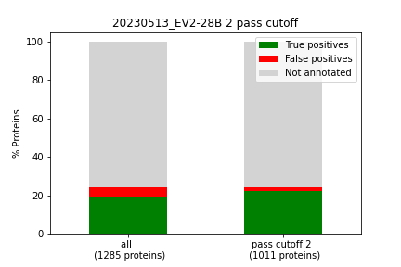
20230512_EV2-28A (male) vs. 20230513_EV2-28B (female)
First we processed both files individually
male
female
Raw data number of proteins: 1648
Removed keratins: 22
Proteins did not pass at least one condition: 417
Proteins after filtering: 1231
Raw data number of proteins: 1518
Removed keratins: 20
Proteins did not pass at least one condition: 221
Proteins after filtering: 1297

Slide 12
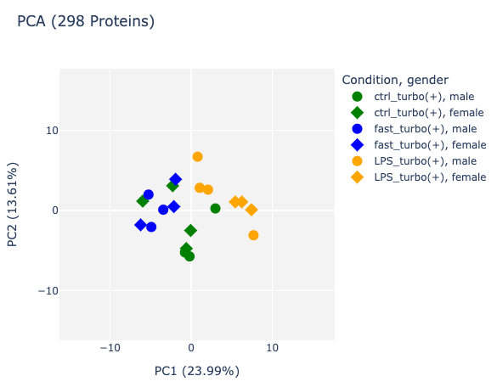
20230512_EV2-28A (male) vs. 20230513_EV2-28B (female)
Using the filtered and normalized files
Normalization to sum per protein (channel ratio)
Then male and female files were merged
And PCA plot was created
Proteins detected in male file: 1231
Proteins detected in female file: 1297
Only ~300 overlap

Slide 13
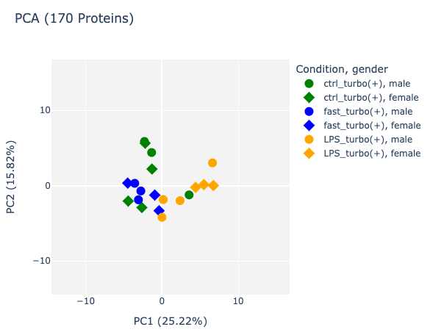
20230512_EV2-28A (male) vs. 20230513_EV2-28B (female)
Using filtered, normalized and roc result
Normalization to sum per protein (channel ratio)
Then male and female files were merged
And PCA plot was created
Proteins detected in male file: 745
Proteins detected in female file: 1011
Only ~300 overlap
And 170 overlap after ROC

Slide 14
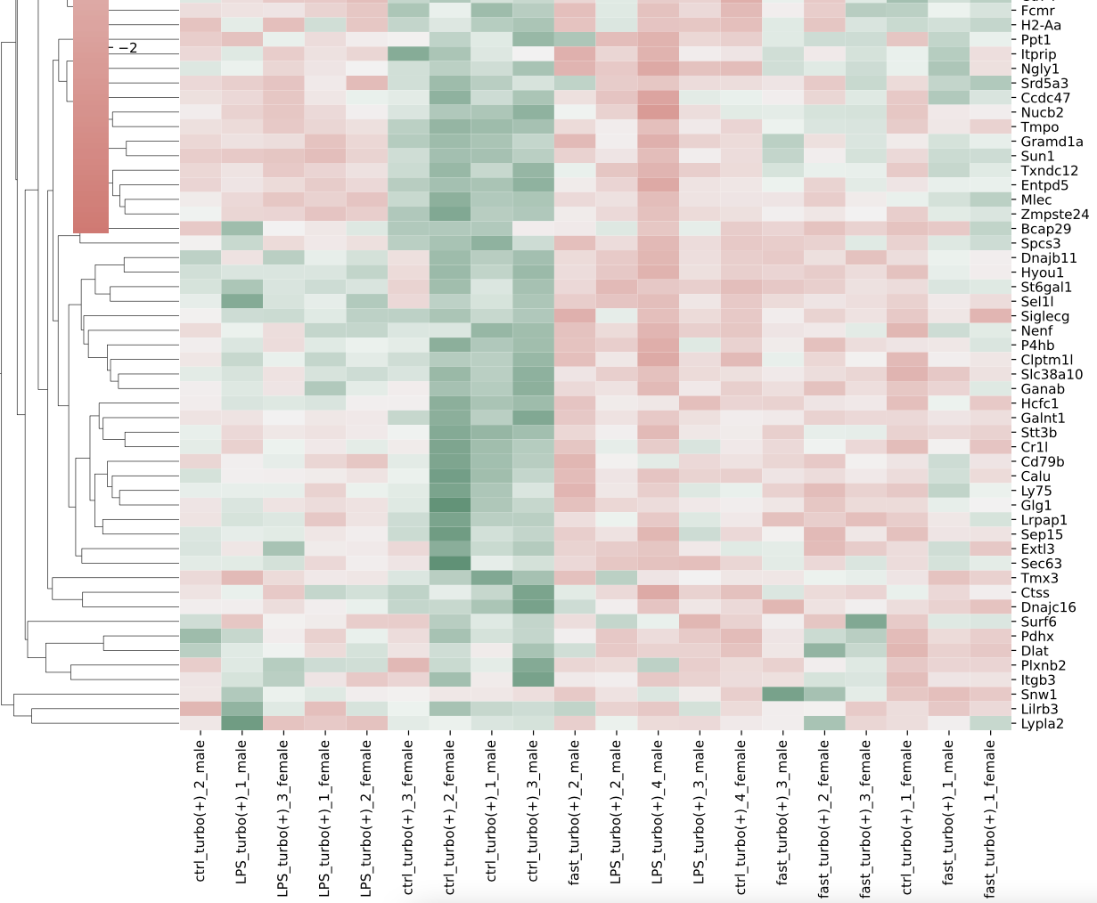
20230512_EV2-28A (male) vs. 20230513_EV2-28B (female)

