Slide 1
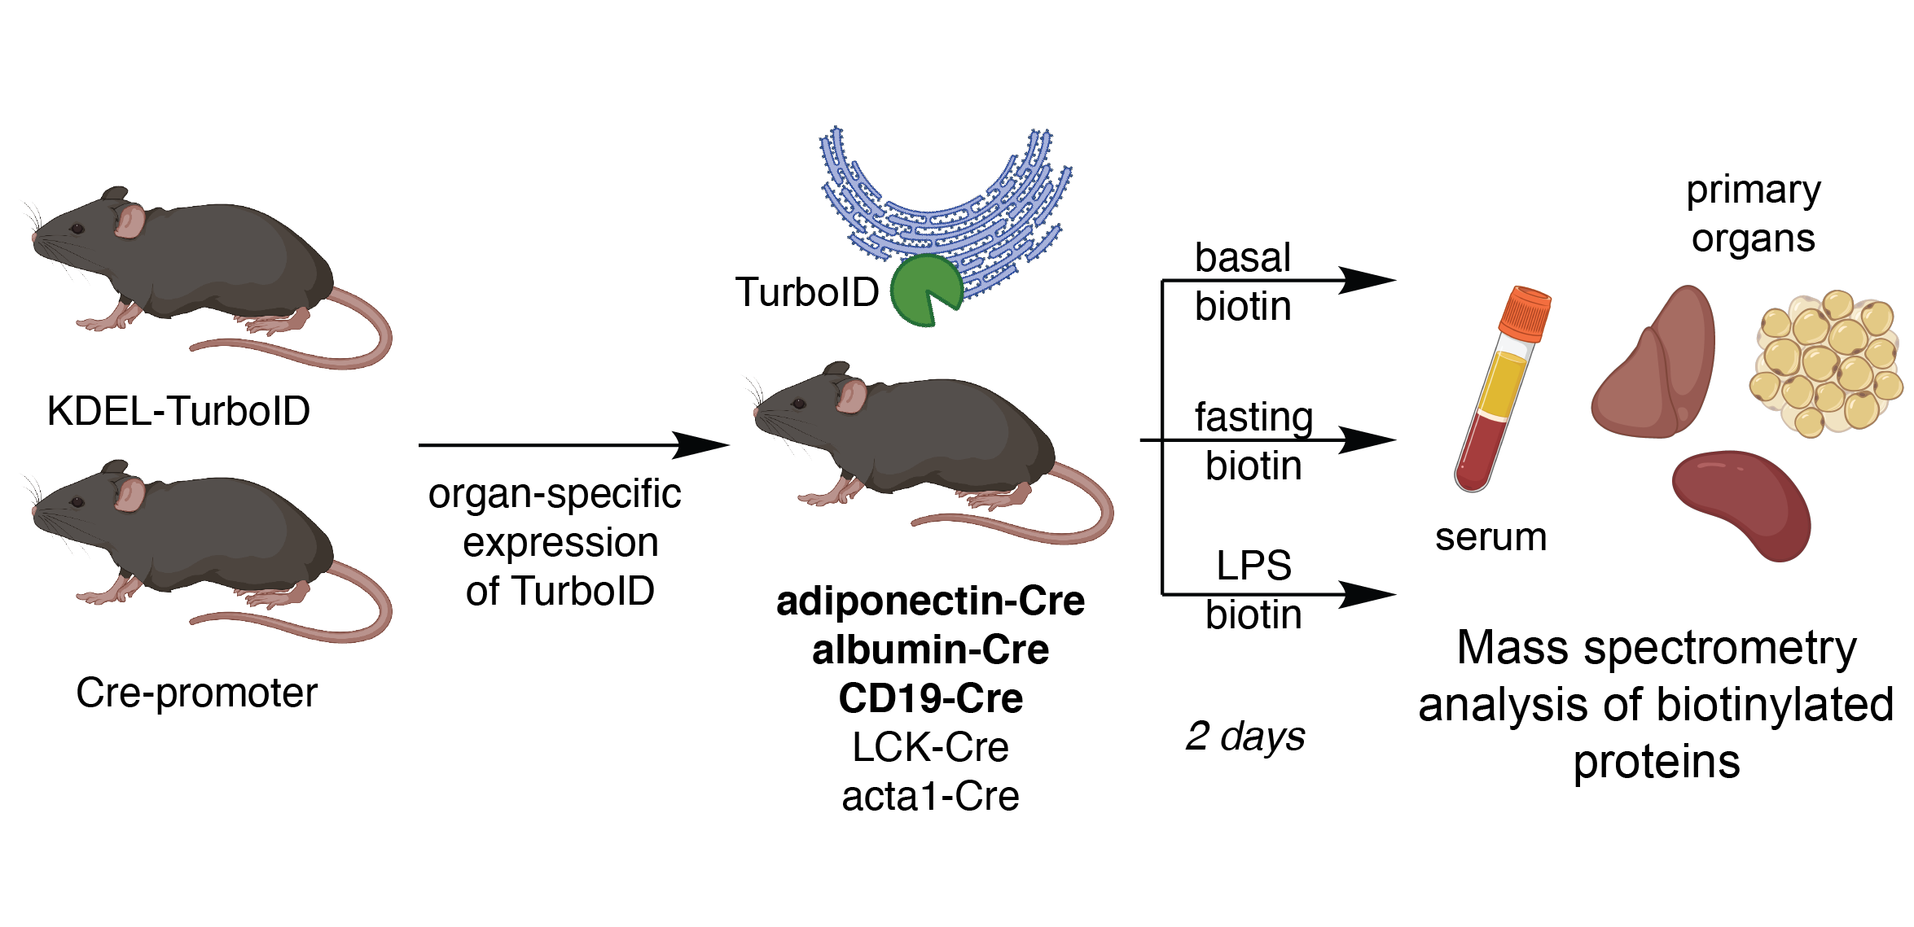
Adiponectin, Albumin Cre Tissue;
Adiponectin, Albumin Cre Serum;
CD19-Cre Tissue (F/M);
CD19-Cre Serum (F/M);

Slide 2
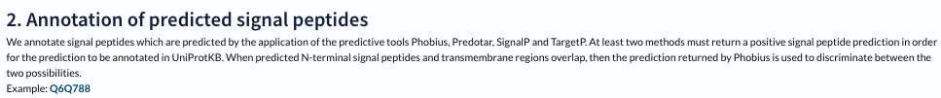
Todos mentioned in last email
We will try to improve the TP lists by excluding “Secreted” from the TP list and restrict the TP list to only proteins annotated as containing a signal peptide
We are also thinking about including another normalization step between different conditions. This might help avoid artificial differences due to differences in turboID expression in different tissues or percent cells that are tagged within that tissue. We will try to identify proteins that are ubiquitously expressed and enriched. We also noticed that fast_turbo vs ctrl_turbo conditions in our study (example below) show mostly downregulated proteins - which might be due to a biological effect, but we want to see how the condition-based normalization might affect this result.
Concerning the Serum samples: I will add a column that shows the fold change/enrichment ratio for each condition
GO term analysis meeting

Slide 3
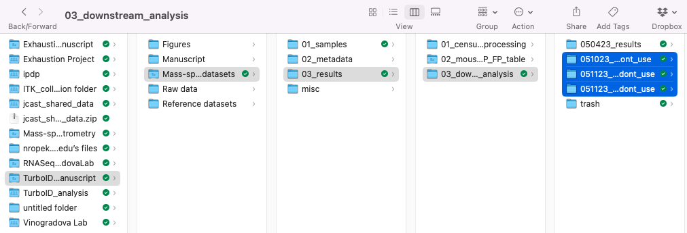
Location of folders mentioned on next slides

Slide 4
Normalization comparison

Slide 5
Description
1) 050423_results
Contains old normalization: Normalization is performed for cre+ channels for each condition
- Per cre+ channel TP proteins with 2+ peptides were used to calculate the median per channel
- normalization factors were calculated by dividing (median of cre+ channel medians)/(median cre+ channel)
- each cre+ channel was then multiplied with the corresponding normalization factor
2) 051123_all_channels_norm_results_dont_use
Median normalization of all channels:
the median for each channel is calculated and norm factors are calculated by dividing the median of column medians by the median of each channel.
Each value in the column is then multiplied with the corresponding normalization factor
3) 051123_allcre+_channels_norm_results_dont_use
Same as 2) but only the cre+ channels
- I noticed that this normalization is most optimal if there are outliers within each cre+ group (see 100A pca plot in 03_normalization plots)
Issue with this normalization each condition was normalized separately

Slide 6
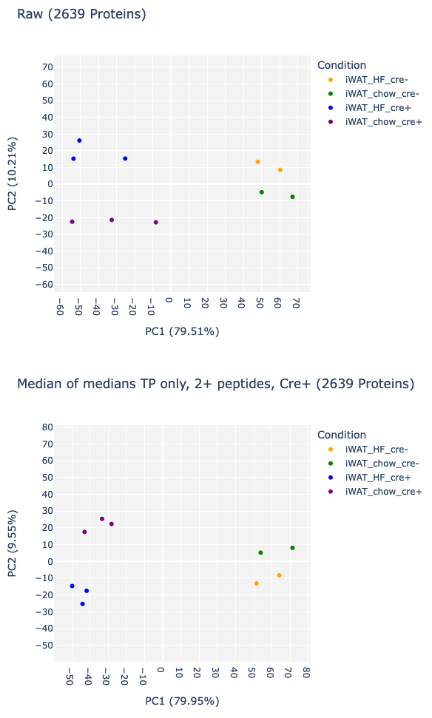
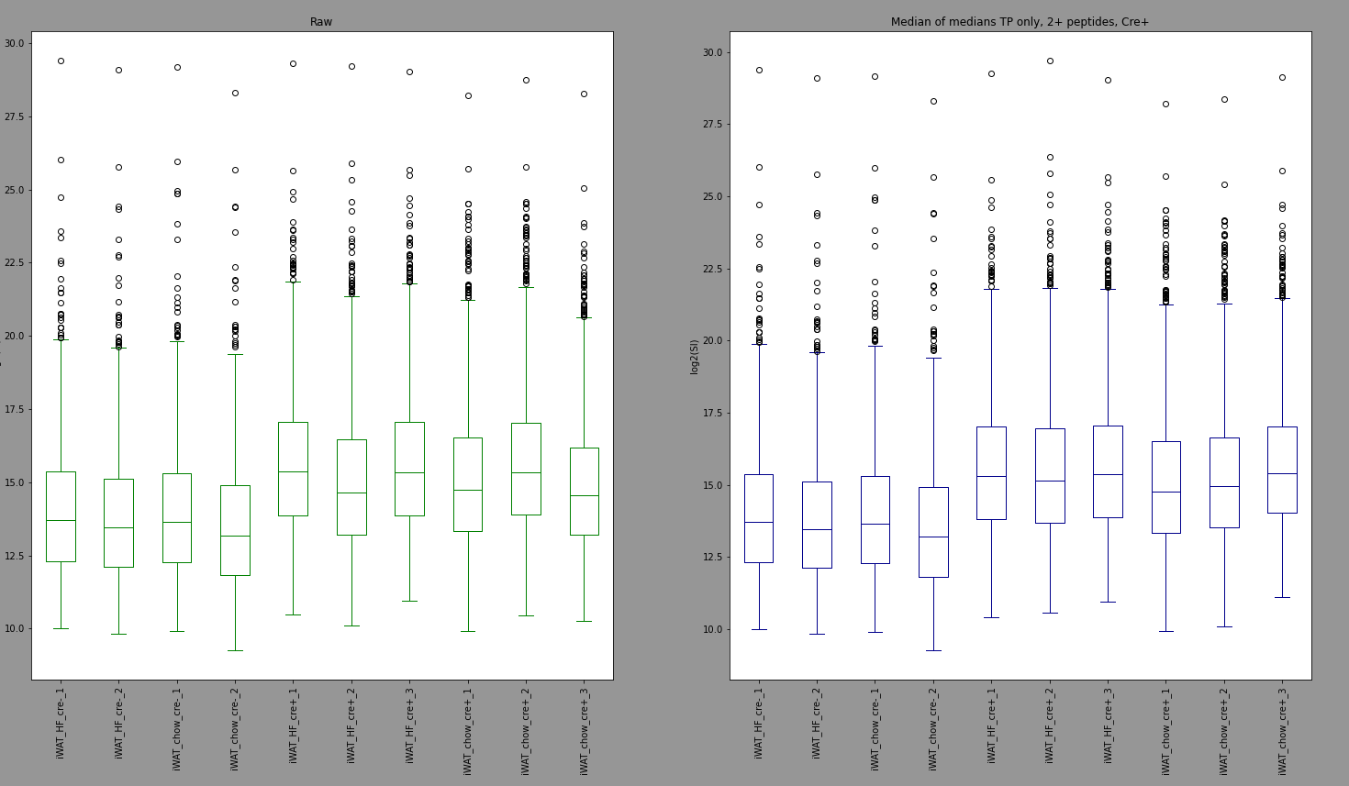
OLD - Median of medians, 2+ peptides, TP only
File 100A
The only reason we were happy with this normalization is because it helped us to group within condition but turned out not to be beneficial for other experiments

Slide 7
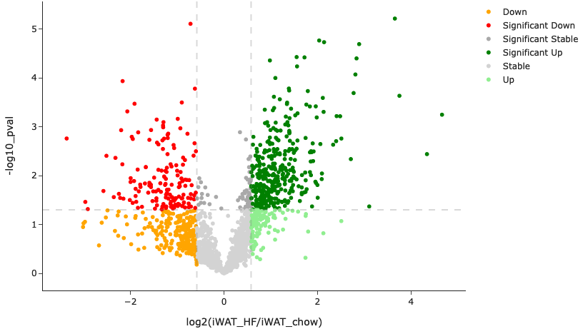
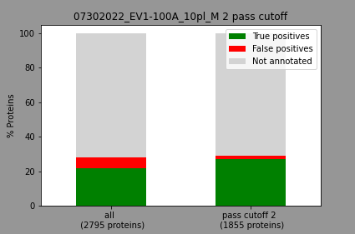
OLD - Median of medians, 2+ peptides, TP only
File 100A
1855

Slide 8
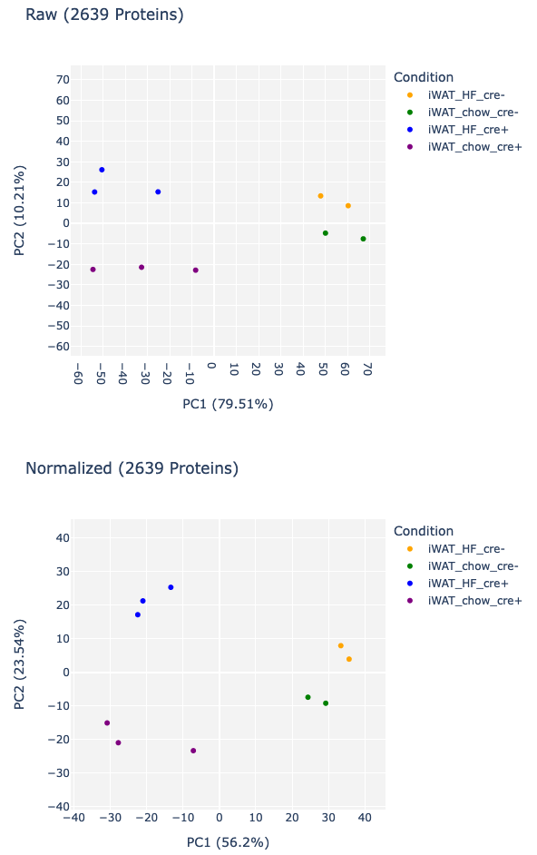
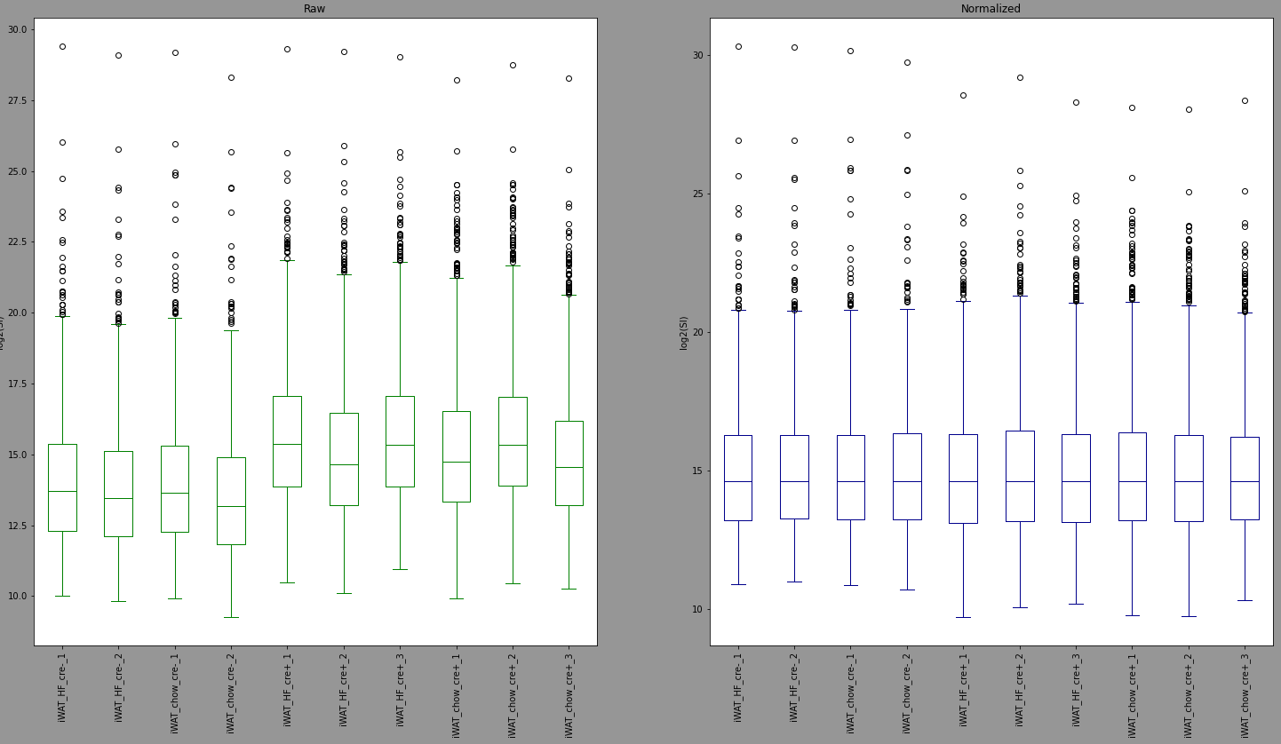
Median all channels
File 100A
We started out with adding normalization to improve this

Slide 9
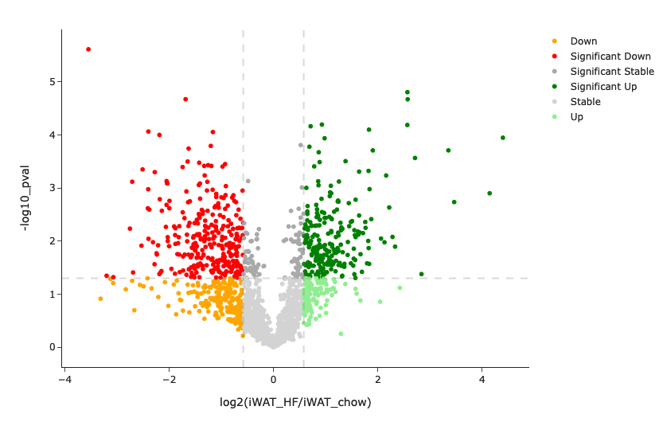
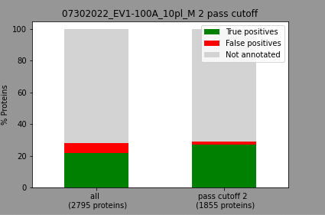
Median all channels
File 100A
The volcano plot looks different because here we actually use the normalized values to show significance and fold change
The same number of proteins pass because our ROC analysis is done per channel (all permutations of cre+ to cre-) and for each channel the highest protein ratio stays the highest protein ratio and determines the same TPR and FPR which in the end determines the cutoff, also we specify a protein to pass if at least 2 replicates passed the cutoff

Slide 10
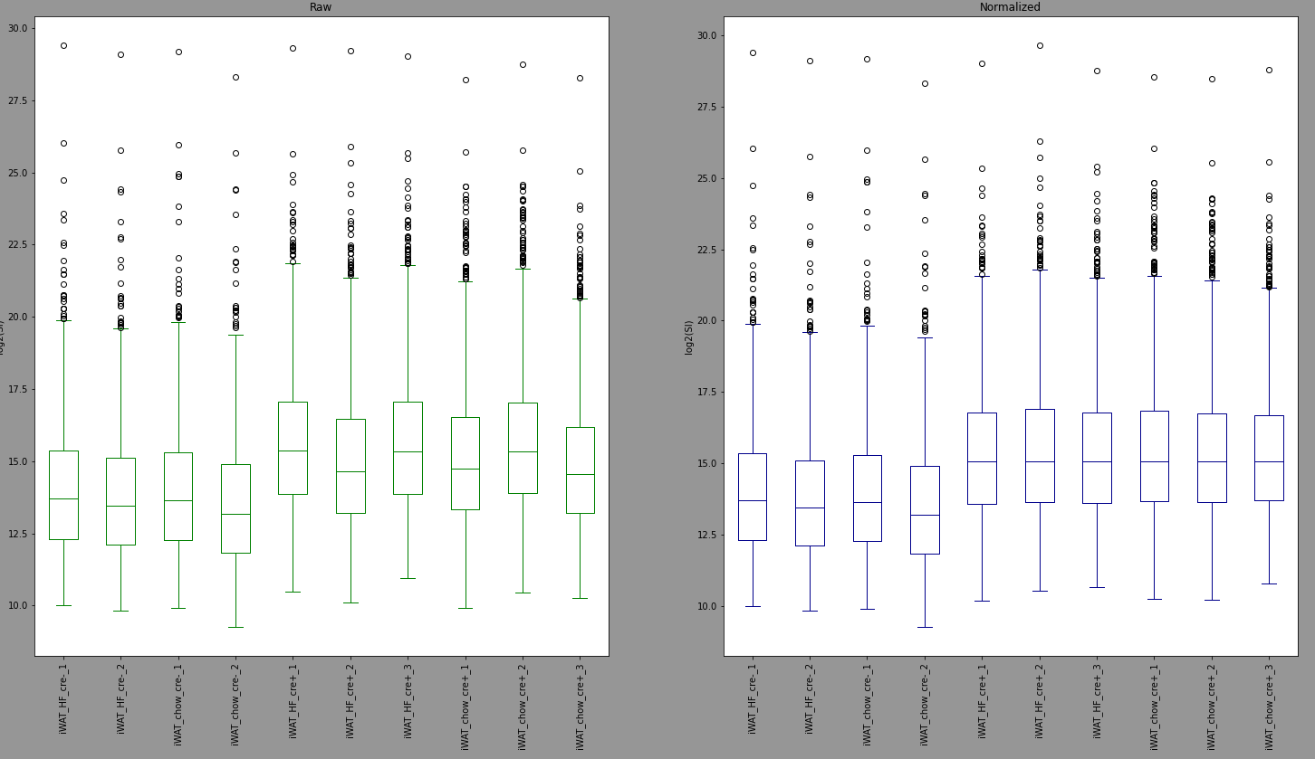
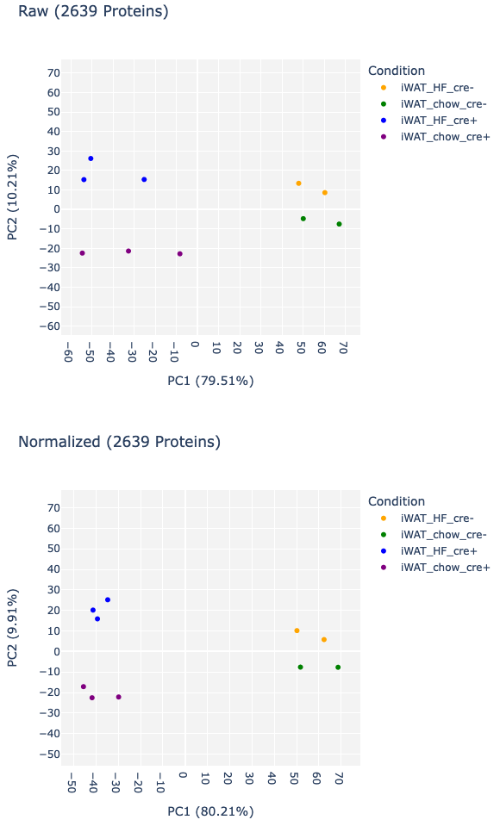
File 100A
Only cre+_channels median
This looks better

Slide 11
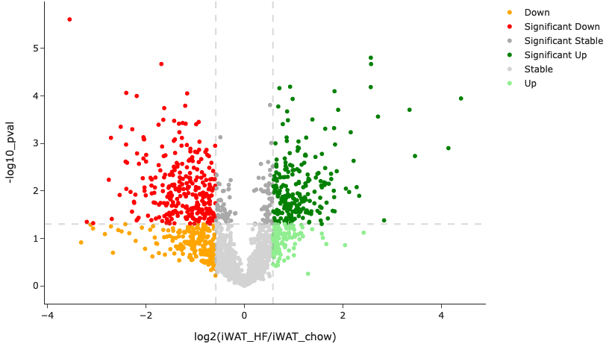
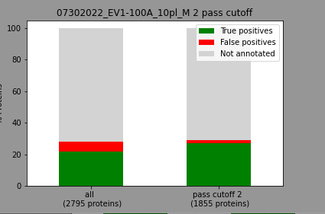
Only cre+_channels median
File 100A
The volcano plot looks the same as the normalization for all channels because the only difference is the normalization factor that was used and the ratio of two condition (fold change) will stay the same
Doesn't change number of proteins that pass cutoff
2*2=4,
3*2=6
4/6=0.6
2*1=2
3*1=3
2/3=0.6
=

Slide 12
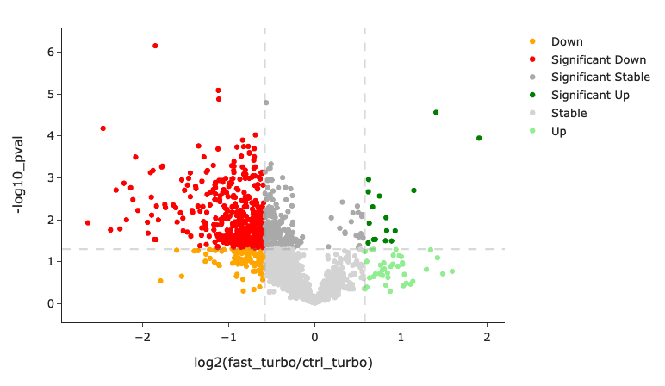
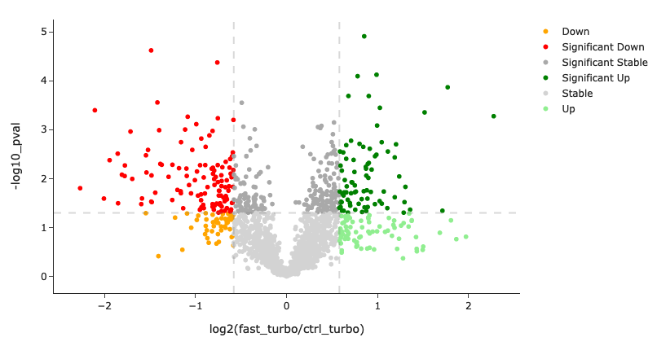
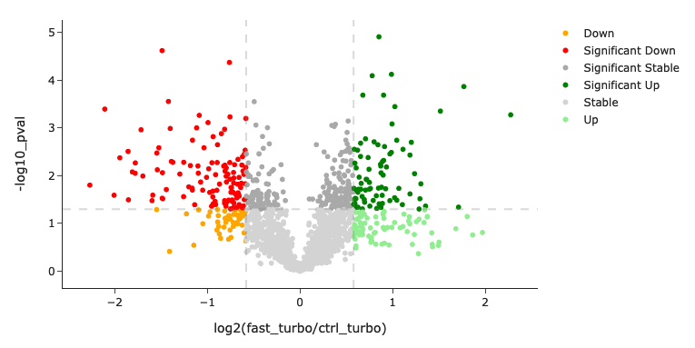
Volcano plot comparison after norm, file 101
OLD
Median all channels
Only cre+_channels median

Slide 13
Conclusion and Notes
Only cre+ channels norm seems to be good for within cre+ channel normalization as well as across the 2 cre+ conditions I think we should do a median normalization of all channels, because it doesn’t affect the number of proteins that pass cutoff but improves the normalization plots and the volcano plots for fast/ctrl
The number of proteins that pass does not change with the normalizations because we do ROC per channel and since we use the same normalization factor for the whole channel all that changes is the multiplication so an increase for each value with the same number so the highest ratio will still be the highest ratio - we sort from highest to lowest and we calculate the tpr and fpr - the cutoff value is not determined by the ratios but by the TPR-FPR value
The reason why volcano plots of blue and green normalization look the same is because without the cre- channels the median of the channel medians is the same so the normalization factors are the same and it does not have an effect on the values between the 2 normalizations (with and without cre- channels), the volcano plots are significance and fold change of cre+ channels of the final protein list so if cre- are not or are normalized doesn't affect the volcano plot since it is both a median normalization

Slide 14
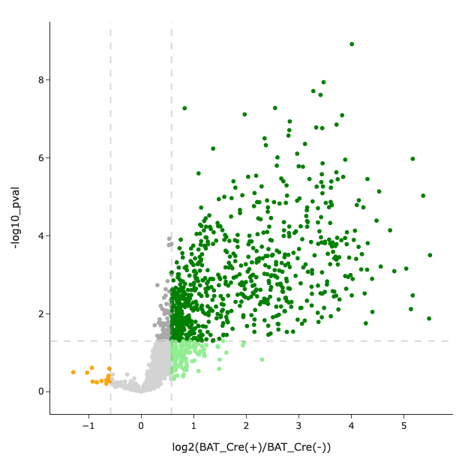
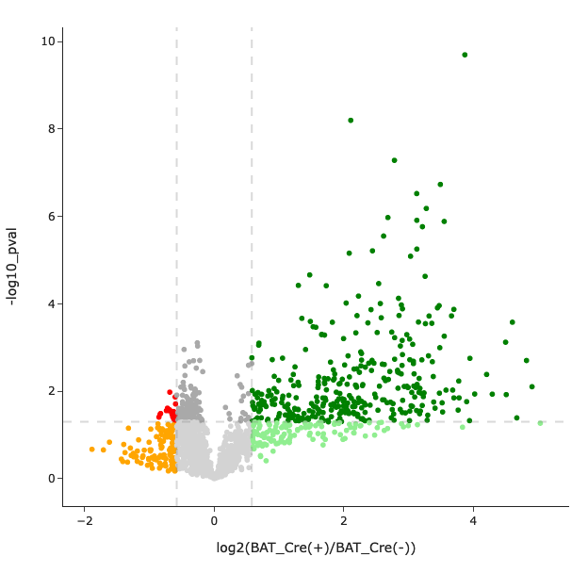
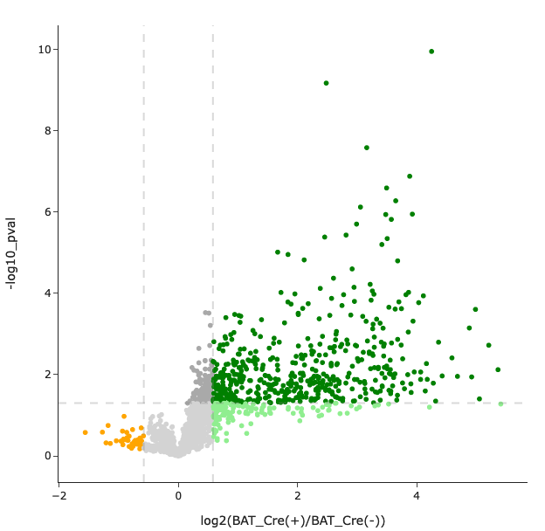
Volcano plot comparison after norm, file CRW condition BAT cre+/cre-
OLD
Median all channels
Only cre+_channels median

Slide 15
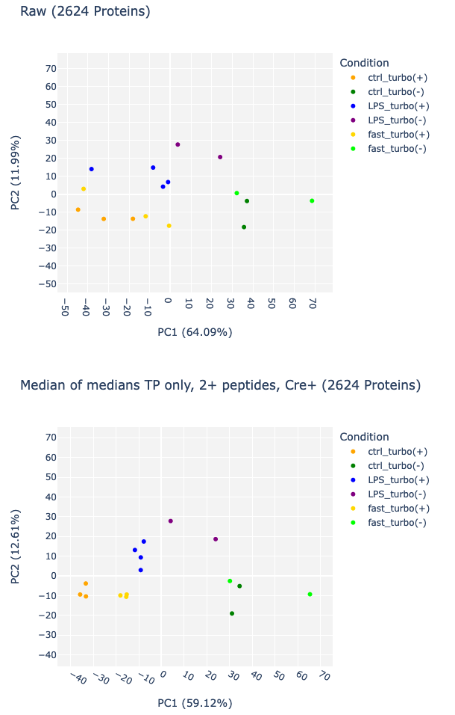
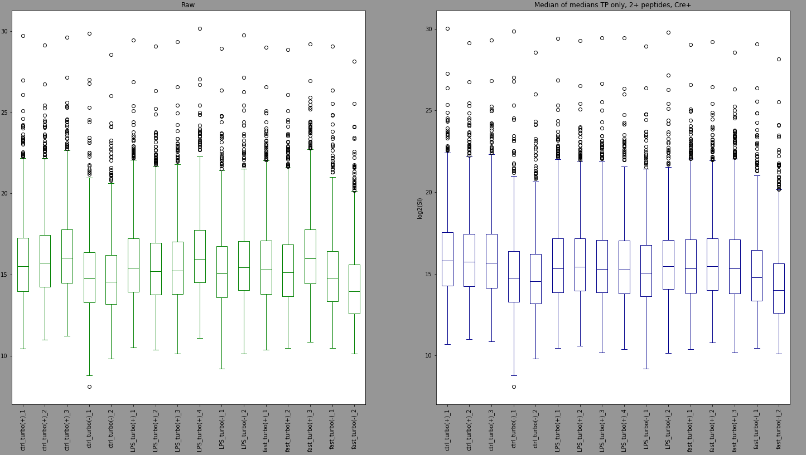
OLD
File 101
Median of medians, 2+ peptides, TP only

Slide 16
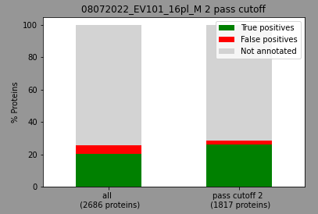
OLD
File 101

Slide 17
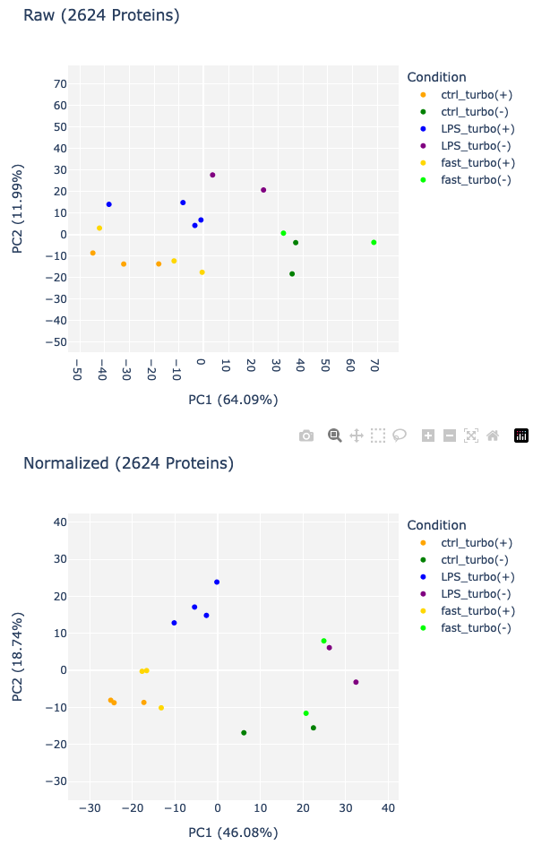
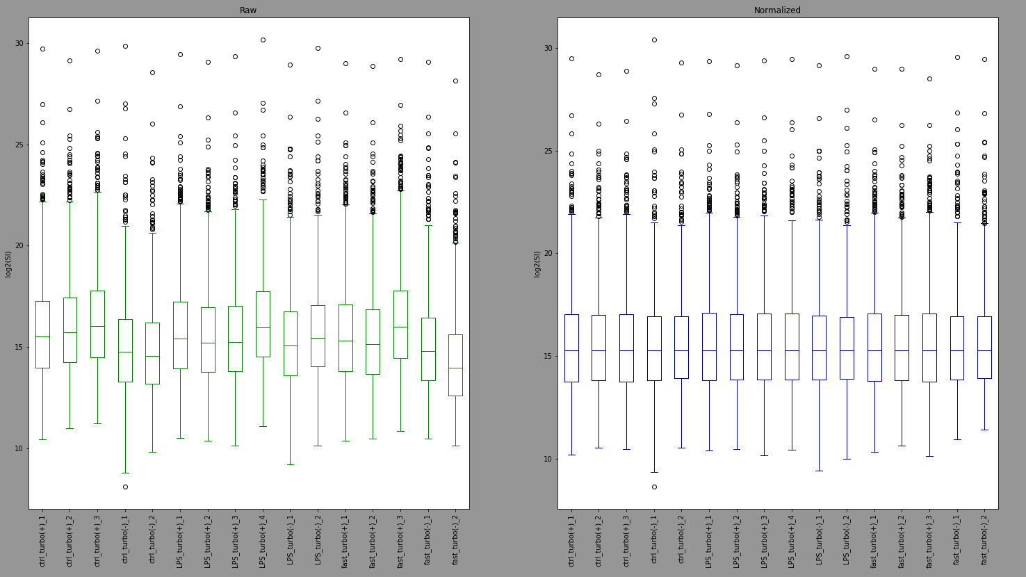
Median all channels
File 101

Slide 18
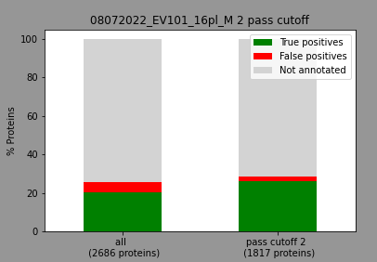
Median all channels
File 101

Slide 19
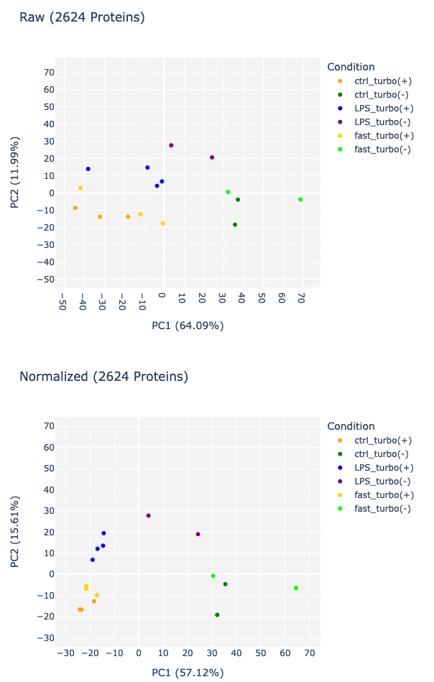
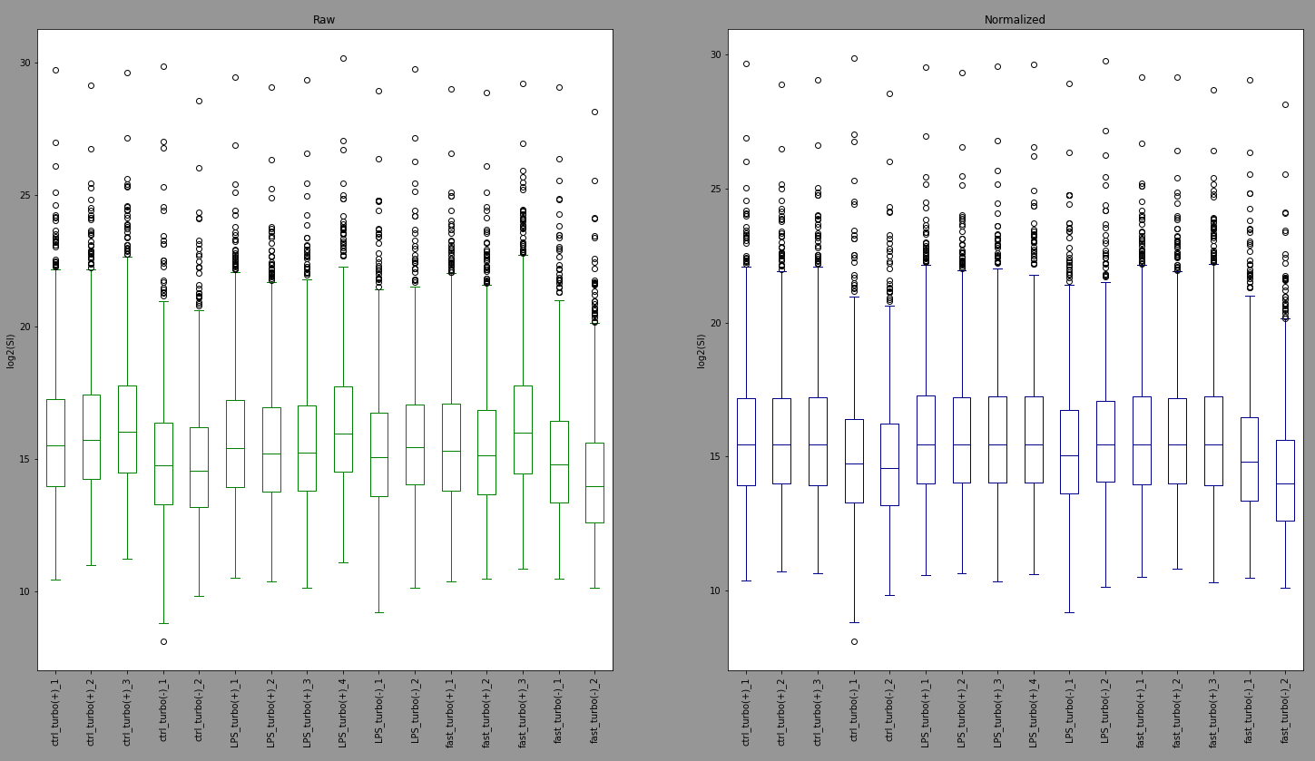
File 101
Only cre+_channels median

Slide 20

Only cre+_channels median
File 101

Slide 21
PCA comparison after norm, file 101
OLD
Median all channels
Only cre+_channels median

Slide 22
Improvement of TP/FP lists

Slide 23
Description
Corey shared SignalP prediction list: Secretion_Prediction_Resource.csv
For each uniprot id we check if the Subcellular location has any of these terms:
Endoplasmic Reticulum
Rough endoplasmic reticulum
If yes, then we check if the score column has a value >= 0.7 but the UPS_score column value is 0
Note from Corey: The “score” column represents the likelihood of classical secretion, while the “UPS_score” is the likelihood of unclassical secretion. Because we expect to be tagging classically secreted proteins, I would actually exclude those proteins from the TP list that have a high UPS_score, as they may not be trafficked through the ER for secretion.
Then for the FP lists use the mitomatrix list – but exclude the proteins with
score column >= 0.7 and UPS_score column value is 0
The results for this test are in 051023_newlists_results_dont_use

Slide 24
Total number of proteins in list
Old lists
New lists (with SignalP)
TP list: 2806 Proteins
FP list: 435 Proteins
TP list: 295 Proteins
FP list: 438 Proteins
There is more here because in the old list I removed proteins that had a signalP annotation from uniprot, now I am using the list Corey shared and only exclude the proteins with
score column >= 0.7 and UPS_score column value is 0

Slide 25
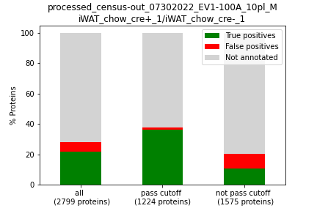
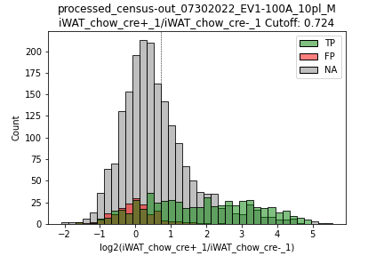
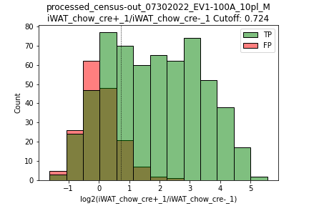
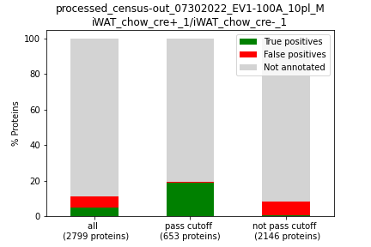
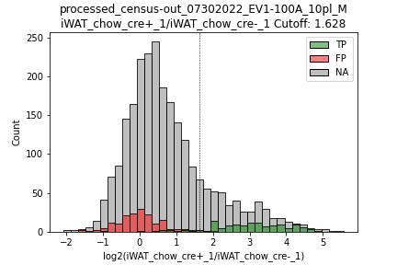
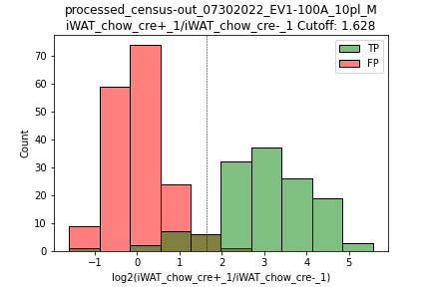
File 100A

Slide 26
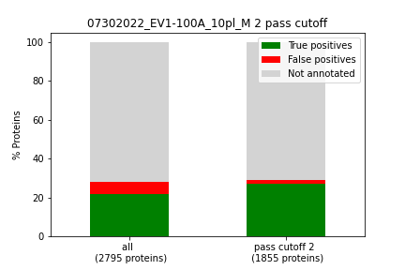
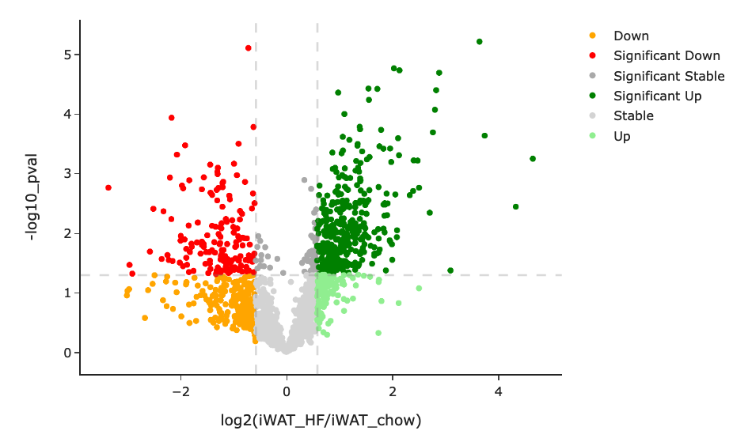
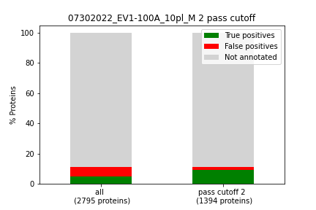
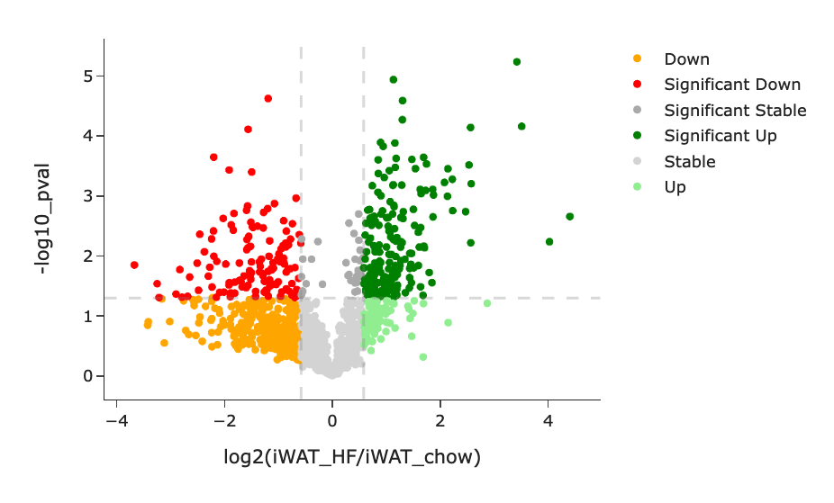
File 100A

Slide 27
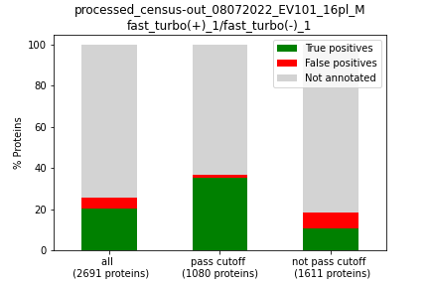
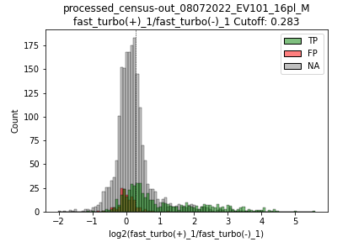
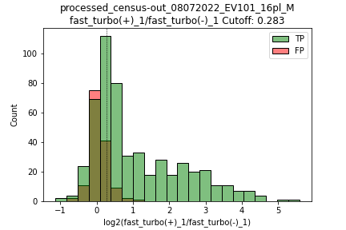
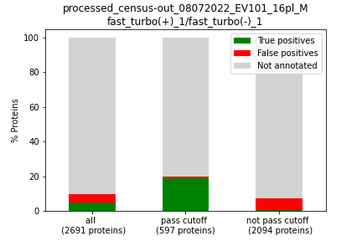
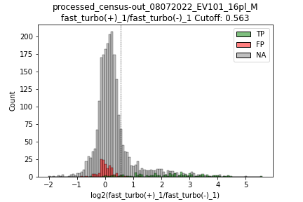
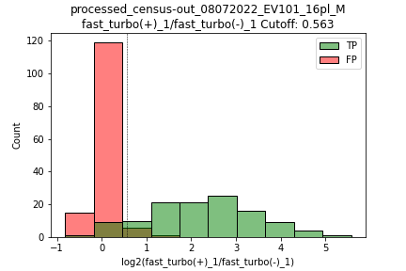
File 101

Slide 28
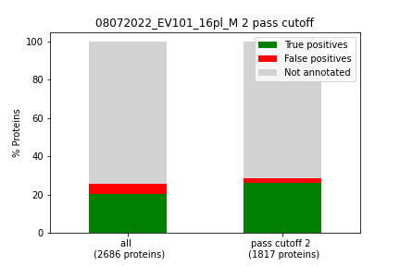
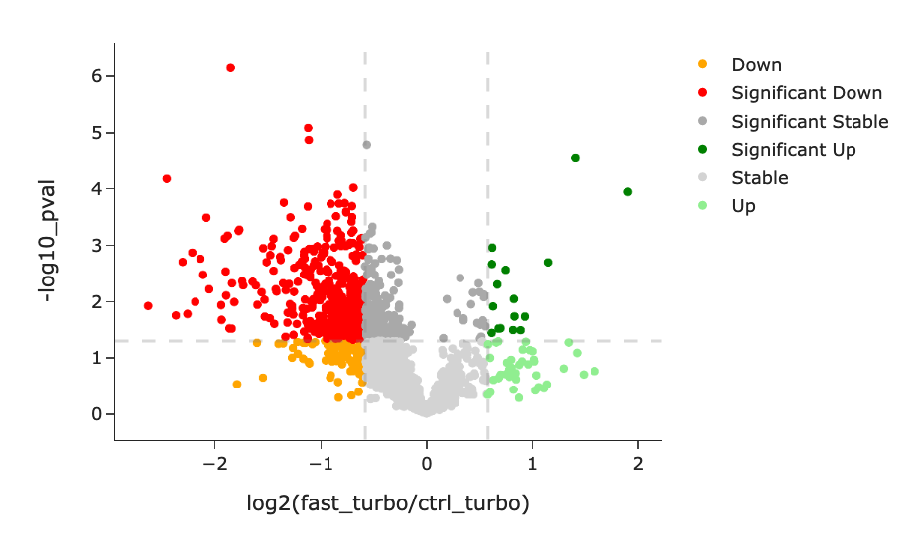
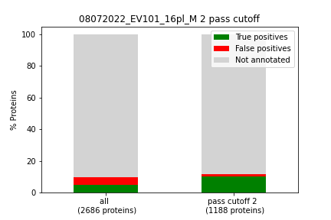
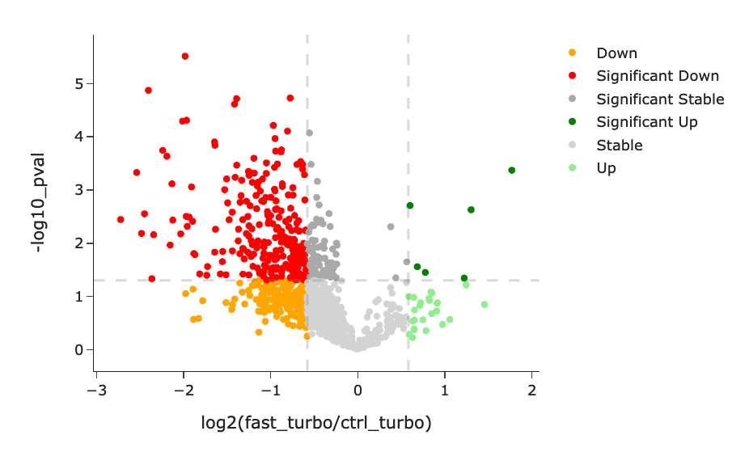
File 101

Slide 29
Conclusion and Notes
The number of proteins that pass drops with the new lists
The distributions overlap less with the new lists
I merged the results of old list and new list for files 100A and 101 and sharing them in this email – filtering NEW_LISTS_pep_num with “blank” will show the proteins that we disregard with the new lists

Slide 30
Decisions
Normalization
Lists

Slide 31
Todos mentioned in last email
We will try to improve the TP lists by excluding “Secreted” from the TP list and restrict the TP list to only proteins annotated as containing a signal peptide
We are also thinking about including another normalization step between different conditions. This might help avoid artificial differences due to differences in turboID expression in different tissues or percent cells that are tagged within that tissue. We will try to identify proteins that are ubiquitously expressed and enriched. We also noticed that fast_turbo vs ctrl_turbo conditions in our study (example below) show mostly downregulated proteins - which might be due to a biological effect, but we want to see how the condition-based normalization might affect this result.
Concerning the Serum samples: I will add a column that shows the fold change/enrichment ratio for each condition
GO term analysis meeting
New todos:
Add fold change/enrichment ratio for each condition to tissue samples?
Add filter to final table for reporting something as different between tissues

