Slide 1
Normalization comparison

Slide 2
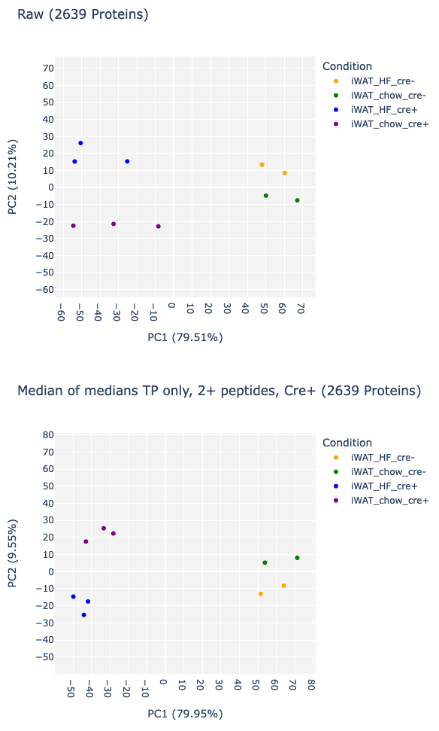
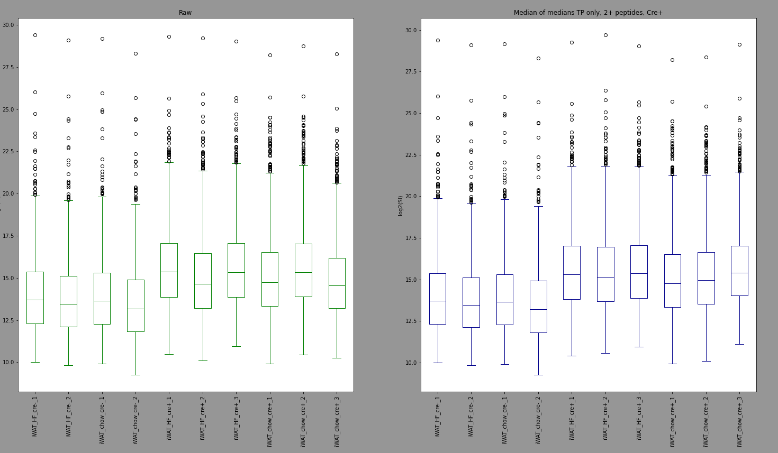
OLD
100A
Median of medians, 2+ peptides, TP only

Slide 3
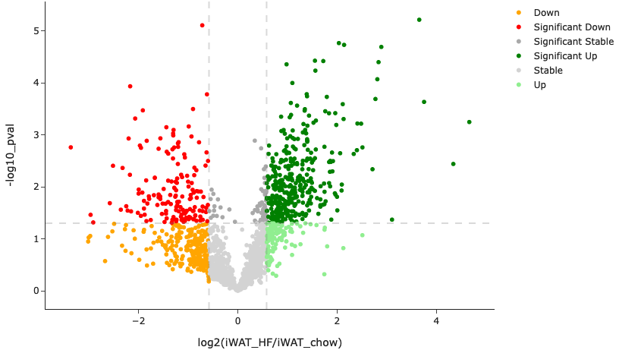
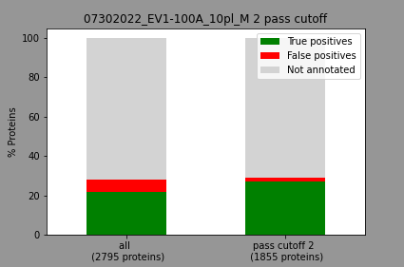
100A

Slide 4
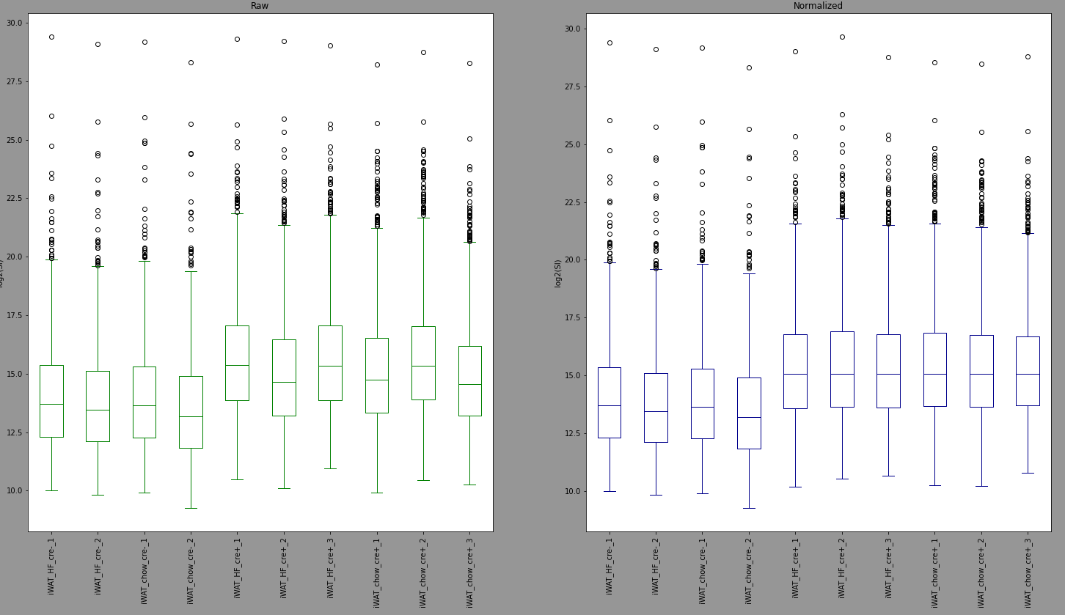
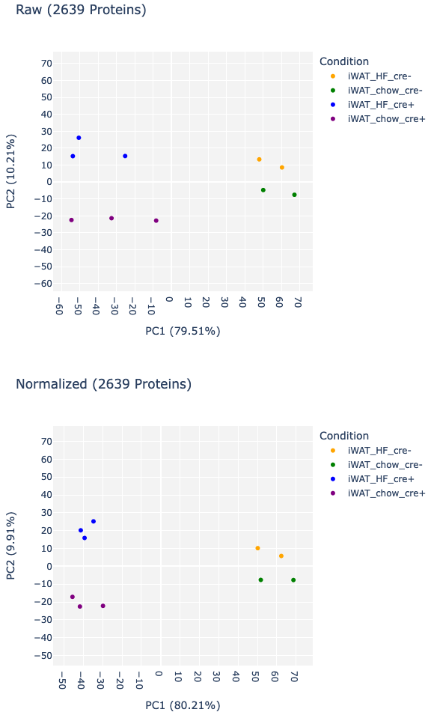
100A
Only cre+_channels median

Slide 5
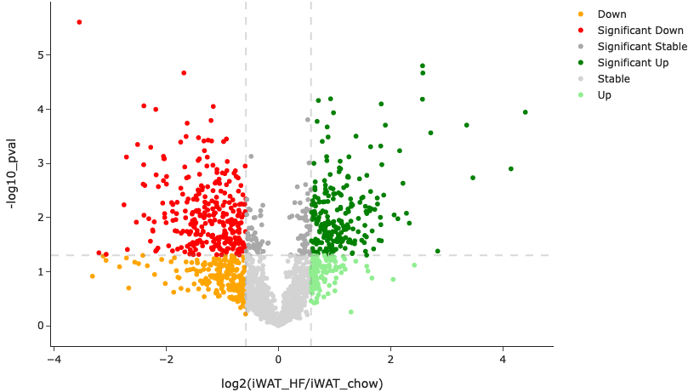
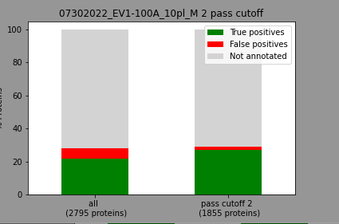
100A

Slide 6
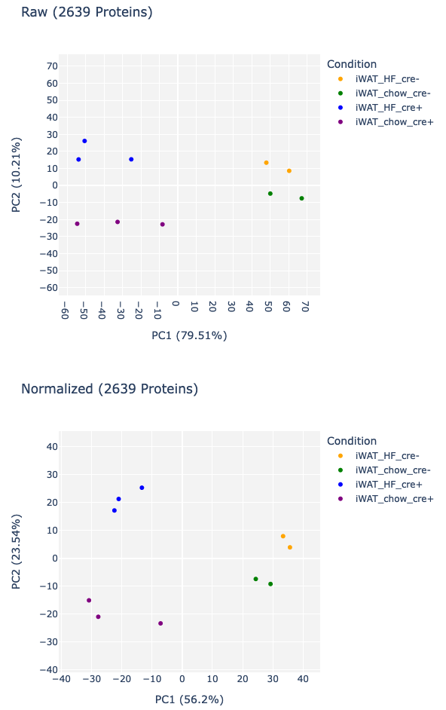
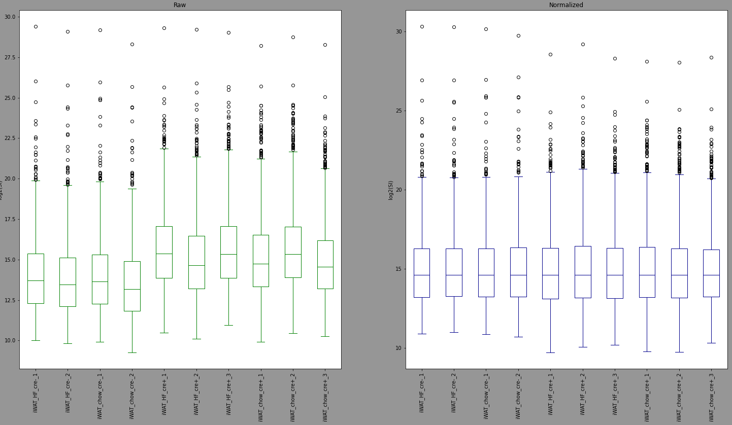
Median all channels
100A

Slide 7
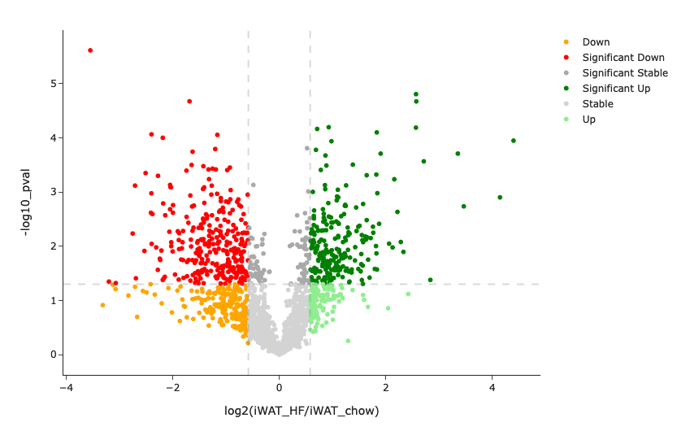
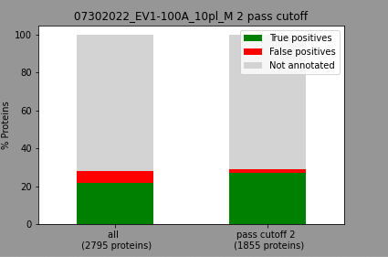
100A

Slide 8
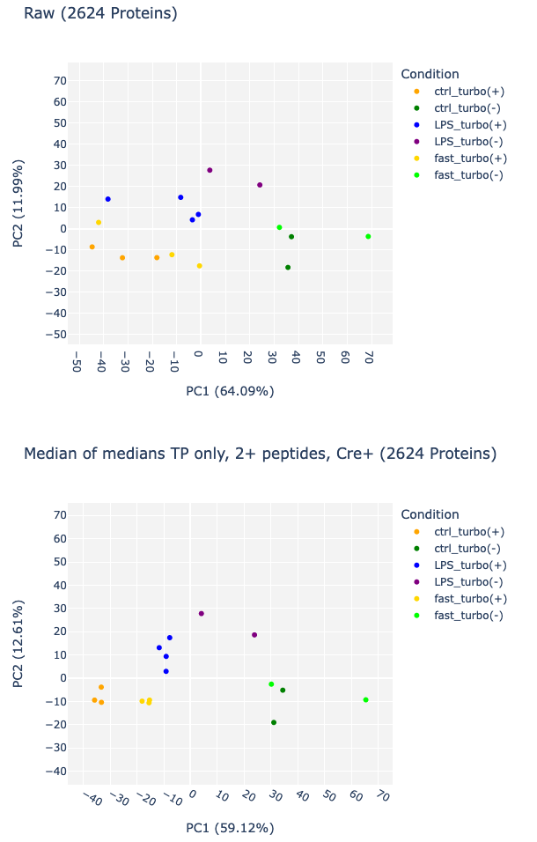
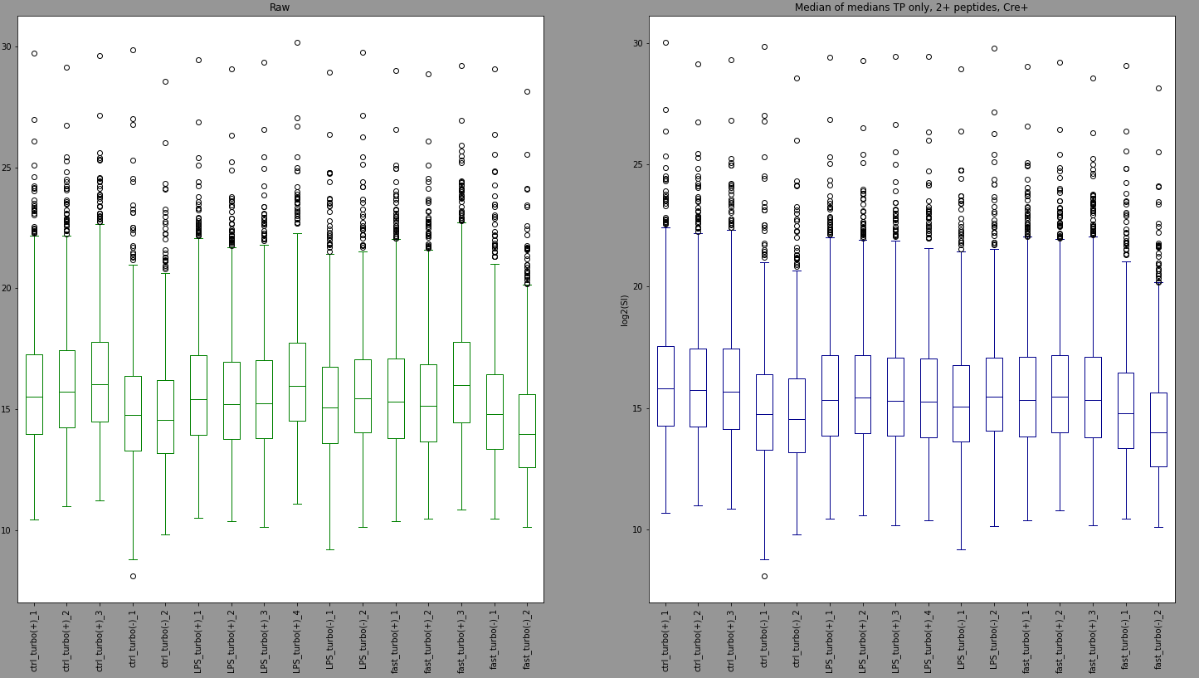
OLD
101
Median of medians, 2+ peptides, TP only

Slide 9
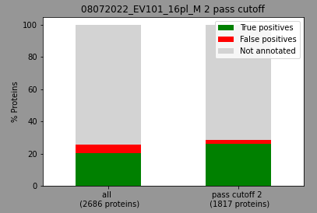
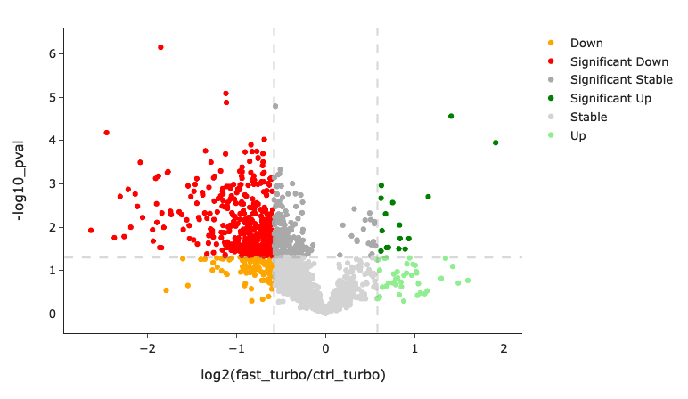
101

Slide 10
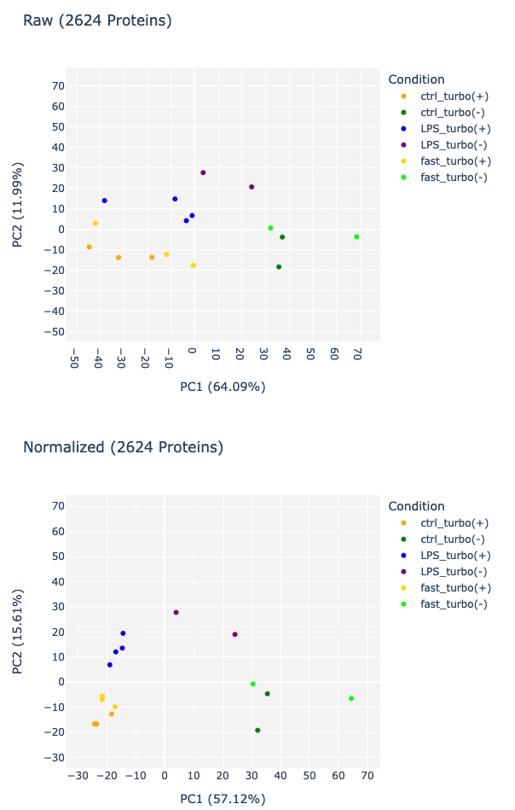
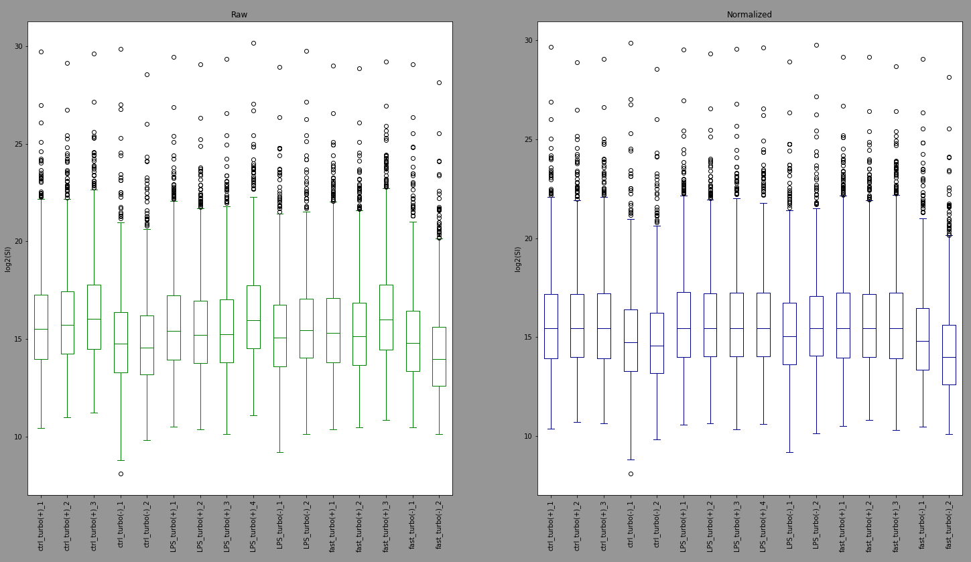
101
Only cre+_channels median

Slide 11

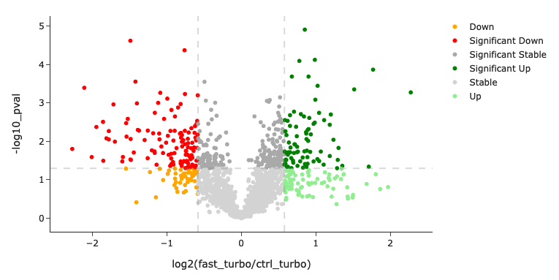
101

Slide 12
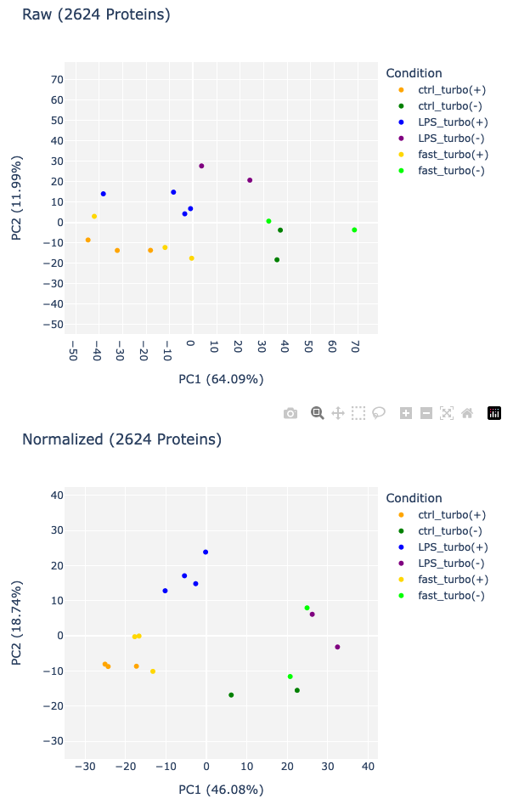
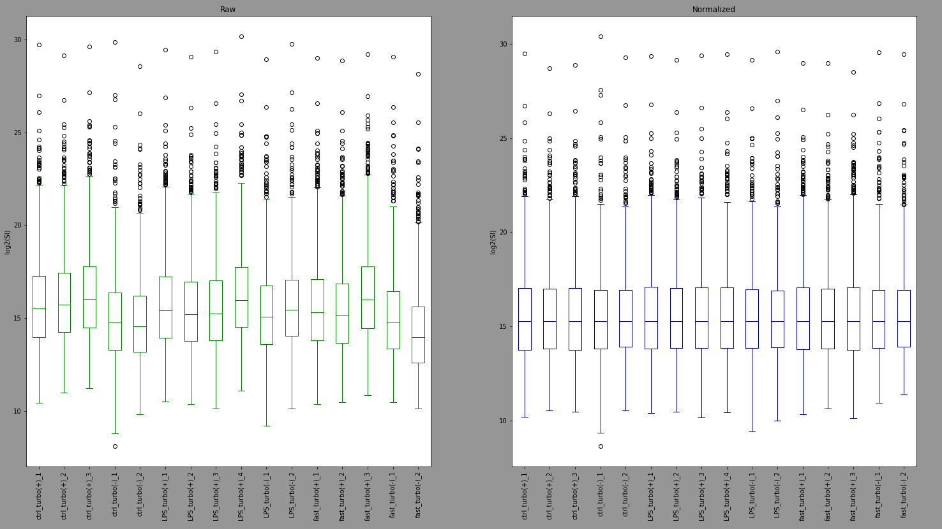
Median all channels
101

Slide 13
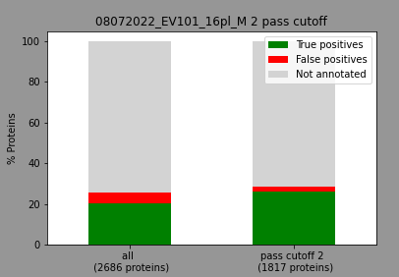
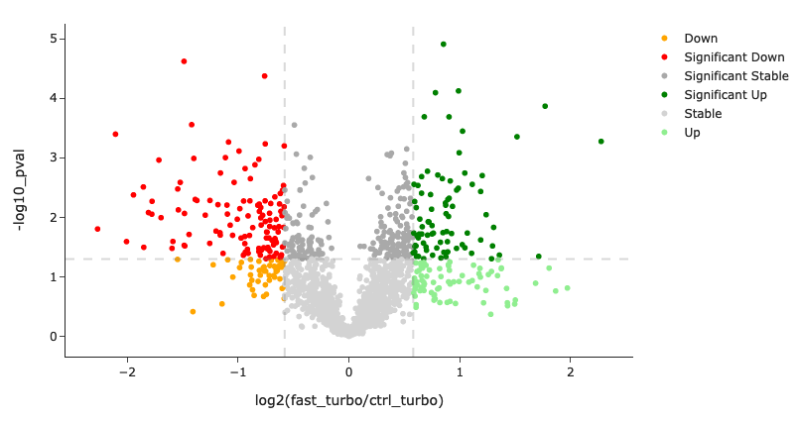
101

Slide 14
PCA comparison after norm, file 101
OLD
Only cre+_channels median
Median all channels

Slide 15
Volcano plot comparison after norm, file 101
OLD
Only cre+_channels median
Median all channels

Slide 16
Conclusion
Only cre+ channels norm seems to be good for within cre+ channel normalization as well as across the 2 cre+ conditions
The number of proteins that pass does not change with the normalizations which indicates that the enrichment values are not affected by the normalizations

