Slide 1
Pipeline update
Pipeline includes removal of contaminants

Slide 2
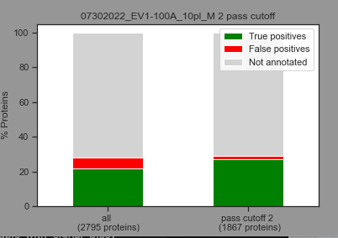
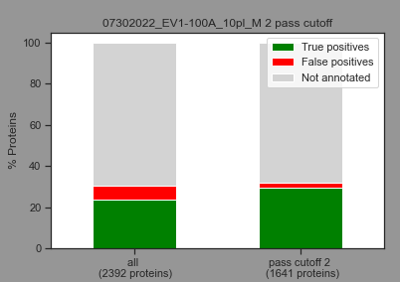
Example file 100A
Removal of contaminants affects ROC analysis and reduces number of proteins that pass cutoffs
But it clears the results from contaminants – which is a good addition to clean up the data

Slide 3
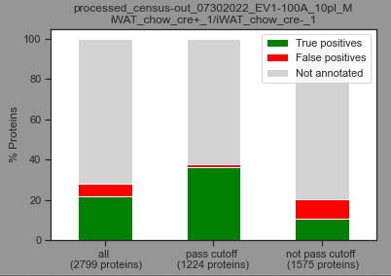
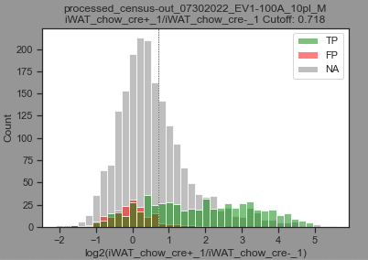
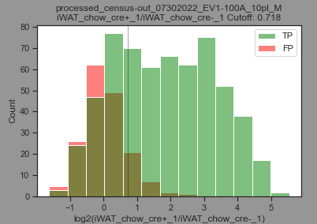
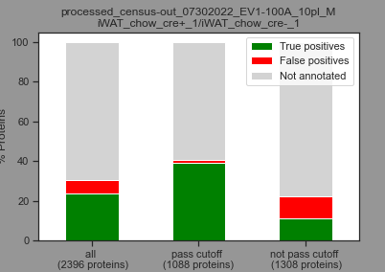
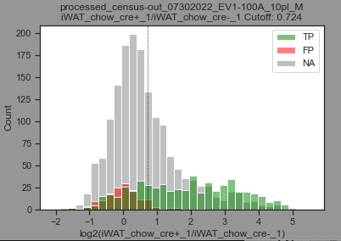
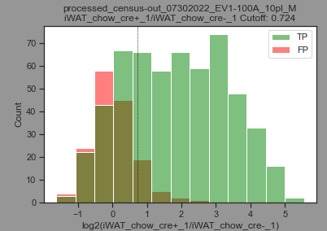
Example file 100A
Here an example of one ratio from the 100A file, the cutoff is higher and around 100 proteins less pass the threshold

Slide 4
Using the new results (results without contaminants)…

Slide 5
Experiments used for creation of lists for Yuvals group
Abbreviation | File name | Experiment type* | Plex | Mod | Type | Notes | List for Yuval's group
EV1-100A_10pl | census-out_07302022_EV1-100A_10pl_M | whole proteome | 10 |  | Tissue |  | yes
EV1-100B_10pl | census-out_07232022_EV1-100B_10pl_M | whole proteome | 10 |  | Tissue |  | yes
EV1-100C_10pl | census-out_07252022_EV1-100C_10pl_M | whole proteome | 10 |  | Tissue |  | yes
EV1-100D_10pl | census-out_08032022_EV1-100D_10pl_M | whole proteome | 10 |  | Tissue |  | yes
EV1-98_16pl | census-out_07142022_EV1-98_16pl_M | whole proteome | 16 |  | Tissue | Albumin/liver | yes
EV101_16pl | census-out_08072022_EV101_16pl_M | whole proteome | 16 |  | Tissue | Adiponectin/fat | yes
EV1-105_16pl | census-out_08182022_ev1_105_16plex | whole proteome | 16 |  | Tissue | basal comparison | yes
EV1-136_16pl | census-out_11292022_ev1_136_16plex | whole proteome | 16 |  | Serum | Albumin/serum | yes
EV1-137_16pl | census-out_11302022_ev1_137_16plex | whole proteome | 16 |  | Serum | Adiponectin/serum | yes
EV1_155_16pl_M | census-out_01202023_EV1_155_16pl_M | whole proteome | 16 |  | Tissue | excluded from analysis | x
EV2-9_16pl_M | census-out_20230214_EV2-9_16pl_M | whole proteome | 16 |  | Serum | Serum | yes
CRW_A-5_16pl_M | census-out_04172023_CRW_A-5_16pl_M | whole proteome | 16 |  | Tissue | Adipo/BAT and GFAP/brain | only BAT conditions
EV2-23_16plex | census-out_04212023_EV2-23_16plex_Mouse_RTS | whole proteome | 16 |  | Serum |  | yes
EV2-28A | census-out_20230512_EV2-28A | whole proteome | 16 |  | Tissue | male | yes
EV2-28B | census-out_20230513_EV2-28B | whole proteome | 16 |  | Tissue | female | yes
Kaja request: please add CRW file with Bat conditions (done!)

Slide 6
Per experiment:
Extracted significantly up or down regulated proteins for each comparison per file

Slide 7
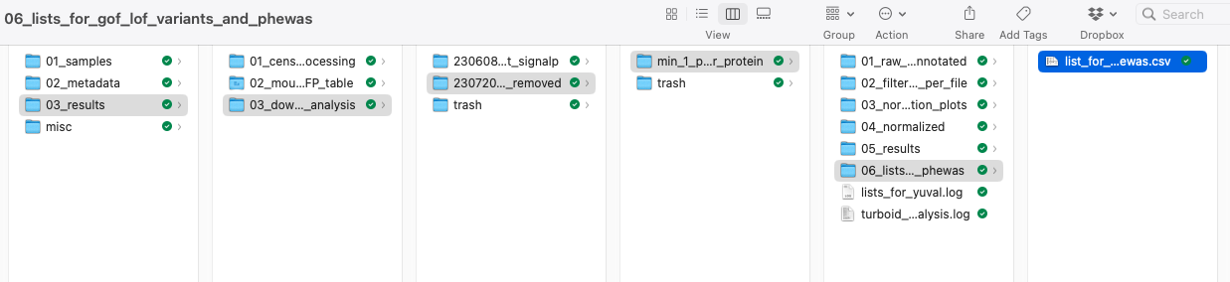
For all experiments
Merged the extracted significant up or down regulated proteins from each experiment into one list and kept the information where it originated from

Slide 8
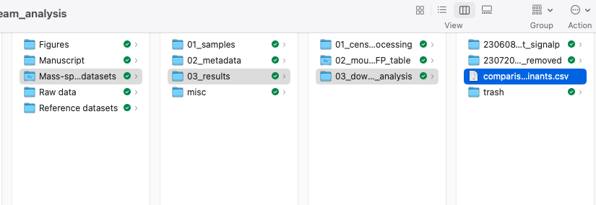
Comparison of results with and without contaminants
Number of proteins in lists for Yuval’s group:
with contaminants: 3316
without contaminants: 2874
I merged the two files and provide a new file (comparison_with_and_without_contaminants.csv) which shows if protein is found in both final lists or only in one list – this really shows us that we remove a lot of contaminants from the results using our updated pipeline

Slide 9
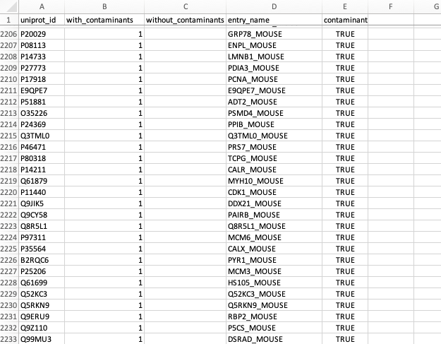
Most proteins which we loose are truly contaminants and should be removed
396 proteins

Slide 10
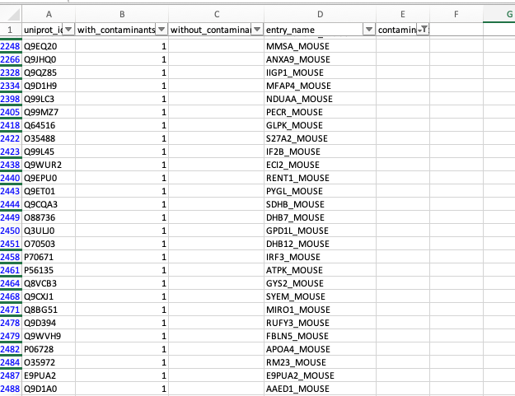
However, we also loose some proteins which are not contaminants, this is due to the change in ROC analysis and the shift in thresholds, these proteins were mostly on the border of the threshold
101 proteins

Slide 11
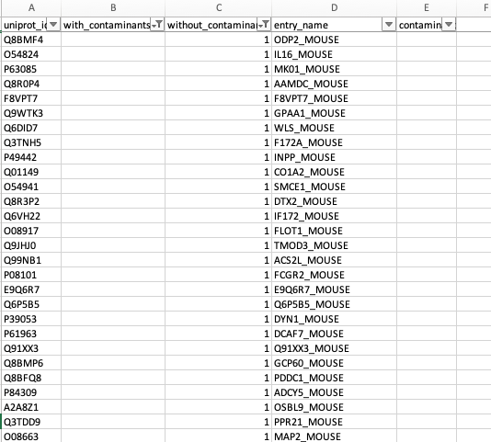
There are also proteins we gain by removing contaminants which we lost before due to having contaminants in the ROC analysis
54 proteins

Slide 12
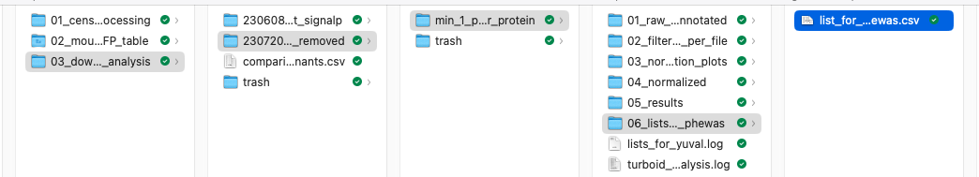
The list we will probably send to Yuval’s group is this one:

Slide 13
What does it contain?
A reference column for each experiment and the conditions we used for differential expression analysis
The mouse to human mapping info (I will inform Yuval’s group to use the SWISS_PROT IDs_human_jackson_homology_db column)
Once we get results from Yuvals group using this file we will be able to trace back which experiments and comparisons had the significantly up or down regulated protein

Slide 14
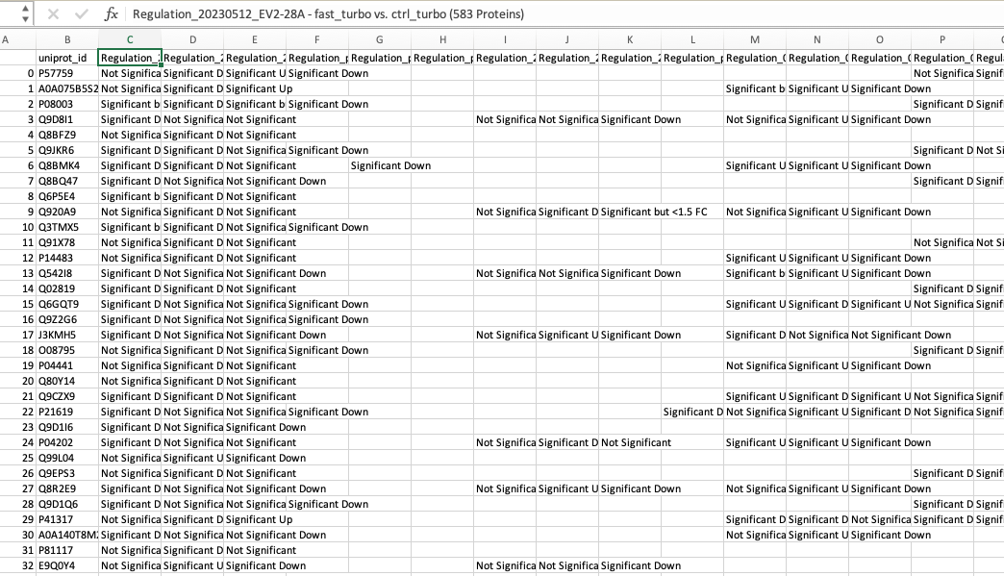
How does it look?

Slide 15
Please let me know if you want to add or change something before we send the list to Yuval’s group!

