Slide 1

TurboID Project

Slide 2
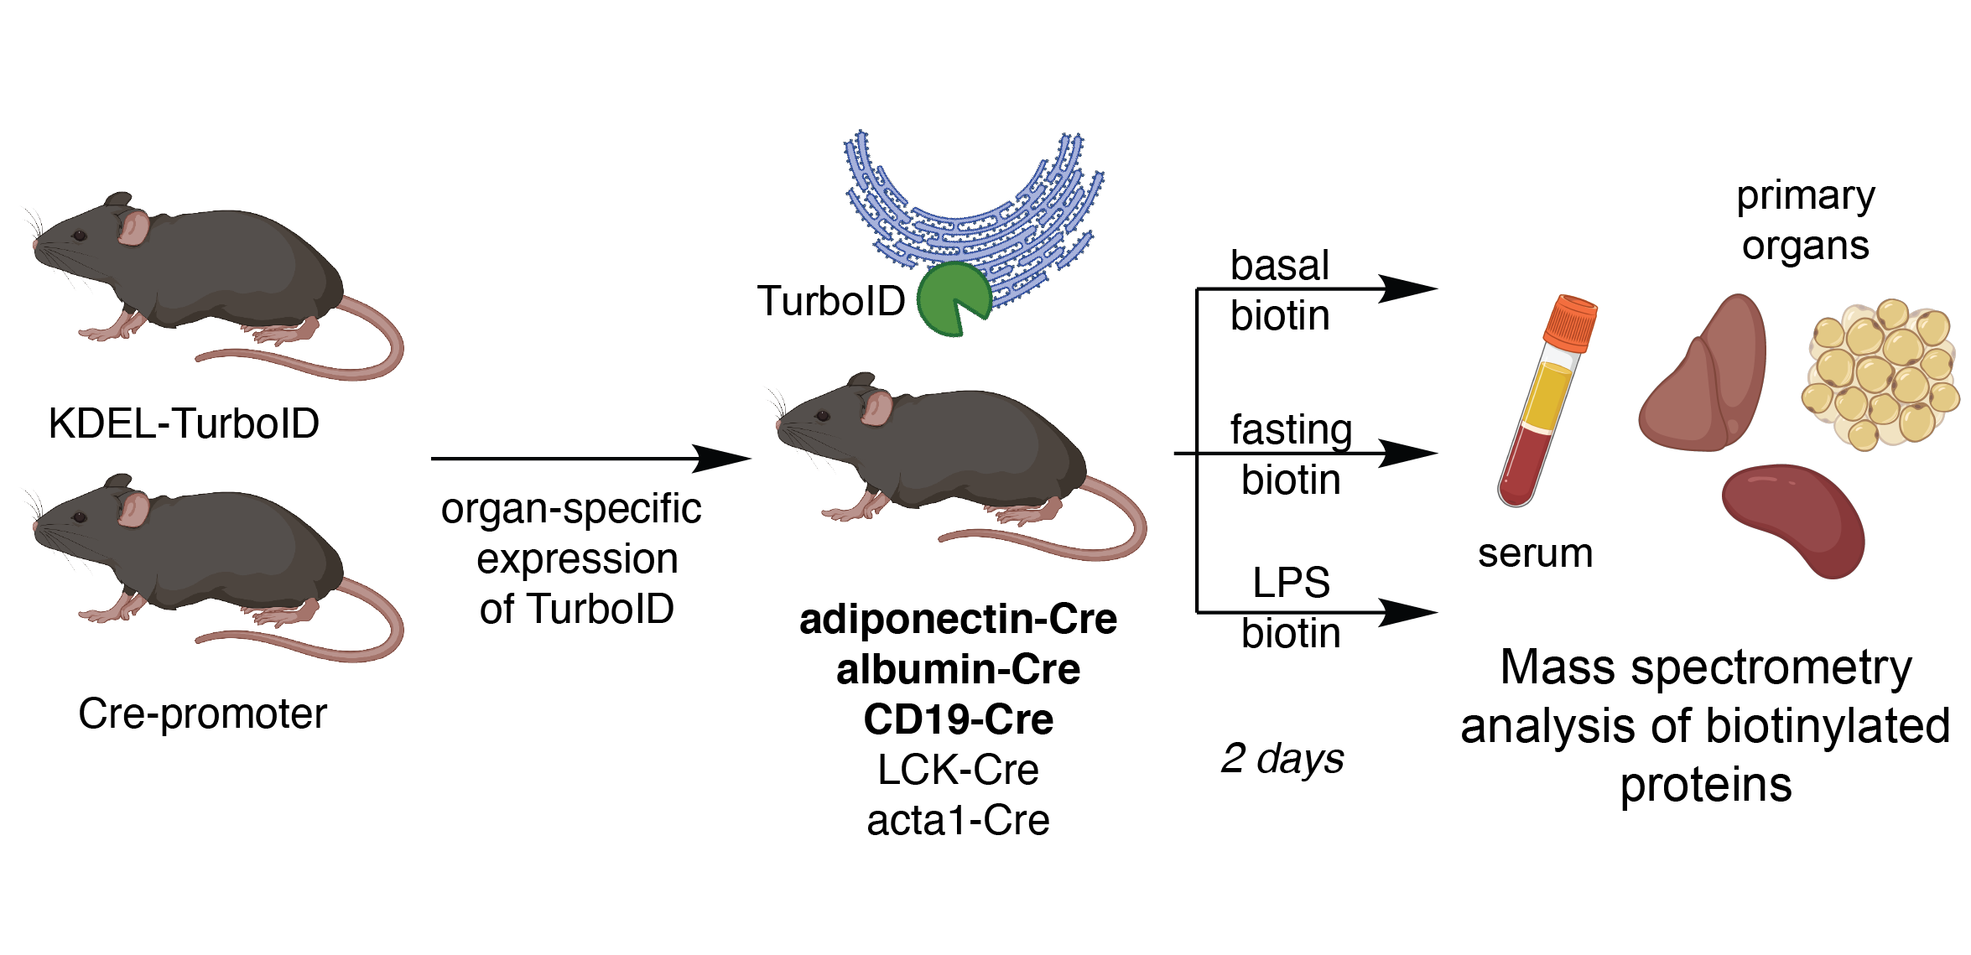
Experiment set up #1
Cell-type specific profiling of secreted and ER-resident proteins under different stress conditions [4 x 16plex TMT + serum]

Slide 3
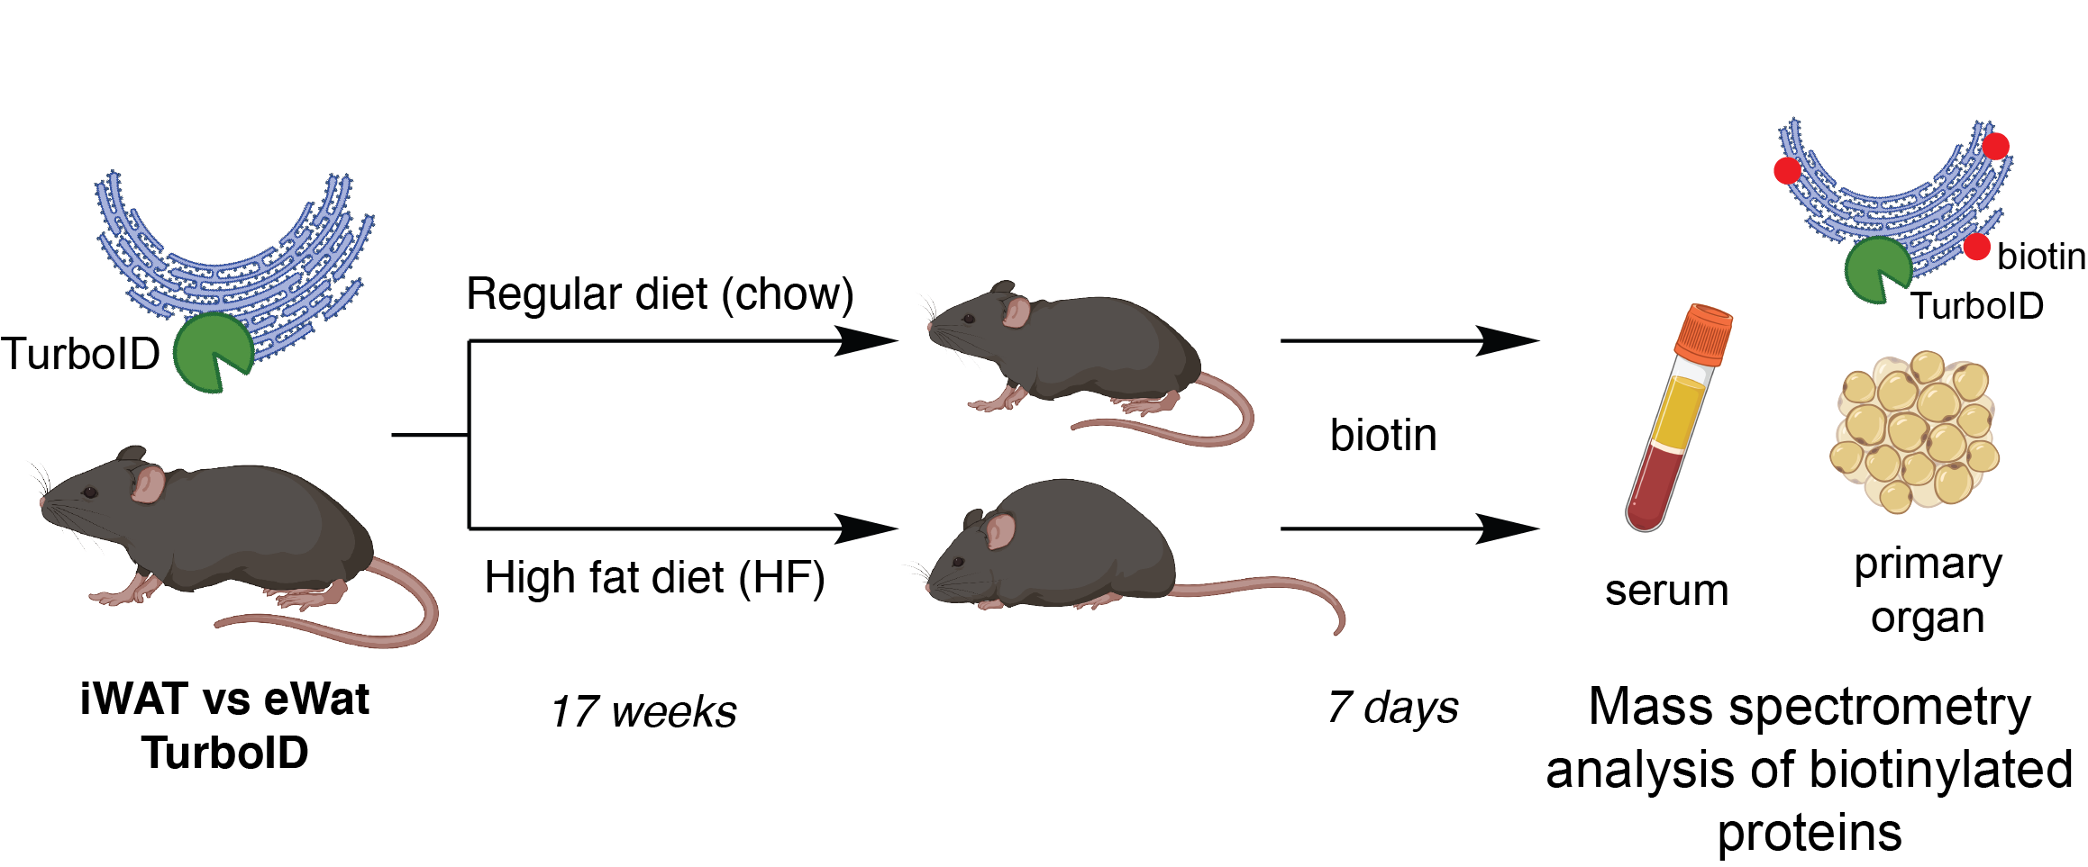
Experiment set up #2
Profiling of secreted and ER-resident proteins in distinct white adipose tissues under different dietary conditions [4 x 10plex TMT + serum]
Notes:
inguinal WAT(iWAT), and epididymal WAT (eWAT)

Slide 4
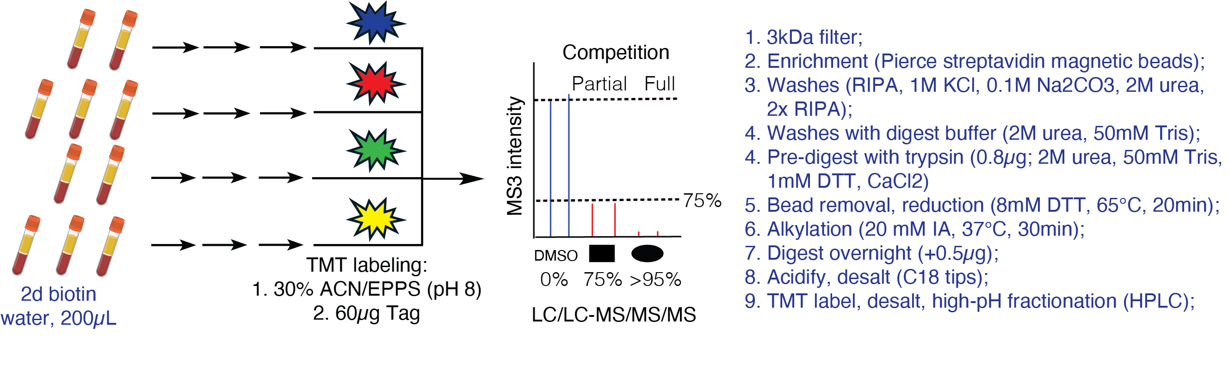
MS sample processing: Serum
Notes:
300
250 >25%
230 >50%

Slide 5
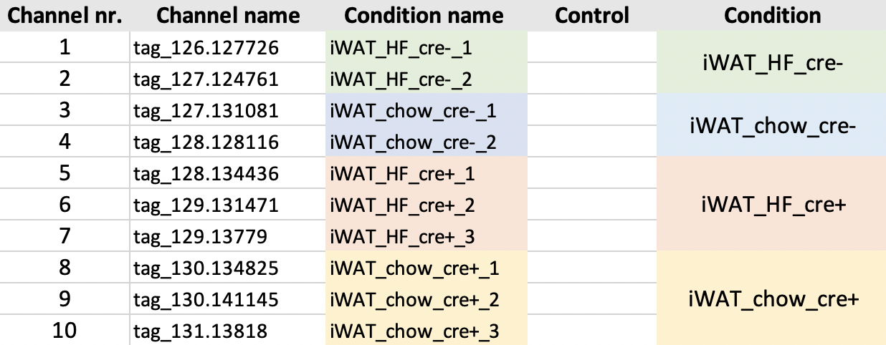
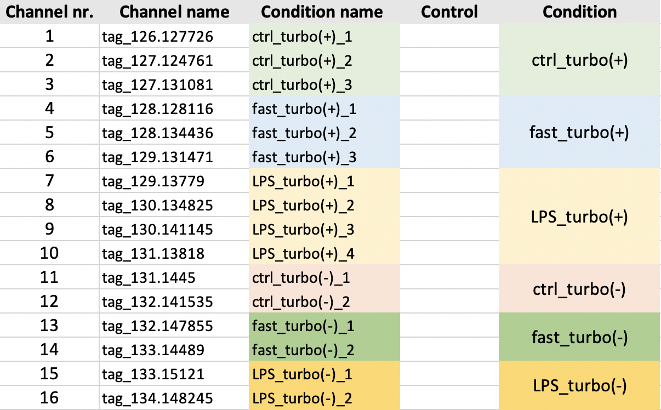
Experimental Layout
Total of 10 files (4 x 10 plex, 6 x 16 plex)
Example layout 10 plex:
Example layout 16 plex:
Notes:
https://www.nature.com/articles/s41596-020-0399-0

Slide 6


Analysis Overview
mass spectrometry data searched against a database of known proteins
Filter based on peptides:
Remove non unique peptides
Remove not fully tryptic peptides
Allowed number of missed cleavage sites: 1
Min 1 or 2 peptides per protein
Peptide SI per protein
are summed
(=summed protein SI)
Raw file
1
2
Processed file
Filtering based on cre+ replicates
and
Normalization
Calculate Ratios
Experimental sample/negative control
Annotate proteins
Using TP and FP lists
ROC-based analysis
Establish optimal cutoffs per ratio
Filtering based on pass/not pass cutoff
Determine biotinylated proteins
Report proteins that pass cutoff
3
4

Slide 7
Filtering of cre+ replicates
1
Filtering is performed based on the experimental sample replicates for each condition
At least one pair (any 2 channels) out of the 3 or 4 cre+ channels should have a min raw signal intensity sum >= 10000 and a coefficient of variation <= 0.5
Example:
4000 | 6000 | 5
1500000 | 5000 | 6000
1 ) and 2) sum: pass, cv: pass
1 ) and 3) sum: not pass, cv: not pass
2 ) and 3) sum: not pass, cv: not pass
= at least one pair passed so this uniport ID passes
1 ) and 2) sum: pass, cv: not pass
1 ) and 3) sum: pass, cv: not pass
2 ) and 3) sum: pass, cv: pass
= at least one pair passed so this uniport ID passes
Notes:
From question

Slide 8
Median Normalization
1
Normalization is performed for cre+ channels
Per cre+ channel TP proteins with 2+ peptides are used to calculate the median per channel
normalization factors are calculated by dividing (median of cre+ channel medians)/(median cre+ channel)
each cre+ channel is then multiplied with the corresponding normalization factor
Notes:
From question

Slide 9
TP and FP lists
2
Lists of TP and FP proteins generated on basis of annotation from UNIPROT
TP list includes proteins expected to be biotinylated
Endoplasmic Reticulum,
Rough Endoplasmic Reticulum
Golgi
Secreted
Extracellular space
FP list includes proteins not expected to be biotinylated
Cytoskeleton
Removed Proteins that have SignalP annotation
TP list: 3436 Proteins
FP list: 4353 Proteins
Notes:
Signal peptides control protein secretion and translocation
Proteins annotated as TP are removed from FP list

Slide 10
Preparation of ratios and annotation of proteins
2
1) Calculate Ratios per condition (experimental sample/negative control sample)
2) Annotate Proteins as TP or FP (depending in which list they are in)
ratio_iWAT_HF_cre+_1
ratio_iWAT_HF_cre+_2
ratio_iWAT_HF_cre+_3
iWAT_HF_cre-1
iWAT_HF_cre-_2
ratio_iWAT_HF_cre+_1/iWAT_HF_cre-1
ratio_iWAT_HF_cre+_1/iWAT_HF_cre-_2
ratio_iWAT_HF_cre+_2/iWAT_HF_cre-_1
ratio_iWAT_HF_cre+_2/iWAT_HF_cre-_2
ratio_iWAT_HF_cre+_3/iWAT_HF_cre-_1
ratio_iWAT_HF_cre+_3/iWAT_HF_cre-_2
Notes:
From question

Slide 11
Approach to determine the final proteome lists
3
receiver operating characteristic (ROC)-based analysis
with use of curated lists of true-positive (TP) and false-positive (FP) proteins
allows to establish optimal cutoffs
cutoffs maximize the TP proteins and minimize FP proteins in the final lists
Cho et al. (2020)
Notes:
From question

Slide 12
Determine biotinylated proteins
3
Normalize
Normalize ratio by the median ratio of proteins that are labelled as FP
Rank
Rank ratios in descending order
Calculate TPR & FPR
Calculate TP rate (TPR) and the FP rate (FPR) (= fraction of detected TP and FP proteins above the cutoff)
Plot (ROC)
Plot TPR and FPR (ROC) to determine how well the experiment enriched TP over FP proteins
Calculate TPR-FPR
calculate TPR-FPR
Find optimal cutoff ratio
find cutoff ratio which has the highest value for TPR-FPR (= the optimal cutoff ratio)
Plot TPR-FPR
Plot log2 ratio and TPR-FPR (see line-plot – cutoff will be the highest point)
Cho et al. (2020)
Notes:
From question

Slide 13
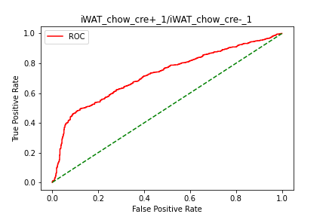
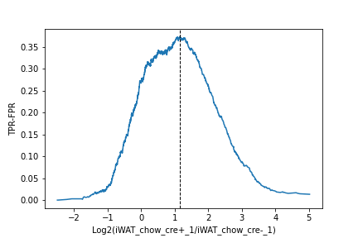
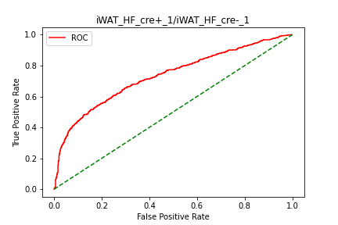
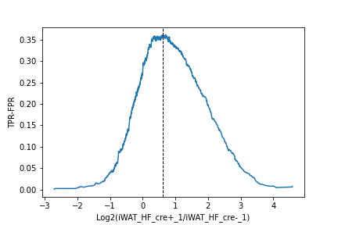
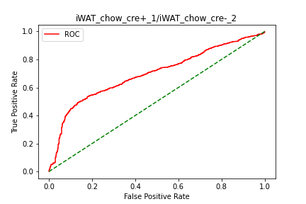
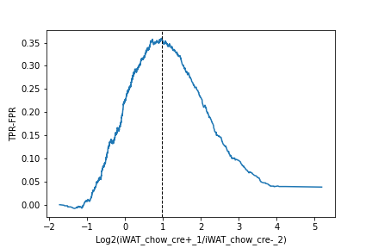

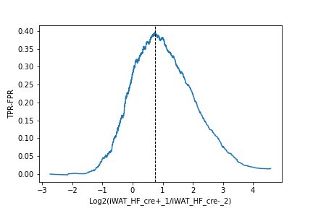
Example EV1-100A
3
1.14
0.62
0.96
0.74
Proteins above the determined TMT ratio cutoff are considered to be biotinylated proteins
Proteins below the cutoff are considered to be likely nonspecific binders

Slide 14
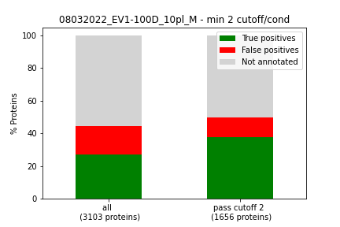
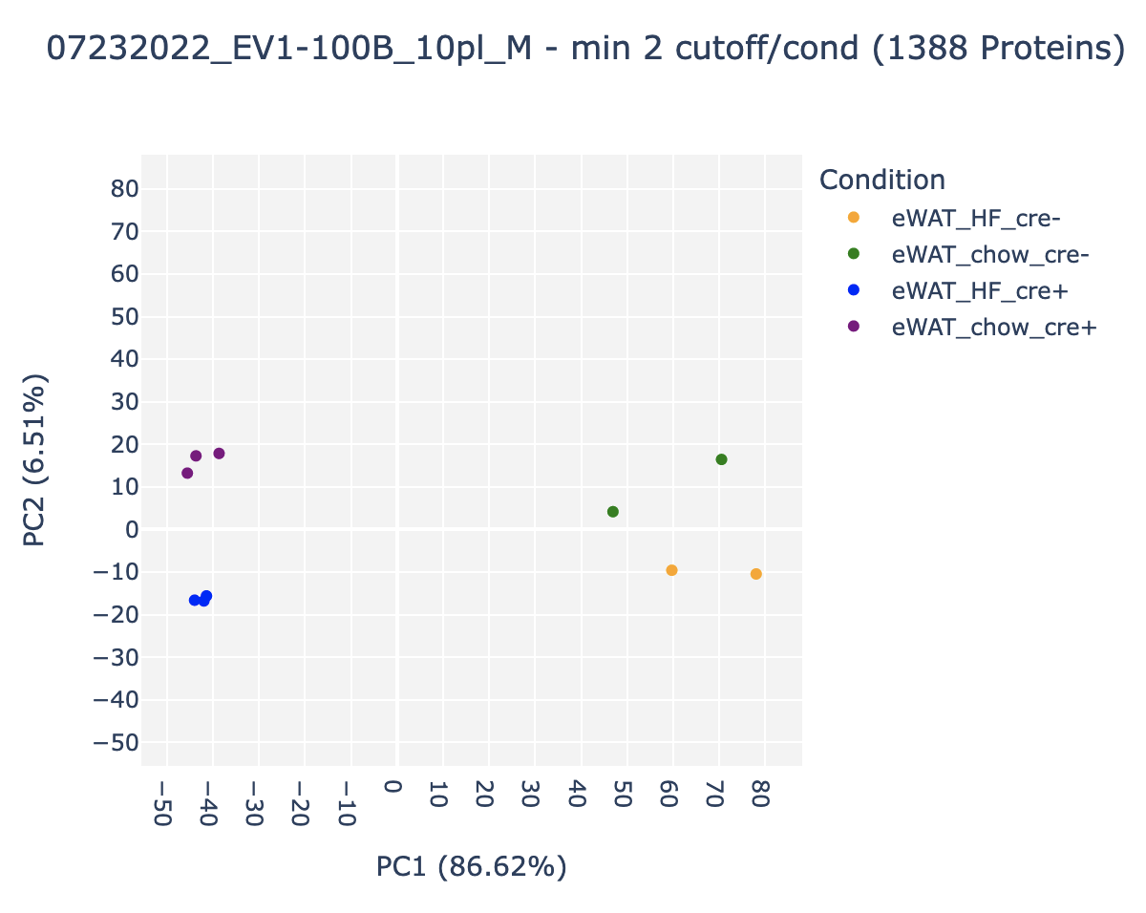
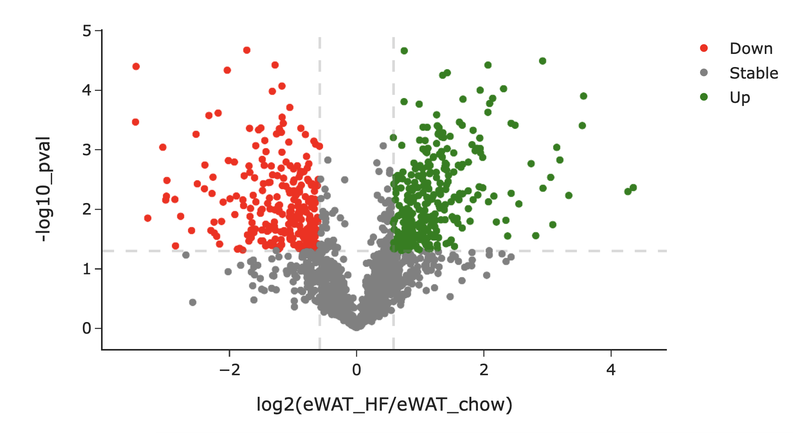
Further Filtering
4
We filter out proteins where at least one condition passes the ratio cutoff with 2 different cre+ replicates and create barplots to see how the amount of TP and FP proteins changes after the ROC cutoff analysis
We show PCA plots to visualize sample clustering
Volcano plots to identify up/down regulated proteins in this filtered out subset
Notes:
From question

Slide 15
Feedback
tp_term_list = ["Endoplasmic Reticulum", "Secreted", "secreted", "Endoplasmic reticulum", "Rough endoplasmic reticulum", "endoplasmic reticulum"], removed: "Golgi", "Extracellular space", "extracellular space",
fp_term_list = ["Nucleus", "nucleus", "Mitochondrion", "mitochondrion"], removed: 'cytoskeleton' "Cytoskeleton",
FP: 5344
TP: 2808
Run analysis with new FP and TP lists
Add table that was use for volcano plots
improve folder structure
Notes:
From question

Slide 16
Thank you!

