Slide 1
TurboID Data processing

Slide 2
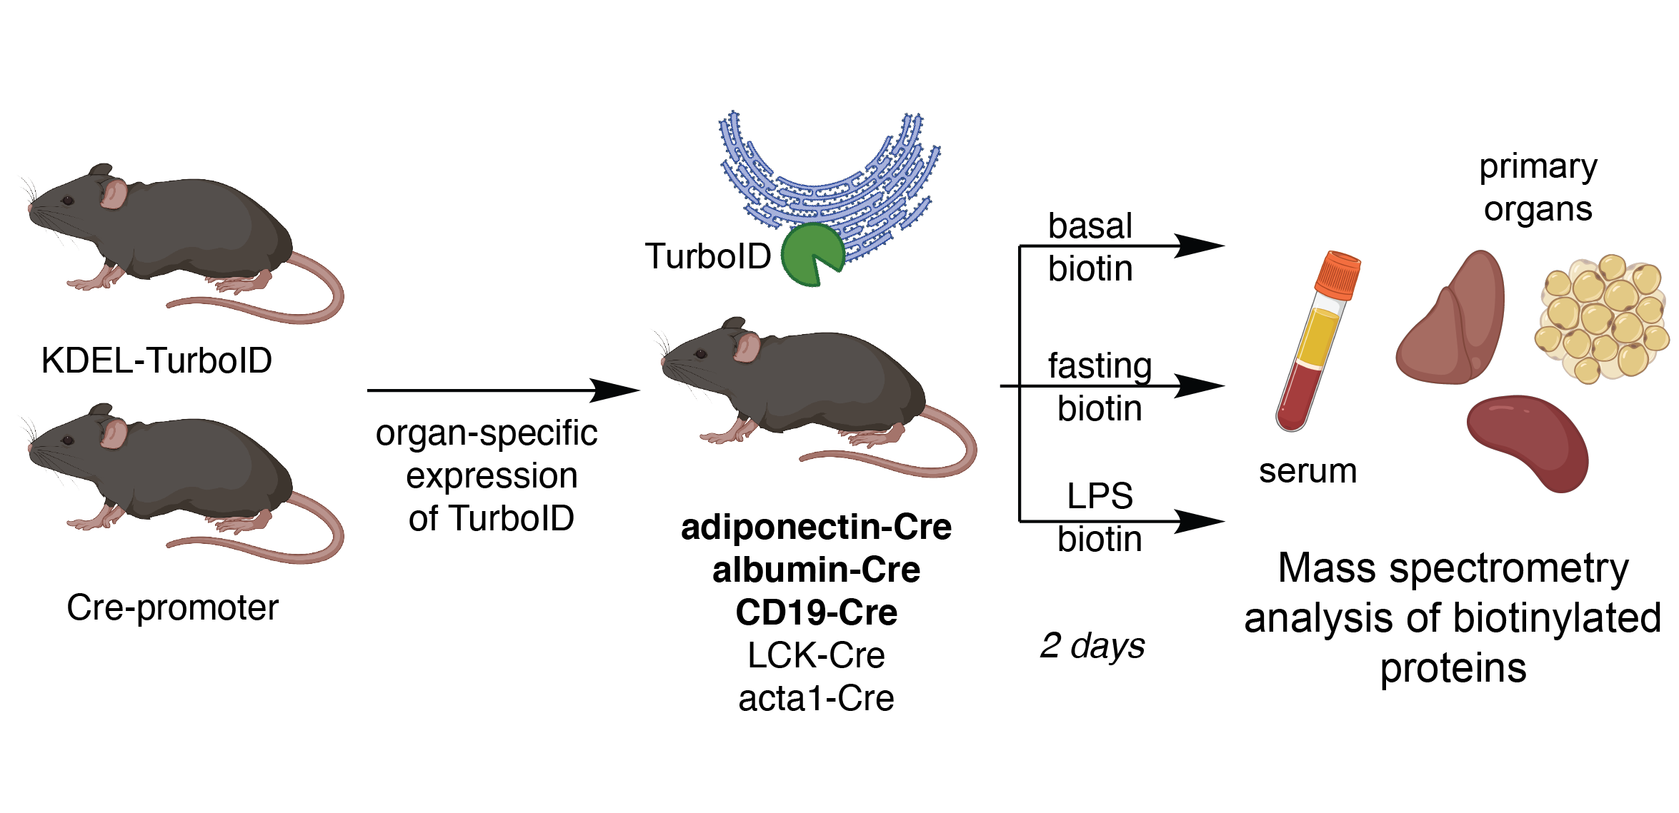
Experiment set up #1
Cell-type specific profiling of secreted and ER-resident proteins under different stress conditions [4 x 16plex TMT + serum]
Notes:
We are using the proximity labeling tool to identify proteins that interact with a specific target protein.
TurboID is a biotin ligase enzyme that can be fused to a protein of interest. So when the turboid fused protein is expressed and biotin is added to the environment turbo id will biotinylate nearby proteins and we are able to identify the interacting proteins
KDEL-TurboID is a modified version of TurboID that is targeted to the endoplasmic reticulum (ER). This allows KDEL-TurboID to label proteins that are in close proximity to the ER.
Adiponectin-Cre, Albumin-Cre, and CD19-Cre are all types of modified mice that express the Cre recombinase enzyme in specific cell types or tissues.
Adiponectin-Cre mice express Cre recombinase under the control of the adiponectin promoter, which is specifically active in adipose tissue. This allows us to induce genetic modifications specifically in adipocytes (fat cells) or other cells within adipose tissue.
Albumin-Cre mice express Cre recombinase under the control of the albumin promoter, which is active in liver cells. This allows us to induce genetic modifications specifically in hepatocytes (liver cells).
CD19-Cre mice express Cre recombinase under the control of the CD19 promoter, which is active in B cells of the immune system. This allows us to induce genetic modifications specifically in B cells.
By crossing these Cre-expressing mice with mice that carry a "floxed" gene of interest (a gene that has been flanked by loxP sites), we can selectively delete or modify the gene in specific cell types or tissues.

Slide 3
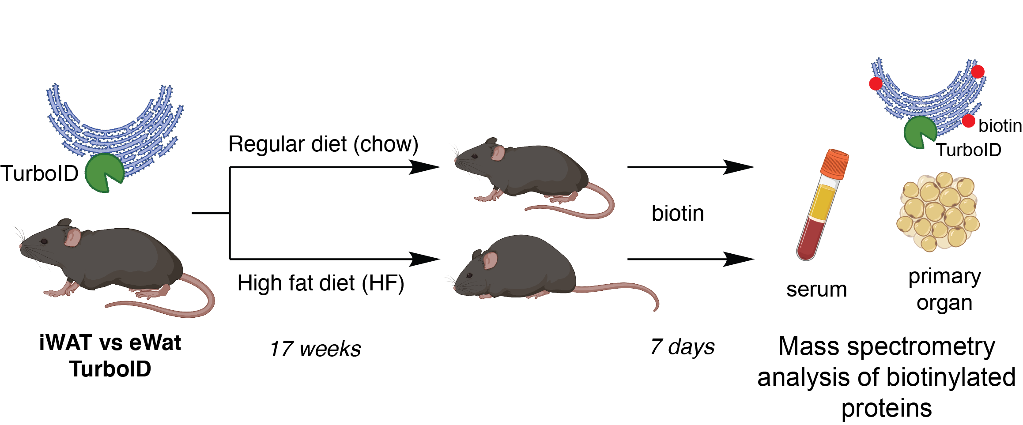
Experiment set up #2
Profiling of secreted and ER-resident proteins in distinct white adipose tissues under different dietary conditions [4 x 10plex TMT + serum]
Notes:
iWAT and eWAT TurboID are two variants of the KDEL-TurboID proximity labeling tool that are used to identify proteins in specific types of adipose tissue.
iWAT stands for "inguinal white adipose tissue," which is a type of subcutaneous white adipose tissue found in the inguinal region of mice.
eWAT stands for "epididymal white adipose tissue," which is a type of visceral white adipose tissue found in the epididymal region of mice.
By expressing KDEL-TurboID in iWAT or eWAT and labeling nearby proteins with biotin, we can identify proteins that are specifically enriched or depleted in these types of adipose tissue.

Slide 4


Analysis Overview
Mass-spec data searched against database of known proteins
IP2
Peptide filtering:
Remove non unique peptides
Remove not fully tryptic peptides
Allowed number of missed cleavage sites: 1
Min 1 | 2 peptides per protein
Peptide SI per protein
are summed
(=summed protein SI)
Raw file
Processed file
Notes:
Once the samples ran through the mass spec we use IP2 to search the data against a database of known proteins (which is known also as the mouse fasta file – which contains canonical protein sequences)
We then obtain the raw files which you know as census out files and which you also know are not human readable and need to be processed, so after putting the raw files in a readable format we know that each protein will have peptides that were indetified
In order to clean up the data fram peptides that we don’t want to qantify we filter the data by removing non unique pepitdes - non unique peptides are the ones that were identified in more than one protein, we remove not fully tryptic peptides, and we allow only 1 msised cleavage site in the peptide
We also specify a filter to quantify all proteins that were quantified with at least one peptide – but we also create a more stricter output where we only allow proteins that have a min of 2 peptides quantified
Now that we cleaned/filtered our peptides – we sum the signal intensities for each channel which leaves us with one row for this protein and its summes signal intensity per channel, which we call our pocessed file

Slide 5
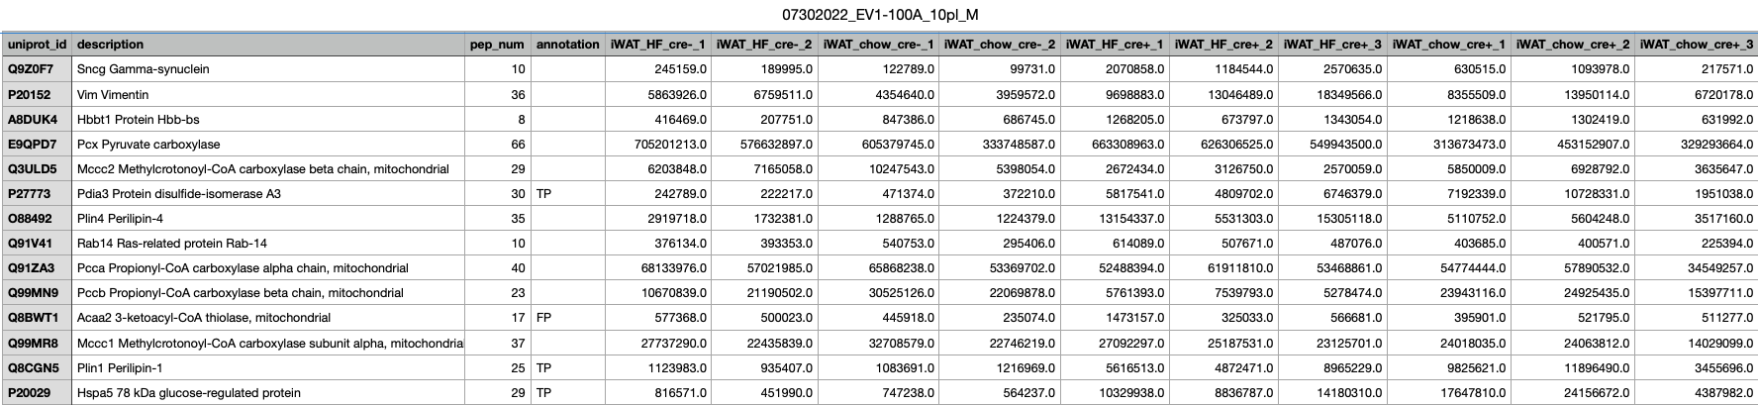
Processed file
quantified unique peptides
Proteins
summed Peptide Signal Intensities per Channel
Notes:
Here is a cutout of a processed file which has proteins and the summed peptide signal intensities per channel
We also have a column that shows us the number of quantified unique peptides

Slide 6
Analysis Overview
Mass-spec data searched against database of known proteins
IP2
Peptide filtering:
Remove non unique peptides
Remove not fully tryptic peptides
Allowed number of missed cleavage sites: 1
Min 1 | 2 peptides per protein
Peptide SI per protein
are summed
(=summed protein SI)
Raw file
1
Processed file
Annotate proteins
Using TP and FP lists
Notes:
Once we have our processed and human readable files we annotate the quantified proteins – annotation is basically adding more information to the table and in specific we want to add the information weather a protein is a true positive or false positive

Slide 7


Annotation
1
True positive – a protein in the ER, secreted from the ER or passing through the ER and biotinylated by TurboID, enriched in comparison to control
False positive – a protein that is detected as biotinylated/enriched but is not actually interacting with the ER, non-specific biotinylation
Fasta file
Uniprot ID Mapping
Excel table
Notes:
We decided to take the mouse fasta file that was used in IP2 to map the peptides to proteins. This is all the proteins we are able to detect with our methodology. So we extract the uniprot ids from the fasta file, we perform Uniprot ID mapping which allows us to get all information available on uniprot for this protein we then save this information as an excel file.
This table acts as our reference table for all proteins we could ever identify and provides all necessary information about them

Slide 8
TP and FP lists
1
TP list: proteins expected to be biotinylated
Endoplasmic Reticulum
Rough Endoplasmic Reticulum
Golgi
Secreted
FP list: proteins not expected to be biotinylated
Mitomatrix proteins
TP list: 2806 Proteins
FP list: 435 Proteins
Notes:
Since we know that we expect all proteins to be biotynalted that have the subcellular location as list above we define them as True positives
annotation based on Supplementary S1 published by Rhee et al. 2013

Slide 9
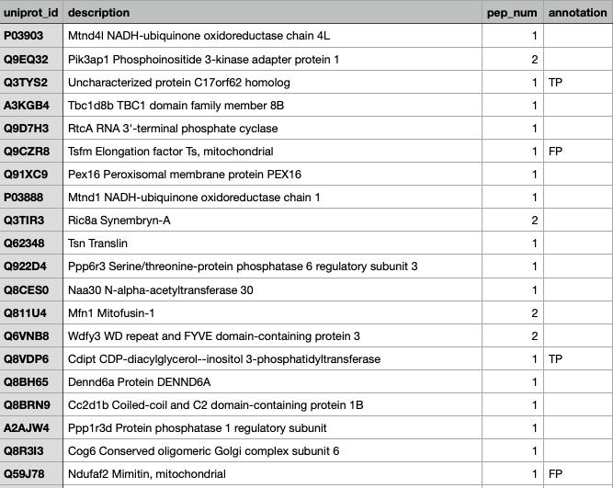
Annotate processed files
1

Slide 10
Analysis Overview
Mass-spec data searched against database of known proteins
IP2
Peptide filtering:
Remove non unique peptides
Remove not fully tryptic peptides
Allowed number of missed cleavage sites: 1
Min 1 | 2 peptides per protein
Peptide SI per protein
are summed
(=summed protein SI)
Raw file
2
1
cre+ replicates filtering
&
Normalization
Processed file
Annotate proteins
Using TP and FP lists
Notes:
Next we take care of filtering and normalization

Slide 11
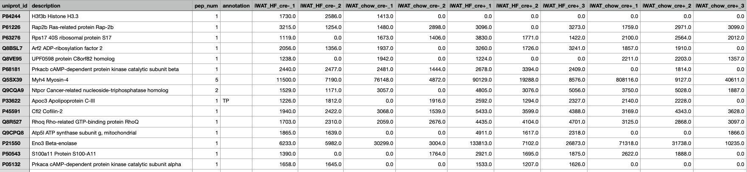
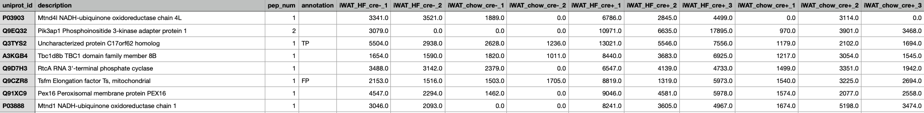
Filtering of cre+ replicates
1
Filtering is performed based on the experimental sample replicates for each condition
At least one pair (any 2 channels) out of all cre+ channels should have a min raw signal intensity sum >= 10000 and a coefficient of variation <= 0.5
Notes:
This type of filtering allows us to keep proteins that seem to have very low values in one condition than the other and might be actually the ones that are interesting so we don’t want to filter those cases out

Slide 12
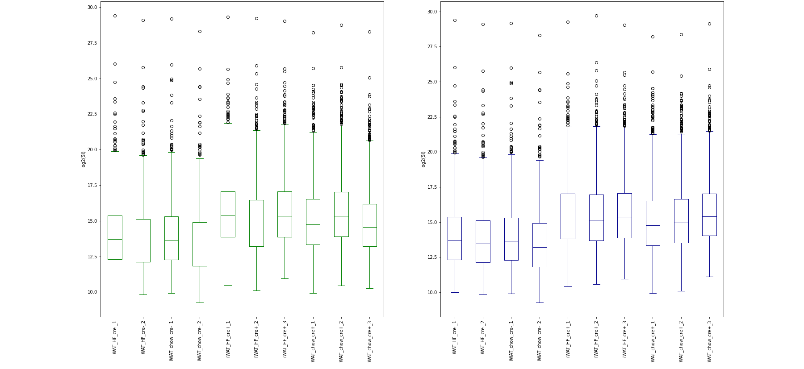
Median Normalization
1
RAW
NORMALIZED
HF cre+
chow cre+
HF cre+
chow cre+
Notes:
On the filtered data we apply a median normalization for the cre+ channels
Per cre+ channel TP proteins with 2+ peptides are used to calculate the median per channel
normalization factors are calculated by dividing (median of cre+ channel medians)/(median cre+ channel)
each cre+ channel is then multiplied with the corresponding normalization factor

Slide 13
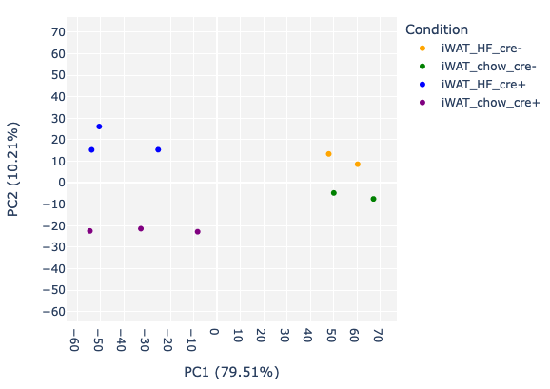
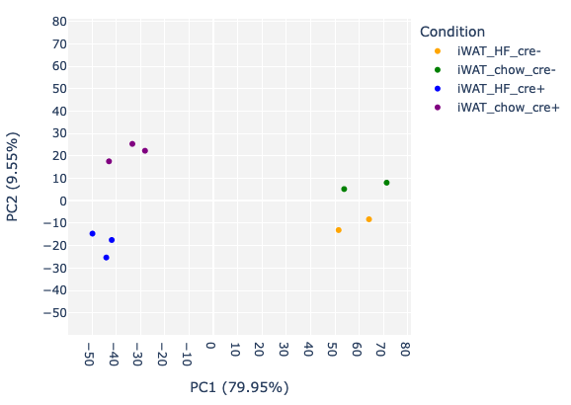
Median Normalization
1
RAW
NORMALIZED
HF cre+
chow cre+
chow cre+
HF cre+
Notes:
On the filtered data we apply a median normalization for the cre+ channels
Per cre+ channel TP proteins with 2+ peptides are used to calculate the median per channel
normalization factors are calculated by dividing (median of cre+ channel medians)/(median cre+ channel)
each cre+ channel is then multiplied with the corresponding normalization factor

Slide 14
Analysis Overview
Mass-spec data searched against database of known proteins
IP2
Peptide filtering:
Remove non unique peptides
Remove not fully tryptic peptides
Allowed number of missed cleavage sites: 1
Min 1 | 2 peptides per protein
Peptide SI per protein
are summed
(=summed protein SI)
Raw file
3
2
1
cre+ replicates filtering
&
Normalization
Processed file
Calculate Ratios
Experimental sample/negative control
Annotate proteins
Using TP and FP lists
Notes:
Once we have our normalized data we calculate the enrichments ratio – the ratio between the cre+ sample and cre- sample

Slide 15
Ratios
3
Calculate Ratios per condition (experimental sample/negative control sample)
ratio_iWAT_HF_cre+_1
ratio_iWAT_HF_cre+_2
ratio_iWAT_HF_cre+_3
iWAT_HF_cre-1
iWAT_HF_cre-_2
ratio_iWAT_HF_cre+_1/iWAT_HF_cre-1
ratio_iWAT_HF_cre+_1/iWAT_HF_cre-_2
ratio_iWAT_HF_cre+_2/iWAT_HF_cre-_1
ratio_iWAT_HF_cre+_2/iWAT_HF_cre-_2
ratio_iWAT_HF_cre+_3/iWAT_HF_cre-_1
ratio_iWAT_HF_cre+_3/iWAT_HF_cre-_2
Notes:
Cre recombinase is used to excise or recombine DNA sequences that are flanked by loxP sites.
Cre+ samples are samples in which Cre recombinase is present
Cre- sample are samples in which Cre recombinase is absent
Because cre recombinase is absent it cant xxx
We do not average the replicates soleley out of the reson to account for changes on a single sample level and make sure we don’t cover anything that could be interesting

Slide 16
Analysis Overview
Mass-spec data searched against database of known proteins
IP2
Peptide filtering:
Remove non unique peptides
Remove not fully tryptic peptides
Allowed number of missed cleavage sites: 1
Min 1 | 2 peptides per protein
Peptide SI per protein
are summed
(=summed protein SI)
Raw file
3
2
1
cre+ replicates filtering
&
Normalization
Processed file
Calculate Ratios
Experimental sample/negative control
Annotate proteins
Using TP and FP lists
ROC-based analysis
Establish optimal cutoffs per ratio
4
Notes:
Next we perform the ROC based anaysis

Slide 17
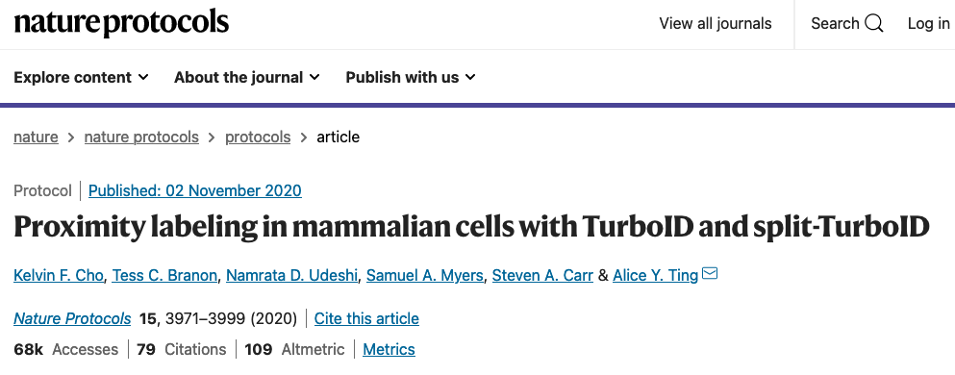
Paper reference
4
Cho et al. (2020)
Notes:
From question

Slide 18
Final protein lists
4
receiver operating characteristic (ROC)-based analysis
with use of curated lists of true-positive (TP) and false-positive (FP) proteins
allows to establish optimal cutoffs
cutoffs maximize the TP proteins and minimize FP proteins in the final lists
Cho et al. (2020)
Notes:
From question

Slide 19

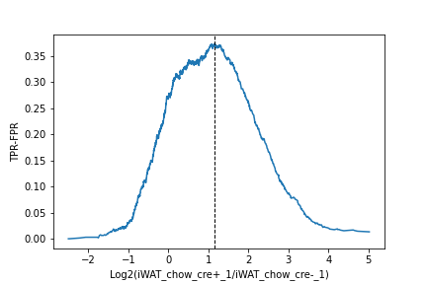
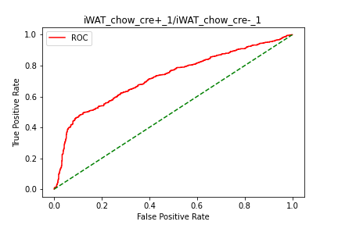
Normalize
Rank
Calculate TPR & FPR
Plot (ROC)
Calculate TPR-FPR
Find optimal cutoff ratio
Plot TPR-FPR
Determine biotinylated proteins
4
By median ratio of proteins labelled as FP
highest
Protein | ratio | annot | TPR | FPR | TPR-FPR
P03903 | 7.23 | TP | 0/170 | 0/80 | 0
Q9EQ32 | 5.78 | TP | 1/170 | 0/80 | 0.05
Q3TYS2 | 5.49 | TP | 2/170 | 0/80 | 0.3
A3KGB4 | 5.37 |  | 3/170 | 0/80 | 0.5
Q9D7H3 | 5.33 |  | 3/170 | 0/80 | 0.7
Q9CZR8 | 5.31 | TP | 4/170 | 0/80 | 0.8
lowest
Cho et al. (2020)
Notes:
Remember we are not processing each ratio column in its onw
First step we normalize, this helps us to center the data around 0 later on in our plots
Next we sort the column by highest to lowest
Next we calcualte the TOR and FPR

Slide 20
Interpretation
4
biotinylated
Proteins above the determined TMT ratio cutoff are considered to be biotinylated proteins
Proteins below the cutoff are considered to be likely nonspecific binders

Slide 21
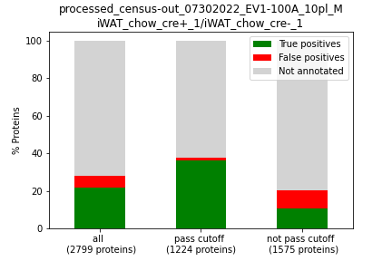
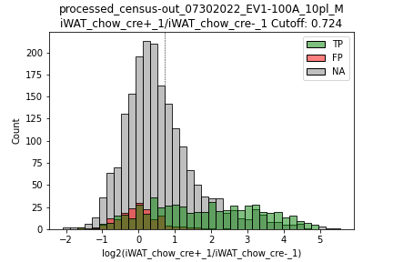
Interpretation
Cutoff

Slide 22
Analysis Overview
Mass-spec data searched against database of known proteins
IP2
Peptide filtering:
Remove non unique peptides
Remove not fully tryptic peptides
Allowed number of missed cleavage sites: 1
Min 1 | 2 peptides per protein
Peptide SI per protein
are summed
(=summed protein SI)
Raw file
3
2
1
cre+ replicates filtering
&
Normalization
Processed file
Calculate Ratios
Experimental sample/negative control
Annotate proteins
Using TP and FP lists
ROC-based analysis
Establish optimal cutoffs per ratio
Filtering based on pass/not pass cutoff
Determine biotinylated proteins
Report proteins that pass cutoff
4
5

Slide 23
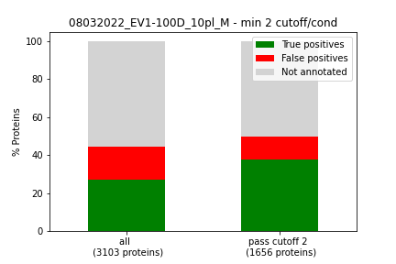
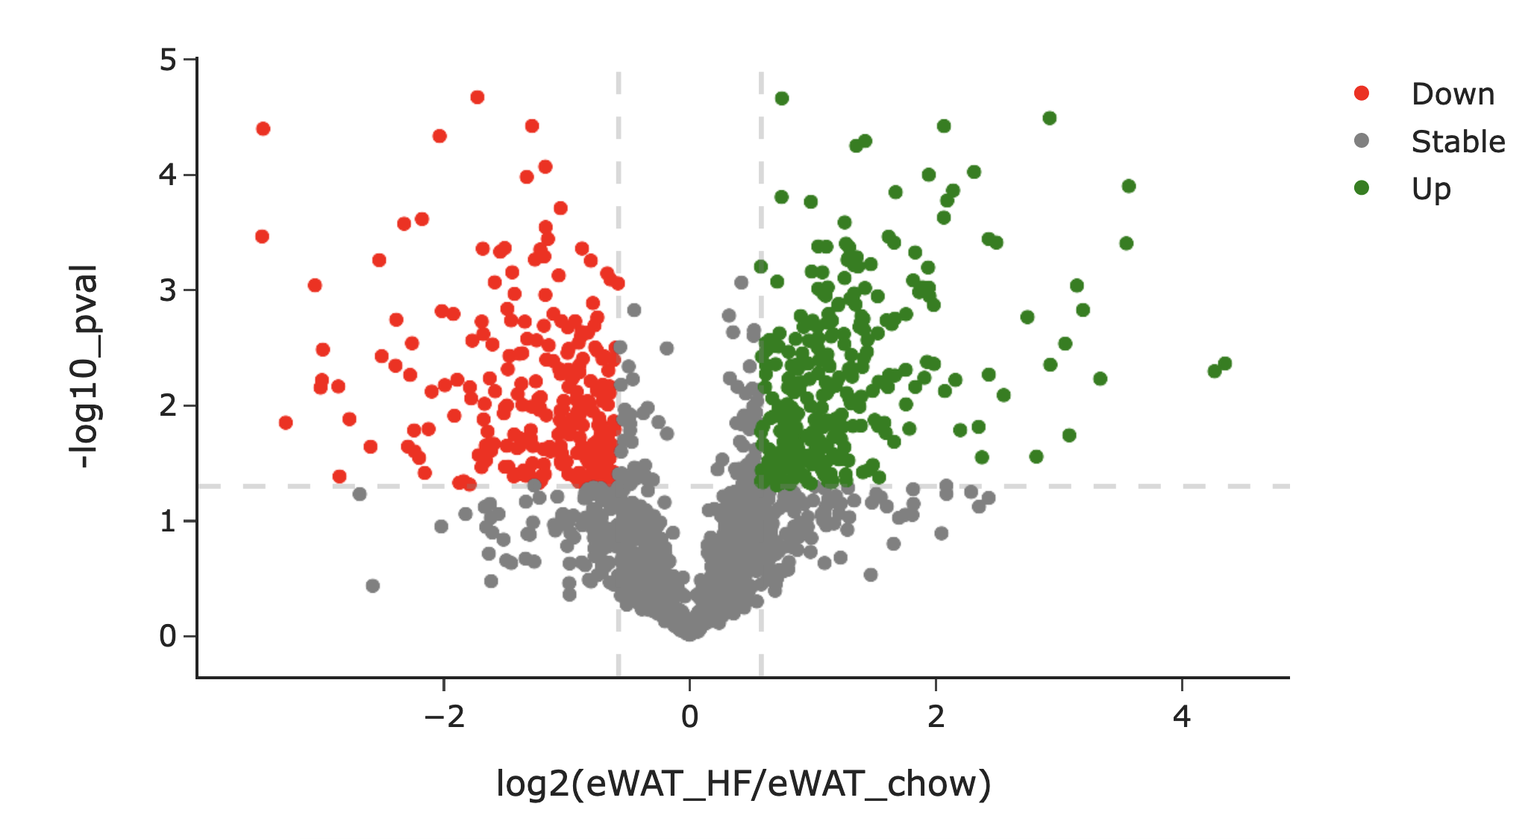
Second filtering step
5
We filter out proteins where at least one condition passes the ratio cutoff with 2 different cre+ replicates and create barplots to see how the amount of TP and FP proteins changes after the ROC cutoff analysis
Then investigate up/down regulated proteins in this filtered subset
Notes:
From question

Slide 24
Thank you!

