Slide 1

TurboID Project
DATA ANALYSIS 01/27

Slide 2
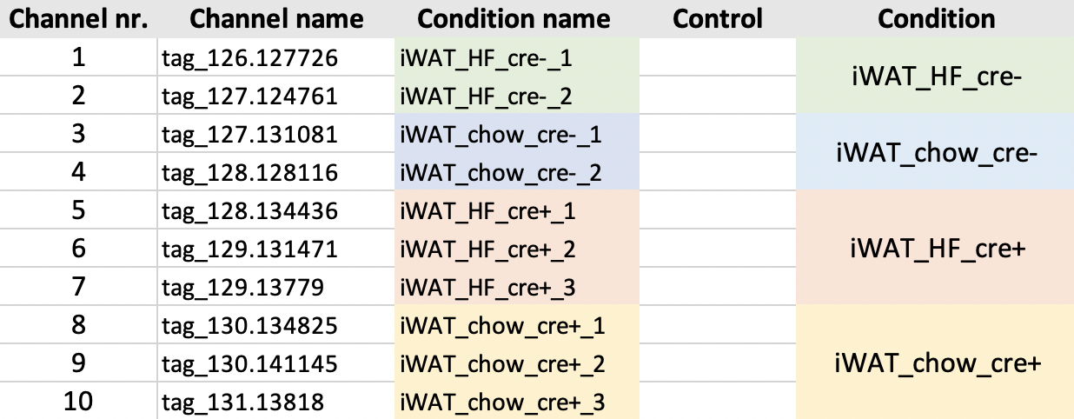
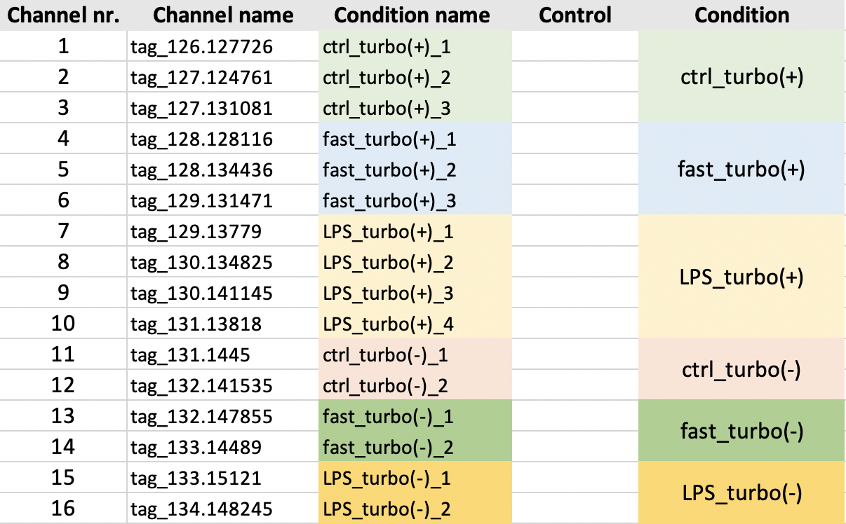
Experimental Setup
Total of 10 files (4 x 10 plex, 6 x 16 plex)
Example layout 10 plex:
Example layout 16 plex:
Notes:
https://www.nature.com/articles/s41596-020-0399-0

Slide 3


Analysis Overview
raw mass spectrometry data searched against a database of known proteins
Filter based on peptides:
Remove non unique peptides
Remove not fully tryptic peptides
Allowed number of missed cleavage sites: 1
Min 1 or 2 peptides per protein
Peptide SI per protein
are summed
(=summed protein SI)
Raw file
Filtering based on cre+ replicates
and
Normalization
Processed file
Calculate Ratios
Experimental sample/negative control
Annotate proteins
Using TP and FP lists
ROC-based analysis
Establish optimal cutoffs per ratio
Determine biotinylated proteins
Report proteins that pass cutoff

Slide 4
Filtering of cre+ replicates
Filtering is performed based on the experimental sample replicates for each condition
At least one pair (any 2 channels) out of the 3 or 4 cre+ channels should have a min raw signal intensity sum >= 10000 and a coefficient of variation <= 0.5
Example:
4000 | 6000 | 5
1500000 | 5000 | 6000
1 ) and 2) sum: pass, cv: pass
1 ) and 3) sum: not pass, cv: not pass
2 ) and 3) sum: not pass, cv: not pass
= at least one pair passed so this uniport ID passes
1 ) and 2) sum: pass, cv: not pass
1 ) and 3) sum: pass, cv: not pass
2 ) and 3) sum: pass, cv: pass
= at least one pair passed so this uniport ID passes
Notes:
From question

Slide 5
Median Normalization
Normalization is performed for cre+ channels
Per cre+ channel TP proteins with 2+ peptides are used to calculate the median per channel
normalization factors are calculated by dividing (median of cre+ channel medians)/(median cre+ channel)
each cre+ channel is then multiplied with the corresponding normalization factor
Notes:
From question

Slide 6
Determine biotinylated proteins
Normalize
Normalize ratio by the median ratio of proteins that are labelled as FP
Rank
Rank ratios in descending order
Calculate TPR & FPR
Calculate TP rate (TPR) and the FP rate (FPR) (= fraction of detected TP and FP proteins above the cutoff)
Plot (ROC)
Plot TPR and FPR (ROC) to determine how well the experiment enriched TP over FP proteins
Calculate TPR-FPR
calculate TPR-FPR
Find optimal cutoff ratio
find cutoff ratio which has the highest value for TPR-FPR (= the optimal cutoff ratio)
Plot TPR-FPR
Plot log2 ratio and TPR-FPR (see line-plot – cutoff will be the highest point)
Cho et al. (2020)
Notes:
From question

Slide 7
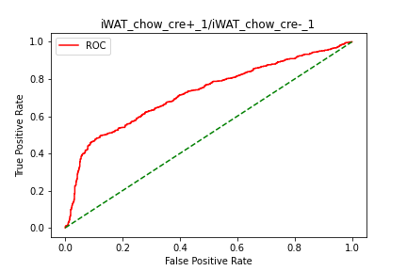
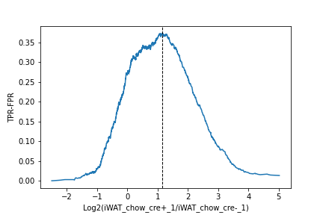
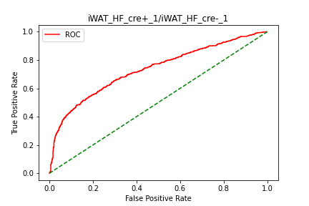
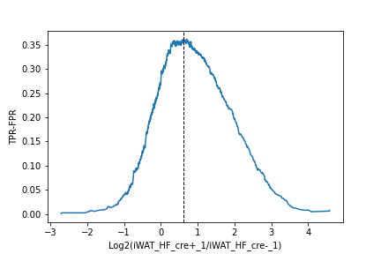
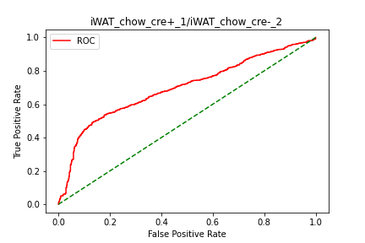
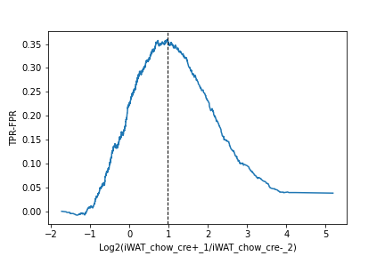

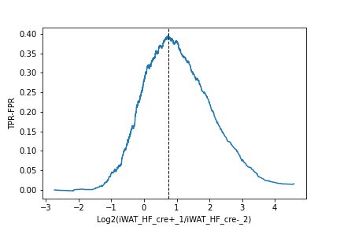
Example EV1-100A
1.14
0.62
0.96
0.74
Proteins above the determined TMT ratio cutoff are considered to be biotinylated proteins
Proteins below the cutoff are considered to be likely nonspecific binders

Slide 9
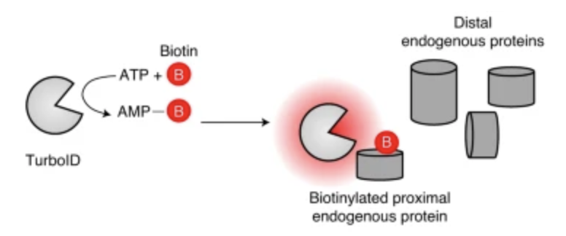
TurboID
proximity labelling enzyme (engineered biotin ligase)
uses ATP to convert biotin into biotin–AMP, a reactive intermediate that covalently labels proximal proteins
covalent tagging is performed in living cells and allows for enrichment and identification by mass spectrometry
has higher activity than previously described biotin ligase–related proximity labeling methods, labelling time 10 min. in cell culture
Goal: subcellular proteomic mapping
Downside: can exhibit biotinylation activity before addition of exogenous biotin, high activity and high biotin affinity can cause cellular toxicity
Cho et al. (2020)
Notes:
https://www.nature.com/articles/s41596-020-0399-0
can exhibit biotinylation activity before addition of exogenous biotin because it can utilize endogenous biotin present in some cell types and organisms, high activity and high biotin affinity can cause cellular toxicity

Slide 10
TP and FP lists
Lists of TP and FP proteins generated on basis of annotation from UNIPROT
TP list includes proteins expected to be biotinylated
Endoplasmic Reticulum,
Rough Endoplasmic Reticulum
Golgi
Secreted
Extracellular space
FP list includes proteins not expected to be biotinylated
Cytoskeleton
Removed Proteins that have SignalP annotation
TP list: 3436 Proteins
FP list: 4353 Proteins
Notes:
Signal peptides control protein secretion and translocation
Proteins annotated as TP are removed from FP list

Slide 11
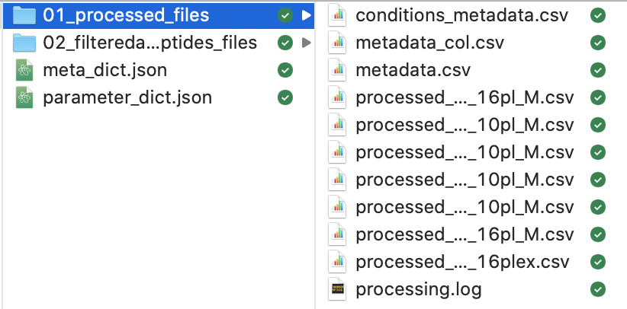
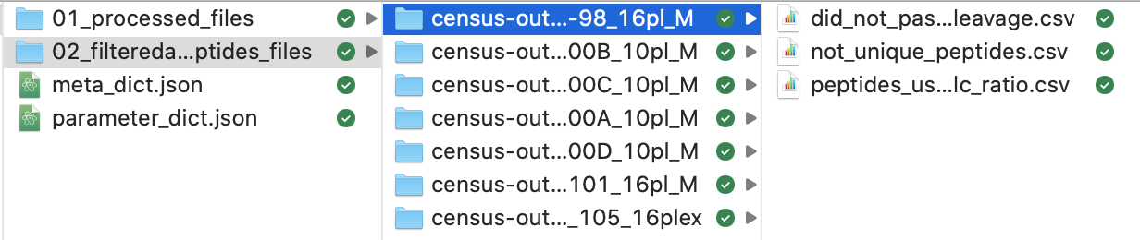
Processed Files Results
The same analysis was performed twice:
At least 1 peptide per protein (7_files_turbo_id_1pepperprotein)
At least 2 peptides per protein (7_files_turbo_id_2pepperprotein)
Both folders have following structure:
Processed files:
Filtered out peptides per file:

Slide 12
For each processed file…

Slide 13
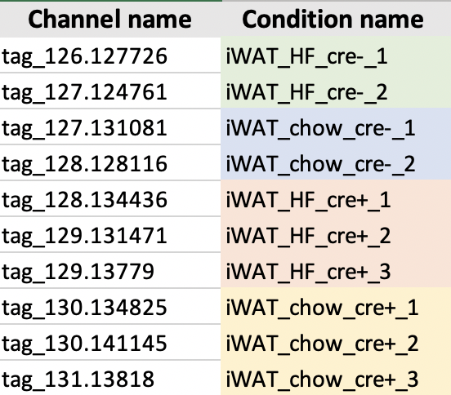
Update column names
Label channels according to provided condition information
Conditions: iWAT_HF, iWAT_chow
Negative control sample: cre-
Experimental sample: cre+
Example EV1-100A:

Slide 14
Remove Keratins
Remove proteins containing ”Keratin” in name
Keratin contamination caused through handling of samples

Slide 15
Filtering of cre+ replicates
Filtering is performed based on the experimental sample replicates for each condition
At least one pair (any 2 channels) out of the 3 or 4 cre+ channels should have a min raw signal intensity sum >= 10000 and a coefficient of variation <= 0.5
Example:
4000 | 6000 | 5
1500000 | 5000 | 6000
1 ) and 2) sum: pass, cv: pass
1 ) and 3) sum: not pass, cv: not pass
2 ) and 3) sum: not pass, cv: not pass
= at least one pair passed so this uniport ID passes
1 ) and 2) sum: pass, cv: not pass
1 ) and 3) sum: pass, cv: not pass
2 ) and 3) sum: pass, cv: pass
= at least one pair passed so this uniport ID passes
Notes:
From question

Slide 16
Normalization
explain
Notes:
From question

Slide 17
Preparation of ratios and annotation of proteins
1) Calculate Ratios per condition (experimental sample/negative control sample)
2) Annotate Proteins as TP or FP (depending in which list they are in)
ratio_iWAT_HF_cre+_1
ratio_iWAT_HF_cre+_2
ratio_iWAT_HF_cre+_3
iWAT_HF_cre-1
iWAT_HF_cre-_2
ratio_iWAT_HF_cre+_1/iWAT_HF_cre-1
ratio_iWAT_HF_cre+_1/iWAT_HF_cre-_2
ratio_iWAT_HF_cre+_2/iWAT_HF_cre-_1
ratio_iWAT_HF_cre+_2/iWAT_HF_cre-_2
ratio_iWAT_HF_cre+_3/iWAT_HF_cre-_1
ratio_iWAT_HF_cre+_3/iWAT_HF_cre-_2
Notes:
From question

Slide 18
For each calculated ratio…

Slide 19
Approach to determine the final proteome lists
receiver operating characteristic (ROC)-based analysis
with use of curated lists of true-positive (TP) and false-positive (FP) proteins
allows to establish optimal cutoffs
cutoffs maximize the TP proteins and minimize FP proteins in the final lists
Cho et al. (2020)
Notes:
From question

Slide 20
Determine biotinylated proteins
Normalize
Normalize ratio by the median ratio of proteins that are labelled as FP
Rank
Rank ratios in descending order
Calculate TPR & FPR
Calculate TP rate (TPR) and the FP rate (FPR) (= fraction of detected TP and FP proteins above the cutoff)
Plot (ROC)
Plot TPR and FPR (ROC) to determine how well the experiment enriched TP over FP proteins
Calculate TPR-FPR
calculate TPR-FPR
Find optimal cutoff ratio
find cutoff ratio which has the highest value for TPR-FPR (= the optimal cutoff ratio)
Plot TPR-FPR
Plot log2 ratio and TPR-FPR (see line-plot – cutoff will be the highest point)
Cho et al. (2020)
Notes:
From question

Slide 21
Example EV1-100A
1.14
0.62
0.96
0.74
Proteins above the determined TMT ratio cutoff are considered to be biotinylated proteins
Proteins below the cutoff are considered to be likely nonspecific binders

