Slide 1
OLIST EXPLORATORY ANALYSIS

Slide 2
General Overview
CUSTOMERS
96096
CUSTOMER CITIES
4119
CUSTOMER STATES
27
ORDERS
99441
SELLERS
3095
SELLER CITIES
611
SELLER STATES
23
REVENUE
R$ 15,915,872
AVG REVIEW SCORE
4.01
AVG DELIVERY TIME(DAYS)
12

Slide 3
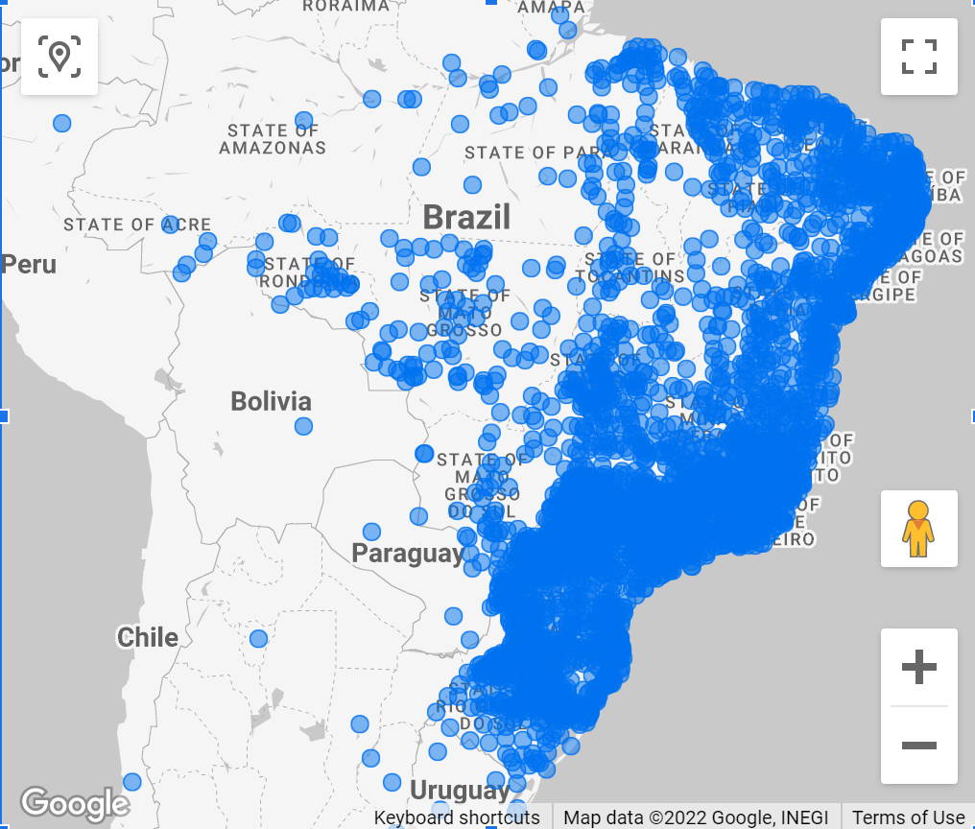
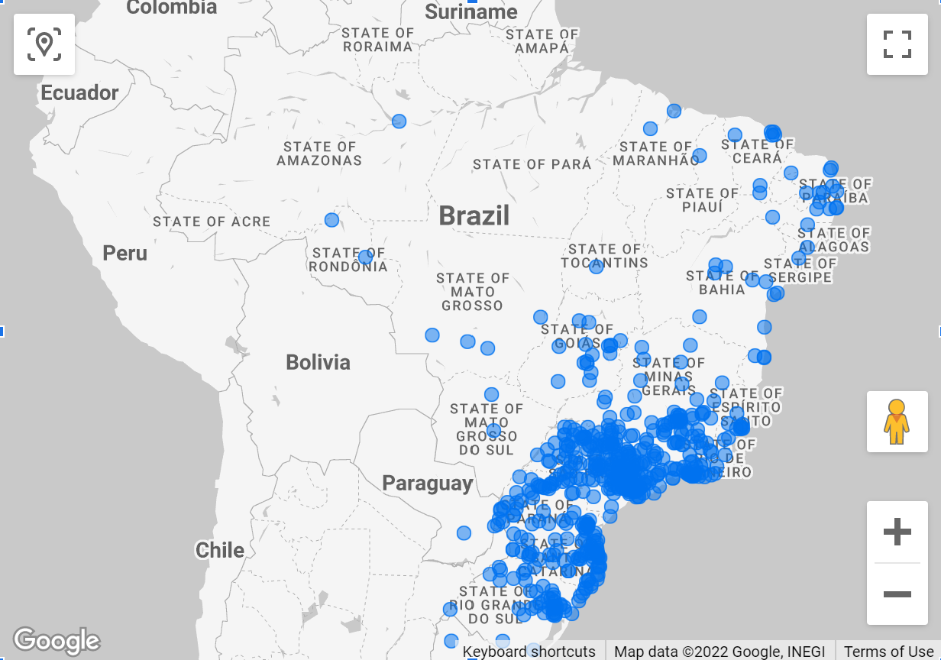
Customers Map – The vast majority of customers are located along the eastern coast and southern part of the country. Delivery times could be improved by analyzing where most of the delivery traffic is going and possibly adjusting or increasing the locations of distribution centers accordingly
Sellers Map – Most of the customers are located in the south – easter part of the country. Further analysis of delivery times throughout the country could reveal the need to attract more sellers in the northern and central locations. Shortening the shipping distance by being as geographically spread out as possible will almost guarantee faster delivery times and increased satisfaction.

Slide 4
Product Reviews
Overall product review are positive with the average score just a tick above 4 out of 5. 77% of all reviews are positive(4 and 5) and 23% are 3 or below.
When delivery times are more than 12 days, reviews are 3 out of 5 or lower. Reducing delivery times below 2 weeks should directly affect customer satisfaction.

Slide 5
Looking at the delivery times by state, and taking into account the apparent relationship between longer times and lower review scores, we should concentrate on the states with delivery times above 2 weeks(red). Improved delivery to these states could lead to increased orders and improved customer satisfaction.

Slide 6
This Pareto Chart shows the top 15 product categories (15 out of 71 – 22%) are responsible for 80.9% of all revenue. The categories within the circle should be treated with care. Efforts to improve customer service(order approval and delivery times) should be taken very seriously since these are the major contributors to overall revenue. Further analysis of the tail end of this chart should also be conducted to determine how to improve sales for these categories and whether it makes sense to continue servicing them at all.

Slide 7
Comparing the number of orders and revenue for each category we can see that some of the lower revenue categories display an interesting characteristic. Categories such as “watches_gifts”, “office_furniture”, “computers” , as well as “cool_stuff”, “small_appliances” and “musical_instruments” bring in a much higher level of revenue than the number of orders might suggest. This means that efforts to increase sales in these categories could quickly lead to significant revenue growth.

Slide 8
Revenue by Time Overview
Looking at revenue for 2017 and 2018 we see rapid growth from the end of 2017 to the beginning of 2018, but it levels out throughout 2018. Number of orders follows a similar path. We need to evaluate the reasons for that growth, whether it was marketing campaigns, improvements in product delivery times or a combination of factors, and try to replicate it going forward.
Looking at revenue from the day of the month perspective, we see spikes in both revenue and the number of orders around the middle and end of the month.

Slide 9
Revenue and the number of orders are highest from Tuesday to Thursday and slow down toward the weekend. This could be an opportunity for increased marketing campaigns during the weekends.
Revenue is highest between the hours of 12PM and 10 PM and lowest at night and early morning hours. Sellers should concentrate their marketing efforts during this timeframe. Further analysis could be conducted to check the amount of traffic the website gets during the low hours and possibly design a campaign to target those off-peak hours customers as well.

Slide 10
Summary
Growth from 2017 to 2018 has stabilized and efforts must be made to reverse that trend going forward.
Revenue is highest between the hours of 12PM and 10 PM and lowest at night and early morning hours. Sellers should concentrate their marketing efforts during this timeframe.
Conduct further analysis to check the amount of traffic the website gets during the low hours and possibly design a campaign to target those off-peak hours customers.
Delivery times could be improved with new distribution centers as well as by acquiring new sellers in different areas of the country.
Reducing delivery times below 2 weeks should improve customer satisfaction.
17 of 27 states experience delivery times close to 3 weeks. Efforts should be made to improve this metric.
15 out 71 product categories or 22% bring in roughly 81% of all revenue amounting to over 12.5 million. Further analysis needs to be preformed to figure out the reason for success of these products.
Increasing sales for Categories such as “watches_gifts”, “office_furniture”, “computers” , “cool_stuff”, “small_appliances” and “musical_instruments” could lead to a substantial revenue increase.

