Slide 1
ONLINE SPORTS TURF PLAYGROUND BOOKING SYSTEM
Presented by :
Prasanth K
Poornima Babu
Raja M
Guide :
Mrs. Suriya
(Professor)
Department of Computer Application
SRMIST , Ramapuram

Slide 2
CONTENT :
• ABSTRACT
• SOFTWARE MODULES
• DATA FLOW DIAGRAM
• ALGRORITHM
• DATABASE DESIGN
• CODING
• SCREENSHOT
• USE CASE DIAGRAM
• CONCLUSION

Slide 3
ABSTRACT :
Turf playground are used to play various sports like football, rugby, tennis, cricket, etc. People enjoy playing on the turf, it has vibrant environment and very safe to play. Many school teams and clubs prefer turf playground for practice and training purpose. Sometime it becomes difficult to book turf playground because of timing issue or the slot getting booked previously. This sports ground booking website is proposed for booking the turf in an easy and efficient way. It has three modules namely, Admin, Manager and User.

Slide 4
SOFTWARE MODULES :
The system comprises of 3 major modules with their sub-modules as follows:
Admin Module
Manager Module
Users Login Module

Slide 5
Admin Module:
Add Manager: Admin can add turf location and manager of the respective turf location.
Add Price List: Admin can add price for the respective turfs.
Manage Turf: Admin can manage turf by allocating turf
View Booking: Admin can view booking done and the user details.

Slide 6
Manager Module:
Login: Manager can login with the credentials provided by user.
Check Rates: Manager can check rates for the respective location turf.
View Request: Manager can view request for turf bookings.
Confirm Booking: Manager can confirm the booking of the turf
Bill Generation: Manager can generate bills as per the rates.
Bookings History: Manager can check previous booking history

Slide 7
Users Login Module:
Check Turf: User can check for turf of nearby location and prices.
Check Availability: User can see the availability of the respective turf which is selected by him.
Book Turf: User can provide date, time and other personal details and he can also do payment.
Booking History: User can see his previous booking history.

Slide 8
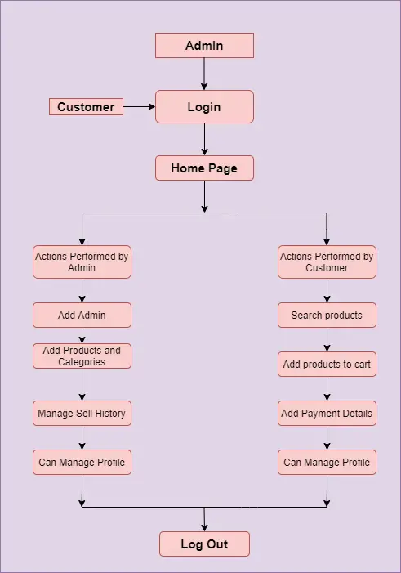
DATA FLOW DIAGRAM :

Slide 9
ALGRORITHM :
User registration: The first step is for users to create an account by providing their personal details, including name, email, phone number, and address. The system should also verify the user's email address and phone number.
Playground listing: The system should display a list of available playgrounds, including their location, available time slots, and prices. The user should be able to filter and sort the list based on various criteria such as location, time, and price.
Booking selection: The user can select the preferred playground and the desired time slot based on availability.
Booking confirmation: The system should verify the user's payment information and confirm the booking.

Slide 10
Payment: The system should accept payment from the user using various payment methods such as credit/debit cards, online payment systems, or mobile payment apps.
Booking management: The system should allow the user to manage their booking, including rescheduling or canceling the booking, and obtaining a refund.
Admin management: The system should allow the admin to manage the playgrounds, including adding, removing, or updating the playgrounds, and setting the available time slots and prices.
Reporting: The system should generate reports that provide insights into the booking trends, revenue, and customer behavior.
Notifications: The system should notify the user of their booking confirmation, payment status, and any changes or updates related to their booking.
Security: The system should ensure the security of user data and payment information by implementing encryption, authentication, and authorization measures.

Slide 11
DATABASE DESIGN :
+---------------+
| Users | +---------------+ | user id (PK) | | name | | email | | phone number | | address | | password | +---------------+
+---------------+ | Booking | +---------------+ | booking_id (PK)| | user_id (FK) | | playground_id (FK)| | start_time | | end_time | | total_price | +---------------+
+---------------+ | Playground | +---------------+ | playground_id | | name | | address | | capacity | | price_per_hour| +---------------+
+---------------+ | Admin | +---------------+ | admin_id (PK) | | name | | email | | phone_number | | password | +---------------+
+---------------+ | Payment | +---------------+ | payment_id (PK)| | user_id (FK) | | booking_id (FK)| | payment_method| | amount | | transaction_id| +---------------+

Slide 12
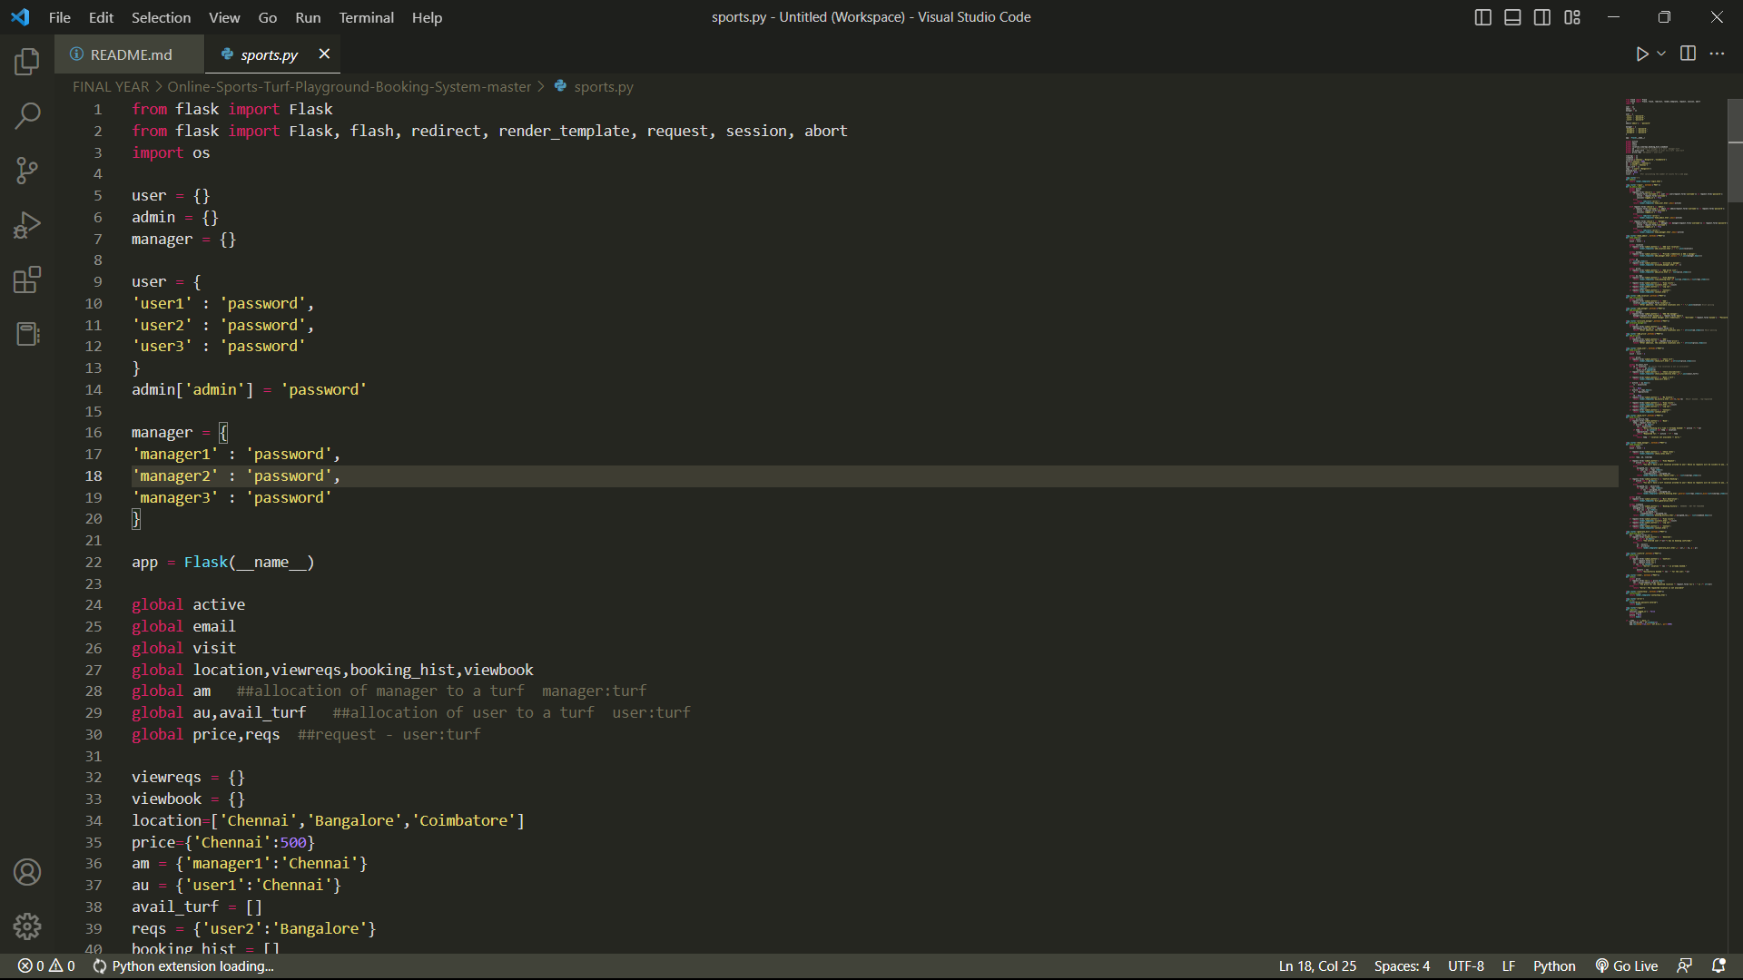
CODING :

Slide 13
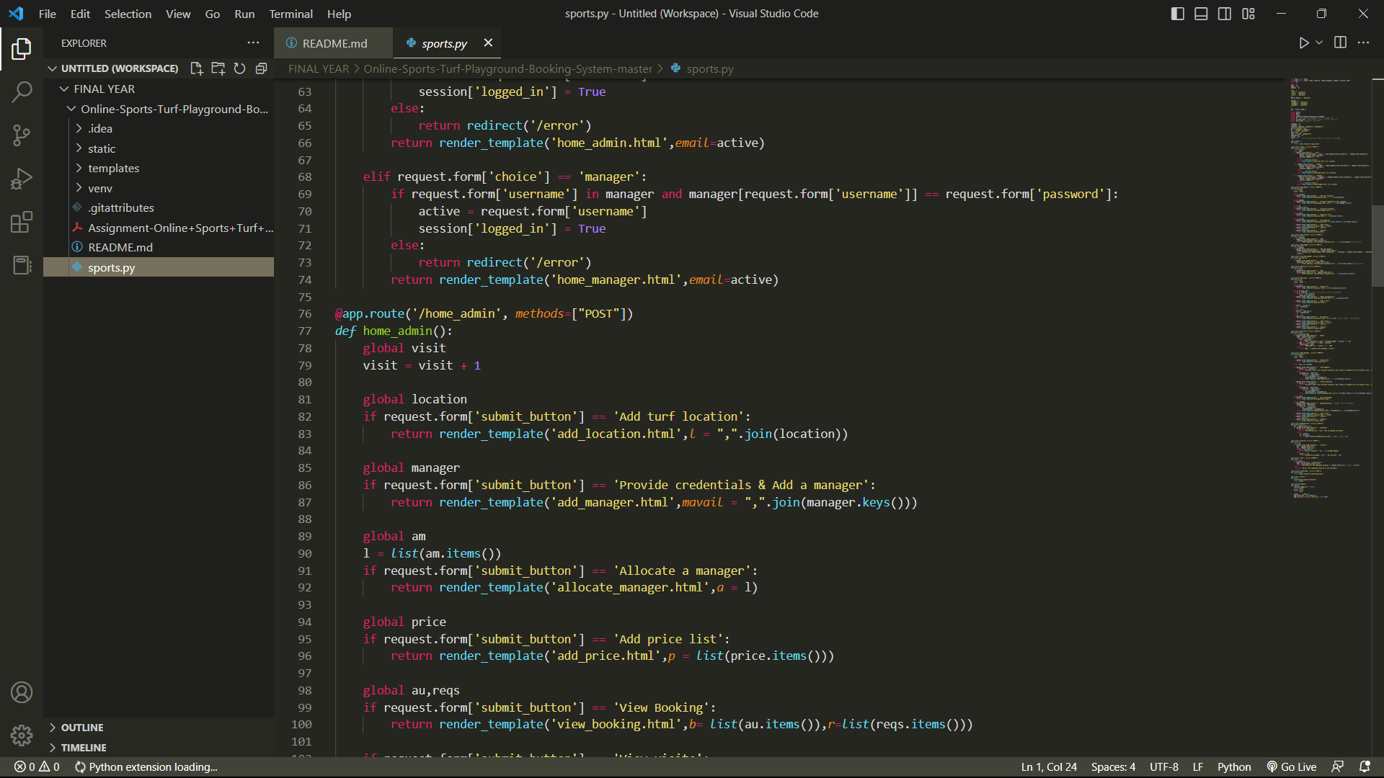

Slide 14
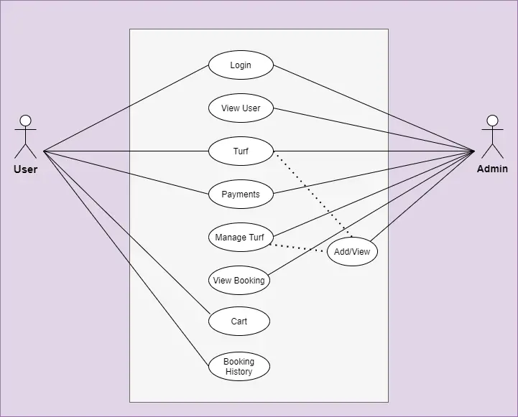
USE CASE DIAGRAM :

Slide 15
CONCLUSION :
Online Sports Turf Playground Booking System this project Sends message reminders to managers and users whenever slots are booked, canceled or rescheduled.
And your users can easily and securely authenticate themselves by linking their existing service by using a password.

