Slide 1


WEEKLY
360
UPDATE
14/10/2021

Slide 2
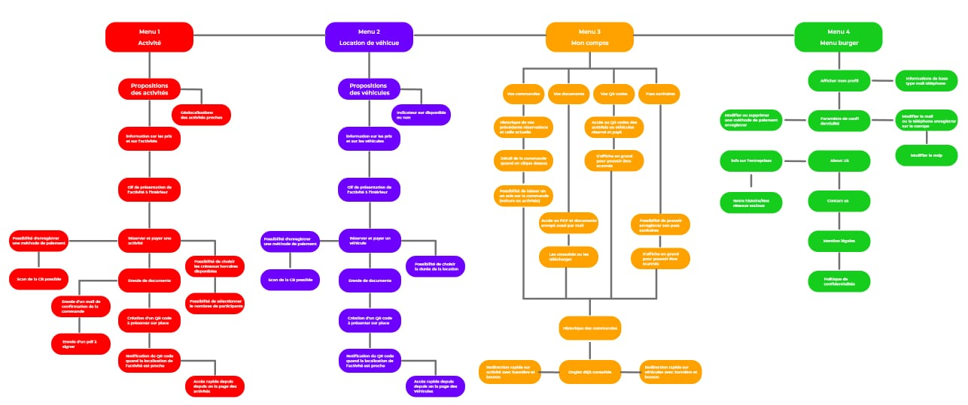
Dubai Access Features ( Brief overview)

Slide 3
Dubai Access Features ( V1 / V2)
PLANNED FOR VERSION 2
3 Event Details (Event details screen)
3.1 Géolocalisation
3.2 Recently visited events
3.3 Add event to cart
4 Payment (Payment by Card)
4.1 Card enter / validation
4.2 Save card for future
4.3 Validate card
4.4 Apple pay integration for iPhone (We need Apple Tab)
5. Confirmation ( Confirmation screen )
5.1 Card enter / validation
5.2 Save card for future
5.3 Validate card
6. Notification & QR Code
6.1 Event based on location
6.2 Read the paid Events QR code
6.3 QR code by confirmation email
7. Marketing campaign
7.1 Deep link for PROMOTED Event
7.2 Notification intégration for Hot/promotion Event
7.3 Whatsapp campaign
8. Whatsapp Bot
8.1 Whatsapp bot support icon in HomeScreen
8.2 Dubai-Access channel
9. Google / Firebase analytics integration
9.1 Analytics for important KPI
7. Marketing campaign
7.1 Deep link for PROMOTED Event
7.2 Notification intégration for Hot/promotion
Event
7.3 Whatsapp campaign
8. Whatsapp Bot
8.1 Whatsapp bot support icon in HomeScreen
8.2 Dubai-Access channel
9. Google / Firebase analytics integration
9.1 Analytics for important KPI
1 Login / registration
1.1 Login username password
1.1.1 Login with facebook
1.1.2 Login with AppleID (We need Apple Tab)
1.1.3 Forgot password
1.2 Registration
1.2.1 OTP
1.3 Welcome Screen
1.3.1 Apple PaySetup
1.3.2 Add event to favorite list
1.3.3 Language choose setup ( English/French )
Only English or French
1.3.4 OneClick payment setup
2 Event Registration (Home screen)
2.1 Event listing
2.2 Recently visited events
2.3 Favorite events
2.4 Cart status

Slide 4
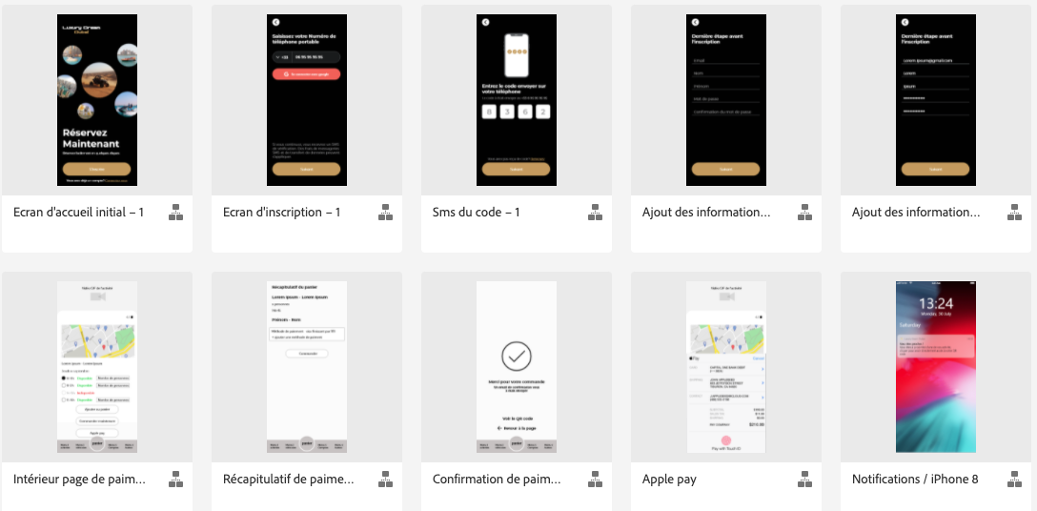
UI Design and Image assets
UI DESIGN LINK
https://xd.adobe.com/view/3cc8b401-b3da-4004-9b2f-01f62434a0fb-699b/grid/

Slide 5
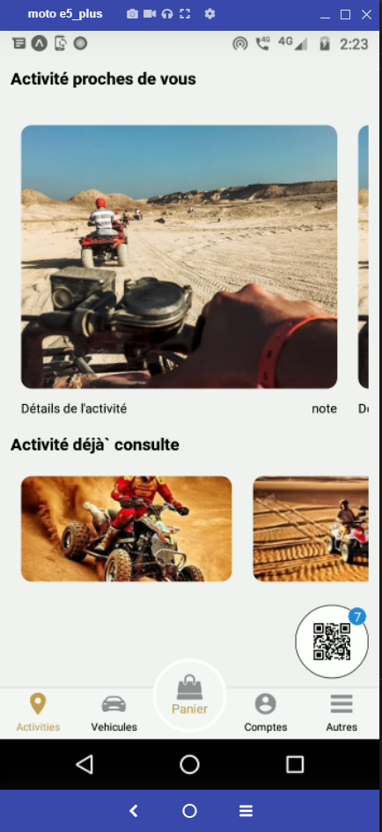
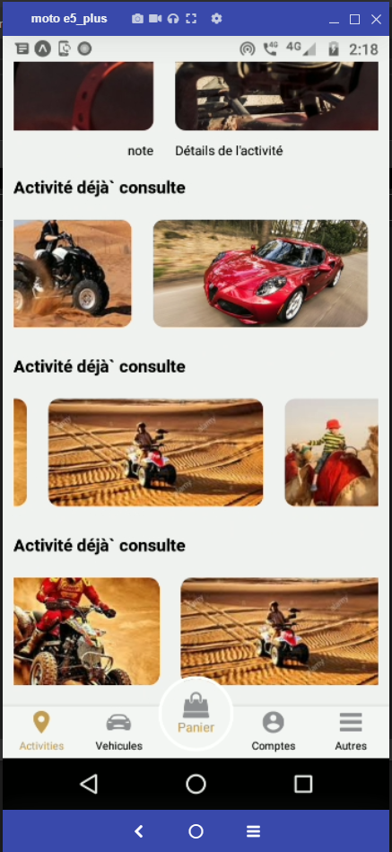
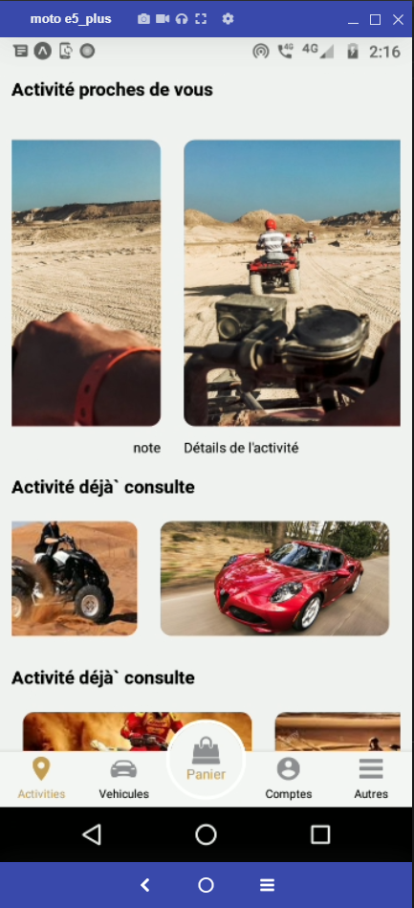
UI Design and Image assets
UI DESIGN LINK
https://xd.adobe.com/view/3cc8b401-b3da-4004-9b2f-01f62434a0fb-699b/grid/

Slide 6
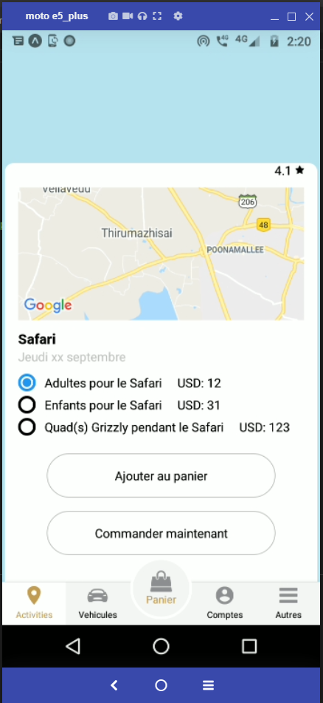
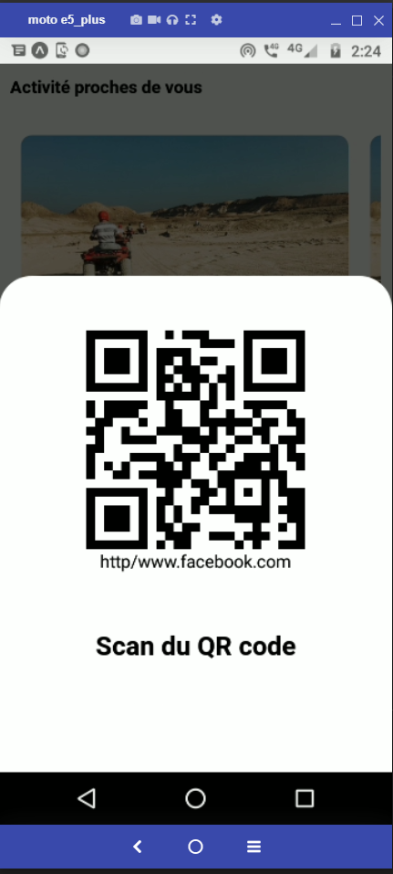
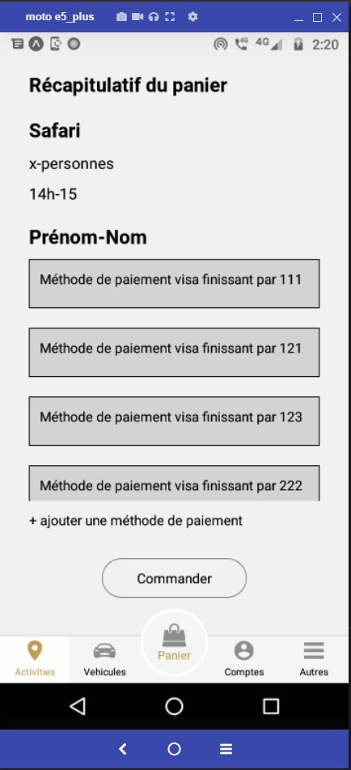
UI Design and Image assets
UI DESIGN LINK
https://xd.adobe.com/view/3cc8b401-b3da-4004-9b2f-01f62434a0fb-699b/grid/

Slide 7
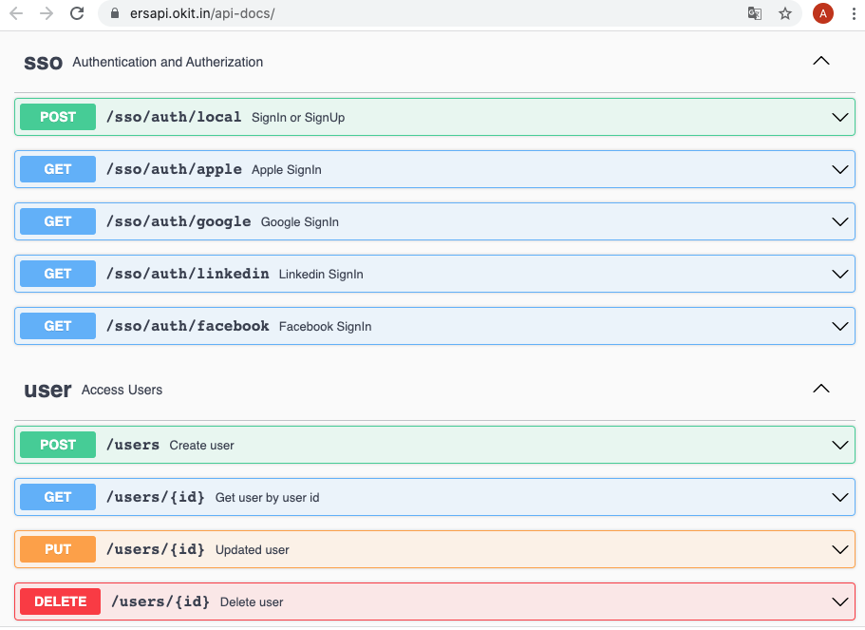
API STATUS
API LINK
https://ersapi.okit.in/api-docs/

Slide 8
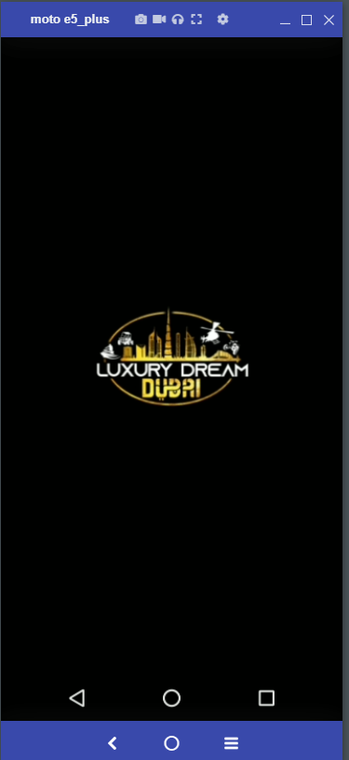
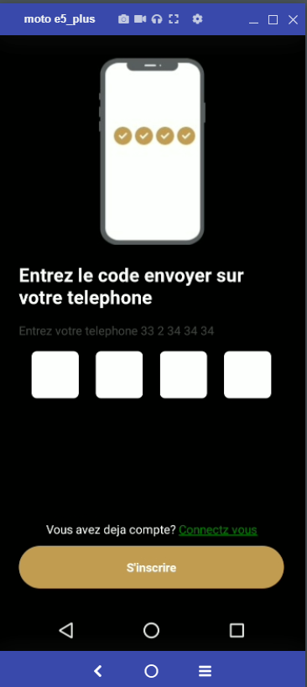
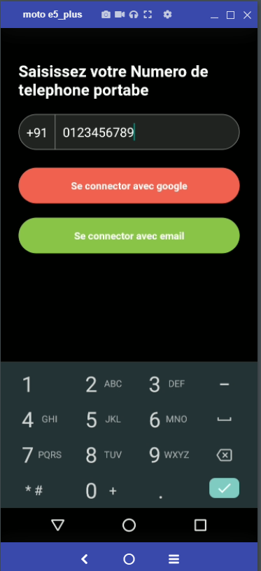
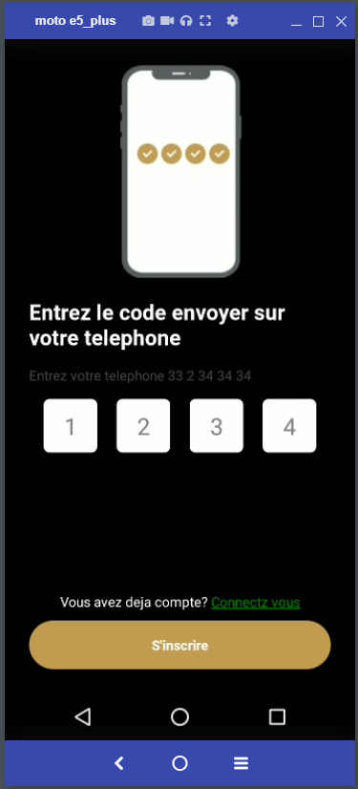
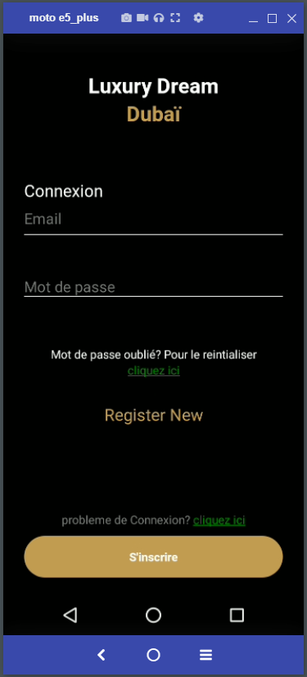
DEVELOPMENT STATUS W40

Slide 9
DEVELOPMENT STATUS W41
UI DESIGN LINK

Slide 10

DEVELOPMENT STATUS W40

Slide 11
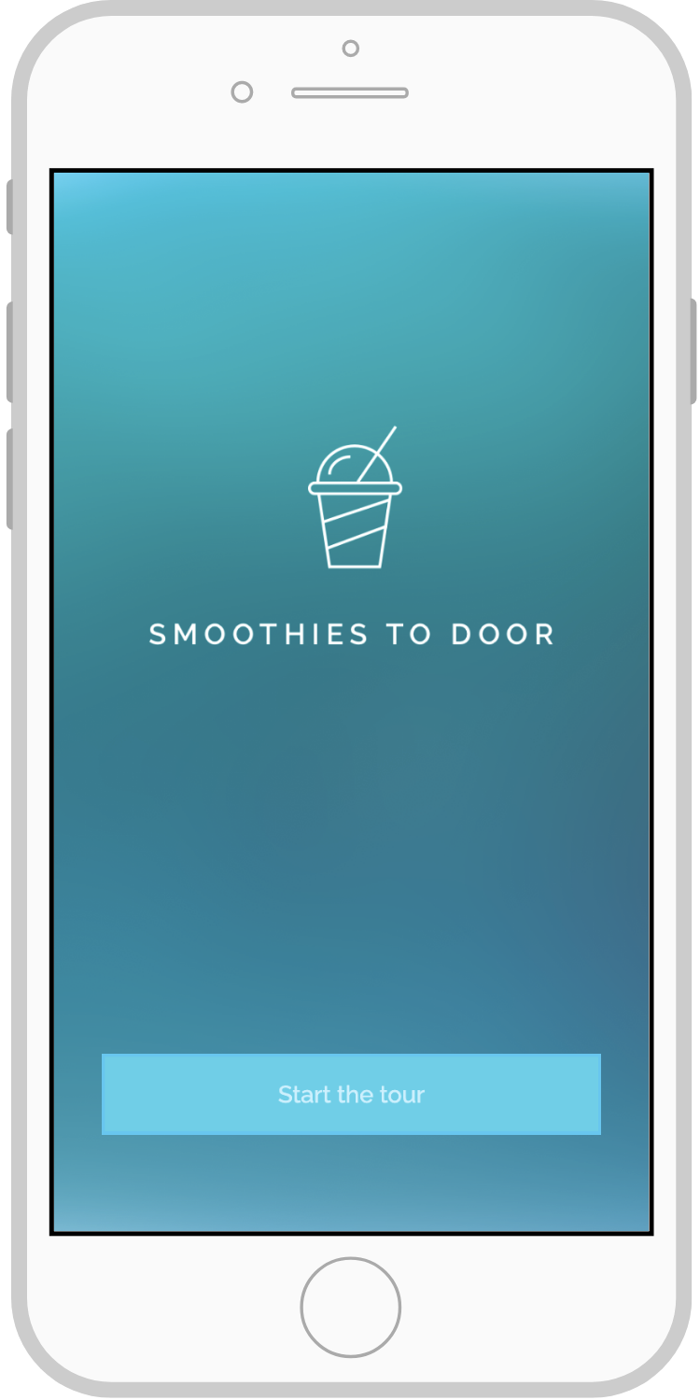
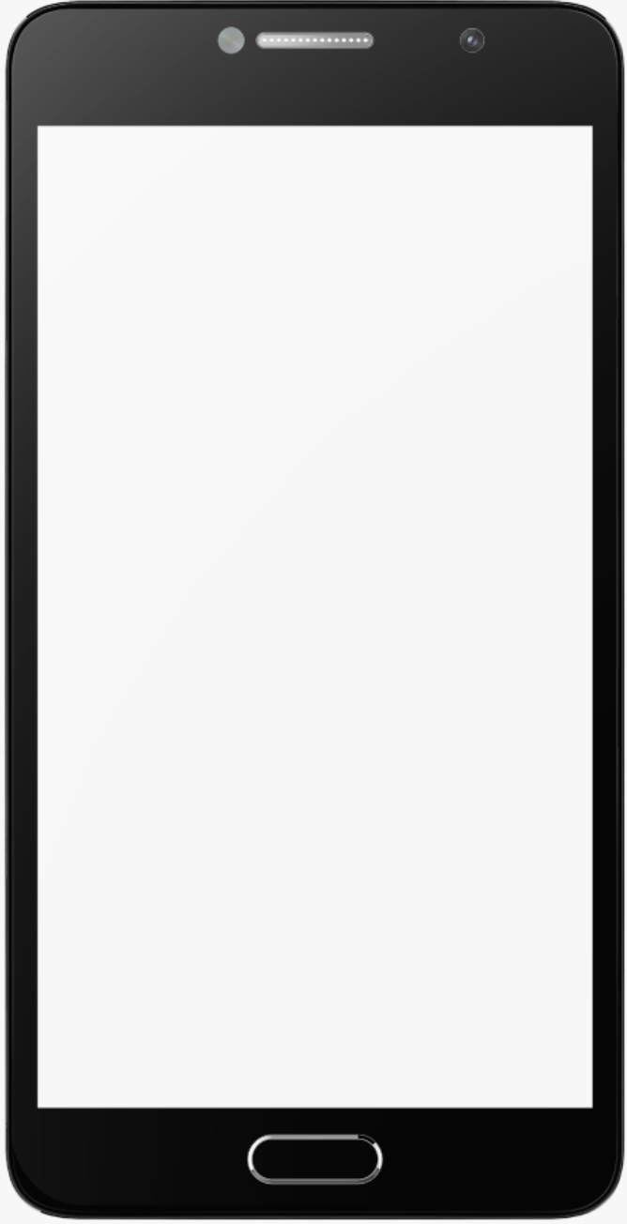



Applications Mobile (Client)
For client screens to be added
DEMO HERE

Slide 12
ANNEXES

Slide 13
Planning, Budget & Team

Slide 14
Team Info
Luxury Dream Dubai
Sufiyan
Ceo
contact@luxurydream.com
OKIT Technologies
TAM Oumarkatar
CEO
tamo@okit.in
Gopalsamy
Project manager ( Offshore )
gopalsamyj@okit.in
Vinoth
Mobile Project leader ( Offshore )
vinotht@okit.in
Vaitheeswari
Mobile developer ( Offshore )
vaitheeswariv@okit.in
Abrar
Project manager ( On site )
abrar@okit.com
Edouard
UI/UX designer ( On Site )
edouard@byglemon.com

Slide 15
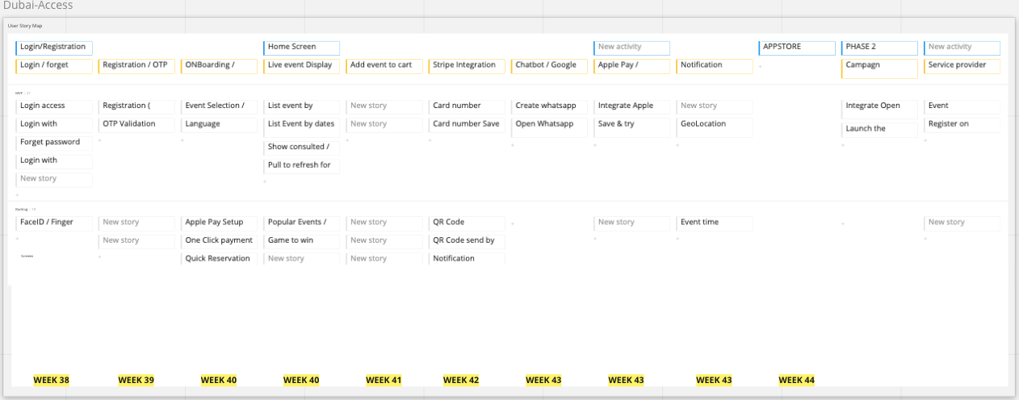
DELIVERY, PUBLICATION & INTEGRATION PLANNING

Slide 16
MERCI

