Slide 1
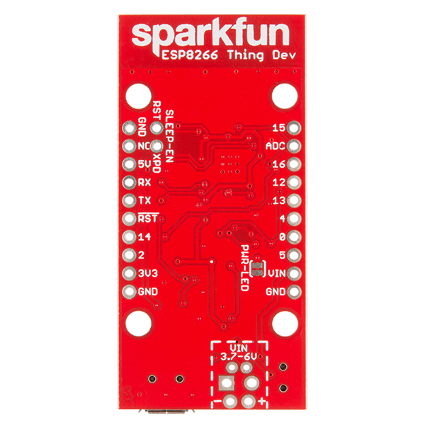


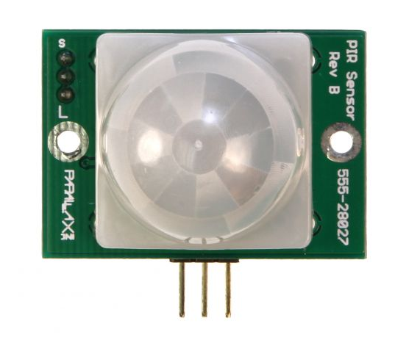
Magnetic door switch
(Reed switch)
Magnetic door switch
(Reed switch)
10k
Parallax PIR rev B

