Slide 1

ACME Learning Co.
CASE STUDY :
Insurance risk management

Slide 2

Problem definition
Methodology
Data transformation and analysis
Model selection and evaluation
Conclusions

Slide 3

Problem definition
The ACME Learning Co. has been given a mandate by NoCoverage Insurance to identify ways to help it’s client lower their insurance coverage risks.

Slide 4

Problem definition - objectives
More specifically NoCoverage Insurance wishes to know :
What are the risk-factors associated with the presence of a heart disease ;
Provide to a way to easily allow insurance brokers to predict the risk of future client having a heart disease based on his lab tests.

Slide 5
Methodology
1. Data transformation
2. Data analysis
3. Model selection and evaluation
4. Model interpretation

Slide 6

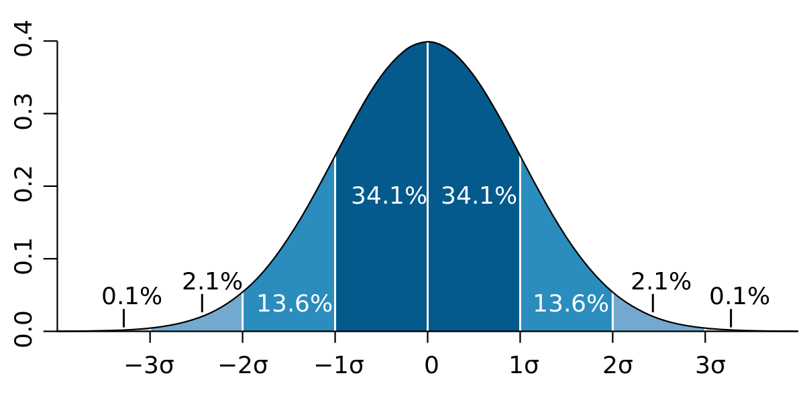
Data transformation
ACME Learning Co. was provided a database of 300 insured clients containing lab results for 14 medical parameters ;
The data contained both quantitative and qualitative data ;
Categorical data was transformed into a binary values. One for each category ;
Qualitative data was standardized so that the mean is at 0 and that one standard deviation is one unit in value

Slide 7
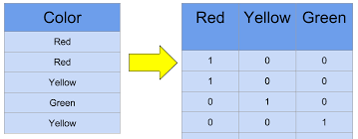
Data transformation
Categories to binary transformation
Following quantitative variables were transformed
cp: chest pain type – 4 categ.
restecg: resting electrocardiographic results – 3 categ.
slope: the slope of the peak exercise ST segment - 3 categ.
thal – 3 categ.

Slide 8

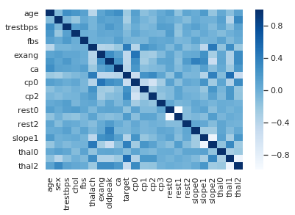
Data analysis
The following correlation data indicates the variables in the data set that are highly related to the risk of heart disease.

Slide 9
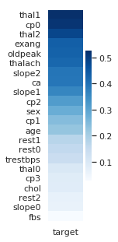
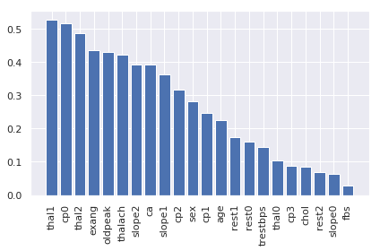
Data analysis

Slide 10
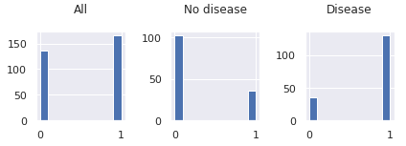
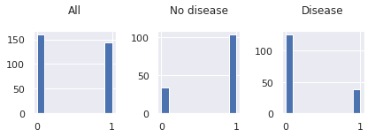
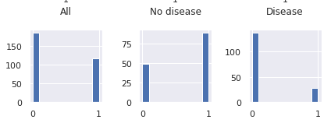
Data analysis
cv
THAL1
CPO
cv
cv
THAL2

Slide 11

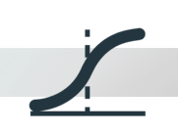

Model selection and evaluation
Two different types of models were created from the transformed data :
Logistic Regression model with regularization ;
Decision Tree with bagging.
These models are suited for classification

Slide 12
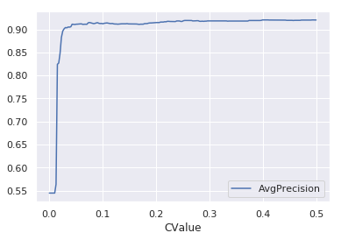
Logistic Regression model
Logistic model was created with 10 fold cross-validation and l1 norm regularization to eliminate unnecessary parameters
Optimized regularization parameter without compromising model accuracy
Reg value = 0.05
Accuracy = 0.92

Slide 13
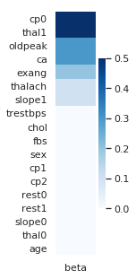
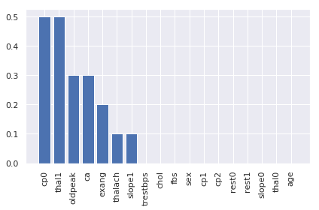
Logistic Regression model
Logistic with regularization identified the following predominant parameters. That is the high risk factors associated with a heart condition.

Slide 14
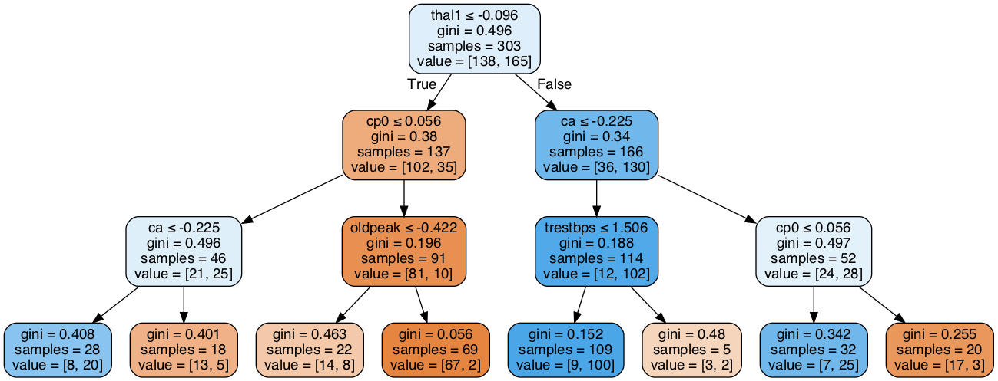
Decision Tree
First a decision tree was created of depth = 3.
Cross validation was used to get the precision

