Slide 1

ACME Learning Co.
CASE STUDY :
Insurance risk management
Vincent Roy

Slide 2

Problem definition
Methodology
Data transformation and analysis
Model selection and evaluation
Conclusions

Slide 3

Problem definition
The ACME Learning Co. has been given a mandate by NoCoverage Insurance to identify ways to help it’s client lower their insurance coverage risks.

Slide 4

Problem definition - objectives
More specifically NoCoverage Insurance wishes to know :
What are the risk-factors associated with the presence of a heart disease ;
Provide to a way to easily allow insurance brokers to predict the risk of future client having a heart disease based on his lab tests.

Slide 5
Methodology
1. Data transformation
2. Data analysis
3. Model selection and evaluation
4. Model interpretation

Slide 6

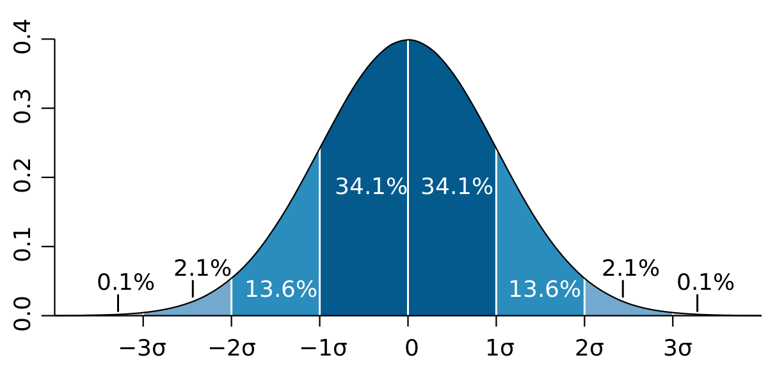
Data transformation
ACME Learning Co. was provided a database of 303 insured clients containing lab results for 14 medical parameters ;
The data contained both quantitative and qualitative data ;
Categorical data was transformed into a binary values. One for each category ;
Qualitative data was standardized so that the mean is at 0 and that one standard deviation is one unit in value

Slide 7
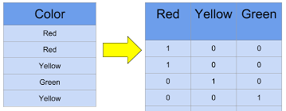
Data transformation
Categories to binary transformation
Following quantitative variables were transformed
cp: chest pain type – 4 categ.
restecg: resting electrocardiographic results – 3 categ.
slope: the slope of the peak exercise ST segment - 3 categ.
thal – 3 categ.

Slide 8

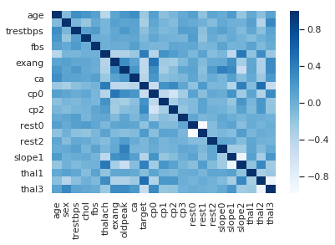
Data analysis
165 out of 303 candidates have a heart disease.
Correlation data indicates the variables in the data set that are highly related to the risk of heart disease are :

Slide 9
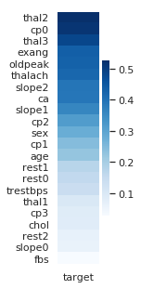
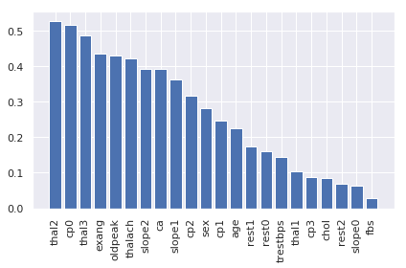
Data analysis

Slide 10
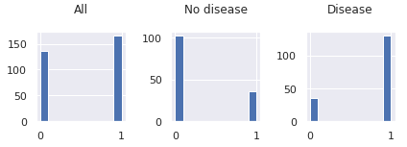
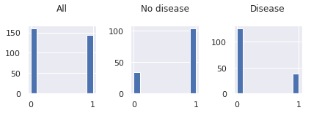
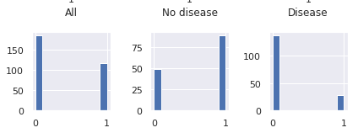
Data analysis
cv
THAL2 – Fixed defect
CPO - typical angina
cv
cv
THAL3 – Reversible defect

Slide 11

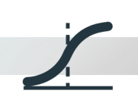

Model selection and evaluation
Two different types of models were created from the transformed data :
Logistic Regression model with regularization ;
Decision Tree with bagging.
These models are suited for classification
Nocoverage is interested in high recall as it relates to a low false negative rate.

Slide 12
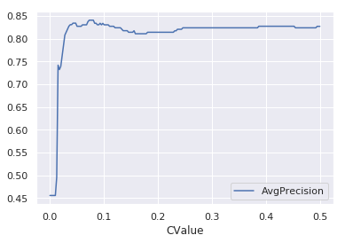
Logistic Regression model
Logistic model was created with 10 fold cross-validation and l1 norm regularization to eliminate unnecessary parameters.
Optimized regularization parameter without compromising model recall.
Reg value = 0.05
Recall = 0.86
Accuracy = 0.85

Slide 13

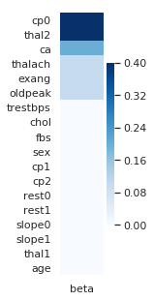
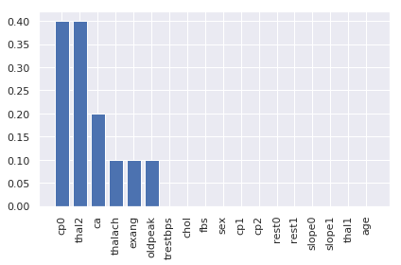
Logistic Regression model
Logistic with regularization identified the following predominant parameters. That is the high risk factors associated with a heart condition.

Slide 14
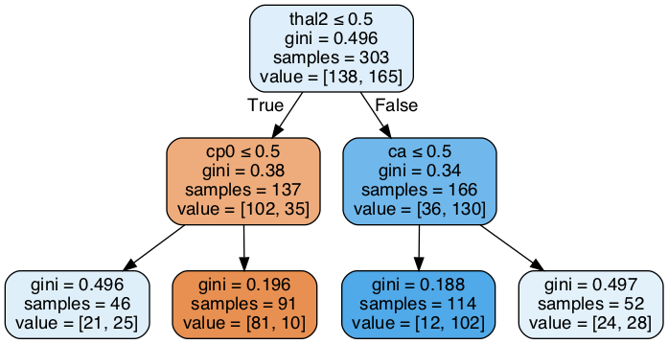
Decision Tree
First a decision tree was created with optimized depth = 2 based on recall.
Cross validation was used to get the recall and accuracy.
Recall = 0.89
Accuracy = 0.83

Slide 15
Decision Tree
From the decision tree it can be seen that the following parameters are risk factors of heart disease :
thal2 : fixed defect
cp0 : typical angina
ca : small number of major vessels

Slide 16

Conclusions
Both Logistic and Decision Tree models identify that the following parameters are highly associated with the risk of heart disease :
thal2 : fixed defect
cp0 : typical angina – chest pain
ca : small number of major vessels
This is in accordance with the raw analysis of the data.
It is possible to build a reliable model for the prediction of heart disease from the data (0.9)
With a decision tree graph an insurance broker could easily predict the risk of heart disease from three parameters.
A more advanced model could be built … but we need another mandate $$$

Slide 17
Questions

