Slide 1
Pivotal Cloud Foundry
Feb 2018

Slide 2
PCF -DAY 02

Slide 3
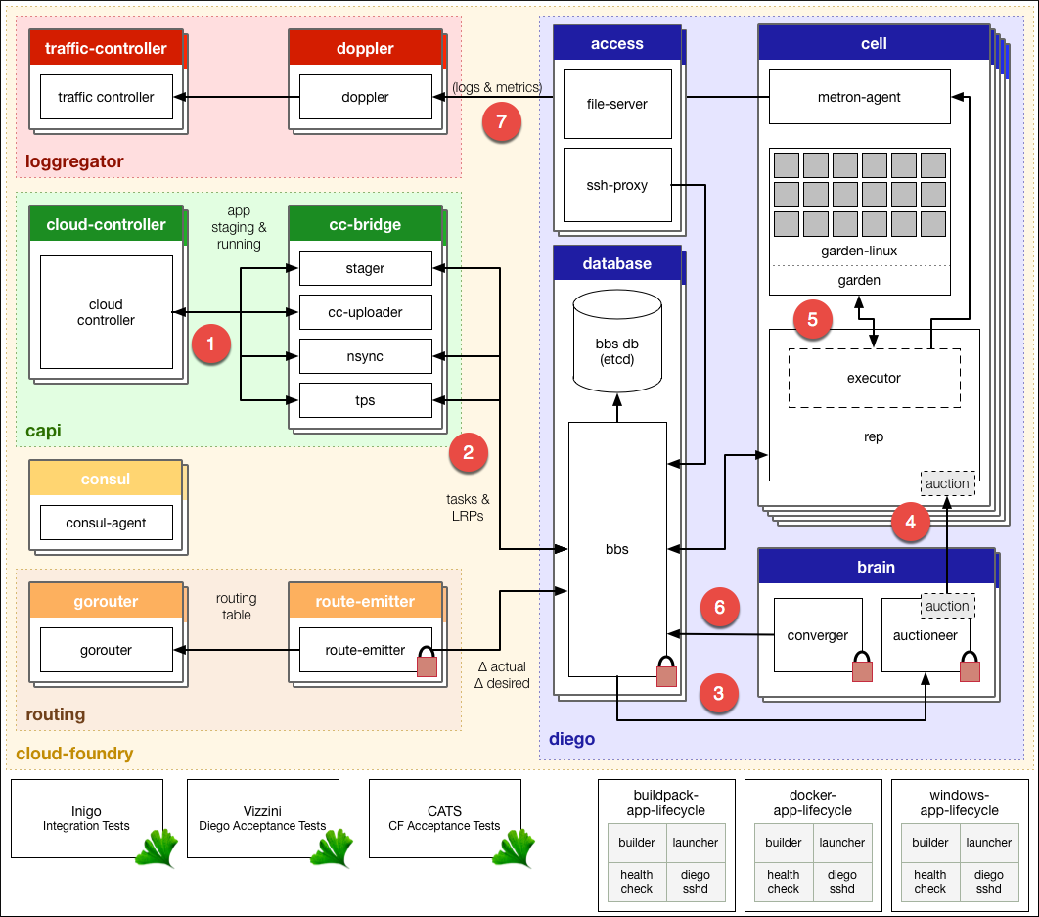
Diego Architecture

Slide 4
Elastic Runtime Architecture Subsystem – Diego
Diego - schedules Tasks and Long running processes
Tasks – Is guaranteed to run at most once ex: staging an application
LRP – Typically represented as a web app. LRPs can have multiple instances
Container – app instance(LRPs & Tasks) is run within an immutable container
Container
App Instance

Slide 5
Elastic Runtime Architecture Subsystem – Diego
Cell- containers are run within a cell
-PCF has pool of cells
Cell
Container
Container
Container
App Instance
App Instance
App Instance

Slide 6
Elastic Runtime Architecture Subsystem – Diego
Garden – Containers are managed by garden.
- Garden is an interface
- has Garden linux/windows is a backend implementation
Garden
Garden-Linux

Slide 7
Elastic Runtime Architecture Subsystem – Diego
Auction – An auction is held to bid on executing an LRP or a task
Executor – Manages container allocations on the cell.
- It streams logs(std out /err) to metron.
Garden
Garden-Linux
Rep
Executor

Slide 8
Elastic Runtime Architecture Subsystem – Diego
BBS- API to access the diego database (etcd) for tasks and LRPs
etcd DB
BBS
Brain – 2 components auctioneer & converger
Auctioneer – holds auction for tasks & LRPs
Converger – Reconciles desired LRPs vs Actual through auctions
Brain
Auctioneer
Converger

Slide 9
Elastic Runtime Architecture Subsystem - Loggregator
Loggregator: doppler – Gathers logs from metron
Loggregator
cell
Metron
Doppler
App syslog drains
Splunk
Papertrail

Slide 10
Elastic Runtime Architecture Subsystem - Loggregator
Loggregator: traffic controller – Handles client request for logs
Also exposes a web socket endpoint called the firehose
Loggregator
cell
Doppler
Traffic controller
Metron
App syslog drains
Splunk
Papertrail
Cf logs APP_NAME

Slide 11
Elastic Runtime Architecture Subsystem - Loggregator
Loggregator: Firehose – a websocket endpoint that exposes app logs, container metrics and ER component metrics..doesnt include ER component logs
Loggregator : Nozzles – Consume the firehose output
Loggregator
cell
Doppler
Traffic controller
Nozzle
Metron
App syslog drains
Splunk
Papertrail
Cf logs APP_NAME

Slide 12
Elastic Runtime Architecture Subsystem - Cloud Controller API
Cloud Controller
Cloud controller exposes an API for using and managing the Elastic Runtime
Cloud controller persists Org/Space/App data in the cloud controller
Cloud controller persists app packages and droplets to the blob store
CC-Bridge
The CC-Bridge translates app specific messages into the generic language of tasks and LRPs

Slide 13
Elastic Runtime Architecture Subsystem - Router
Router routes traffic to appropriate component
Cloud Controller
router
Cf push
Cell
Http://...

Slide 14
Diego Architecture
The Cloud Controller passes requests to stage and run applications to the Cloud Controller Bridge (CC-Bridge).
The CC-Bridge translates staging and running requests into Tasks and Long Running Processes(LRPs), then submits these to the Bulletin Board System (BBS) through an API over HTTP.
The BBS submits the Tasks and LRPs to the Auctioneer part of the Diego Brain.
The Auctioneer distributes these Tasks and LRPs to Cells through an Auction. The Diego Brain communicates with Diego Cells using SSL/TLS protocol.
Once the Auctioneer assigns a Task or LRP to a Cell, an in-process Executor creates a Garden container in the Cell. The Task or LRP runs in the container.
The BBS tracks desired LRPs, running LRP instances, and in-flight Tasks. It also periodically analyzes this information and corrects discrepancies to ensure consistency between ActualLRP and DesiredLRP counts.
The Metron Agent, part of the Cell, forwards application logs, errors, and metrics to the Cloud Foundry Loggregator.

Slide 15
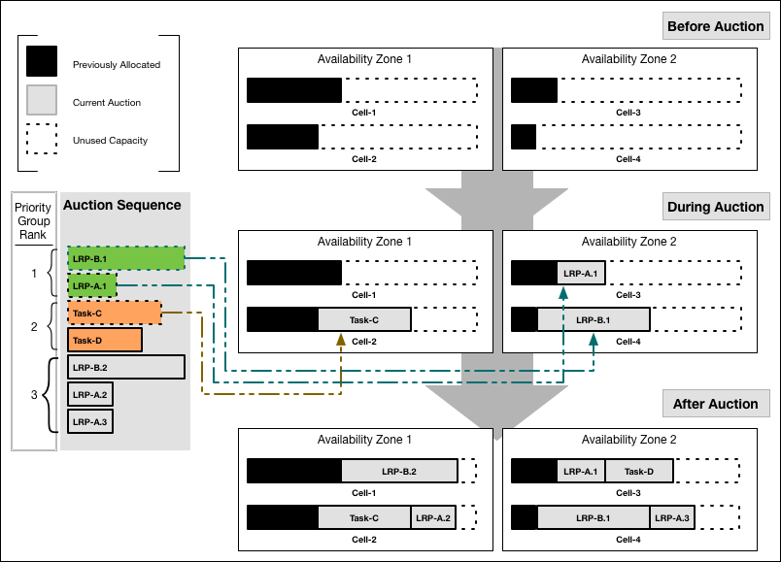
Job Allocation
Notes:
Our example auction sequence has seven jobs: five LRP instances and two Tasks. The above shown diagram shows how the Auctioneer might distribute this work across four Cells running in two Availability Zones:

Slide 16
Four Levels of HA
Availability Zones.
Application instances are evenly distributed across availability zones
Application stays up despite loosing an AZ
Availability Zones
Availability Zones
Zone 1
Zone 3
Zone 2
Zone 4

Slide 17
Four Levels of HA
Bosh Managed Processes
Elastic runtime processes are monitored and automatically restarted
Restart event is reported back to the health monitor for further investigation
Bosh/ops Manager Director
Cloud controller
Health Monitor
Plugins
Pager, email, Resurrector
Cloud Controller Process
Message Bus
Cloud controller processess are restarted by monit on failure
Monit
Bosh Agent

Slide 18
Four Levels of HA
Failed VMs
Failed VMs will be recreated automatically
Bosh Agent continuously report the health of the VM/job
Director recreates the VM
BOSH/ops Manager Director
Cloud Controller VM
Cloud Controller Process
BOSH Director
Monit
Bosh Agent
Router VM
Health Monitor
Resurrector
Router Process
Message Bus
Monit
Bosh Agent
Resurrector determines that there is a missing VM

Slide 19
Four Levels of HA
Self healing Application instances
Once running, failed application instances will be recreated
Brain
BBS
Auctioneer
Cell
Cell
Converger
Rep
Rep
executor
executor

Slide 20
Configuring the Deployed applications
CF Logs
CF start
CF stop
cf logs APP_NAME --recent
cf start APP_NAME
cf stop APP_NAME

Slide 21
Restart/Restage
Restart Your Application
Restarting your application stops your app and starts it with the already compiled droplet
cf restart <YOUR-APP>
Restart your application to refresh the application’s environment after actions such as binding a new service to the app or setting an environment variable that only the app consumes.
Restage Your Application
Restaging your application stops your application and restages it, by compiling a new droplet and starting it.
cf restage< YOUR-APP>
Restage your application if you have changed the environment in a way that affects your staging process, such as setting an environment variable that the buildpack consumes.
Note:
Restaging your application compiles a new droplet from your application without updating your application source. If you need to update your application source, re-push your application

Slide 22
Services
Cloud Foundry offers a marketplace of services, from which users can provision reserved resources on-demand
Managed services advertise a catalog of plans from which service instances can be provisioned
These resources are known as service instances and the systems that deliver and operate these resources are known as Services.

Slide 23
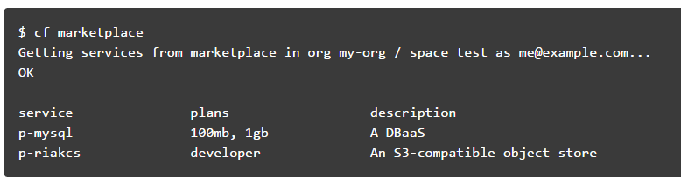
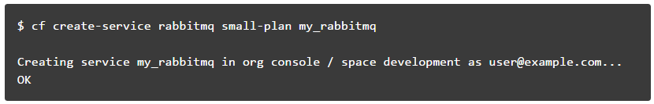
Manage Service Instances with the CLI
List Marketplace Services
Creating Service Instances
create a service instance with the command;
cf create-service <SERVICE> <PLAN> <SERVICE_INSTANCE>
Notes:
For a service to be available in the marketplace, it must be integrated with Cloud Foundry by way of APIs.

Slide 24
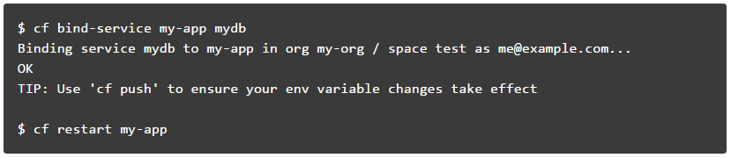
Manage Service Instances with the CLI
Bind a Service Instance
binding a service instance to an application after pushing an application
Binding a service with Application Manifest
Alternatively, a service instance can be bind to an app after pushing an application, you can use the application manifest to bind the service instance during push
Manifest.yml
services:
- test-mysql-01

Slide 25
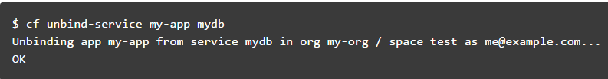
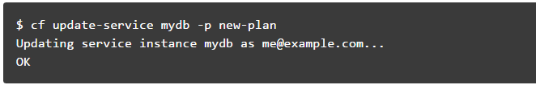
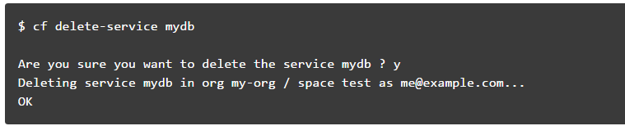
Manage Service Instances with the CLI
Unbind a Service Instance
Unbinding a service instance from an application removes the credentials created for your application from the VCAP_SERVICES environment variable.
Update a Service Instance
If any service plan needs to be updated to your service instance, then cf update-service can be performed,
Delete a service Instance
Notes:
Note: You must restart or in some cases re-push your application for changes to be applied to the VCAP_SERVICES environment variable and for the application to recognize these changes.

Slide 26
User-Provided Service Instances
Cloud Foundry enables users to leverage services that are not available in the marketplace using a feature called User-Provided Service Instances (UPSI).
User-Provided Service Instances
Use (alias cf cups) creates a new service instance.
E.g. cf cups sql-service-instance -p "host, port, dbname, username, password“
To create a service instance that sends data to a third-party.
Use the -l option followed by the external destination URL.
E.g. cf cups mylog -l syslog://logs4.example.com:25258
Use (alias cf uups) to update a existing service instance.
E.g. cf uups sql-service-instance -p "host, port, dbname, username, password“

Slide 27
Lab: Managed and User Provided Services
https://docs.pivotal.io/pivotalcf/2-0/console/manage-apps.html

Slide 28
Scaling an Application
Factors such as user load, or the number and nature of tasks performed by an application, can change the disk space and memory the application uses. For many applications, increasing the available disk space or memory can improve overall performance
Scaling :
Running additional instances of an application can allow the application to handle increases in user load and concurrent requests.
Scaling Horizontally
cf scale myApp -i 5
Scaling Vertically
cf scale myApp -k 512M
cf scale myApp -m 1G

Slide 29
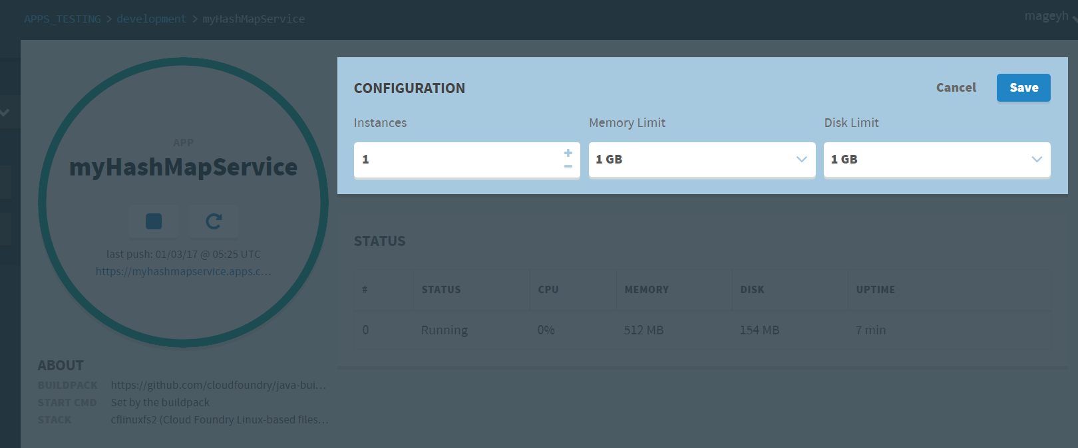
Scaling an Application

Slide 30
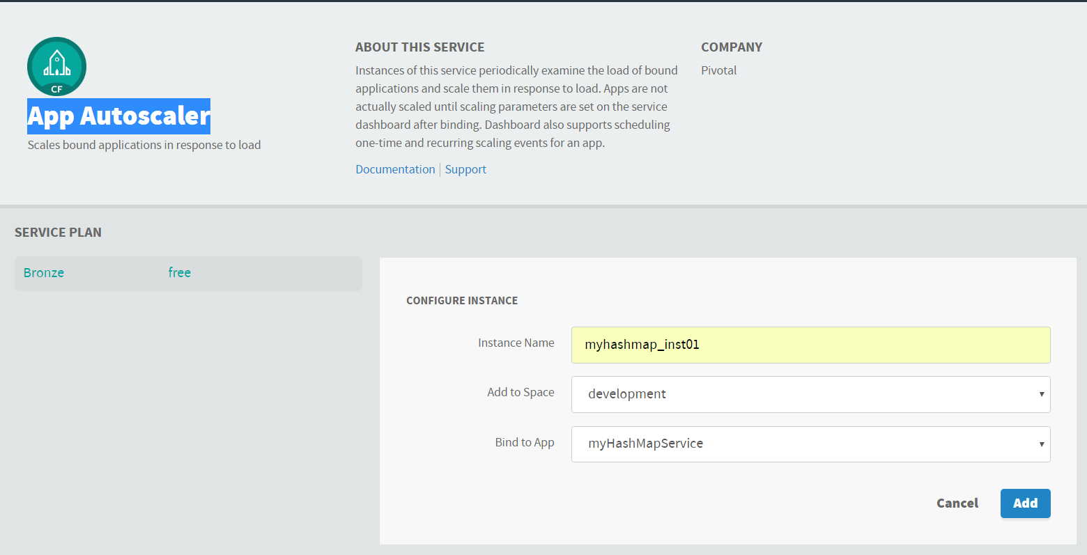
Scaling an Application
Configure Autoscaling for an App
Autoscaler keeps instance counts within an allowable range defined by minimum and maximum values, or instance limits.
Instance Limits
Scaling Rules
Scheduled Limit Changes
Configure Autoscaling for an App
Creating Autoscalar instance and binding to an App

Slide 31
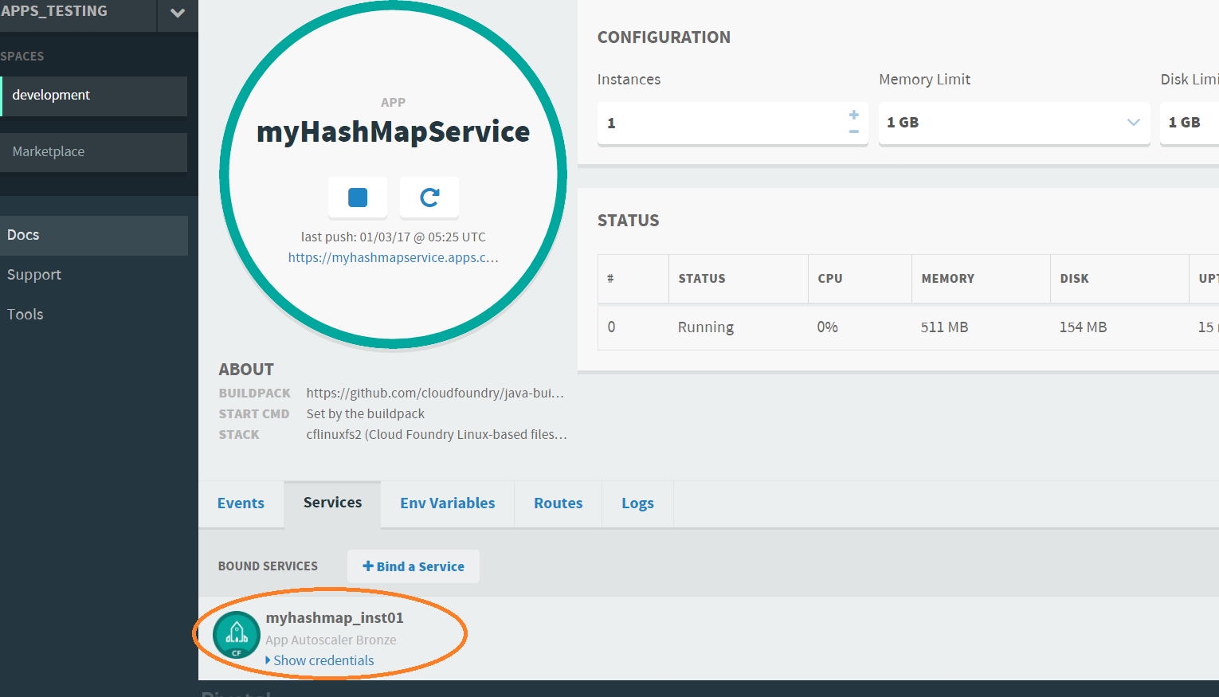
Scaling an Application
Configuring Autoscaler instance to an App

Slide 32
Manual Scaling and Auto-scaling Lab

