Slide 1
Pivotal Cloud Foundry
Feb 2018

Slide 2
PCF -DAY 03

Slide 3
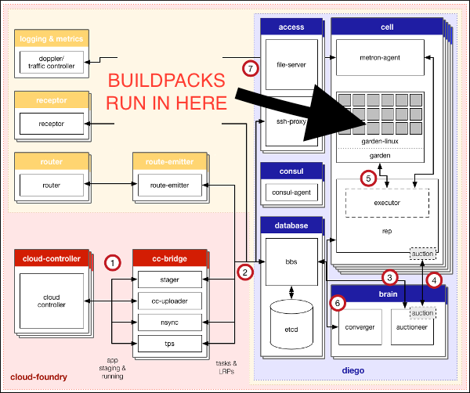
Buildpacks
Buildpacks provide framework and runtime support for your applications.
Buildpacks typically examine user-provided artifacts to determine what dependencies to download and how to configure applications to communicate with bound services.

Slide 4

Buildpacks
When you push an application, Cloud Foundry automatically detects which buildpack is required and installs it on the Diego cell where the application runs.
During staging, each buildpack has a position in a priority list (identified by running cf buildpacks).
Cloud Foundry checks if the buildpack in position 1 is a compatible buildpack. If the position 1 buildpack is not compatible, Cloud Foundry moves on to the buildpack in position 2. Cloud Foundry continues this process until the correct buildpack is found. If no buildpack is compatible cf push fails.
System
Admin
Types
System – Deployed with PCF
Admin- Uploaded to PCF
-b – During the application push

Slide 5
Buildpacks
Elements of Buildpack
Buildpack API
/bin/detect app_directory
/bin/compile app_directory cache_directory
/bin/release app_directory
Inspect app bits to determine buildpack applicability return 0 on success
Download and install runtime, container,package,libraries;install app bits as necessary
Build app start command
Detect
Compile
Release

Slide 6
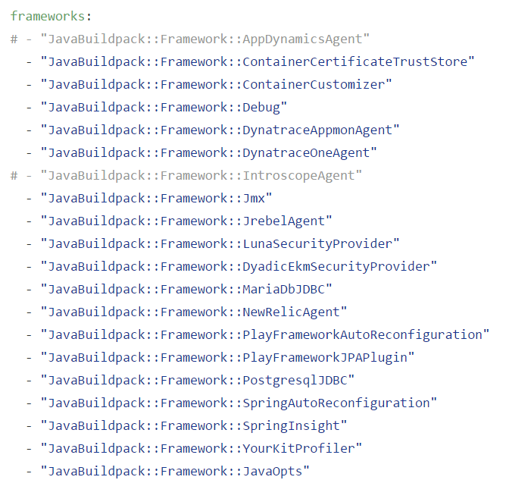
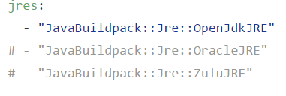
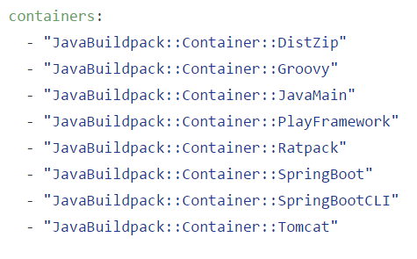
Java Buildpack
Java Buildpack supports a variety of JVM Languages, containers and frameworks with a modular,configurable and extensible design

Slide 7
Java Buildpacks
Framework Detection Criteria
Container Detection Criteria
spring | spring-core*.jar exists
Play config | play application detected
play jpaconfig | play-java-jpa plugin exists in app
Spring insight | insight service bound to app
New Relic | service bound to app
App dynamics agent | App Dynamics service bound to app
Java main() | Main-Class attribute set in META-INF/MANIFEST.MF or java_main_class set in config/java_main.yml
Tomcat | Existence of a WEB-INF/ folder in the application directory and Java Main not detected
Groovy | A .groovy file exists which has a main() method, or which is not a POGO, or which has a shebang (#!) declaration
Spring Boot | The lib/spring-boot-.*.jar file exists in either the top-level directory or an immediate subdirectory of the application.
Ratpack | The lib/ratpack-core-.*.jar file exists in either the top-level directory or an immediate subdirectory of the application.

Slide 8
https://docs.pivotal.io/pivotalcf/2-0/buildpacks/index.html
Lab: Customizing Buildpacks

Slide 9
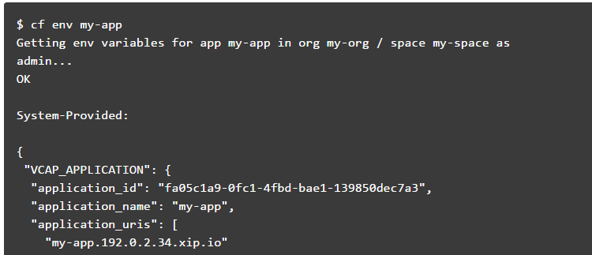
Cloud Foundry Environment Variables
Environment variables are the means by which the Cloud Foundry runtime communicates with a deployed application about its environment.
View Environment Variables

Slide 10
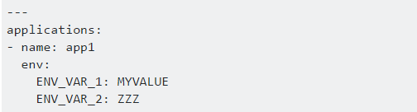
Cloud Foundry Environment Variables
Setting env variable via CF CLI
E.g.
cf set-env APP_NAME ENV_VAR_NAME ENV_VAR_VALUE
Reverting the env variable
E.g.
cf unset-env APP_NAME ENV_VAR_NAME
In addition, you can set environment variables in an application manifest file.

Slide 11
Cloud Foundry Environment Variables
VCAP_SERVICES
The VCAP_SERVICES environment variable is a JSON object that contains information that you can use to interact with a service instance
The information includes service instance name, credential, and connection URL to the service instance. These values are populated into the VCAP_SERVICES environment variable when your application is bound to a service instance.
The value of the VCAP_SERVICES environment variable is available only when you bind a service instance to your application.
The service object contains a child object for each service instance of that service that is bound to the application.

Slide 12
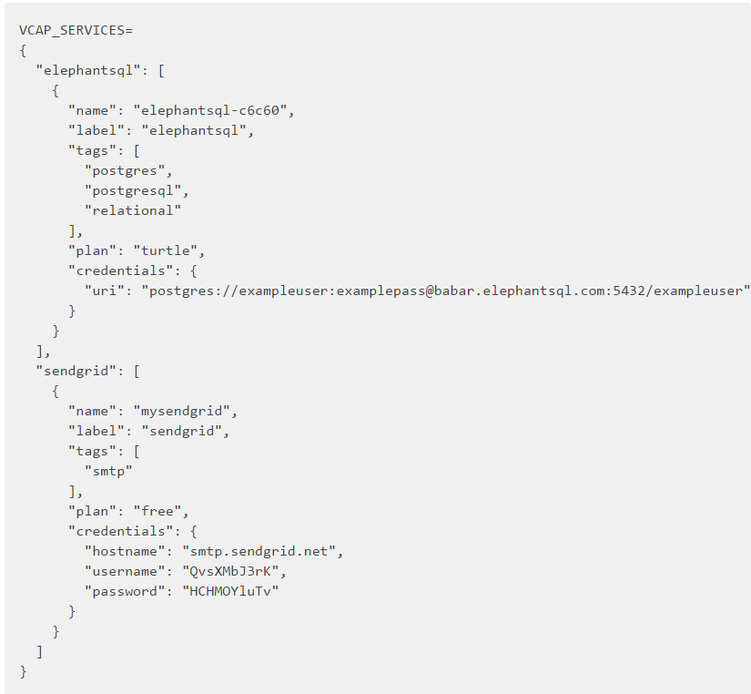
Cloud Foundry Environment Variables
VCAP_SERVICES
The example below shows the value of VCAP_SERVICES for bound instances of several services available in the Pivotal Web Services Marketplace.

Slide 13
Lab: Environment Variables
https://docs.pivotal.io/pivotalcf/2-0/devguide/deploy-apps/environment-variable.html

Slide 14
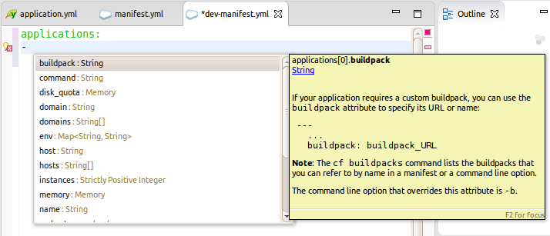
Manifest.yml

Slide 15
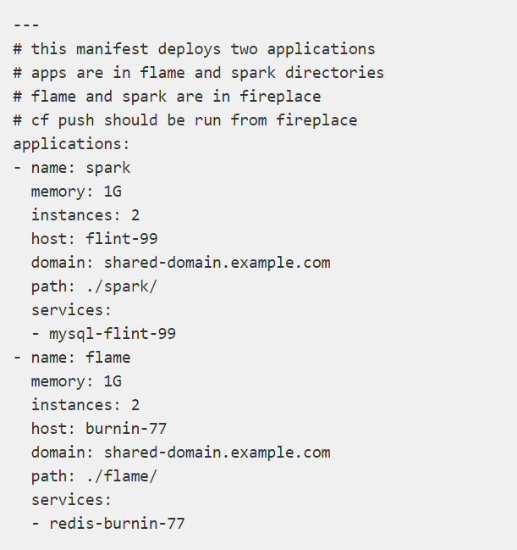
Sample Manifest file

Slide 16
Create Manifest.yml
Change directories to the application.
Generate a manifest.
cf create-app-manifest appname -p ./manifest.yml
Edit the manifest if required.
Example: Increase the instances / Set the path
Push the app
cf push
Confirm the app is running and the latest push parameters are reflected.

Slide 17
Lab for Manifest.yml
https://docs.pivotal.io/pivotalcf/2-0/devguide/deploy-apps/manifest.html

Slide 18
Application Security Groups
ASGs are virtual firewalls that control egress /outbound traffic for applications
container
MySQL
App instance
There are different levels of security groups that are applied at different times during the app lifecycle

Slide 19
Staging Security Groups
Whitelist what the app should have access to when staging
MySQL
container
Buildpack
Bin/compile
App dependencies

Slide 20
Running Security Groups
Whitelist what all apps should have access to when running
MySQL
container
App Instance
Internet

Slide 21
Space Security Groups
Whitelist what the app should have access to when running (space)
MySQL
container
App Instance
Fraudster site

Slide 22
Security Groups File
[
{
“protocol”: ”tcp”,
“destination”: “10.0.23.0/12”
“ports”: “1-65535”
},
{
“protocol”: ”udp”,
“destination”: “10.0.23.0/12”
“ports”: “1-65535”
}
]

Slide 23
ASG- Commands
cf security-groups
cf security-group groupname
cf staging-security-groups
cf running-security-groups
cf unbind-running-security-group groupname → will not affect the running applications. Apps need to be restarted
cf create-security-group mygrpname ./mygrprules.json
cf bind-security-group mygrpname org space -> to bind a group security with a space
Applied system wide

Slide 24
Demo: Security Group

Slide 25
Log drain Lab
https://docs.pivotal.io/pivotalcf/2-0/devguide/services/log-management-thirdparty-svc.html#papertrail
cf create-user-provided-service log-drain–name -l syslog://<SYSLOG-DRAIN-URL>

Slide 26
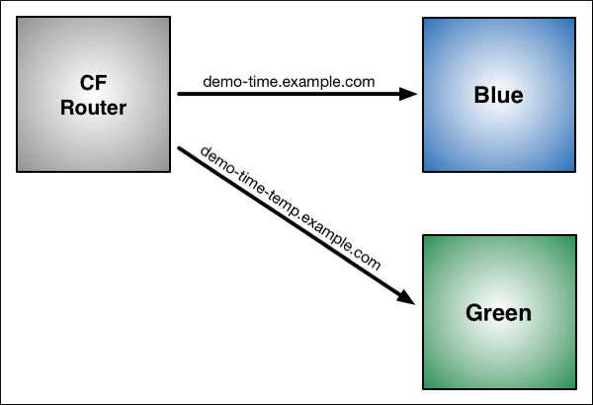
Blue-Green Deployment
Blue-green deployment is a release technique that reduces downtime and risk by running two identical production environments called Blue and Green.
At any time, only one of the environments is live, with the live environment serving all production traffic. For this example, Blue is currently live and Green is idle.
Notes:
Notes:
If your app uses a relational database, blue-green deployment can lead to discrepancies between your Green and Blue databases during an update. To maximize data integrity, configure a single database for backward and forward compatibility.
You can adjust the route mapping pattern to display a static maintenance page during a maintenance window for time-consuming tasks, such as migrating a database. In this scenario, the router switches all incoming requests from Blue to Maintenance to Green.

Slide 27
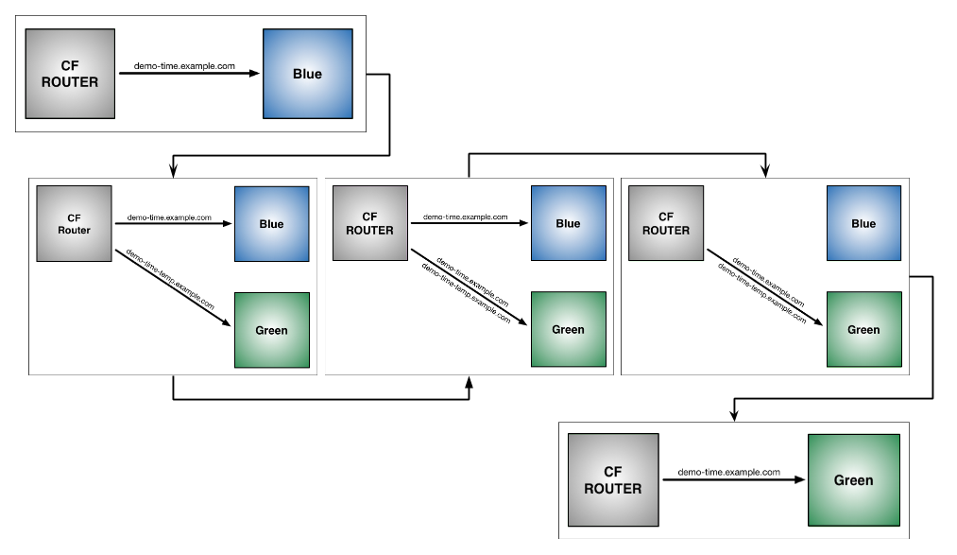
Blue-Green Deployment

Slide 28
Lab: Blue-Green Deployment
https://docs.pivotal.io/pivotalcf/2-0/devguide/deploy-apps/blue-green.html

Slide 29
Implications
Serializing Objects
If using serializable objects, don’t make destructive changes
Ex:Don’t remove fields, do have a serial VersionUID
Database
Do make changes idempotent
Ex:Copy data to the new field. Don’t delete data
No destructive database changes allowed
Ex: Don’t drop a column
Do have backward compatible changes
Ex: Nullable fields

Slide 30
Task
A task is an application or script whose code is included as part of a deployed application, but runs independently in its own container.
About Tasks:
run for a finite amount of time, contrast to LRPs.
run in their own containers and designed to use minimal resources.
after running, CF destroys the container.
they are always executed asynchronously.
As a single-use object, a task can be checked for its state and for a success or failure message.

Slide 31
Jobs performed
Migrating a database
Sending an email
Running a batch job
Running a data processing script
Processing images
Optimizing a search index
Uploading data
Backing-up data
Downloading content

Slide 32
Lifecycle of tasks
Initiate task using the value “cf run-task APPNAME "TASK“.”
CF creates a container specifically for the task.
CF runs the task on the container using the value passed to the “cf run-task command.”
The container also inherits environment variables, service bindings, and security groups bound to the application.

Slide 33
Application Container Lifecycle
The application deployment process involves uploading, staging, and starting the app in a container.
Each phase has certain time limits for completion.
Developers can change the default time.
The default time limits for the phases are as follows:
Upload: 15 minutes
Stage: 15 minutes
Start: 60 seconds
contd..

Slide 34
Crash Events
If an app instance is crashed, CF restarts it:
by rescheduled the instance on other container three times.
after three failed attempts, CF waits for another 30 seconds.
the wait time doubles each restart until the ninth restart, and remains at that duration until the 200th restart.
After the 200th restart, CF stops trying to restart the app instance.

Slide 35
Stacks
A stack is a prebuilt root filesystem (rootfs) that supports a specific operating system. Like Linux systems has /usr & /bin.
Cell VMs can support multiple stacks.
Docker apps do not use stacks.
Restaging Applications on a New Stack
For deployment, default stack is cflinuxfs2.
For using another stack append –s STACKNAME to the command

Slide 36
Routes
Each application is associated with an address known as route, which is called as mapping.
Routes are globally unique.
Routes are considered HTTP if they are created from HTTP domains, and TCP if they are created from TCP domains.
By default routes are HTTP.
Routes belong to a space, and developers can only map apps to a route in the same space.
Developers can also map an individual app to multiple routes, enabling access to the app from many URLs.

Slide 37
Application Health Checks
An application health check is a monitoring process that continually checks the status of a running Cloud Foundry app.
Developers can configure a health check using CLI or application manifest.
Application health checks function as part of the app lifecycle managed by Diego architecture.
Health Check Timeouts
amount of time allowed to elapse between starting up an app and the first healthy response from the app.
If health check is not receiving a healthy response, then the app is declared unhealthy.
the default timeout is 60 seconds and the maximum configurable timeout is 600 seconds

