Slide 1

Lending Club Case Study
upGrad and IIIT-B batch ML67 (Vishal and Vinoth)

Slide 2
Overview
Lending loans to ‘risky’ applicants is the largest source of financial loss (called credit loss). Credit loss is the amount of money lost by the lender when the borrower refuses to pay or runs away with the money owed. In other words, borrowers who default cause the largest amount of loss to the lenders. In this case, the customers labeled as 'charged-off' are the 'defaulters'.
The main objective is to be able to identify these risky loan applicants by identifying the consumer attributes and loan attributes that influence the tendency of default. In other words, the company wants to understand the driving factors (or driver variables) behind loan default, i.e. the variables which are strong indicators of default.
The company can then utilize the findings of the EDA for risk assessment and to minimize financial (credit) loss.
The dataset used for analysis contains the complete loan data for all loans issued through the time period 2007 to 2011.

Slide 3
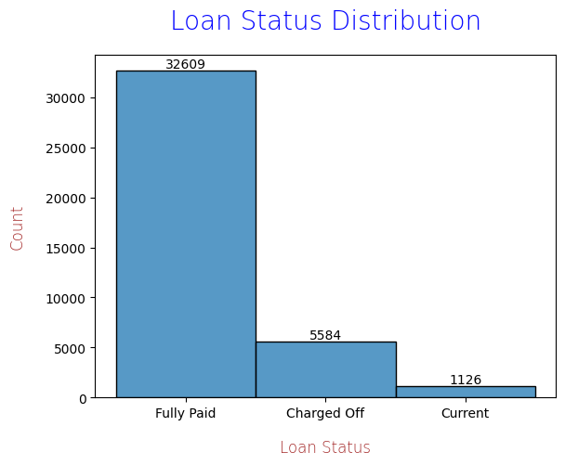
Loan Status Distribution
The dataset provided for analysis contains below loan statuses:
  Fully paid: Applicant has fully paid the loan
  Current: Applicant is in the process of paying the instalments
  Charged-off: applicant has defaulted on the loan
  Out of the total approved loan applications, 5584 cases defaulted.
  In next few slides, we will try to determine that attributes
  that may have influenced these cases.

Slide 4
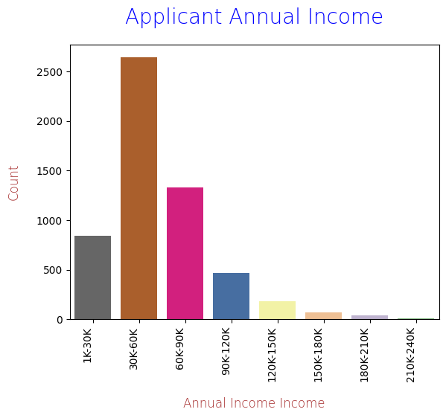
Applicant's Annual Income Analysis
The analysis shows that applicants
with annual income in the range of
30000 to 60000 defaulted the most.
Interestingly, applicants in very low
income range (1000 to 30000) have fewer
number of defaulted cases.

Slide 5
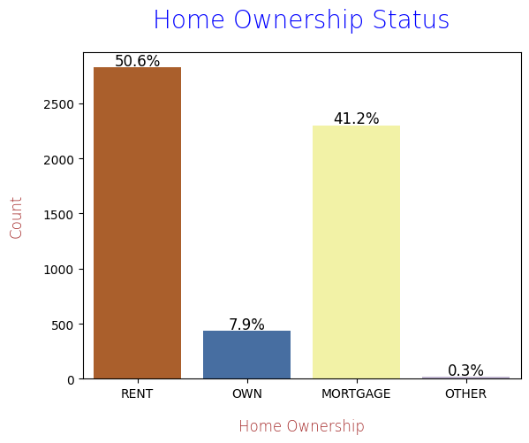
Home ownership analysis
The analysis shows that applicants
with RENTED home defaulted the most

Slide 6
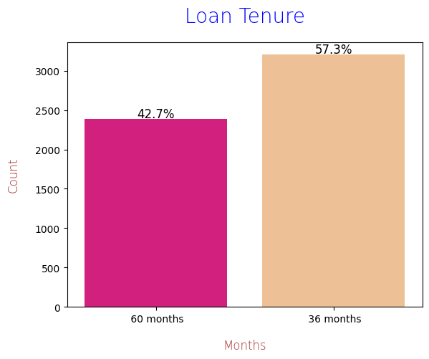
Loan Tenure Analysis
The analysis shows that applicants
who opted for 36 months loan tenure defaulted more
compare to 60 months.

Slide 7
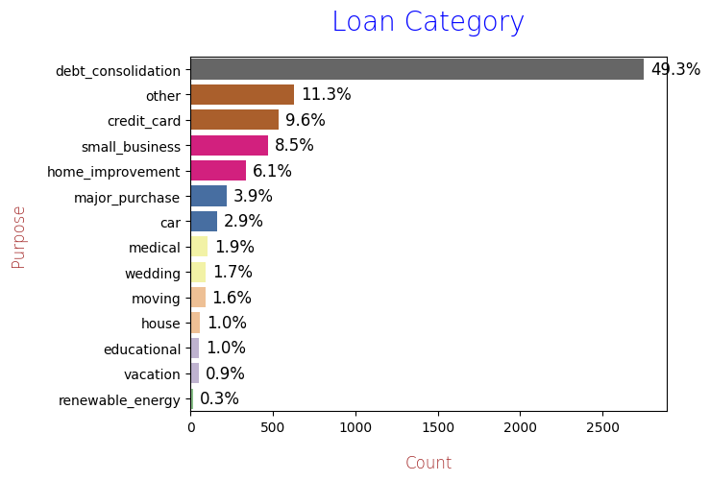
Loan Category Analysis
Applicants who took loan for
debt consolidation defaulted the most

Slide 8
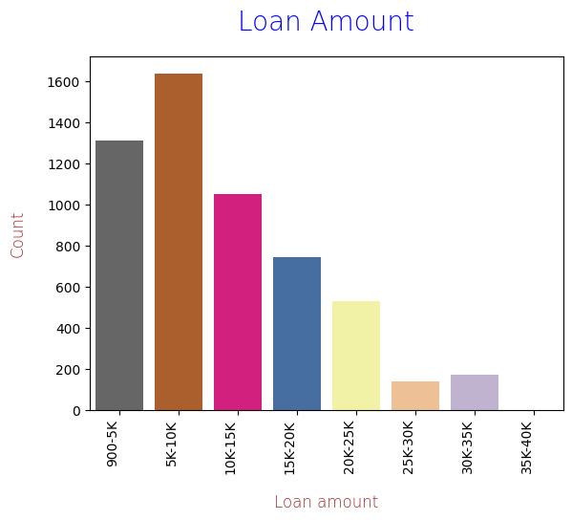
Analysis Based on Loan Amount
Applicants who took loan for the
amount in range of 5000 to 10000
defaulted the most.

Slide 9
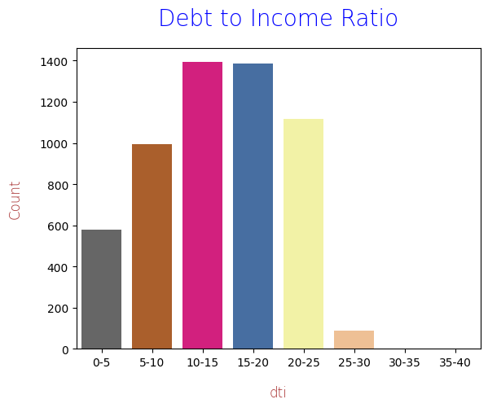
Debt to Income Analysis
Applicants having monthly debt to monthly
income ratio in range of 10 to 20
defaulted the most

Slide 10
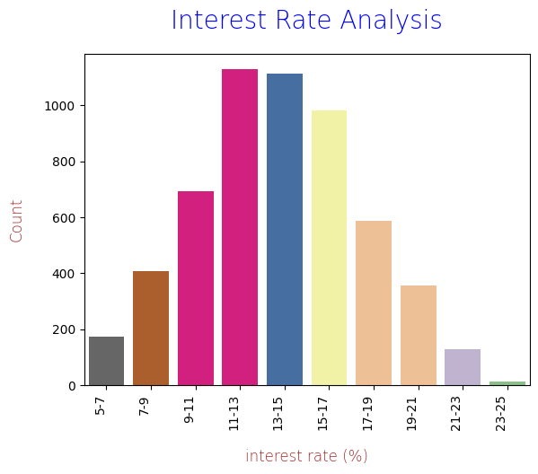
Interest Rate Analysis
Applicants who got loan at rate of interest
between 11% to 17% defaulted the most

Slide 11
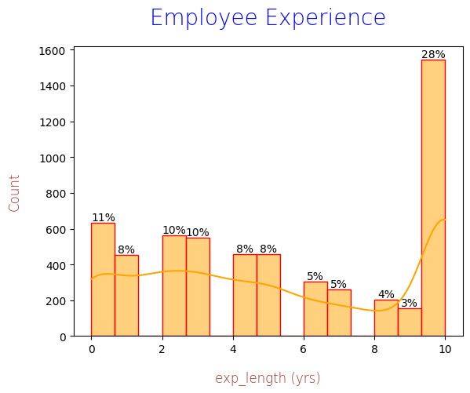
Applicant's Employment Length Analysis
Applicants having experience of 10 or more years
defaulted the most

Slide 12
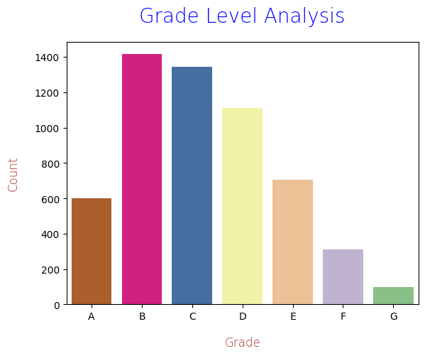
Loan Grade Analysis
Loan grading is a classification system
that involves assigning a quality score
to a loan based on a borrower's credit history.
Applicants having Grades B,C,D defaulted the most.

