Slide 1
Employee Training Impact Analysis
Analysing the Impact of a New Training Program on Employee Performance using paired sample t-test

Slide 2
Hypothesis
Null Hypothesis : H₀ -> There is no significant difference between the evaluation scores before and after the training
Alternate Hypothesis : H₁ -> There is a significant difference between the evaluation scores before and after the training

Slide 3
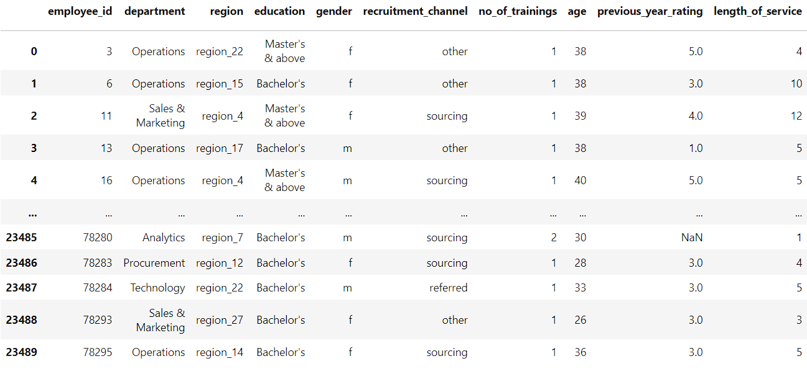
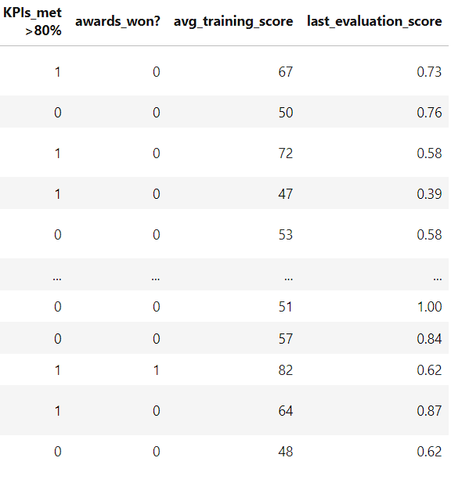
Datset

Slide 4
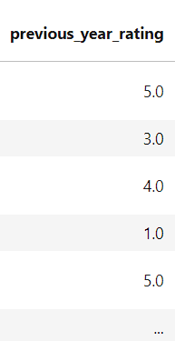
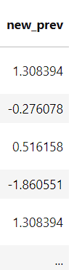
Performing Z-score Normalization
We are performing Z-score normalization of previous_year_rating to match the scale of last_evaluation_score

Slide 5
Variable Selection
new_prev : Performance score of the employees before the training
last_evaluation_score : Performance score of the employees after the training

Slide 6
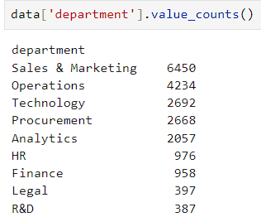
Group Identification
We identify that there are 9 different departments in the company and all the employees of every department are undergoing a training program respective of their department

Slide 7
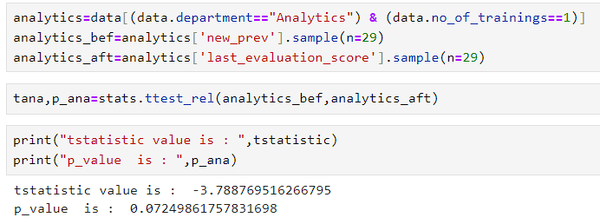
Performing t-test on Analytics Department
We are selecting random 29 employees from the Analytics Department and performing paired sample t-test on those samples

Slide 8
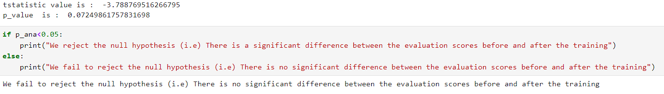
Findings on Analytics Department
Since the p-value is greater than the significance level 0.05, we fail to reject the null hypothesis and identify that there is no significant difference between the evaluation scores before and after the training (i.e) The Training does not lead to higher last evaluation scores

Slide 9
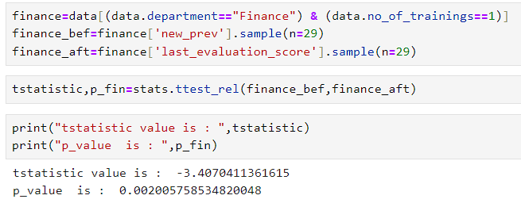
Performing t-test on Finance Department
We are selecting random 29 employees from the Finance Department and performing paired sample t-test on those samples

Slide 10
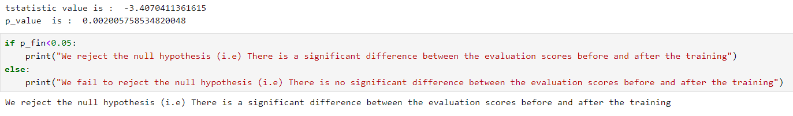
Findings on Finance Department
Since the p-value is less than the significance level 0.05, we are rejecting the null hypothesis and identify that there is a significant difference between the evaluation scores before and after the training (i.e) The Training leads to higher last evaluation scores

Slide 11
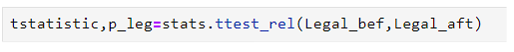
Similarly performing t-test on other Departments
We are selecting random 29 employees from the each Department and performing paired sample t-test on those samples

Slide 12
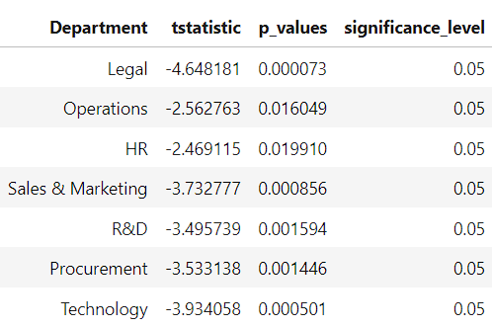
Findings on other Departments
Since the p-value is less than the significance level 0.05 on remaining department’s t-test, we are rejecting the null hypothesis and identify that there is a significant difference between the evaluation scores before and after the training on remaining departments (i.e) The Training leads to higher last evaluation scores

Slide 13
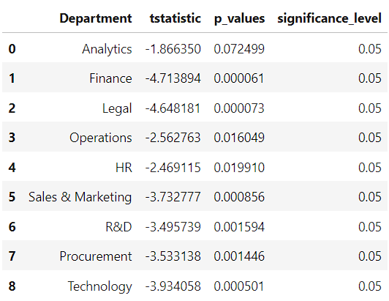
Conclusion
In conclusion, we can say that except the Analytics department there is a significant difference between the evaluation scores before and after the training
In other words, the Training program is useful for all the departments except the Analytics department

Slide 14
Thank You

