Slide 1



AUTOMATIC TIMETABLE GENERATOR
Presented By,
Srihari Prasad.S (811722104153)
Vijay.V (811722104182)
Vinoth.T(811722104185)
Guided By,
Mrs.V.Kalpana,M.E,(Ph.d)
Assistant Professor,CSE
11/06/2025

Slide 2
ABSTRACT
To design a system that automatically generates optimized academic timetables for schools or colleges, reducing manual effort and scheduling conflicts.
Manual timetable creation is time-consuming and prone to errors such as overlapping classes, uneven workload distribution, and room or faculty clashes.
The system takes input like subjects, teachers, classrooms, and time slots, then uses constraint-based logic or algorithms (e.g., rule based) to generate a conflict-free timetable.
Saves time, ensures balanced workload for staff and students, adapts quickly to changes (e.g., teacher unavailability), and improves institutional efficiency.
11/06/2025

Slide 3
OBJECTIVE
The system aims to replace the manual, tedious process of timetable creation with a fully automated solution for academic coordinators.
The system ensures that no teacher is scheduled to be in two places at once, and no classroom is double-booked.
The generator makes effective use of available classrooms, faculty members, and time slots use of institutional resources.
In case of last-minute changes such as teacher absence or classroom reallocation, the system can quickly regenerate a revised timetable
11/06/2025

Slide 4
LITERATURE SURVEY
S.No | Paper Title | Year | Remark
1 | Automated Timetable Scheduling using Genetic Algorithms | 2019 | Effectively demonstrates how evolutionary strategies can optimize large scheduling problems.
2 | A Constraint Programming Approach to University Timetable Scheduling | 2020 | Uses constraint satisfaction models to enforce hard and soft academic scheduling rules.
3 | Cloud-Based Collaborative Timetable Generator for Institutions with Remote Staff | 2021 | Facilitates cross-location coordination with a real-time cloud scheduler.
11/06/2025

Slide 5
LITERATURE SURVEY
S.No. | Paper Title | Year | Remark
4 | Machine Learning for Predicting Academic Performance and Timetable Optimization | 2019 | Integrates student performance data to enhance timetable relevance and learning outcomes.
5 | Reinforcement Learning-Based Adaptive Timetable Generator for Educational Institutions | 2022 | Applies RL agents to learn and adapt scheduling policies from past data.
6 | Deep Learning-Assisted Conflict Resolution in University Timetable Generation | 2023 | Uses neural networks to detect and resolve scheduling conflicts in real-time.
11/06/2025

Slide 6
LITERATURE SURVEY
S.No. | Paper Title | Year | Remark
7 | Hybrid Genetic Algorithm and Tabu Search for Exam Timetable Scheduling | 2019 | Combines exploration and exploitation strategies for improved exam scheduling efficiency.
8 | AI-Driven Automated Scheduling for Multi Department Universities | 2021 | Scales well across departments and adapts to complex institutional constraints.
9 | Real-Time Staff Availability Tracking for Dynamic Timetable Generation | 2022 | Enables adaptive timetable creation based on live availability data.
11/06/2025

Slide 7
EXISTING SYSTEM
Features:
Allows input of subject details along with credits
Option to select Odd or Even semester
Lab allocation is supported manually
Timetable is generated based on credit prioritization
Users can view and download the timetable
Working:
The system depends on user inputs for all details
Generates timetable by giving higher weight to subjects with more credits
Follows a static logic without intelligent conflict detection
No automation in handling staff availability or classroom constraints.
11/06/2025

Slide 8
PROPOSED SYSTEM
Features:
Easy input of subject details through a simplified interface
Automated processing of subject data
Timetable is generated intelligently using pre-defined rules or AI logic
Provides immediate preview of the generated timetable
Potential for future integration with dynamic data like staff availability
Working:
User enters subject information, which is automatically processed
The system intelligently schedules classes, reducing clashes and manual effort
Generates a complete timetable with better accuracy and efficiency
Designed to be scalable and adaptive for future enhancements
11/06/2025

Slide 9
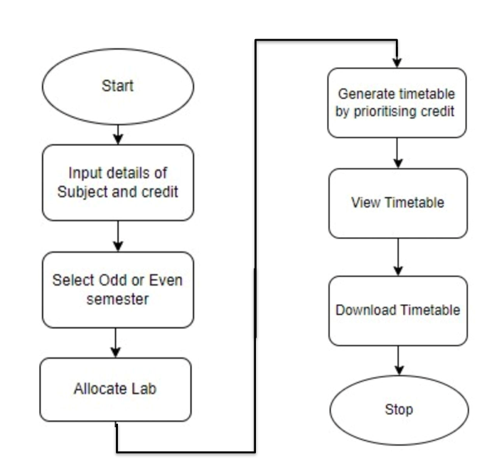
SYSTEM ARCHITECTURE
11/06/2025

Slide 10
SYSTEM ARCHITECTURE
The system follows a modular design where each module has a specific role, such as data input, constraint checking, timetable generation, and output rendering.
This separation of concerns makes the system easier to develop, test, and maintain. Each module processes its task independently and passes structured data to the next stage, ensuring clarity and reducing complexity.
At the core of the system is the timetable generation engine, which uses constraint-based logic (to avoid conflicts) and optimization algorithms (e.g., rule based) to generate efficient schedules.
11/06/2025

Slide 11
MODULES
Subjects Module
Timetable Generator Module
Timetable Display Module
Subject Summary Module
Download And Navigation Module
11/06/2025

Slide 12
MODULE 1: Subject Module
Allows users to add subjects with their respective credits. Ensures subjects with the same number of credits are assigned the same number of periods.
Handles "Once per week" subjects with three continuous periods. Displays the total number of periods per week for each subject in a separate summary page (subjects_summary.html).
The Subjects Module in an Automatic Timetable Generator plays a crucial role in managing and scheduling subjects efficiently.
11/06/2025

Slide 13
MODULE 2: Timetable Generator Module
The Timetable Generator Module creates a structured timetable based on Even or Odd semester rules while ensuring no free periods.
Subjects are allocated proportionally to their credits, with higher-credit subjects receiving more periods (maintaining a 2-3 period difference). 1-credit subjects get only one period per week (except labs).
Breaks and lunch remain fixed, and randomized distribution prevents repetitive patterns. The system dynamically generates, displays, and allows downloading of the timetable for easy access.
11/06/2025

Slide 14
MODULE 3: Timetable Display Module
Timetable Display Module (timetable.html). Shows the final timetable in a structured format.
Uses a table layout with: Days as rows (Monday - Friday).
Time slots as columns (Periods including Breaks and Lunch). Provides a Download Timetable button .
The Time Table Display Module is responsible for presenting the generated timetable in an organized and user-friendly format.
11/06/2025

Slide 15
MODULE 4: Subject Summary Module
The Subject Summary Module provides a comprehensive overview of all subjects included in the timetable.
Additionally, this module can generate summary reports, including faculty workload analysis, subject-wise room utilization, and the number of sessions assigned per subject.
The module categorizes subjects based on departments, course levels (undergraduate/postgraduate), and subject types (lecture, lab, tutorial).
11/06/2025

Slide 16
MODULE 5: Download & Navigation Module
The Download and Navigation Module plays a crucial role in enhancing user accessibility and interaction with the timetable system.
It provides a seamless navigation experience, allowing students, faculty, and administrators to move effortlessly between different timetable views, such as student-wise, faculty-wise, department-wise, and room-wise schedules).
The module also ensures responsiveness across various devices, enabling smooth access on desktops, tablets, and mobile phones. Additionally, the download functionality allows users to export timetables in PDF, Excel ensuring flexibility for offline access.
11/06/2025

Slide 17
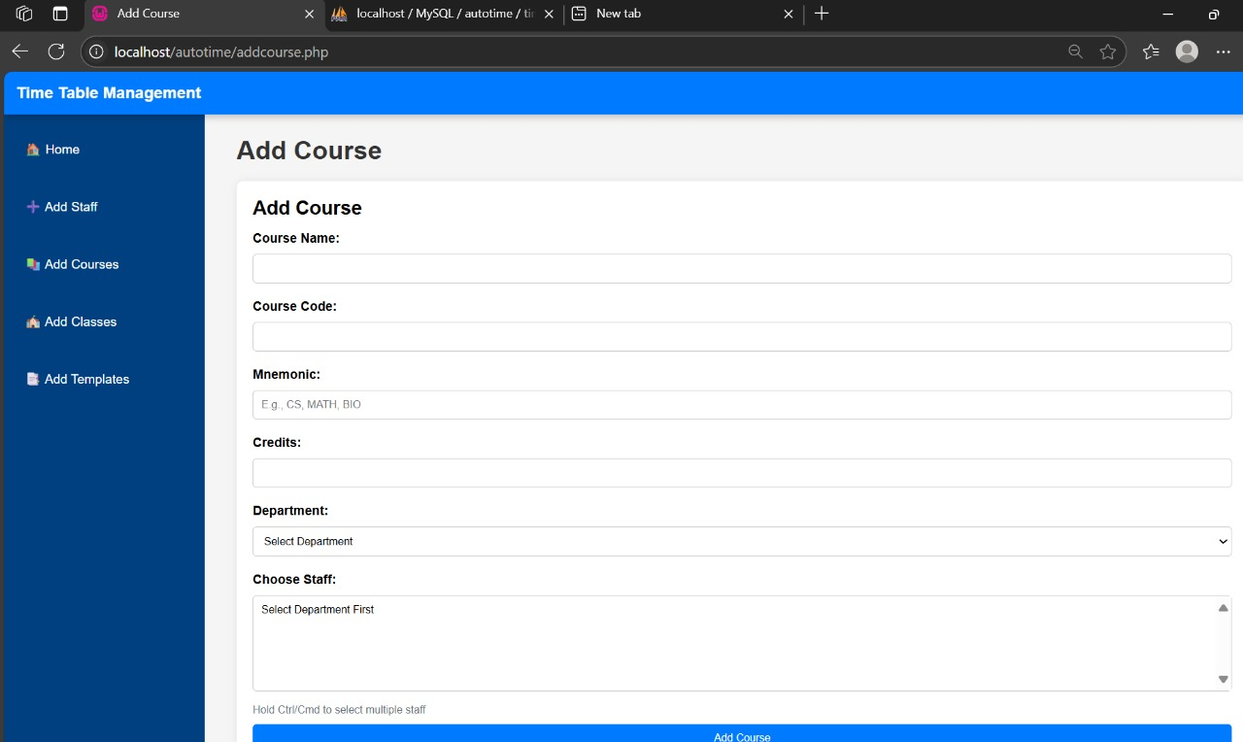
OUTPUT
11/06/2025

Slide 18
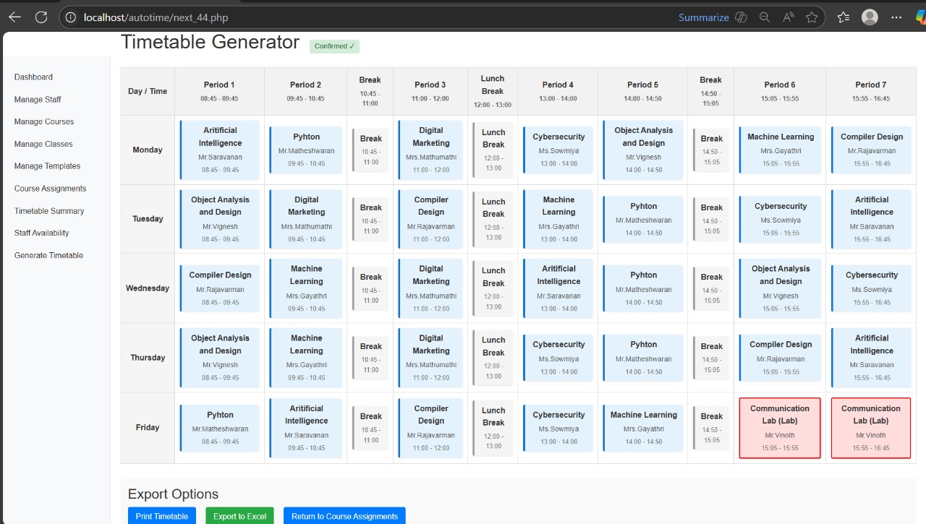
OUTPUT
11/06/2025

Slide 19
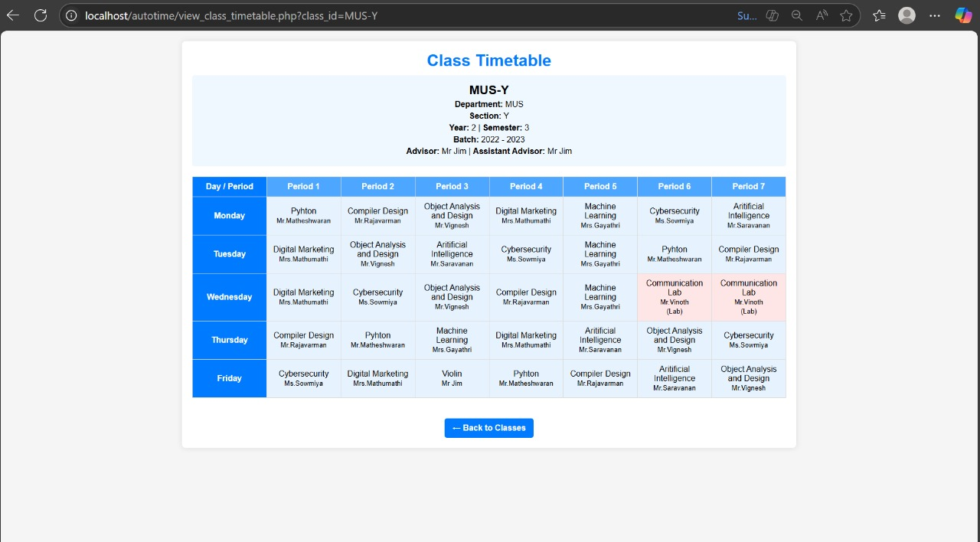
OUTPUT
11/06/2025

Slide 20
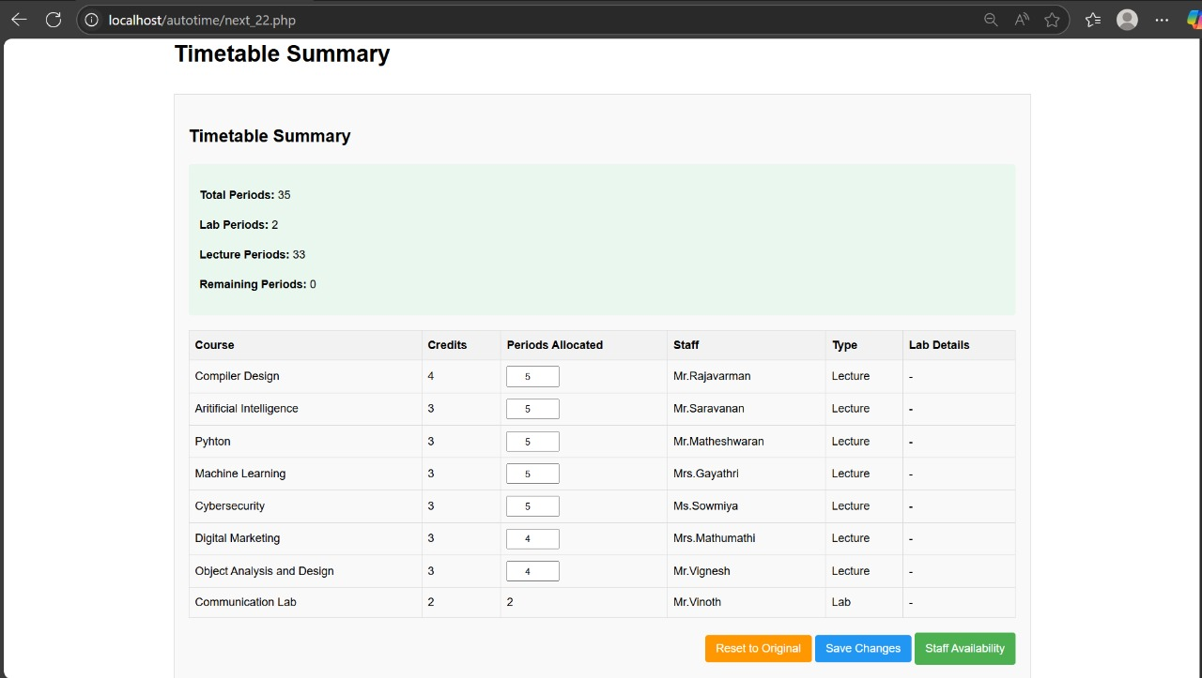
OUTPUT
11/06/2025

Slide 21
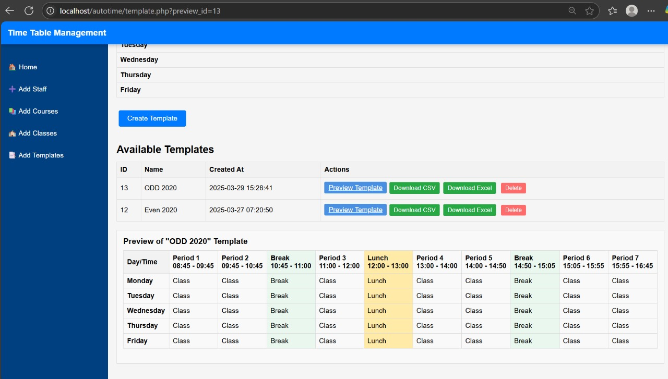
OUTPUT
11/06/2025

Slide 22
CONCLUSION & FUTURE ENHANCEMENT
The Automated Timetable Generator significantly simplifies and streamlines the process of academic scheduling. By reducing human effort and minimizing scheduling conflicts, it enhances productivity, accuracy, and resource utilization in educational institutions.
Integrate artificial intelligence or machine learning to improve timetable efficiency based on past patterns and faculty preferences.
Develop a mobile app version to allow students and faculty to view, download, and receive notifications about their timetable changes instantly.
Enable real-time conflict detection and resolution when changes occur, such as faculty leave or room unavailability.
11/06/2025

Slide 23
REFERENCES
Williams Kehinde Oladipo, Ajayi Olutayo Bamidele, and Ajinaja Micheal Olalekan, "Automatic Timetable Generation using Genetic Algorithm," International Journal of Applied Information Systems, vol. 12, no. 19, pp. 1–3, 2019.
Sanjay R. Sutar and Rajan S. Bichkar, "An Application of Genetic Algorithm for University Course Timetabling Problem," International Journal of Applied Information Systems, vol. 11, no. 3, pp. 26–30, 2016.
Bhavadharani Swaminadhan Prabhakaran, Maheswari Shanmugam, Chaaru Bhala Karunakaran, Bhumika Murugesan, and Deepalakshmi Manimaran, "Automatic Timetable Generator Using Genetic Algorithm," in Proceedings of the 6th International Conference on Intelligent Computing (ICIC-6 2023), pp. 84–89, 2023.
11/06/2025

Slide 24

DD/MM/YYYY

