Slide 1


DEPARTMENT OF COMPUTER SCIENCE AND ENGINEERING
20CS8504 & PROJECT WORK
END SEMESTER PRACTICAL EXAMINATION- APRIL / MAY - 2026
Batch No : 13
Date : 30/3/2026
Session : AN

Slide 2
TITLE OF THE PROJECT
Guide Name:
Mrs. K. Valli Priyadharshini, M.E,(Ph.D.)
Assistant Professor
CSE
Team Members:
Seralathan S (811722104136)
Uma Maheswari M (811722104171)
Vijay V (811722104182)
Vinoth T (811722104185)

Slide 3
OBJECTIVE OF THE PROJECT
To analyze patient medical data for early heart disease detection.
To evaluate key health parameters such as age and cholesterol.
To classify uploaded medical images as normal or abnormal.
To provide clear prediction explanations using Explainable AI.
To visualize prediction results using graphical representations.
To generate downloadable reports for analysis and monitoring.

Slide 4
INTRODUCTION
Heart disease is a leading global health problem requiring early detection.
Traditional diagnosis relies on manual medical data analysis.
Machine learning helps analyze medical data efficiently.
Advanced algorithms improve prediction accuracy.
Such systems support better healthcare decision-making.

Slide 5
LITERATURE SURVEY
TITLE OF PAPER | AUTHOR(S) | PAPER GIST | TECHNOLOGY USED
Advanced Heart Attack Risk Prediction Using Stacked Hybrid Machine Learning (2025) | Rudraksh Singh Bhaduaria, Iqra Javid, Anirban Khara | Multiple machine learning algorithms are combined to improve heart disease risk prediction. | Random Forest, SVM, Logistic Regression,KNN
Cardiac Clarity: Harnessing Machine Learning for Accurate Heart Disease Prediction (2025) | Sujith Santhosh, Krishnaraj Chadaga, R Vijaya Arjunan, Sandra D'Souza | Explainable AI techniques are used to improve transparency in heart disease prediction. | Random Forest, Logistic Regression, Decision Tree, XGBoost, SHAP
Heart Disease Classification From Echocardiogram Images Using Deep Learning (2025) | Muhammad Raoof, Muhammad Mahtab, Sohail Masood Bhatti, Muhammad Rashid | Deep learning models classify heart disease using echocardiogram medical images. | CNN, VGG16, Deep Learning
A Robust Heart Disease Prediction System Using Hybrid Deep Neural Networks (2023) | Mana Saleh Al Reshan, Samina Amin, Muhammad Ali Zeb, Adel Sulaiman, | Hybrid deep learning models are used to improve heart disease prediction accuracy. | CNN, LSTM, Hybrid Deep Neural Network

Slide 6
LITERATURE SURVEY
TITLE OF PAPER | AUTHOR(S) | PAPER GIST | TECHNOLOGY USED
Efficient Prediction Method for Coronary Heart Disease Risk Using Deep Neural Networks (2021) | Tsatsral Amarbayasgalan, Van-Huy Pham, Nipon Theera-Umpon, Yongjun Piao | Deep neural networks are used to improve heart disease prediction using optimized datasets. | PCA, Variational Autoencoder, Deep Neural Networks
Integrated Machine Learning Framework for Cardiovascular Disease Prediction (2021) | Aqsa Rahim, Yawar Rasheed, Farooque Azam, Muhammad Waseem Anwar | Feature selection and data balancing techniques improve heart disease prediction accuracy. | Logistic Regression, KNN, SMOTE, Feature Selection
Heart Disease Identification Method Using Machine Learning Classification in E-Healthcare (2020) | Jian Ping Li, Amin Ul Haq, Salah Ud Din, Jalaluddin Khan | ML classification models are used to detect heart disease with improved prediction accuracy. | SVM, Logistic Regression, Decision Tree, KNN, Naïve Bayes
Interpretable Hybrid Multichannel Deep Learning Model for Heart Disease Classification Using 12-Lead ECG Signal | Friedhelm Schwenker, Bisrat Derebssa Dufera, Taye Girma Debelee | Deep learning models analyze ECG signals to classify heart disease with high accuracy. | CNN, BiLSTM, Attention Mechanism, Explainable AI (SHAP, Grad-CAM)

Slide 7
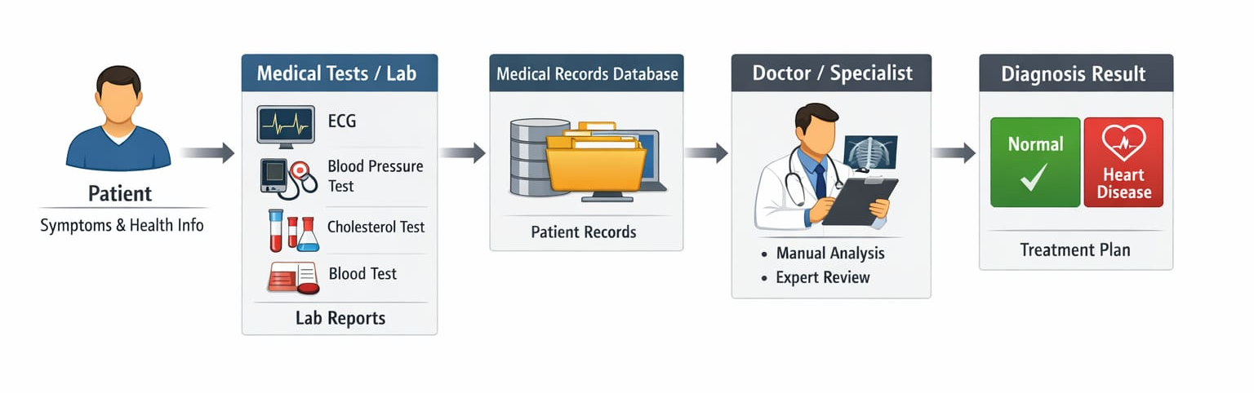
EXISTING SYSTEM ARCHITECTURE

Slide 8
PROBLEM IDENTIFIED
Traditional healthcare systems mainly store patient records.
ECG analysis is mostly performed manually by doctors.
Lack of automated analysis for clinical and ECG data.
Advanced ML models like XGBoost and CNN are rarely used.
Limited use of explainable AI reduces prediction transparency.

Slide 9
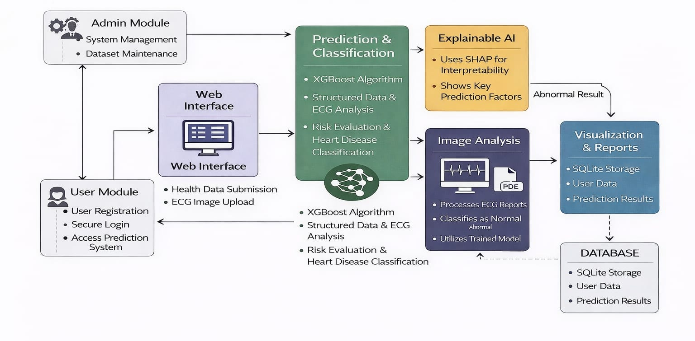
PROPOSED SYSTEM ARCHITECTURE

Slide 10
SOFTWARE AND HARDWARE REQUIREMENTS
HARDWARE
Processor : Intel Core i5 or higher
Hard Disk : 256 GB SSD or higher
Network : Internet Connection
Monitor : Standard Display Monitor
Input Devices : Keyboard and Mouse
SOFTWARE
Programming Language : Python
Backend Framework : Flask
Database : SQLite
Report Generation : ReportLab
Frontend : HTML5, CSS3, JavaScript
Supporting Libraries : NumPy, Torchvision, Scikit-learn

Slide 11
MODULES
Admin Module
User Module
Heart Disease Prediction Module
Image Classification Module
Report Generation and Visualization Module

Slide 12
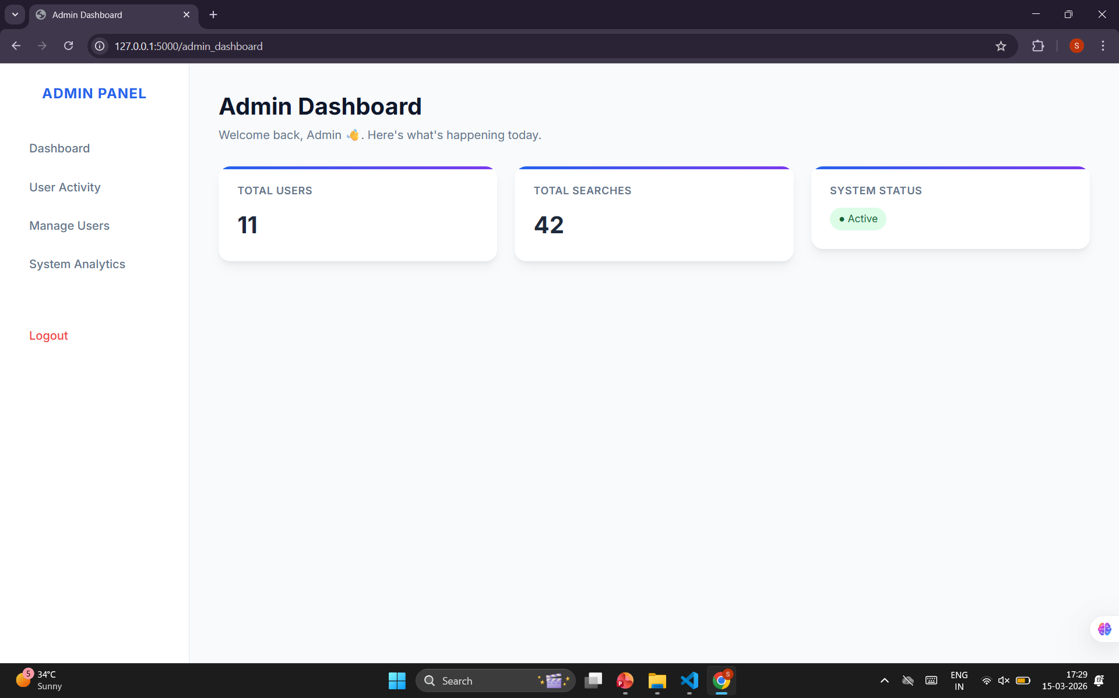
MODULE-1
Manages the overall system operations and settings.
Maintains and updates the medical datasets used for training.
Monitors system performance and model functionality.
Ensures smooth working of prediction and classification modules.

Slide 13
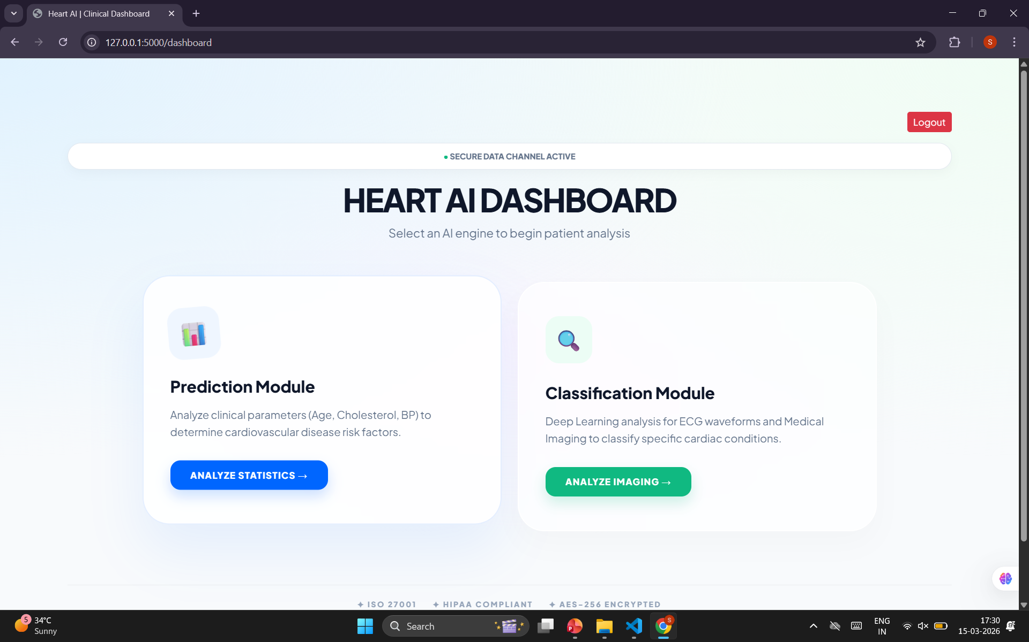
MODULE-2
Allows users to access the system through a simple interface.
Enables users to enter health-related parameters for prediction.
Provides option to upload medical images for analysis.
Displays prediction results, visualizations, and reports.

Slide 14
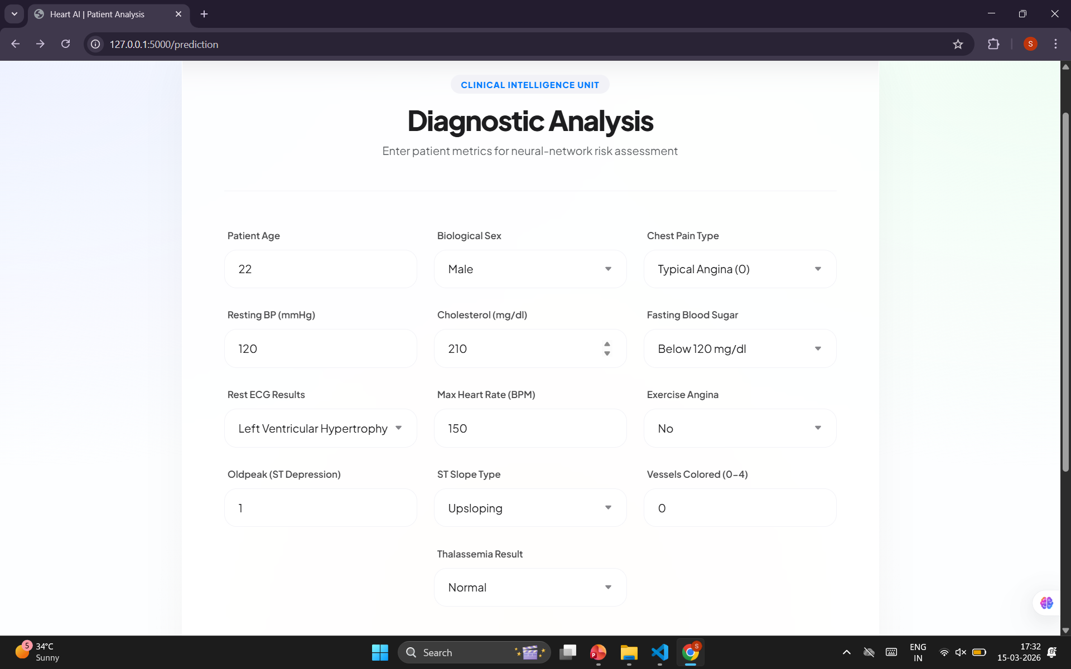
MODULE-3
Accepts patient health parameters as input.
Uses the trained XGBoost model to analyze the data.
Predicts whether the condition is normal or abnormal.
Provides explanation for predictions using Explainable AI.

Slide 15
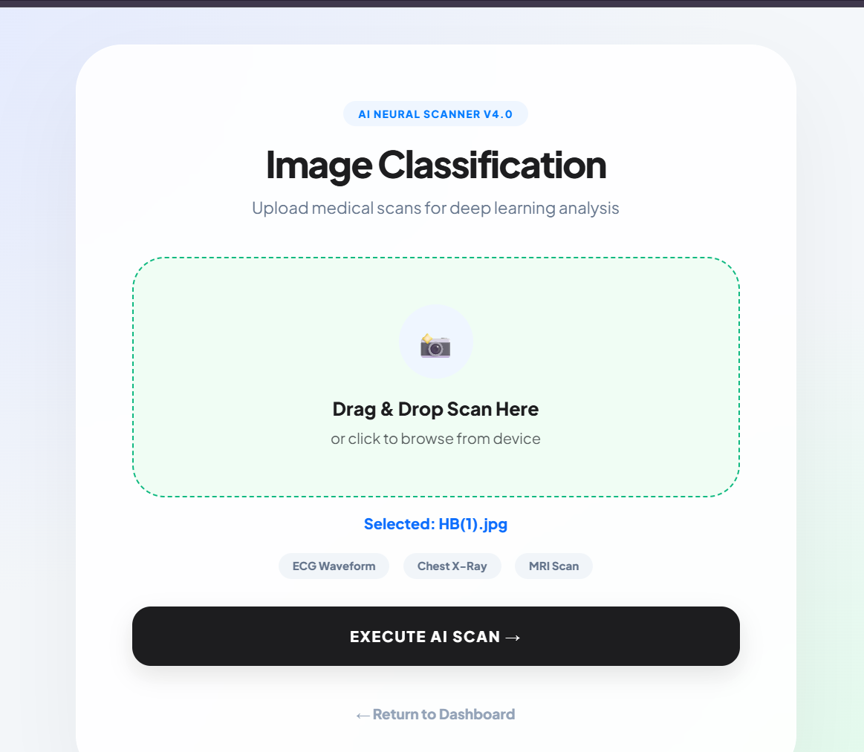
MODULE-4
Allows users to upload medical images for analysis.
Processes images using image processing techniques.
Applies machine learning model for classification.
Displays result as normal or abnormal condition.

Slide 16
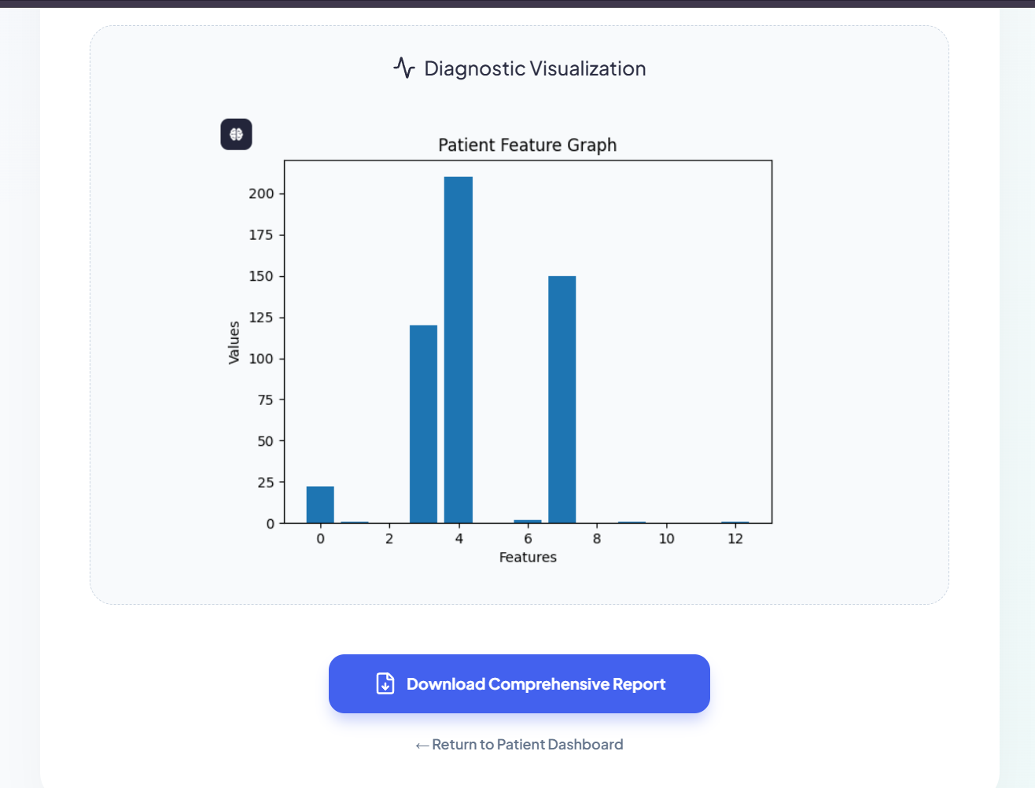
MODULE-5
Generates graphical representation of prediction results.
Displays charts and graphs for better understanding.
Creates detailed reports based on system analysis.
Allows users to download reports for future reference.

Slide 17
CONCLUSION
The system successfully predicts heart disease risk using machine learning techniques by analyzing patient health parameters and providing accurate results.
The integration of Explainable Artificial Intelligence helps users understand the factors influencing the prediction, improving transparency and reliability.
The developed system supports early detection of heart disease and can assist healthcare professionals in better monitoring and decision-making.

Slide 18
FUTURE ENHANCEMENTS
Integrate larger and more diverse medical datasets to improve prediction accuracy and system reliability.
Implement advanced deep learning models such as CNN for more accurate medical image classification.
Develop a mobile application version to allow users to access the system easily from smartphones.
Integrate real-time health monitoring devices to automatically collect patient health data for continuous analysis.

