Slide 1
Capstone Project - The Battle of Neighborhoods
IBM Data Science

Slide 2
Business Problem
Business request to come up with recommendations of possible best pizza restaurant location in the Toronto city. And provide a report with more insight about various other influencing factors in the location for the business such as competitors, nearby shopping places and restaurants etc.
Data Source
Foursquare API is used as primary data source for this analysis.
Below Data sources for our analysis in Toronto around the 5000m radius
Pizza shops
Restaurants
shopping places

Slide 3
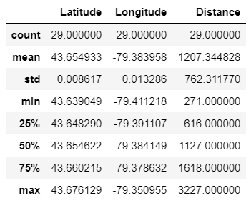
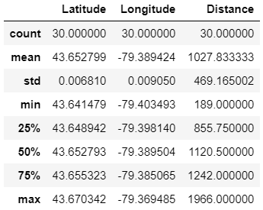
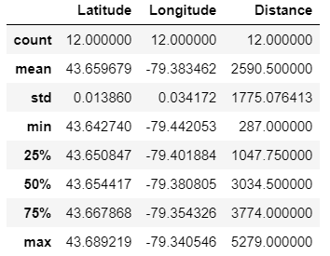
Data Statistics
Pizza Shops
Restaurants
shopping

Slide 4
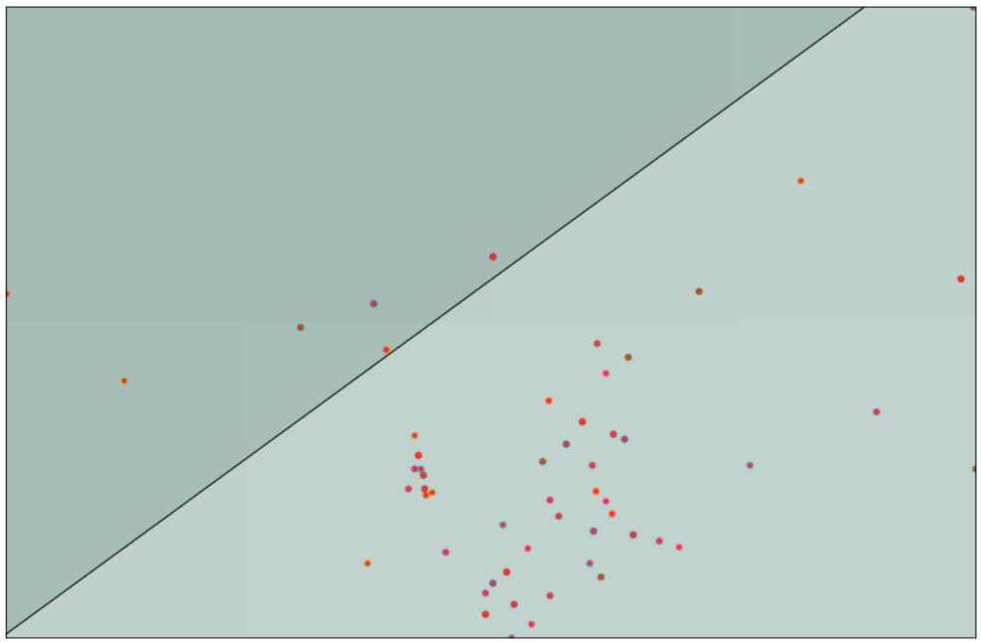
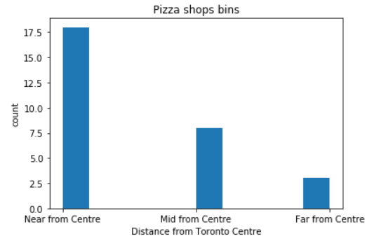
Pizza Shops Distribution
Base map visualization using location

Slide 5
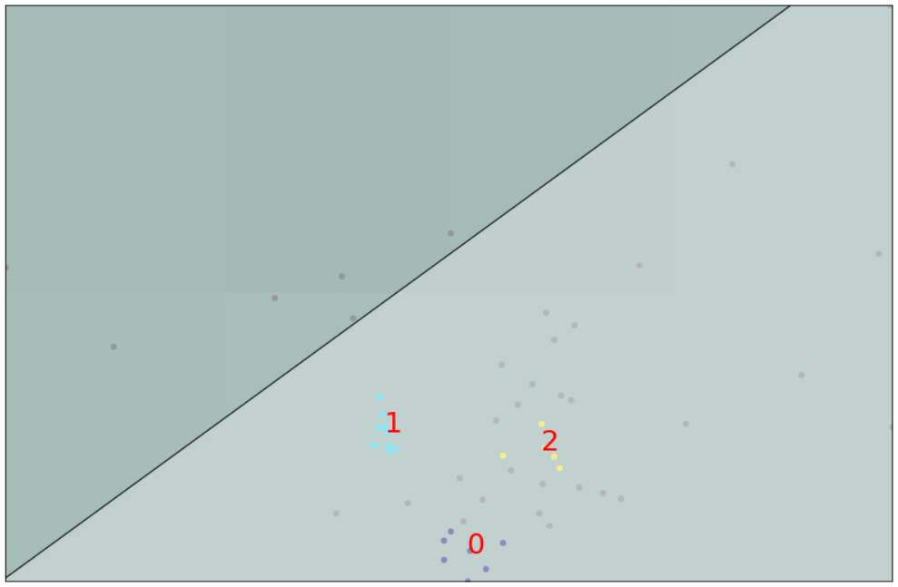
Classification Cluster Modelling - DBSCAN

Slide 6
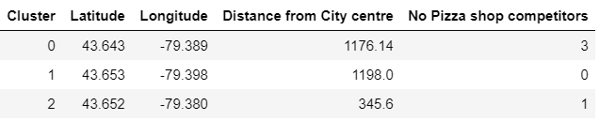
Conclusion and Recommendation
If there are more happening places in that location. and number of pizza shops are less, then there is good chance to launch a pizza shop in that place.
Note that mean distance of current pizza shops are around 1207.344 meters from city center. This give an idea about how the competitors are strategically running their business.
This analysis could be further enhanced by collecting the further data from each of the venues based on ratings, feedbacks.

