Slide 1

Data Warehousing package built on top of Hadoop

Slide 2
Topic of today
What is hive?
Where to use hive?
Why go for hive when pig is there?
Let’s start – Hive Architecture
Hive Components
Hive Background
How Facebook uses hive
Limitation of hive
Abilities of hive query language
Difference with traditional RDBMS
Hive Types
Examples

Slide 3
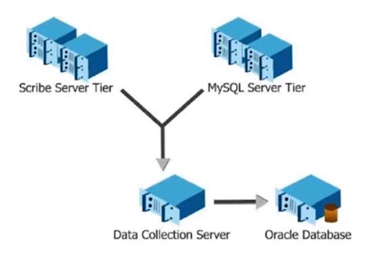
Hive Background
Started at Facebook
Data was collected and stored into Oracle DB
Data Grew from 10s of GB (2006) to 1 TB/day new data(2007)

Slide 4
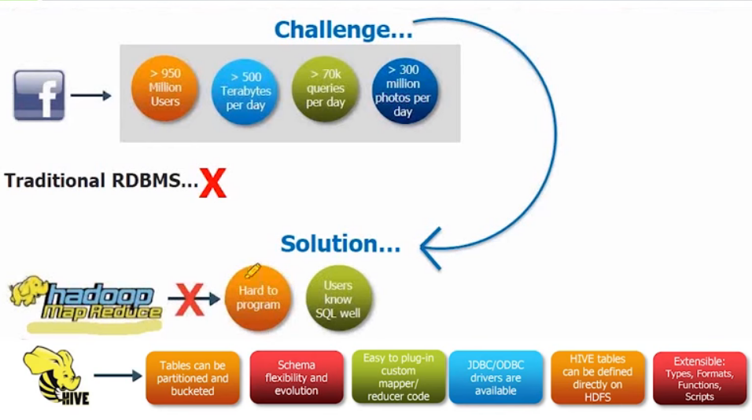
Hive use case @ Facebook

Slide 5
What is Hive
Data Warehousing package built on top of Hadoop
Used for data analysis
Targeted towards users comfortable with SQL
It is similar to SQL and called HiveQL.
For managing and querying structured data
No need to learn Java and Hadoop APIs
Developed by Facebook and contributed by community.
Facebook analyzed several Terabytes of data every day using Hive

Slide 6
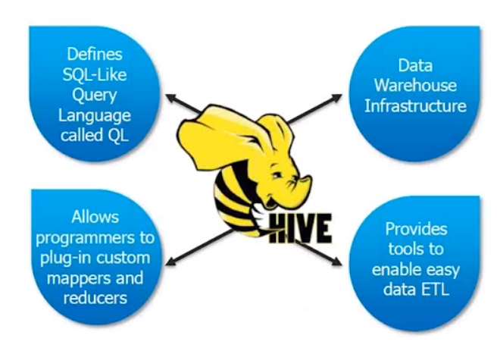
What is Hive

Slide 7
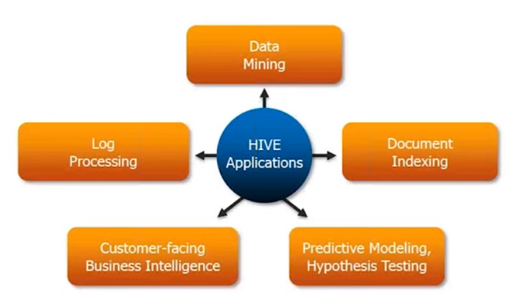
Why go for Hive When Pig is there

Slide 8


Why go for Hive When Pig is there
PigLatin: | HiveQL:
Procedural data-flow language A=load’mydata’; Dump A; | Declarative SQLish language Select * from ‘mytable’;
Pig is used by programmer and Researchers | Hive is used by Analysts generating daily reports

Slide 9
Pig vs Hive
Features | Hive | Pig
Language | SQL-like | Piglatin
Schemas/Types | Yes(Explicit) | Yes(Implicit)
Partitions | Yes | No
Server | Optional(Thrift) | No
User Defined Functions(UDF) | Yes(Java) | Yes(Java)
DFS Direct access | Yes | Yes
Join/Order/Sort | Yes | Yes
Shell | Yes | Yes
Web Interface | Yes | No
JDBC/ODBC | Yes | No

Slide 10
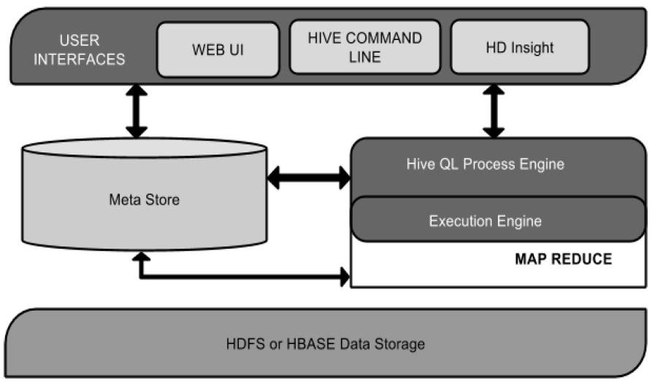
Hive Architecture

Slide 11
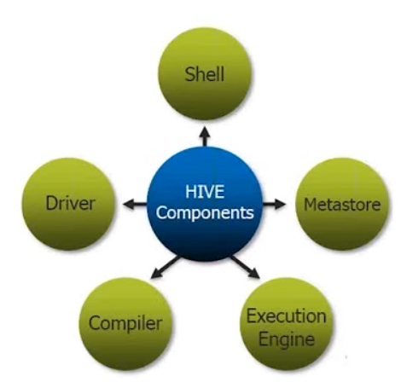
Hive Components

Slide 12
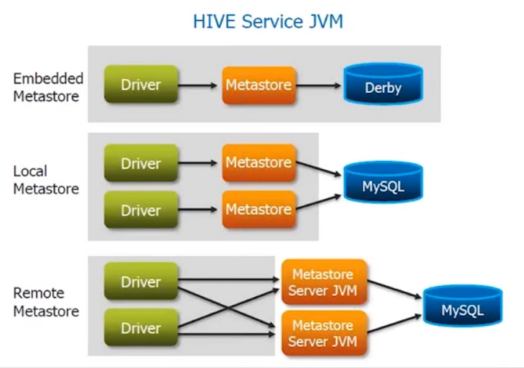
Metastore

Slide 13
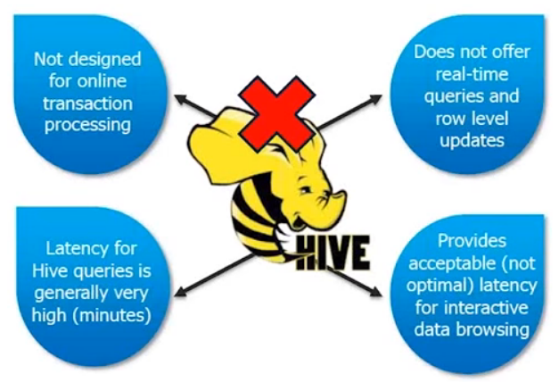
Limitations of Hive

Slide 14
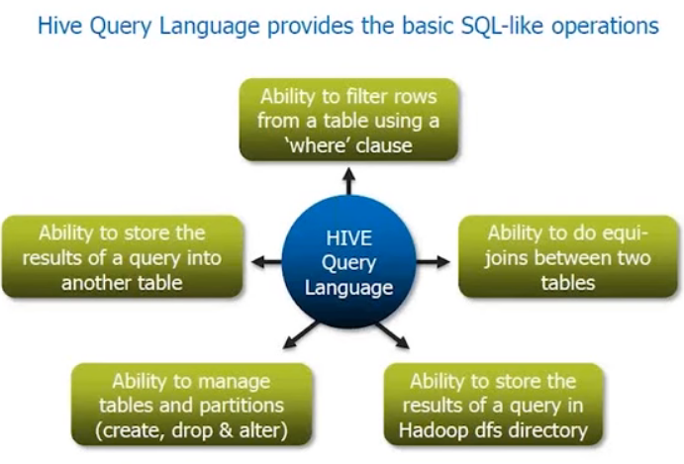
Abilities of Hive Query Language

Slide 15
Difference with Traditional RDBMS
Schema on Read vs Schema on Write
Hive does not verifies the data when it is loaded, But rather when a query is issued.
No Updates, Transactions and Indexes

Slide 16
Serialization and Deserialization
Serialization is used when writing data
Like “INSERT-SELECT” Statement
Deserialization is used during query time
Like execute “SELECT” Statement

Slide 17
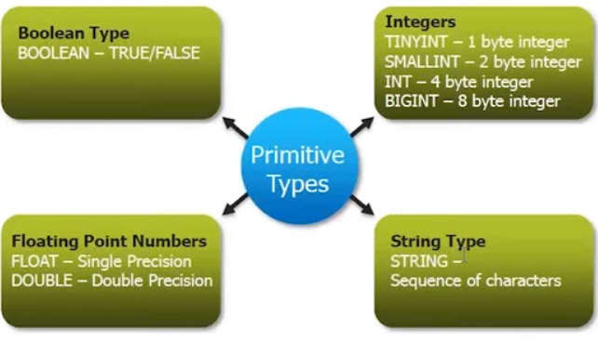
Type System

Slide 18
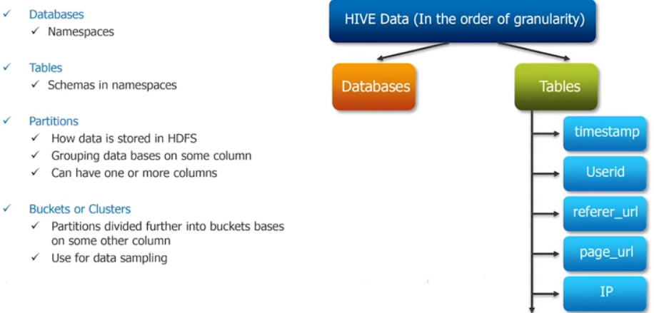
Hive Data Models

Slide 19
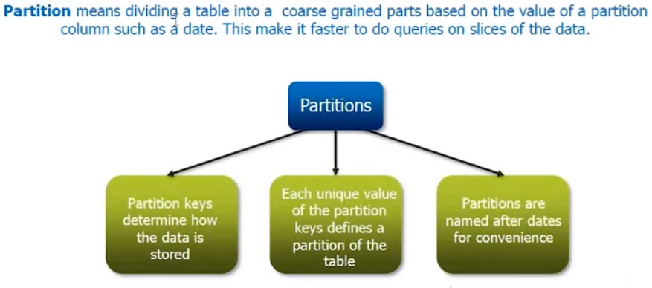
Partitioning

Slide 20
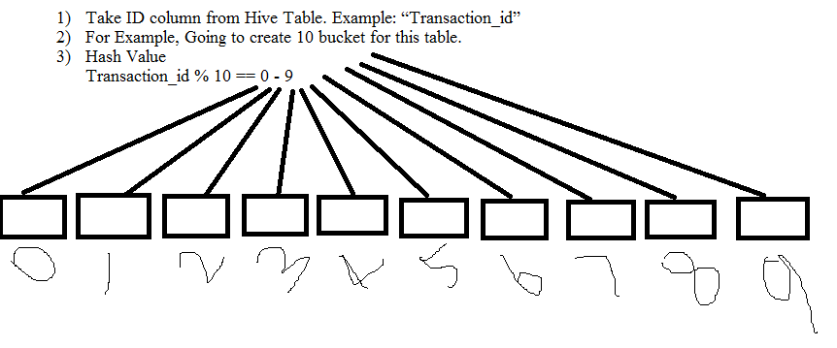
BUCKETING
Bucket concept is based on (Hashing function) mod (By total number of bucket)

