Slide 1
Media Mix Modelling
By
Vinoth

Slide 2
Agenda
MMM
Data
Flow Diagram
Data Pre-processing & Dataset
Model Building
MMM Modeling
Sigmoid Curve
Optimized Spending
Deliverables and Insights

Slide 3
What is MMM?
Media mix modeling uses historical data on sales activity and media activity in order to quantify the return on investment of media activity. So the media activities such as—TV advertising, radio, print, online, search engine, mobile apps, and more—are simulated to increase, to determine the amount of increase, in sales caused by these media activities.
The return on investment can be done, the simulation can be done, not just for one type of media but for an entire media plan. So the amount of spending by media type across month of the year to fill out your annual budget. The simulation can be done for this entire media plan in order to optimize the spend and the media activities (to optimize your spending to increase your sales to the optimal level).
The return on investment can be done, the simulation can be done, not just for one type of media but for an entire media plan. So the amount of spending by media type across month of the year to fill out your annual budget. The simulation can be done for this entire media plan in order to optimize the spend and the media activities (to optimize your spending to increase your sales to the optimal level).

Slide 4
DATA
Sales data
Marketing data
Advertising Company data
Market Competitors data
Weather data
Macro economic
Weather
Historical Media spend
Ideal Campaign period
Budget/Media pressure

Slide 5
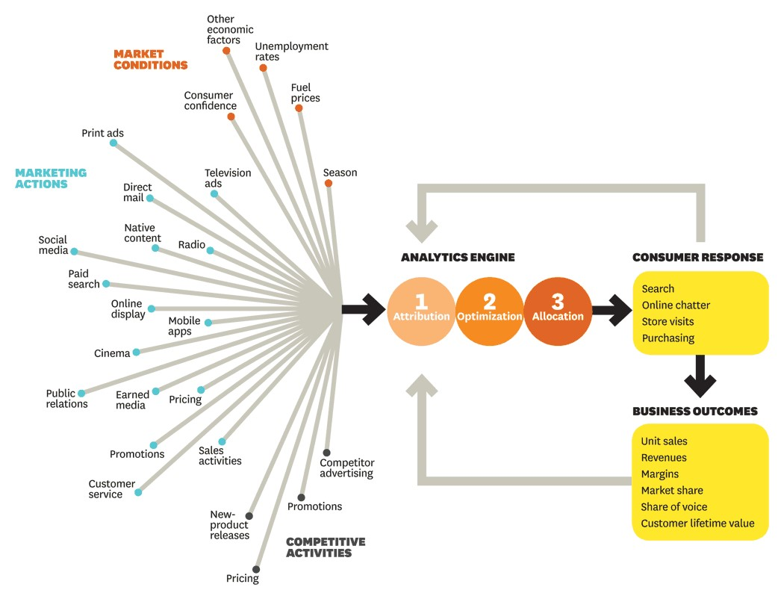
Flow Diagram

Slide 6
Data Pre-processing & Dataset
EDA
Target Column
Missing Values
Column types
Anomalies
Correlations
Feature Engineering
Imputation
Handling Outlier
Binning
Encoding
Scaling & Feature Split
Feature Selection
Feature Selector
SelectKBest & RFE

Slide 7
Model Building Steps
Load the data
Pre-process the data – Data cleaning and Data conversion
Feature Analysis & Extraction
Categorical encoding
Exploratory Data Analysis
Model fitting & Hyper-parameter tuning
Pick the best
Evaluate with new data

Slide 8


MMM Modeling
Sales Equation
Multi-Linear Regression
Linear and Non-Linear Impact of predictors eg TV GRP
Base Sales(No Ads Market value) and Incremental Sales (with Multiple Ads)
Contribution Charts (https://www.arymalabs.com/blogDetails.aspx?id=4)
Deep Dives
Budget Optimization

Slide 9
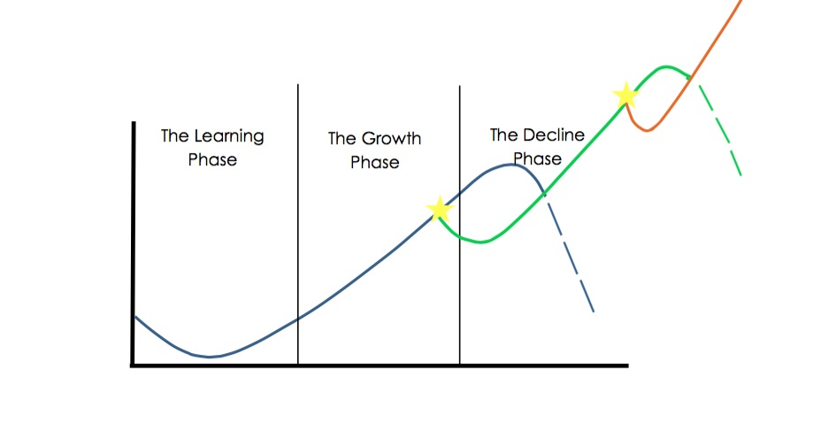
Sigmoid Curve
The Learning Phase
The Growth Phase
The Decline Phase
By surfing the Sigmoid Curve and taking leaps every time you hit the peak of a Growth Phase, your business will experience growth phase after growth phase after growth phase with only minor dips in profit, as opposed to a malignant crash.
growth
Time

Slide 10
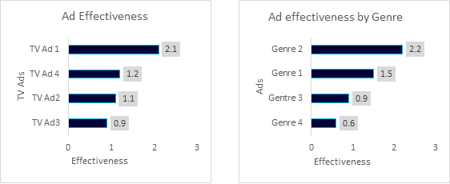
Optimized Spending
Sales Equation
Deep Dives
Deep Dives can be used to assess the effectiveness of each campaign by understanding which campaigns or creatives work better than the other ones. It can be used to do a copy analysis of creatives by genre, language, channel etc.
Insights from Deep Dives are considered for Budget optimization. Money is shifted from low performing channels or genres to high performing channels/genres to increase overall sales or market share.
Budget Optimization
Budget optimization is one of the key decisions to be taken for planning purposes.
MMM approach, it is established that which mediums are working better than the other ones. Then, budget allocation is done, by shifting money from low ROI mediums to high ROI mediums thus maximizing sales while keeping the budget constant.

Slide 11
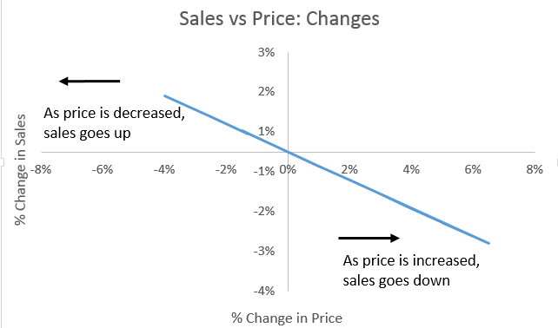

Optimized Spending
Sales Equation
Elasticity
Elasticity is a measure of the degree to which one variable would be impacted as a result of change in the other variable.Insights from Deep Dives are considered for Budget optimization.
If you have sales as a dependent variable, elasticity would be defined as the degree to which sales would be impacted as a result of change in an input variable..

Slide 12
Deliverables and Insights
INTEGRATED MARKETING DATA MANAGEMENT PLATFORM:
PREDICTIVE STATISTICAL MODELS
CONSULTATIVE DISCOVERY AND VALUE PROPOSITION:
EXPERIENCED CONSULTATIVE SUPPORT AND VALUE:
Insights that report granular results — of specific campaigns, tactics, products, retailers or geographies — allow you to take specific actions to improve results. For example, how drivers of sales differ depending on product variants.

Slide 13
Five KEY Important to succeed MMM
Which sales drivers are included in the Media mix model?
How is data collected?
What level of granularity are the data inputs?
How do you ensure the accuracy of the data inputs?
How granular are the insights?

Slide 14

Any queries?

Slide 15
Thank you

