Slide 1


KGiSL Institute of Technology
(Approved by AICTE, New Delhi; Affiliated to Anna University, Chennai)
Recognized by UGC, Accredited by NBA (IT)
365, KGiSL Campus, Thudiyalur Road, Saravanampatti, Coimbatore – 641035.
EARLY CHRONIC KIDNEY DISEASE PREDICTION USING MACHINE LEARNING
HARIPRIYA C-711719205019
SRI RANGANATH M-711719205054
VINITHA V-711719205061
VINOTHINI J-711719205062
GUIDED BY
Mr.SURESHKUMAR C
Assistant Professor - IT

Slide 2
ABSTRACT
Chronic Kidney Disease prediction is one of the most important issues in healthcare analytics. The most interesting and challenging tasks in day-to-day life is prediction in medical field and proper balanced diet.
10% of the population worldwide is affected by chronic kidney disease (CKD), and millions die each year because they do not have access to affordable treatment. Chronic kidney Disease can be cured, if treated in the early stages.
The main aim of this project is to predict whether the patient have chronic kidney disease or not, in more accurate and faster way based on certain diagnostic measurements like Blood Pressure (Bp), Albumin(Al) and also provide the food and medical suggestions.
Machine learning (ML) can help predict CKD risk, and a combined food and exercise recommendation system can help patients less the effectiveness of the disease.

Slide 3
INTRODUCTION
Chronic kidney disease (CKD) has emerged as a problem for the world's health. As a result of the injury, the kidneys are unable to filter hazardous wastes from the body. The proposed method primarily focuses on applying regression algorithms to forecast this fatal condition, Chronic Kidney Disease (CKD) (random forest). The proposed method automates the diagnosis of chronic renal disease using supervised learning algorithms and regression techniques. The dataset was created using data from a machine learning repository and includes 25 parameters (features), including the class, that were collected from a survey of CKD patients in India last year (CKD or NOT CKD).

Slide 4
EXISTING SYSTEM
By using dataset of CKD patients within 14 attributes and 200 records to use various machine learning techniques like SVM.
Dataset that requires unrelated disease-related fields.
The prediction process takes more time.
By giving the values it classifies whether the person has chronic kidney disease or not.

Slide 5
PROPOSED SYSTEM
The proposed dataset was gathered from a medical survey conducted throughout India in 2022 and was trained and tested using the random forest regression algorithm, which produces more accurate results.
Dataset that contains more related disease-related fields.
The prediction process takes less time.
Recommendations for healthy food, yoga and exercise to avoid chronic kidney disease.
By giving the values it predicts the accurate values and that are classified to three stages.

Slide 6
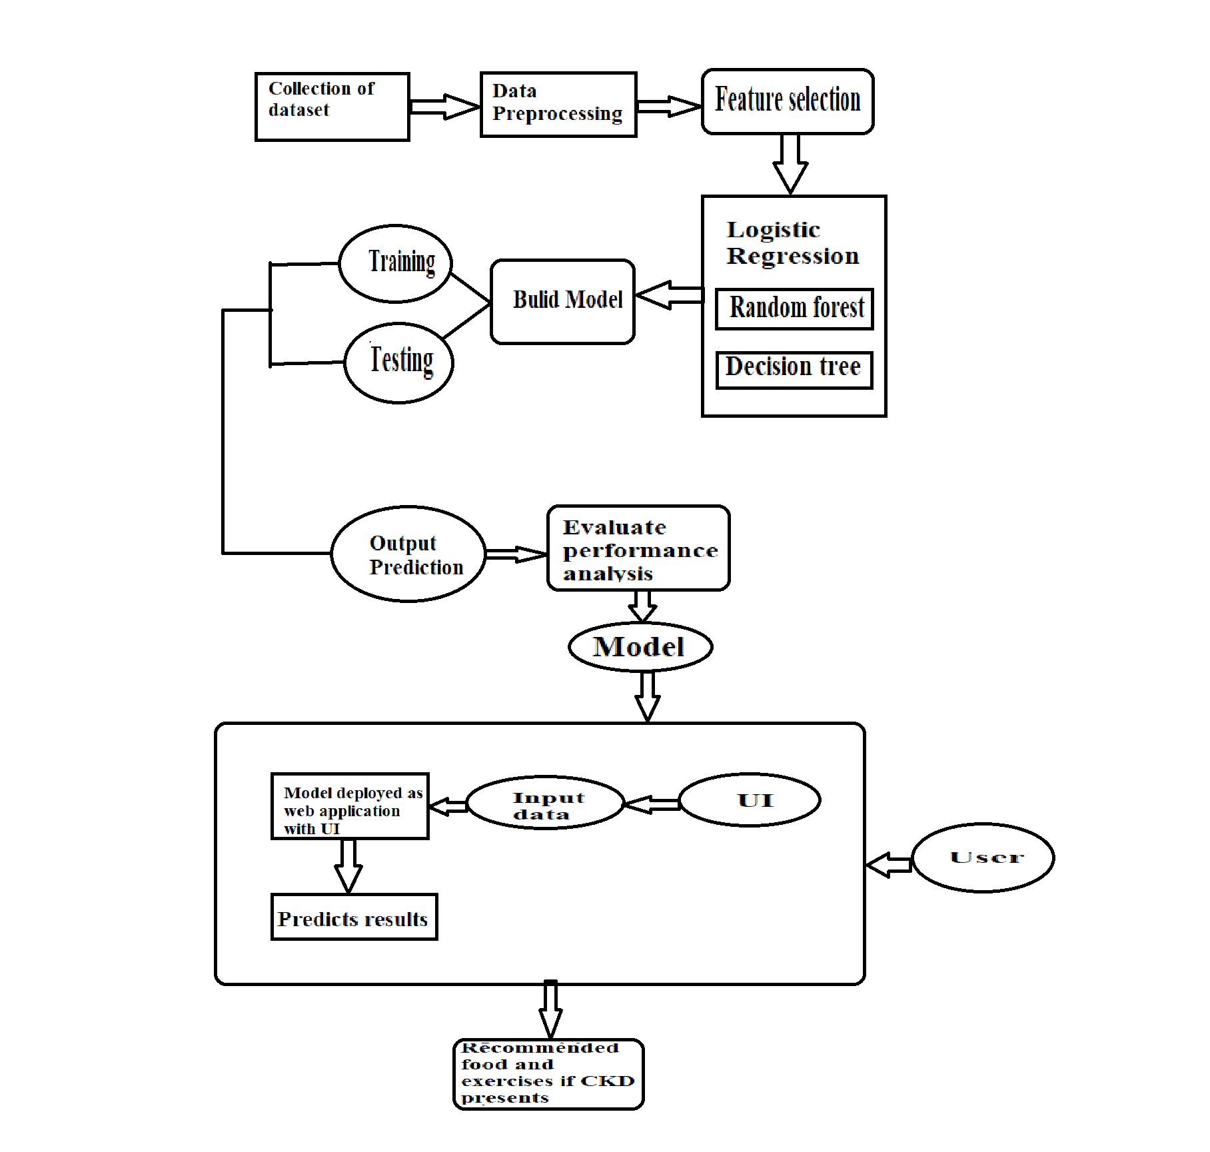
SYSTEM ARCHITECTURE

Slide 7
MODULE DESCRIPTION
1. Data preprocessing component: This component is responsible for cleaning and preprocessing the patient data before it is fed into the regression machine learning model. The data preprocessing component may include tasks such as data cleaning, data normalization, feature selection, and data transformation.
2. Regression model: This component uses various regression algorithms such as linear regression, random forest regression to predict the likelihood of a patient developing CKD. The regression model is trained on a dataset containing patient data and corresponding CKD status.

Slide 8
MODULE DESCRIPTION
3. Evaluation metrics: An evaluation metric quantifies the performance of a predictive model. This typically involves training a model on a dataset, using the model to make predictions on a holdout dataset not used during training, then comparing the predictions to the expected values in the holdout dataset.
4. User interface: The user interface component provides an easy-to-use interface for healthcare providers to input patient data and obtain CKD prediction results.It also provides the recommendations of food , excercise and yoga that they should follow.

Slide 9
SYSTEM REQUIREMENTS :
SOFTWARE REQUIREMENTS:
Operating System: Windows 8 (minimum)
Language: Python,HTML,CSS,Javascript,bootstrap,flask
Version: Python 3.8.16 (64 bit or 32 bit)
IDE: Visual Studio Code
HARDWARE REQUIREMENTS
i3 Processor with 4 GB Ram

Slide 10
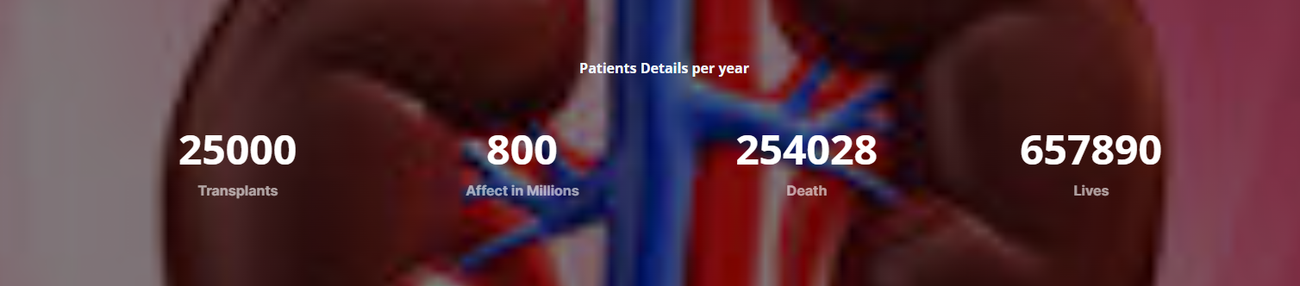
PATIENT DETAILS

Slide 11
DATASET
Dataset contains of 25 parameters that are namely described below
1. age - age (in years)
2. bp - blood pressure (mm/Hg)
3. sg - specific gravity (nominal - 1.005 ,1.010,1.015,1.020,1.025)
4. al - albumin (0-5)
5. su - sugar
6. rbc - red blood cells (normal , abnormal)
7. pc - pus cell (Pyuria) , (normal , abnormal )
8. pcc - pus cell clumps (white cells with pyuria) ,(present , not present)
9. ba - bacteria (present , not present)
10. bgr - blood glucose random in mgs/dl
11. bu - blood urea in mgs/dl
12. sc - serum creatinine mgs/dl

Slide 12
DATASET
13. sod - sodium in mEq/L
14. pot - potassium in mEq/L
15. hemo - hemoglobin in gms
16. pcv - packed cell volume
17. wc - white blood cell count in cells/cumm
18. rc - red blood cell count in millions/cmm
19. htn - hypertension (yes or no)
20. dm - diabetes mellitus (yes or no)
21. cad - coronary artery disease (yes or no)
22. appet - appetite (yes or no)
23. pe - pedal edema (yes or no)
24. ane - anemia (yes or no)
25. class - classification (ckd , not ckd)

Slide 13
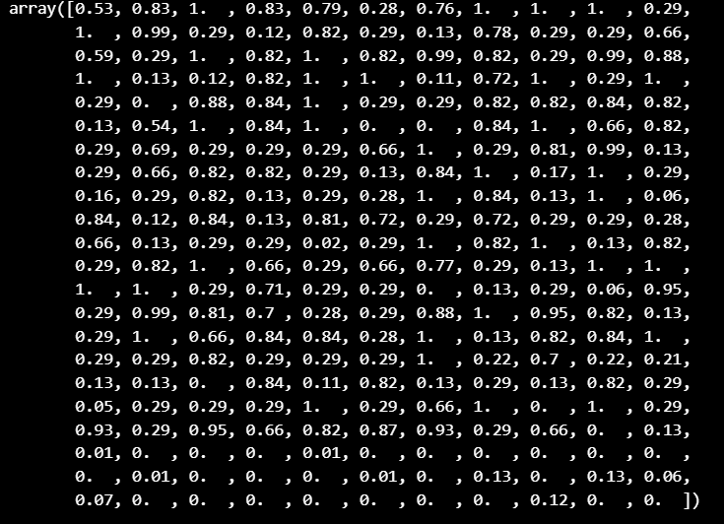
PROCESSED DATA
Array of trained and processed data with accurate results for the records in the dataset.

Slide 14
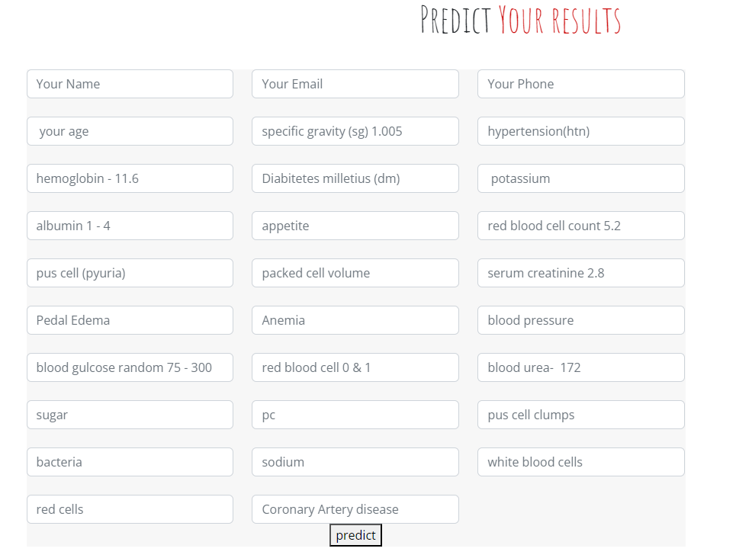
INPUT FIELDS

Slide 15
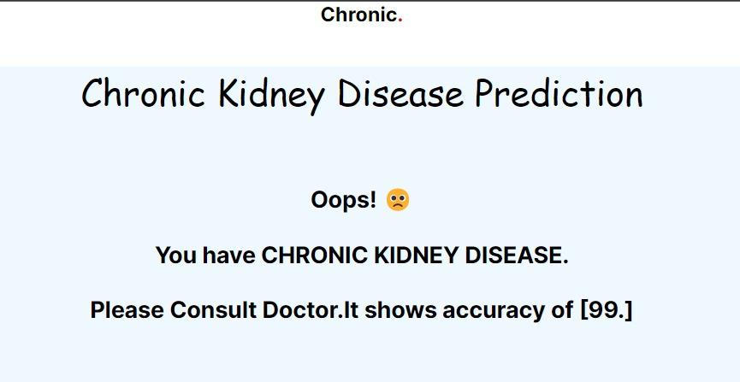
RESULT
STAGE 1:

Slide 16
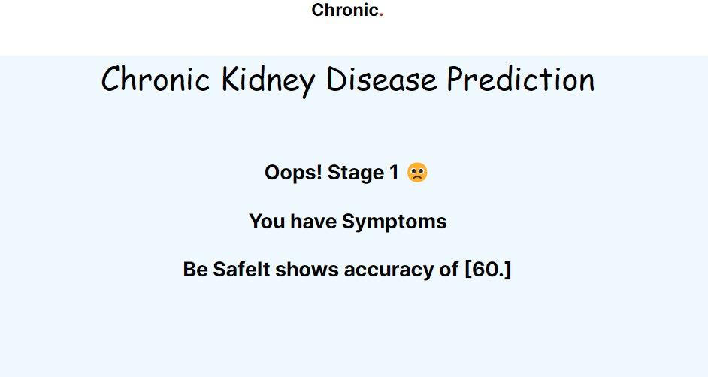
RESULT
STAGE 2:

Slide 17
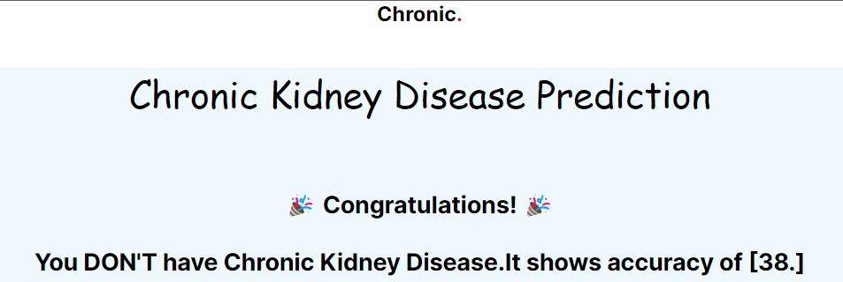
RESULT
STAGE 3:

Slide 18
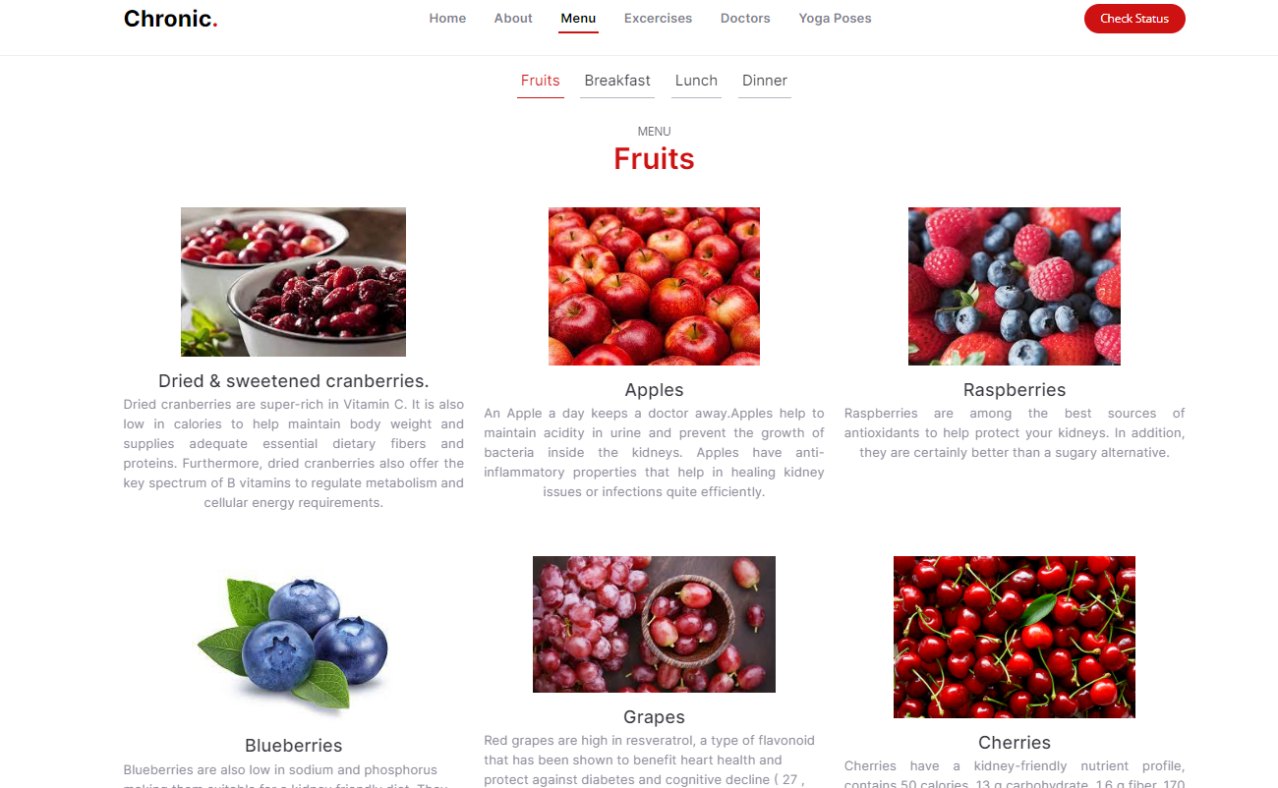
RESULT

Slide 19
FUTURE ENHANCEMENT
One potential enhancement to the proposed ML-based system for early CKD detection is the integration of image processing techniques to analyze kidney images and identify early signs of kidney damage. This would involve incorporating machine learning algorithms that can accurately classify kidney images into normal or damaged kidney tissue. The integration of image processing would allow for a more comprehensive and accurate assessment of CKD risk.

Slide 20
REFERENCE
Optimal Feature Selection for Chronic Kidney Disease Classification using Deep Learning Classifier K. Shankar;P. Manickam;G. Devika;M. Ilayaraja 2018 IEEE International Conference on Computational Intelligence and Computing Research (ICCIC).
Survey on Diagnosis of Chronic Kidney Disease UsingMachine Learning Algorithms A. Vijayalakshmi;V. Sumalatha 2020 3rd International Conference on Intelligent Sustainable Systems (ICISS).
Analysis of Chronic Kidney Disease Dataset by Applying Machine Learning Methods Yedilkhan Amirgaliyev;Shahriar Shamiluulu;Azamat Serek 2018 IEEE 12th International Conference on Application of Information and Communication Technologies (AICT).
Predicting the Chronic Kidney Disease using Various Classifiers Pramila Arulanthu;Eswaran Perumal 2019 4th International Conference on Electrical, Electronics, Communication, Computer Technologies and Optimization Techniques (ICEECCOT).
Early Discovery of Chronic Kidney Disease by Attributing Missing Values S. Madhavi;Pathmanaban. J;Sangeetha. S;Riya K S 2022 6th International Conference on Trends in Electronics and Informatics (ICOEI)

Slide 21
REFERENCE
Multilevel Ensemble Method to Identify Risks in Chronic Kidney Disease Using Hybrid Synthetic Data,Karamsetty Shouryadhar;P Kiran Rao;Subarna Chatterjee, 2022 13th International Conference on Computing Communication and Networking Technologies (ICCCNT).
Chronic Kidney Disease Detection using AdaBoosting Ensemble Method and K-Fold Cross Validation N. Mohana Suganthi;Jemin V.M;P. Rama;E. Chandralekha 2022 International Conference on Automation, Computing and Renewable Systems (ICACRS).
Intelligent Systems for Diagnosis of Chronic Kidney Disease – A Review Arvind Sharma;Dalwinder Singh 2022 10th International Conference on Reliability, Infocom Technologies and Optimization (Trends and Future Directions) (ICRITO).
Texture analysis of ultrasound images of chronic kidney disease Fadil Iqbal;Aruna S. Pallewatte;Janaka P. Wansapura 2017 Seventeenth International Conference on Advances in ICT for Emerging Regions (ICTer)
Predicting Chronic Kidney Disease by Applying Feature Engineering & Performance Analysis of Machine Learning Classifiers R. Praveen Kumar;Sarath Erive;Ganta Jayasri;Annapalli Srujana;Vallala Niharika 2021 5th International Conference on Electronics, Communication and Aerospace Technology (ICECA).

Slide 22
Thank You

