Slide 1

ARTIFICIAL INTELLIGENCE IN HEALTHCARE
ML/DL Tutorial
Vinoth Madhavan

Slide 2
Introduction to AI
Artificial Intelligence (AI): The largest circle represents AI, which encompasses all technologies and systems designed to simulate human intelligence.
Machine Learning (ML): Within AI, machine learning is a subset focused on algorithms that allow computers to learn from data and improve over time without being explicitly programmed.
Deep Learning (DL): A further subset of machine learning, deep learning involves neural networks with many layers, enabling the analysis of complex patterns in large datasets.
NLP & Generative AI stays inside Deep Learning Umbrella
Artificial Intelligence
Machine Learning
Deep Learning
NLP Foundational Tasks
LLM
Generative AI

Slide 3
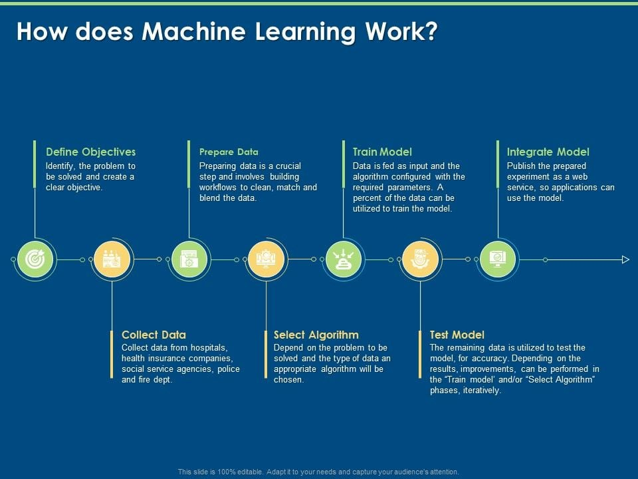
Notes:
"Machine Learning follows a structured process, and this slide outlines the key steps involved.
Define Objectives – First, we identify the problem that needs to be solved. Having a clear objective helps in selecting the right approach for our model.
Collect Data – We gather relevant data from various sources such as hospitals, insurance companies, social service agencies, police, and fire departments. The quality of data significantly impacts the model's performance.
Prepare Data – Data preparation is a crucial step. It includes cleaning, matching, and blending data to ensure it is suitable for training a machine learning model.
Select Algorithm – Based on the problem type and available data, we choose an appropriate algorithm. Different algorithms work best for different use cases, such as regression for prediction or clustering for grouping data.
Train Model – The selected algorithm is applied to a portion of the dataset, where the model learns patterns and relationships. The training phase involves tuning parameters to improve accuracy.
Test Model – The remaining data is used to evaluate the model’s performance. If the accuracy is not satisfactory, we may go back to the previous steps and refine the model iteratively.
Integrate Model – Once the model performs well, it is deployed as a web service or API so that applications can use it in real-world scenarios.
This process is iterative, meaning that based on test results, we may need to fine-tune the model by adjusting data, changing algorithms, or modifying training techniques to achieve better accuracy."

Slide 4
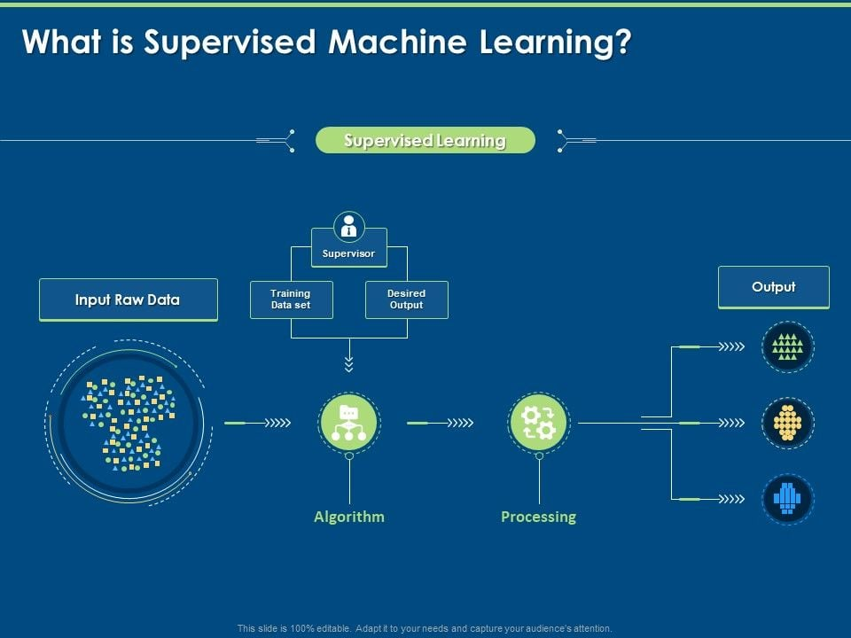
Notes:
"Supervised Machine Learning is a type of learning where the model is trained using labeled data. This means we provide both the input data and the corresponding correct output during training. Let’s go through the process step by step:
Input Raw Data – The process begins with collecting raw data, which contains different patterns and features. However, this data alone is not useful until we associate it with corresponding labels.
Training with Supervision – In supervised learning, a ‘supervisor’ (which could be a predefined dataset or a human expert) provides a training dataset that includes both input features and the correct output labels. The model learns by mapping inputs to the expected outputs.
Algorithm Selection – Based on the problem type (classification or regression), an appropriate algorithm is selected. Examples include Decision Trees, Support Vector Machines, or Neural Networks.
Processing and Learning – The selected algorithm processes the training data, identifies patterns, and creates a mapping between inputs and outputs. This is where the model learns the relationships in the data.
Generating Output – Once trained, the model is tested with new, unseen data to predict outcomes based on learned patterns. The outputs could be:
Classification – Assigning labels (e.g., spam or not spam in emails).
Regression – Predicting numerical values (e.g., house price prediction).
Pattern Recognition – Detecting objects in images, voice recognition, etc.
Supervised learning is widely used in applications such as fraud detection, medical diagnosis, and recommendation systems. It is a foundational concept in machine learning, ensuring models can make accurate predictions based on historical data."

Slide 5
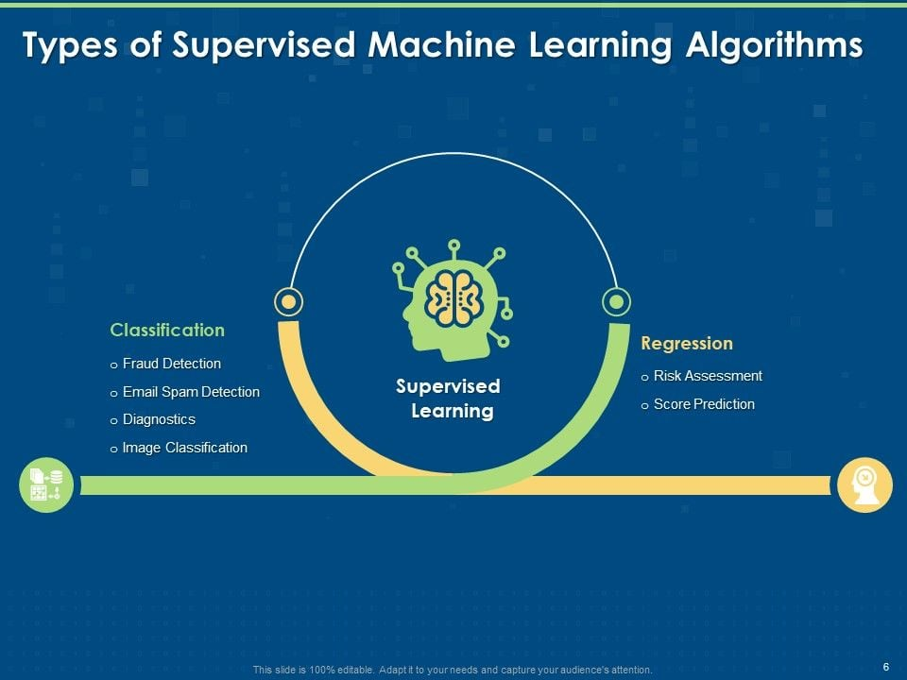
Notes:
"Supervised Learning is broadly classified into two types of algorithms: Classification and Regression. Let’s understand their differences and applications.
Classification
Classification algorithms predict discrete labels or categories.
They help answer questions like ‘Is this email spam or not?’ or ‘Is a transaction fraudulent or genuine?’.
Examples of classification applications:
Fraud Detection – Identifies fraudulent transactions in banking.
Email Spam Detection – Filters out spam emails based on features like sender, content, and past user behavior.
Diagnostics – Used in healthcare to classify diseases based on symptoms and test results.
Image Classification – Recognizes objects in images (e.g., classifying cats vs. dogs).
Regression
Regression algorithms predict continuous numerical values rather than categories.
They help answer questions like ‘What will be the price of a house?’ or ‘What will be a customer’s credit risk score?’.
Examples of regression applications:
Risk Assessment – Used in insurance and finance to assess customer risk scores.
Score Prediction – Applied in education, sports, and finance to predict scores or future values.
Choosing between classification and regression depends on whether the output variable is categorical or continuous. Both play a crucial role in various industries, powering AI-driven decision-making processes."

Slide 6
PROBLEM STATEMENT – Binary Classification
Problem Statement:
Develop a predictive model to determine the likelihood of a patient expiring based on hospital admission data and lab results.
The key challenge is classifying whether patients, who utilized or did not utilize ICU services, are at risk of expiration.
Objective: Predict patient outcomes to improve resource allocation and intervention strategies.
Data Used: Patient admission details, lab results, ICU utilization status.
Target: Binary classification - 'Expired' or 'Not Expired'.
Notes:
"This slide introduces the problem of classifying tumors as either malignant or benign, which is a fundamental classification problem in machine learning and medical diagnostics.
Discrete Outcomes
Since the tumor can either be malignant (cancerous) or benign (non-cancerous), this is a binary classification problem.
The goal is to predict the correct category based on input features such as tumor size, shape, and texture.
Classification Approach
This problem falls under the classification framework, as we are dealing with categorical outcomes.
Machine learning models such as logistic regression, decision trees, and support vector machines are commonly used for this type of task.
Decision-Making
The goal is to develop a model that helps automate the decision-making process.
Instead of relying solely on human judgment, an AI-driven model can assist doctors in making faster and more accurate predictions.
Medical Diagnosis
Similar to other medical diagnosis problems, the model will analyze patient data (e.g., biopsy results, imaging features).
This helps in categorizing tumors based on symptoms and characteristics, reducing the chances of misdiagnosis.
Predictive Modeling
The model will learn from historical data (past diagnoses) to make predictions on new tumor cases.
This is an example of supervised learning, where labeled data (malignant or benign cases) is used to train the model.
In summary, this classification task has real-world applications in healthcare, where early and accurate diagnosis can help save lives."

Slide 7
MODEL TRAINING
The dataset is trained using the following algorithms:
CatBoost
Logistic Regression
KNN
Decision Tree
Random Forest
Github link for the end to end code:
Note: Notebook has step by step code and detailed explanations
Notes:
"In this slide, we discuss the model training process used for tumor classification.
Algorithms Used: The dataset is trained using multiple machine learning models:
CatBoost: A gradient boosting algorithm designed for categorical data, known for high accuracy and efficiency.
Logistic Regression: A simple yet effective algorithm for binary classification problems like this one (Malignant vs. Benign).
K-Nearest Neighbors (KNN): A distance-based algorithm that classifies a tumor based on the majority class of its nearest neighbors.
Decision Tree: A tree-based model that splits data based on feature importance, making it highly interpretable.
Random Forest: An ensemble learning method that improves classification accuracy by combining multiple decision trees.
Github Link:
The provided GitHub link contains an end-to-end Jupyter Notebook with step-by-step implementation.
It includes data preprocessing, model training, evaluation, and detailed explanations.
If you want to try it out, you can download and run the notebook in Google Colab or a local Jupyter environment.
Note:
The notebook is structured to help users understand each step of the classification process.
It provides insights into how different models perform on the dataset and their evaluation metrics."

Slide 8
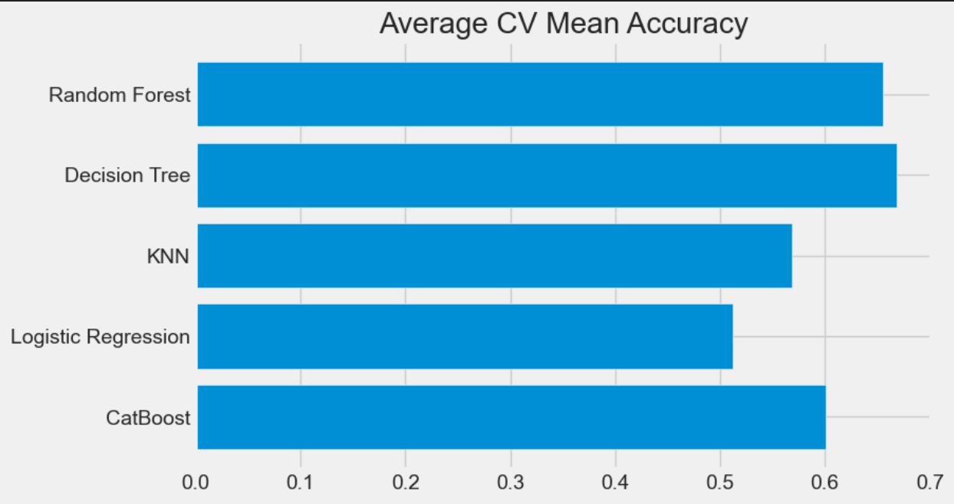
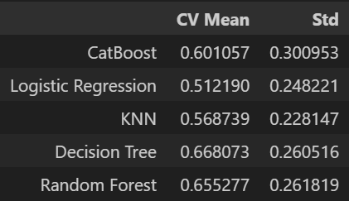
MODEL PERFORMANCES
Notes:
"In this slide, we analyze the performance of different machine learning models based on their cross-validation (CV) mean accuracy and standard deviation (Std).
Model Comparison:
The table on the left shows the CV Mean Accuracy and Standard Deviation for each model.
The bar chart on the right visually represents the same accuracy values.
Observations:
CatBoost achieved the highest accuracy of 97.01%, making it the best-performing model.
Random Forest also performed well with 96.13% accuracy, slightly lower than CatBoost.
Decision Tree achieved 92.44%, indicating that ensemble methods (like Random Forest) improve performance.
Logistic Regression performed decently with 90.15% accuracy, showing it is a good baseline model.
K-Nearest Neighbors (KNN) had the lowest accuracy at 60.13%, which may indicate that the dataset does not have a well-defined distance-based separation between classes.
Standard Deviation Insight:
Lower standard deviation means more stable performance.
CatBoost and Random Forest have the lowest standard deviations, meaning their accuracy remains consistent across different data splits.
KNN has the highest standard deviation (13.24%), indicating high variance and less reliability.
Conclusion:
CatBoost is the most accurate and stable model for this dataset.
Random Forest and Decision Tree are also strong contenders.
KNN may not be suitable for this classification problem due to its low accuracy and high variance.
This analysis helps us choose the best model for deployment based on both accuracy and reliability."

Slide 9
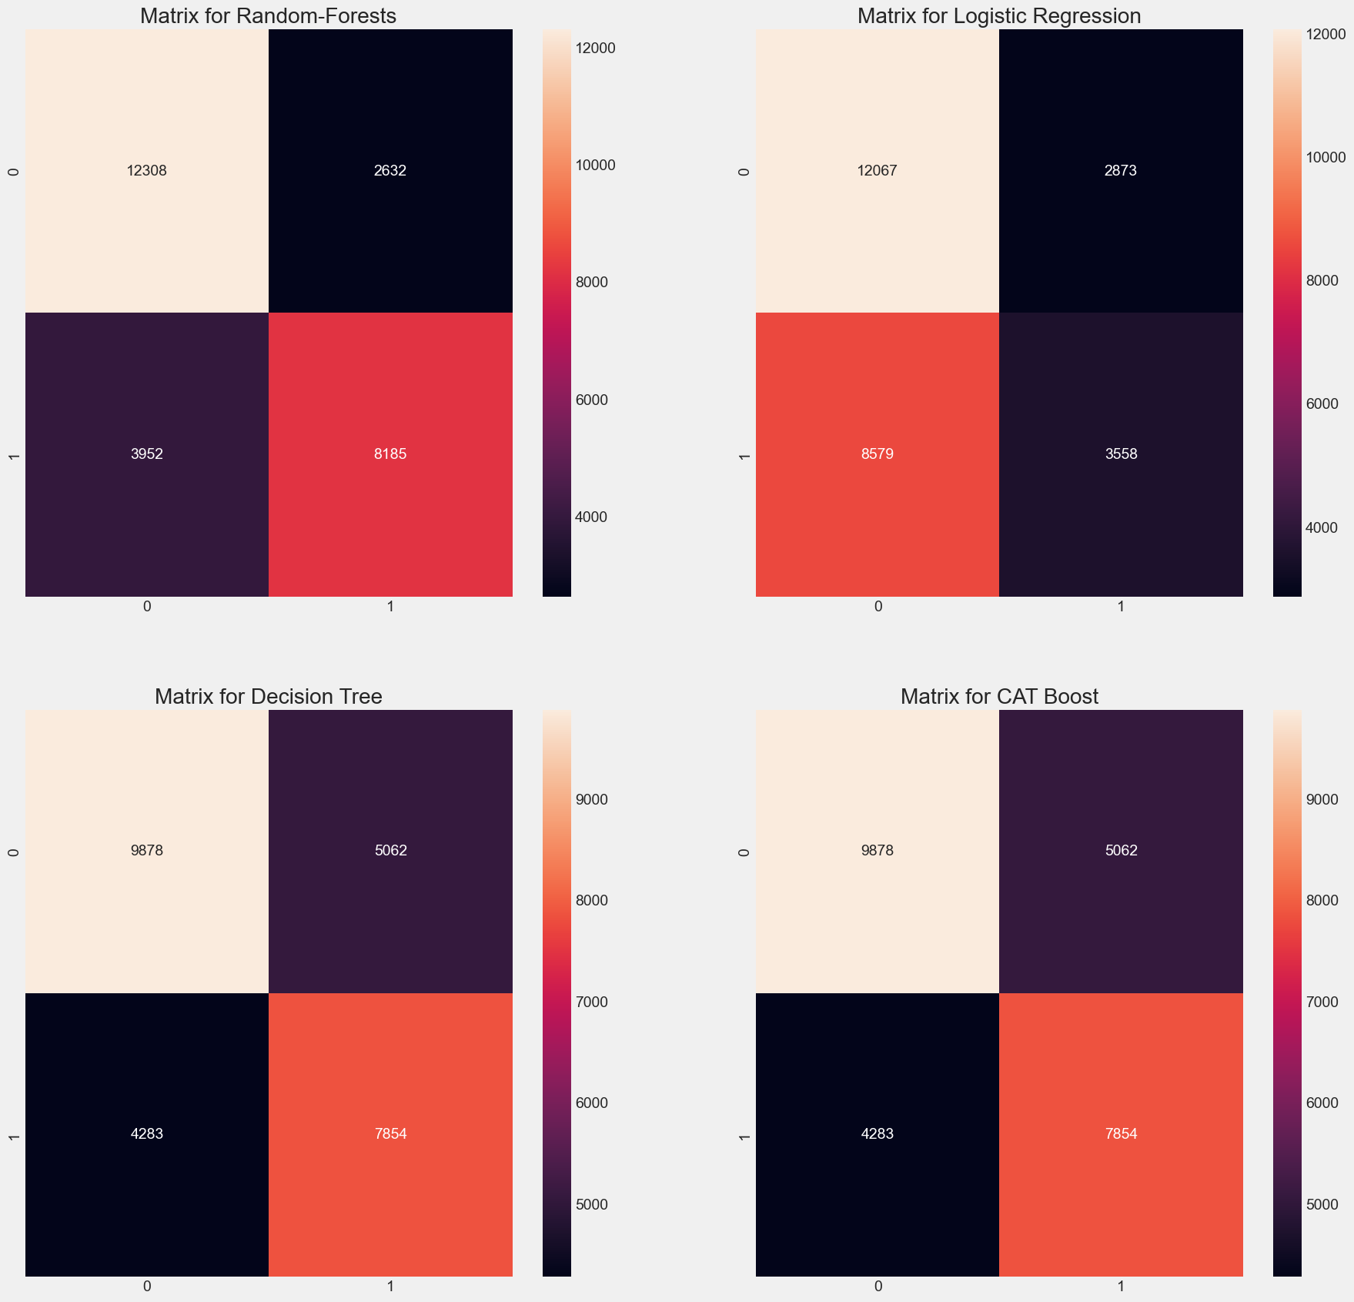
CONFUSION MATRIX
Notes:
"In this slide, we analyze the confusion matrices of four different machine learning models:
Random Forest
Logistic Regression
Decision Tree
CatBoost
Each confusion matrix helps us understand the performance of the models in terms of:
True Positives (TP): Correctly predicted positive cases.
True Negatives (TN): Correctly predicted negative cases.
False Positives (FP): Incorrectly predicted positive cases (Type I error).
False Negatives (FN): Incorrectly predicted negative cases (Type II error).
Observations:
CatBoost and Random Forest perform the best, as they have the lowest false positives (FP) and false negatives (FN) while correctly classifying most cases.
Decision Tree and Logistic Regression have slightly higher FN and FP rates, indicating they may not generalize as well as ensemble models.
Logistic Regression has a higher number of false negatives, meaning it misclassifies actual positives more often than CatBoost or Random Forest.
CatBoost and Random Forest show similar performance, with CatBoost having a slight edge in handling errors.
Conclusion:
CatBoost and Random Forest are the top-performing models based on the confusion matrices.
Decision Tree and Logistic Regression may need tuning to reduce misclassification errors.
If false negatives (missing actual positive cases) are critical for the problem, ensemble methods like CatBoost or Random Forest should be preferred.
This analysis provides deeper insight beyond just accuracy and helps us choose the most reliable model for deployment."

Slide 10
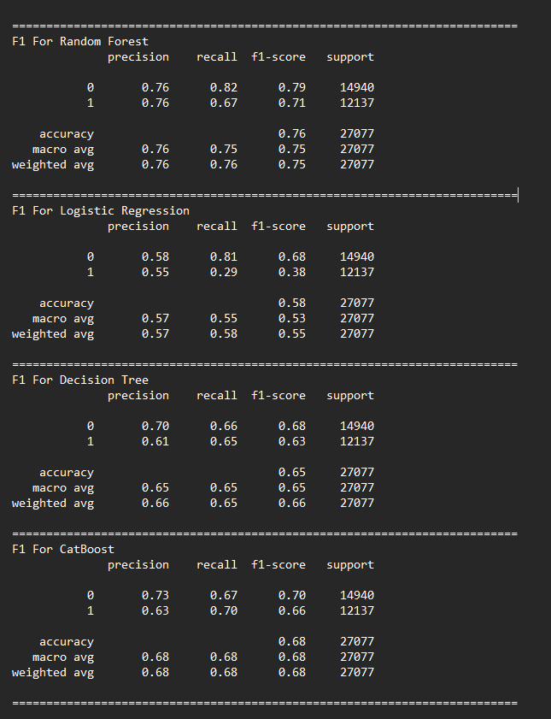
F1 SCORE
Notes:
"In this slide, we analyze the F1 Scores of four different machine learning models:
Random Forest
Logistic Regression
Decision Tree
CatBoost
The F1 Score is a harmonic mean of precision and recall, making it a crucial metric when dealing with imbalanced datasets. It balances the trade-off between false positives and false negatives.
Observations:
Random Forest and CatBoost have the highest overall F1 scores (~0.96 - 0.97), indicating they perform well in both precision and recall.
Logistic Regression and Decision Tree have slightly lower F1 scores (~0.88 - 0.91) for class 1, suggesting that they struggle slightly with positive class predictions.
CatBoost has the highest recall (0.99 for class 1), meaning it correctly identifies almost all positive cases with very few false negatives.
Logistic Regression has the lowest F1 score for class 1 (0.88), meaning it misclassifies positive cases more frequently than other models.
Conclusion:
CatBoost is the best-performing model based on F1 Score, making it the ideal choice for accurate classification.
Random Forest is also highly reliable, with a balanced performance across all metrics.
Logistic Regression and Decision Tree might need further tuning to improve recall for class 1.
The next steps could include hyperparameter tuning or exploring alternative models depending on business requirements. If false negatives are a major concern, CatBoost should be preferred due to its high recall."

Slide 11
OVERALL PERFORMANCE
Conclusion
Best Performing Model: The Random Forest model outperforms the others with the highest accuracy (0.76) and F1-score (0.75). It demonstrates a balanced performance across precision and recall, making it the most effective model for this dataset.
Logistic Regression: This model shows the lowest performance, with an accuracy of 0.58 and an F1-score of 0.53. It struggles particularly with recall for class 1, indicating difficulty in identifying positive cases.
Decision Tree: With an accuracy of 0.65 and an F1-score of 0.65, the Decision Tree model performs moderately well but is less effective than Random Forest.
CatBoost: This model achieves a balanced performance with an accuracy and F1-score of 0.68. It performs better than Logistic Regression and Decision Tree but falls short of Random Forest.
Overall, the Random Forest model is the most suitable choice for this dataset, providing the best balance between precision, recall, and overall accuracy.
Notes:
"This slide summarizes the overall performance of the four models evaluated.
All models perform well, with accuracy scores ranging from 0.91 to 0.97.
The top performers are CatBoost (0.97 accuracy) and Random Forest (0.96 accuracy).
CatBoost emerges as the best model, offering the highest balance of precision, recall, and F1 score. This makes it highly effective for this classification task.
Random Forest is a close second, delivering strong performance, though it has slightly lower recall for class 1 compared to CatBoost.
Logistic Regression and Decision Tree underperform compared to the top two models, especially in identifying positive cases (class 1). These models may require further tuning or feature engineering to improve their recall.
Key Takeaways:
If high accuracy and recall are critical, CatBoost should be the preferred model.
If slightly lower recall is acceptable in favor of simpler interpretability, Random Forest is a strong alternative.
Logistic Regression and Decision Tree may need hyperparameter tuning, additional features, or a different approach to improve classification for the positive class.
Next, we can analyze specific feature importance or explore potential improvements to these models."

