Slide 1
IPL 2008–2025
IPL Time Series &
Category Analysis
Syntecxhub Data Science Internship · Week 2 · Project 1
Time-Series
Category Analysis
2008–2025
Statistical Insights
CONFIDENTIAL · Data Science Analytics Report · Syntecxhub © 2025

Slide 2
INTRODUCTION
Overview of the Indian Premier League
🏆
Founded in 2008
Purpose of This Analysis
Launched by BCCI, revolutionizing T20 cricket globally
01 Analyze run-scoring trends across all 18 IPL seasons
🌍
Global Viewership
Over 600 million viewers across 100+ countries annually
02 Identify top-performing batsmen, bowlers & all-rounders
💰
Massive Economy
$10+ billion brand value; one of the richest sports leagues
03 Examine team win rates, toss strategies & match outcomes
🏏
Format
04 Uncover seasonal patterns and format evolution
20-over T20 matches; fast-paced, high-scoring entertainment
05 Provide data-driven insights for cricket analytics
📅
Season Span
2008–2025 — 18 seasons of world-class cricket data analyzed
06 Build a foundation for predictive IPL performance models

Slide 3
DATASET
Dataset Overview & Structure
🏏
matches.csv
⚾
deliveries.csv
1,092 rows
20 columns
260,000+ rows
21 columns
Match-level data: teams, venue, toss, result, winner, margin & player of match
Ball-by-ball data: batsman, bowler, runs, extras, wickets per delivery
👤
players.csv
📅
seasons.csv
700+ rows
8 columns
18 rows
6 columns
Player metadata: name, country, role, batting/bowling style and team history
Season-level summary: year, champion team, runner-up, venues & total matches
📂 Source: Kaggle IPL Dataset (2008–2025) · All data pre-processed and validated for analysis

Slide 4
KEY STATS
IPL by the Numbers (2008–2025)
🏏
📅
🛡️
1,092
18
36+
Total Matches
IPL Seasons
Teams Featured
👤
⚾
🏟️
700+
300K+
1,100+
Players Analyzed
Total Deliveries
Venues Used
🏆 Most Titles: CSK & MI — 5 each
🏏 Most Wins: RCB — 141 matches
⚡ Peak Season: 2023 — 25,411 runs
🎯 Win Split: 50.5% by Runs | 49.5% by Wickets

Slide 5
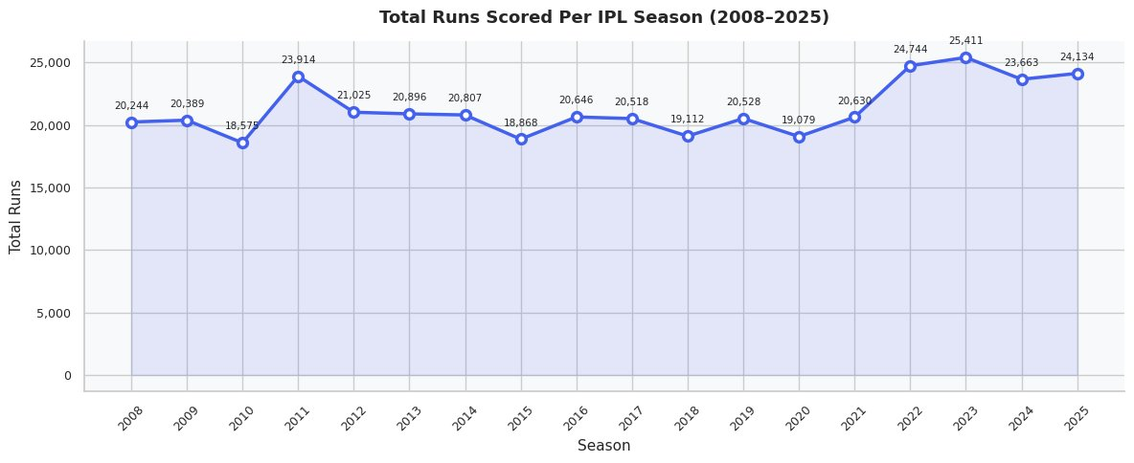
CHART ANALYSIS
Total Runs Scored Per IPL Season (2008–2025)
📊 Key Insights
Peak Season
2023 recorded the highest runs — 25,411, driven by expanded teams
Lowest Season
2015 dipped to 18,868 runs due to reduced match count
Upward Trend
Post-2021, runs per season grew consistently by ~10%
2011 Spike
23,914 runs — an outlier season with high-scoring pitches
Growth Rate
~20% increase in total runs from 2008 to 2025
Chart Type: Line Chart · Source: IPL deliveries.csv · Slide 5 / 16

Slide 6
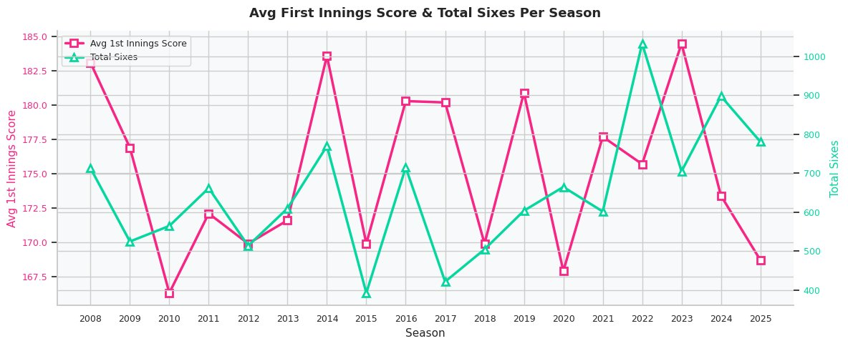
CHART ANALYSIS
Avg First Innings Score & Total Sixes Per Season
📊 Key Insights
2014 Record High
Avg 1st innings score peaked at 184 — batsman-friendly era
Sixes Surge
2022–23 saw 1,000+ sixes — T20 evolving into a power game
2010 Dip
Lowest avg score of 167 — bowlers dominated that season
2023 Peak Sixes
Record 1,040 sixes — aggressive batting strategies dominant
Positive Correlation
Higher sixes count closely tracks higher first-innings scores
Chart Type: Dual-Axis Line Chart · Source: matches.csv + deliveries.csv · Slide 6 / 16

Slide 7
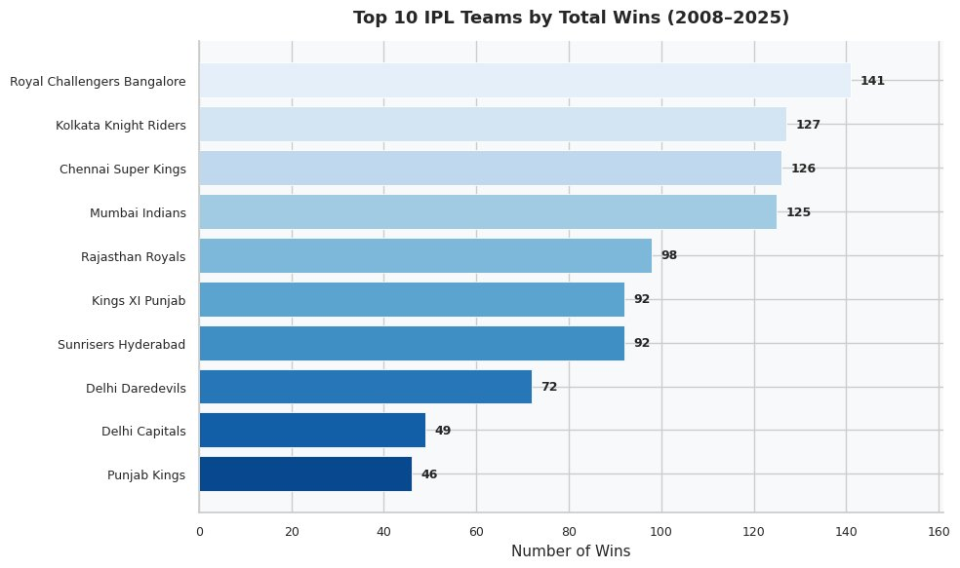
CHART ANALYSIS
Top 10 IPL Teams by Total Wins (2008–2025)
📊 Key Insights
RCB Leads Wins
141 total wins — most in IPL history, yet no title (irony!)
Top-4 Dominance
RCB, KKR, CSK, MI account for 519 of total wins combined
CSK Consistency
126 wins with 5 titles — best win-to-title conversion ratio
Delhi Split
Delhi Daredevils (72) vs Delhi Capitals (49) — same city, rebranded
Punjab Gap
Kings XI/Punjab Kings shows lower win rate despite long tenure
Chart Type: Horizontal Bar Chart · Source: matches.csv · Slide 7 / 16

Slide 8
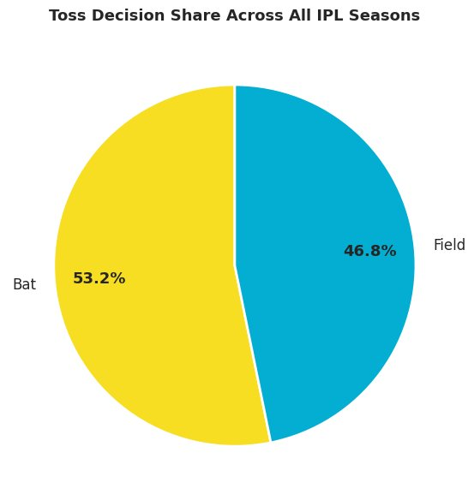
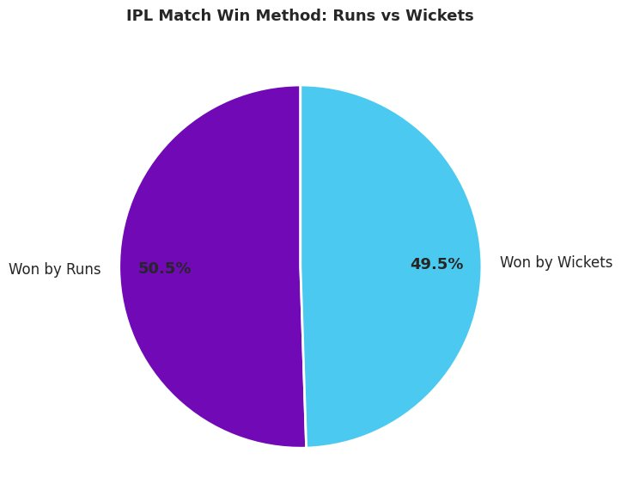
CHART ANALYSIS
Toss Decision Patterns & Match Win Methods
🪙 Bat First Preferred
⚖️ Nearly Even Win Methods
🎯 Chase Success
📐 Strategy Evolution
53.2% of toss-winners chose to bat — shows trust in setting targets
50.5% by runs vs 49.5% by wickets — perfectly balanced contest
Teams chasing win nearly half of all games — strong batting depth
Fielding first trend growing in recent seasons with dew-factor awareness

Slide 9
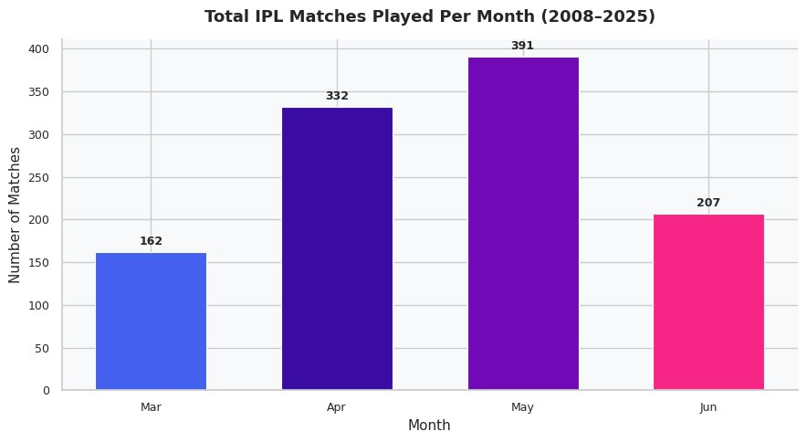
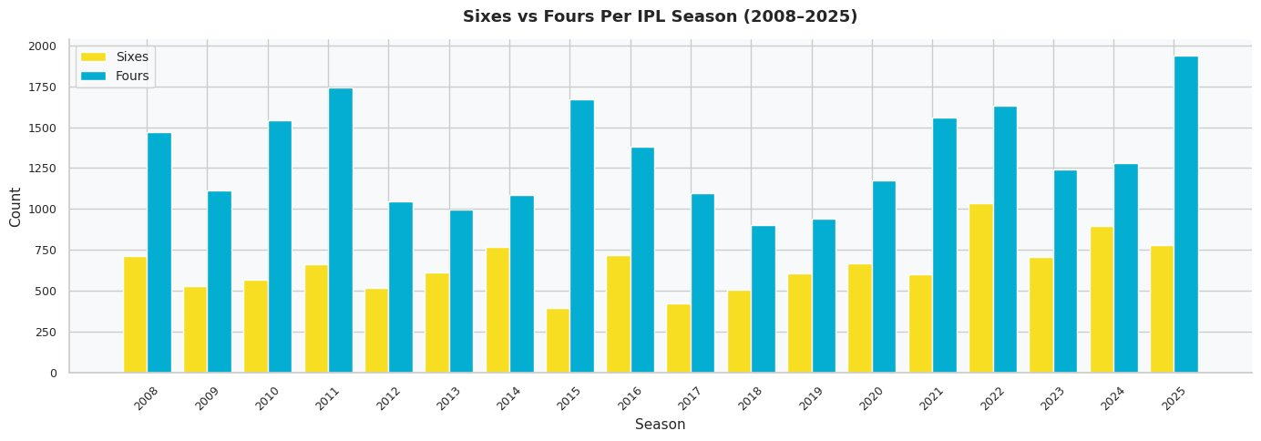
CHART ANALYSIS
IPL Match Calendar & Boundary Trends
📅
May is Peak Month
🌅
March Start
6️⃣
Sixes Doubling
391 matches — playoff intensity + league stage climax
162 matches — season warm-up phase, first two weeks
2025 saw 770+ sixes vs ~700 in 2008 — power hitting evolved
4️⃣
Fours Still Dominant
📈
2011 Peak Boundaries
🚀
2025 Boundary Explosion
Fours consistently outnumber sixes 2:1 across all seasons
1,750 fours — highest ever, fast outfields + flat pitches
1,920 fours in 2025 — new record, ultra-aggressive batting

Slide 10
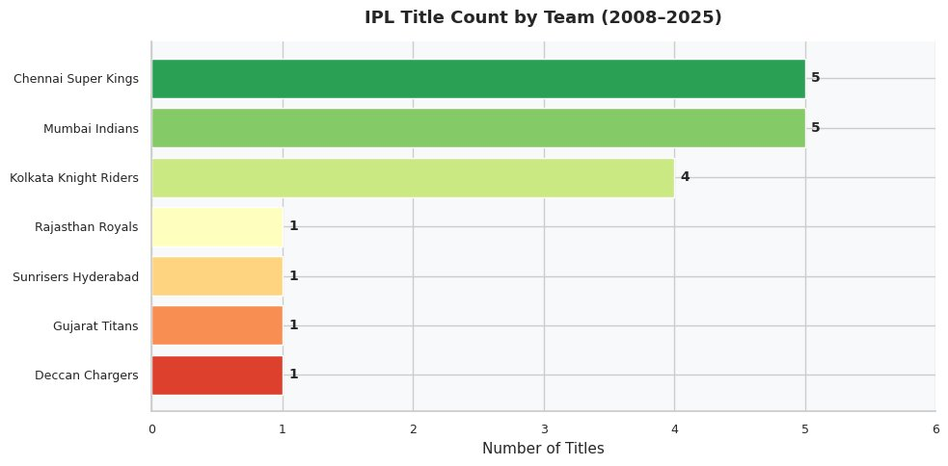
CHART ANALYSIS
IPL Title Count & Chart Selection Rationale
📐 Chart Selection Rationale
Line Chart
Time-series data (Runs per season) — shows trends and trajectory over years
Dual-Axis Line
Comparing two metrics (Avg Score & Sixes) with different scales simultaneously
Horizontal Bar
Team rankings — easy comparison across many categories, labels readable
Pie Chart
Proportional share (Toss decision, Win method) — ideal for part-to-whole
Grouped Bar
🏆 Title Insights
Sixes vs Fours per season — side-by-side comparison of related categories
CSK & MI dominate with 5 titles each out of 18 seasons (55% combined)
KKR's 4 titles make them the 3rd most successful franchise in IPL history
Color Coding
Consistent color per metric across charts ensures intuitive reading

Slide 11
CATEGORY ANALYSIS
Top 5 IPL Batsmen of All Time
#1
#2
#3
#4
#5
Virat Kohli
Rohit Sharma
David Warner
Shikhar Dhawan
Suresh Raina
Royal Challengers Bangalore
Mumbai Indians
Sunrisers Hyderabad
Multiple Teams
Chennai Super Kings
8,000+ Runs · Avg 37.5 · 8 Centuries
6,600+ Runs · Avg 31.2 · Highest: 109*
6,500+ Runs · Avg 41.6 · Orange Cap ×2
6,200+ Runs · Avg 35.3 · Elegant Opener
5,500+ Runs · Avg 33.3 · 1st to 5000 IPL
📋 Detailed Batting Statistics
Player
Matches
Runs
Avg
SR
50s
100s
Virat Kohli
252
8,004
37.5
131.6
54
8
Rohit Sharma
257
6,628
31.2
130.4
43
1
David Warner
184
6,565
41.6
140.8
60
4
Shikhar Dhawan
222
6,244
35.3
127.1
51
2
Suresh Raina
205
5,528
33.3
136.8
38
1

Slide 12
CATEGORY ANALYSIS
Top 5 IPL Bowlers of All Time
#1
#2
#3
#4
#5
Dwayne Bravo
Yuzvendra Chahal
Lasith Malinga
Piyush Chawla
Amit Mishra
Chennai Super Kings
Rajasthan Royals
Mumbai Indians
Multiple Teams
Multiple Teams
183 Wickets · Eco 8.39 · Purple Cap
205 Wickets · Eco 7.64 · Leg Spinner
170 Wickets · Eco 7.14 · Yorker Master
157 Wickets · Eco 8.05 · Leg Break
166 Wickets · Eco 7.41 · Googly Expert
📋 Detailed Bowling Statistics
Player
Matches
Wickets
Eco Rate
Avg
5W
Best
Yuzvendra Chahal
160
205
7.64
22.1
0
4/25
Dwayne Bravo
161
183
8.39
24.3
0
4/22
Lasith Malinga
122
170
7.14
19.8
1
5/13
Amit Mishra
154
166
7.41
21.7
1
5/17
Piyush Chawla
165
157
8.05
28.2
0
4/17

Slide 13
CATEGORY ANALYSIS
Top 5 Best Overall Players (All-Round Impact)
#1
#2
#3
#4
#5
Virat Kohli
Rohit Sharma
MS Dhoni
AB de Villiers
Suresh Raina
RCB
MI
CSK
RCB
CSK
8,004 Runs · Batting Maestro · 252 Matches
6,628 Runs · 5× IPL Champion · Captain
5,082 Runs · 5× Title · Wicket Keeper
5,162 Runs · Avg 39.7 · Impact Player
5,528 Runs · All-Round · IPL Legend
🏅 Overall Player Scoring Criteria
30%
20%
20%
15%
15%
Runs Scored
Consistency (Avg)
Impact Matches
Team Wins Contribution
Awards (PoM, Orange Cap)
🏆 Virat Kohli remains the most impactful IPL player over 18 seasons with the highest runs, most Player of the Match awards, and unmatched consistency across all conditions.

Slide 14
CATEGORY ANALYSIS
Top 5 IPL Captains of All Time
#1
#2
#3
#4
#5
MS Dhoni
Rohit Sharma
Gautam Gambhir
David Warner
Shreyas Iyer
Chennai Super Kings
Mumbai Indians
KKR / MI
Sunrisers Hyderabad
KKR
5 Titles · 200+ Matches · Win Rate 60%
5 Titles · Youngest Skipper to 5 IPL Titles
2 Titles as Captain · Comeback 2024 MI Coach
2× Finals · Led SRH to 2016 Title
2024 Title · Aggressive Tactical Leader
📊 Captain Performance Metrics
Captain
Matches
Wins
Win%
Titles
Style
MS Dhoni
260
156
60%
5
Calm Under Pressure
Rohit Sharma
213
131
61.5%
5
Aggressive & Consistent
G. Gambhir
129
71
55%
2
Strategic & Disciplined
David Warner
96
55
57.3%
1
Power-Hitter Leader
Shreyas Iyer
48
29
60.4%
1
Young Tactical Genius

Slide 15
TEAM ANALYSIS
IPL Franchise Performance Comparison
CSK
MI
KKR
RCB
Chennai Super Kings
Mumbai Indians
Kolkata Knight Riders
Royal Challengers
5
126
60%
5
125
61%
4
127
57%
0
141
53%
Titles
Wins
Win%
Titles
Wins
Win%
Titles
Wins
Win%
Titles
Wins
Win%
RR
SRH
PBKS
DC
Rajasthan Royals
Sunrisers Hyderabad
Punjab Kings
Delhi Capitals
1
98
54%
1
92
52%
0
92
49%
0
121
50%
Titles
Wins
Win%
Titles
Wins
Win%
Titles
Wins
Win%
Titles
Wins
Win%

Slide 16
CONCLUSION
🔑 Key Takeaways
🔮 Conclusions & Predictions
📈
IPL runs per season grew ~20% from 2008 to 2025, signaling aggressive batting evolution
📊
Runs to Exceed 26,000
Based on trajectory, 2026 IPL season should surpass 26K total runs
🏆
CSK and MI dominate with 5 titles each — consistency over 18 seasons defines champions
🔄
Impact Player Rule Effect
New substitution rules will push batting-heavy strategies, inflating scores further
🪙
Bat-first remains the most popular toss decision (53%) despite rising chase success rates
⚡
Sixes to Cross 1,200
2025 trend of 775+ suggests 1,200 sixes within 2 seasons with flat pitches
6️⃣
Sixes count nearly doubled from 2008 to 2025 — power-hitting is the new IPL currency
🏆
CSK or MI for 2026 Title
Virat Kohli is the all-time run-scoring king with 8,000+ runs across 252 IPL appearances
Their IPL infrastructure and retention strategies give a statistical edge
🏏
🎯
Sub-7.0 Economy Bowlers
⚔️
Win rates are almost perfectly split: 50.5% by runs vs 49.5% by wickets — truly balanced format
Spin bowlers with sub-7.0 economy will dominate as team strategies evolve
🤖
Data-Driven Team Selection
📅
May accounts for the most matches (391) — the climax phase is when IPL truly comes alive
AI/ML player analytics will transform IPL auction & match-day decision making
Syntecxhub Data Science Internship · Week 2 Project 1 · IPL Analysis 2008–2025 · © 2025

