Slide 1
Agenda
Introduction
Aim and Research Questions
Methodology
Results and Findings
Impact and application of the research
Summary , Limitations and Future work

Slide 2
Introduction
What is Sentiment Analysis?
Sentiment analysis is nothing but understanding opinion of texts using
Natural Language Processing technique
How sentiment analysis on product reviews help a company?
Sentiment analysis helps in understanding the emotions of customers and can
also extract important information from the text which can be used to improve
business or product
Implementing Sentiment Analysing techniques and its impact in the business
13.09.2022

Slide 3
Aim and Research Question
Aim
The main purpose of this paper is to perform sentiment analysis on Amazon product reviews and classify each review into positive , negative or neutral sentiment.
Research Questions
Which pre-processing methods give better results when passing pre-processed data to ML Model?
What are the suitable Machine Learning models?
13.09.2022

Slide 4
Literature review
Author | Topic | Data | Feature selection technique | Models | Accuracy
Boiy, E.et al., 2009 | Blog Sentiment Analysis | 500 blog posts | Unigram | SVM MNB ME Classification | 57.01% 52.08% 54.21%
Neethu, M.S. et al.,2013 | Twitter Sentiment Analysis | Twitter data 19340 rows | WordNet unigram | Navie Bayes Maximum Entropy SVM | 88% 85% 84%
Hasan, et al.,2018 | Twitter Urdu Sentiment Analysis | 1690 for training and 400 for testing | SentiWordNet Text-Blob W-WSD- WordNet | NB with Text Blob NB with SentiWordNet NB with W-WSD | 76% 54.75% 79%
Elbagir, S.et al.,2019 | Twitter Sentiment Analysis | 2000 Tweets on USA 2016 Election | NLTK | VADER Sentiment Analyzer | No accuracy only classifier
Thavareesan, S. et al.,2019 | Twitter Sentiment Analysis | Twitter data around 8000 tweets | TF-IDF Word2Vec Fast Text | Extreme Gradient Boosting Random Forest MNB Linear SVM | 74% 70% 73% 73%
Sun, S. et al., 2012 | Twitter Sentiment Analysis | 4000 Postive tweets , 4000 Negative tweets | Parts of speech | Navie Bayes SVM Ensemble approach | 30% 35% 75%
AlQahtani, A.S. et al., 2021 | Product sentiment analysis for amazon reviews | Open Library dataset | Bag of Words | GloVE LSTM BERT NB Classifier Logistic Regression | 94.2% 93.3% 98.3% 78.4% 85.5%
AlBadani, B. et al.,2022 | Twitter Sentiment Analysis | IMDB US Airlines Twitter GOP Debate |  | ULMFiT-SVM (IMDB, US Airlines,GOP) LSTM ( US Airlines) BERT (IMDB) RCNN(IMDB) | 99.78% 99.78% 95.78%, 79.64% 95.8%
13.09.2022

Slide 5
Methodology
Application of Data mining techniques to predict sentiment of Amazon product reviews:
Implementation of CRISP-DM method
Business Understanding , Data Understanding
Pre-processing techniques: Text-Blob , NLTK -Natural Language Toolkit , SpaCy
Building Statistical Models and its Evaluation:
Vectorizing methods: Count-Vectorizer and TfidfVectorizer
Models – Logistic Regression(Multinomial) , Multinomial Naïve Bayes, Random Forest ,XGBoost
Evaluation – Accuracy Train , Accuracy Test , Precision , Recall and F1 Score
13.09.2022

Slide 6
Methodology – Part 1/4
Data
Text Blob
CountVectorizer
TfidfVectorizer
Logistic Regression
Logistic Regression
Random Forest
Random Forest
Multinominal Naive Bayes
Multinominal Naive Bayes
XGBoost
XGBoost
13.09.2022

Slide 7
Results and Findings -Methodology – Part 1/4
 | Count - Vectorizer
Model | Accuracy Train | Accuracy Test | Precision | Recall | F1 Score
Logistic Regression | 0.96 | 0.94 | 0.931 | 0.94 | 0.93
Random Forest | 0.928 | 0.901 | 0.91 | 0.9005 | 0.905
Multinominal Naive Bayes | 0.94 | 0.91 | 0.896 | 0.909 | 0.907
XG Boost | 0.976 | 0.955 | 0.952 | 0.954 | 0.953
 | TfidfVectorizer
Model | Accuracy Train | Accuracy Test | Precision | Recall | F1 Score
Logistic Regression | 0.9 | 0.9 | 0.869 | 0.901 | 0.885
Random Forest | 0.9 | 0.9 | 0.911 | 0.901 | 0.906
Multinominal Naive Bayes | 0.904 | 0.902 | 0.911 | 0.901 | 0.906
XG Boost | 0.981 | 0.952 | 0.949 | 0.951 | 0.950
Best Model: XG Boost – 95.3%
Random Forest is hyper-tuned model the max_depth is changed from 15 to 50
Best Model: XG Boost – 95.0%
13.09.2022

Slide 8
Methodology – Part 2/4
Data
NLTK
CountVectorizer
TfidfVectorizer
Logistic Regression
Logistic Regression
Random Forest
Random Forest
Multinominal Naive Bayes
Multinominal Naive Bayes
XGBoost
XGBoost
13.09.2022

Slide 9
Results and Findings – Methodology – Part 2/4
 | Count - Vectorizer
Model | Accuracy Train | Accuracy Test | Precision | Recall | F1 Score
Logistic Regression | 0.97 | 0.93 | 0.91 | 0.931 | 0.921
Random Forest | 1 | 0.93 | 0.926 | 0.936 | 0.931
Multinominal Naive Bayes | 0.955 | 0.936 | 0.94 | 0.936 | 0.938
XG Boost | 0.96 | 0.937 | 0.91 | 0.937 | 0.923
 | TfidfVectorizer
Model | Accuracy Train | Accuracy Test | Precision | Recall | F1 Score
Logistic Regression | 0.938 | 0.937 | 0.908 | 0.937 | 0.922
Random Forest | 0.99 | 0.93 | 0.91 | 0.93 | 0.920
Multinominal Naive Bayes | 0.97 | 0.936 | 0.94 | 0.936 | 0.938
XG Boost | 0.96 | 0.937 | 0.91 | 0.937 | 0.923
Best Model – MNB – 93.8%
Best Model – MNB with hyper parameter tuning 93.8% - alpha value changed to 0.01
13.09.2022

Slide 10
Methodology – Part 3/4
Data
NLTK
Lemmatization
CountVectorizer
TfidfVectorizer
Logistic Regression
Logistic Regression
Random Forest
Random Forest
Multinominal Naive Bayes
Multinominal Naive Bayes
XGBoost
XGBoost
13.09.2022

Slide 11
Results and Findings – Methodology – Part 3/4
 | Count - Vectorizer
Model | Accuracy Train | Accuracy Test | Precision | Recall | F1 Score
Logistic Regression | 0.969 | 0.932 | 0.915 | 0.935 | 0.925
Random Forest | 0.99 | 0.93 | 0.92 | 0.93 | 0.925
Multinominal Naive Bayes | 0.939 | 0.937 | 0.914 | 0.937 | 0.925
XG Boost | 0.957 | 0.938 | 0.912 | 0.938 | 0.925
 | TfidfVectorizer
Model | Accuracy Train | Accuracy Test | Precision | Recall | F1 Score
Logistic Regression | 0.93 | 0.93 | 0.908 | 0.937 | 0.922
Random Forest | 0.99 | 0.936 | 0.919 | 0.936 | 0.927
Multinominal Naive Bayes | 0.941 | 0.936 | 0.908 | 0.936 | 0.922
XG Boost | 0.96 | 0.9387 | 0.91 | 0.938 | 0.924
Best Model : Random Forest – 92.5 %
Best Model : Random Forest – 92.7%
Hyper-tuned model – MNB - 92.2% - alpha value changed to 0.01
13.09.2022

Slide 12
Methodology – Part 4/4
Data
SpaCy
CountVectorizer
TfidfVectorizer
Logistic Regression
Logistic Regression
Random Forest
Random Forest
Multinominal Naive Bayes
Multinominal Naive Bayes
XGBoost
XGBoost
13.09.2022

Slide 13
Results and Findings – Methodology – Part 4/4
 | Count - Vectorizer
Model | Accuracy Train | Accuracy Test | Precision | Recall | F1 Score
Logistic Regression | 0.972 | 0.924 | 0.903 | 0.924 | 0.913
Random Forest | 0.99 | 0.92 | 0.928 | 0.926 | 0.927
Multinominal Naive Bayes | 0.943 | 0.92 | 0.89 | 0.92 | 0.905
XG Boost | 0.968 | 0.925 | 0.896 | 0.925 | 0.910
 | TfidfVectorizer
Model | Accuracy Train | Accuracy Test | Precision | Recall | F1 Score
Logistic Regression | 0.94 | 0.924 | 0.898 | 0.924 | 0.911
Random Forest | 0.99 | 0.922 | 0.89 | 0.922 | 0.906
Multinominal Naive Bayes | 0.931 | 0.921 | 0.849 | 0.921 | 0.884
XG Boost | 0.96 | 0.926 | 0.902 | 0.926 | 0.914
Best Model: Random Forest - 92.7 %
Best Model: XG Boost – 91.4%
13.09.2022

Slide 14
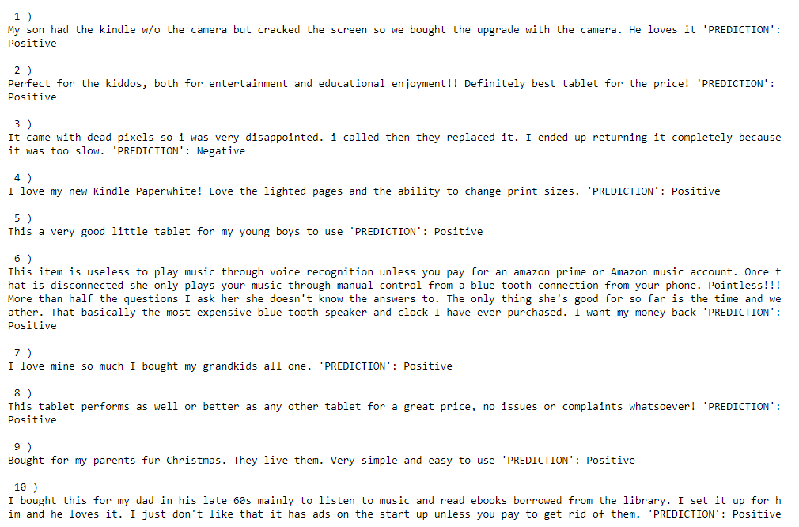
Results and Findings – Methodology – Part 4/4
With the help of XG boost we manually tested the first 10 comments to check the output and the model performs better in detecting the sentiment 9/10 times.
13.09.2022

Slide 15
Results and Findings
F1 Score is the used to determine the best performing model because the score provides the Harmonic mean of Accuracy and Precision of a given model
The best performing model is XG-Boost with Text-Blob and coming to Vectorizers both gives the same F1 score of 95% and detects neutral labels better than other models
For some reviews users give 3 star which is assigned as neutral label but has positive review and the user rating is 4 but has neutral review
Words like good , better , great followed by could , will , would, makes the model to predict the review as Positive instead of Neutral or Negative
Long sentences need to be split into short sentences to detect the sentiment properly
13.09.2022

Slide 16
Impact & application of the research
Can be used in various sector such as education , e-commerce , blogs and forums , news and survey.
Helps in getting over all sentiment of a product or service
Understanding larger audience is made simple
Can have broad customer reach in high level
Assists in planning business strategy by doing research on market and competitor

Slide 17
Summary , Limitations and Future work
Summary:
All the model perform similarly irrespective of the vectorization method and has minimal difference which may seems admissible when applied in a real world problem or based on the business question
The main factor which affects the accuracy of the model is pre-processing methods
Limitations:
This research is done in imbalanced dataset and need to check how theabove research method perfroms on balanced dataset
Hyper parameter tuning is done only for models that overfit
Future Work:
Next steps are to do the research in a balanced dataset or to use a larger dataset
Try different pre-processing libraries and vectorization methods
Using Different ML models
Fine tune the model with which neutral label can be detected better

