Slide 1
Digital Portfolio
STUDENT NAME: vinoth M
REGISTER NO AND NMID:24132251802521056 /9A0FF4988C8860686FE450B79A129ABF
DEPARTMENT: B.Sc computer science
COLLEGE: govt.arts and science college vanur/annamalai university

Slide 2
PROJECT TITLE
Student Digital Portfolio Structure
1. Project Title
A clear, concise, and meaningful name for your project.
Example: *"Smart Waste Management System using

Slide 3


AGENDA
Problem Statement
Project Overview
End Users
Tools and Technologies
Portfolio design and Layout
Features and Functionality
Results and Screenshots
Conclusion
Github Link
3/21/2024 Annual Review

Slide 4

PROBLEM STATEMENT
Define the issue or challenge your project is addressing. Why is this problem important? What gap or need does it fulfill?

Slide 5

PROJECT OVERVIEW
A brief description of the project. Objectives and goals. The significance of your work in the real world.

Slide 6

WHO ARE THE END USERS?
Who will use or benefit from this project? Example: Students, Teachers, Local Community, Businesses, Healthcare Professionals, etc.

Slide 7

TOOLS AND TECHNIQUES
Software, hardware, programming Languages, or frameworks used. Example: Python, Java, HTML/CSS, MySQL, Arduino, Figma, Canva.

Slide 8
POTFOLIO DESIGN AND LAYOUT
How you structured your portfolio. The design approach (minimalist, interactive, professional). Screenshots of the design/wireframe.
8

Slide 9
FEATURES AND FUNCTIONALITY
List of main features your project provides. Example: User Login system Data visualization dashboard Automated notifications Search/filter option

Slide 10
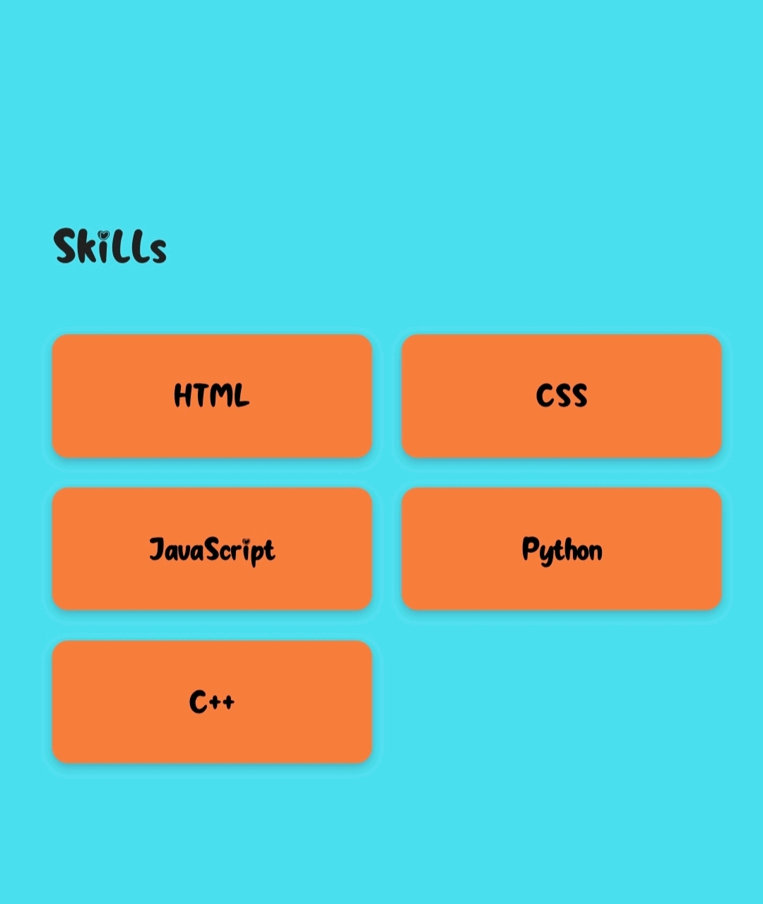
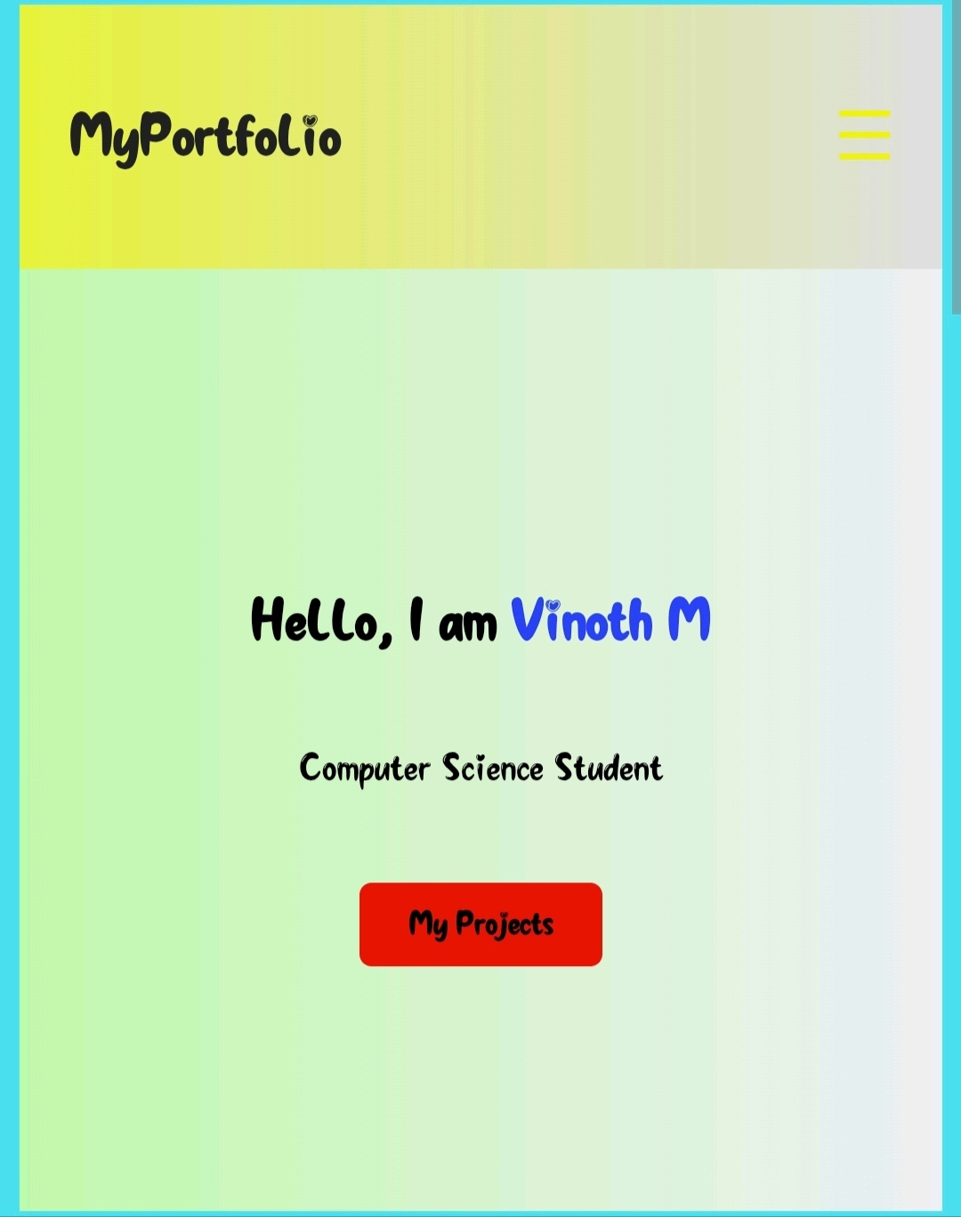
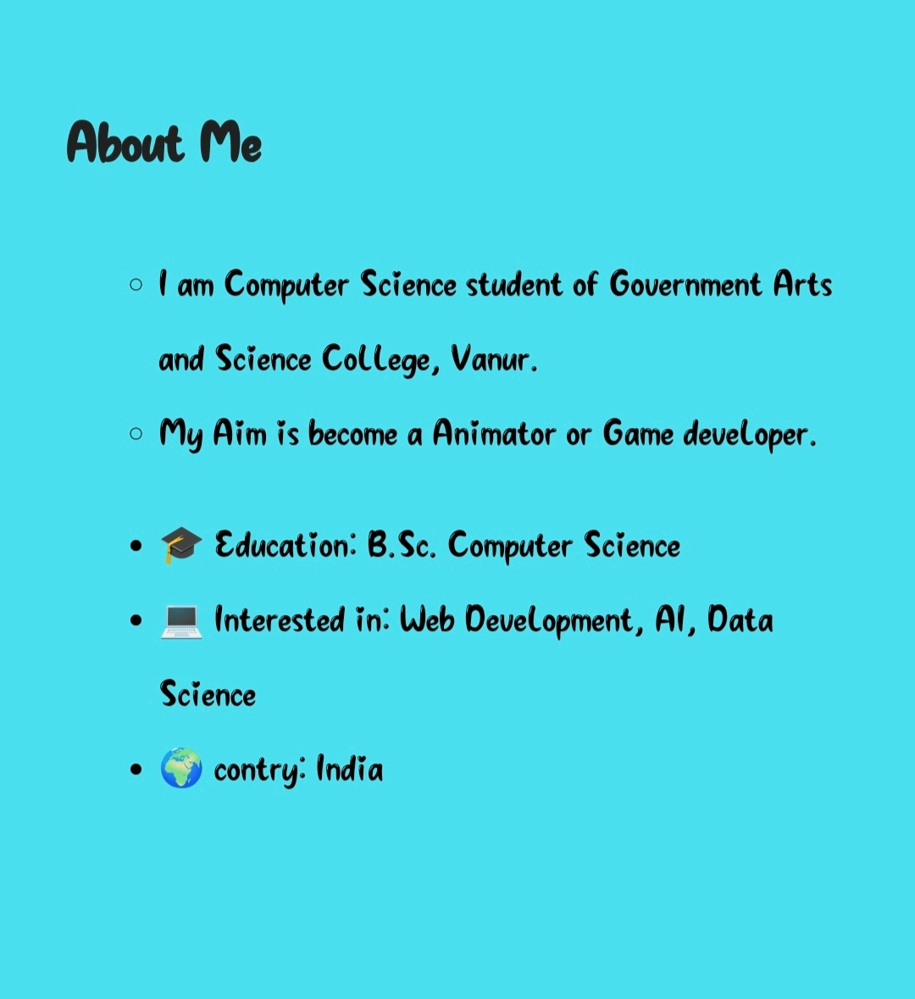

RESULTS AND SCREENSHOTS
3/21/2024 Annual Review
10

Slide 11
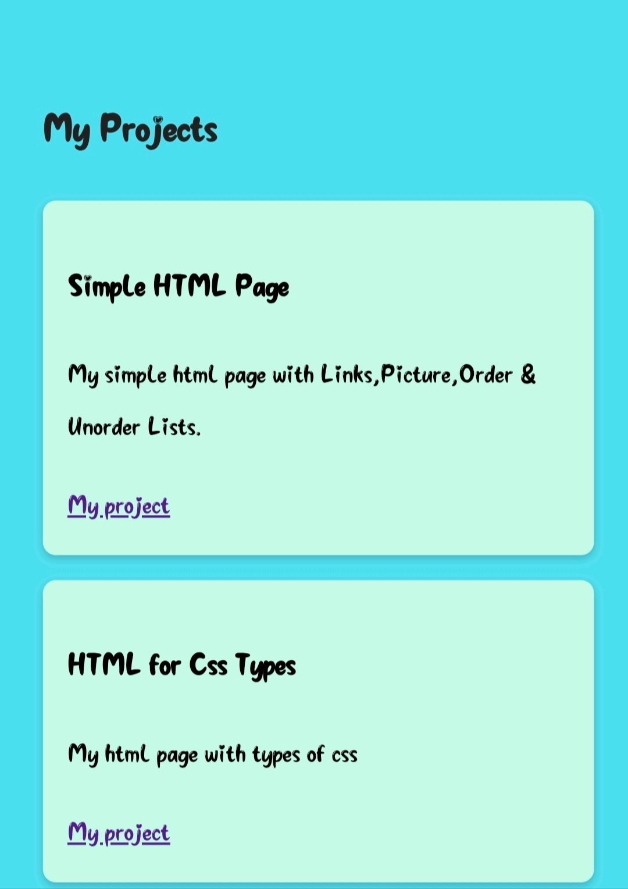
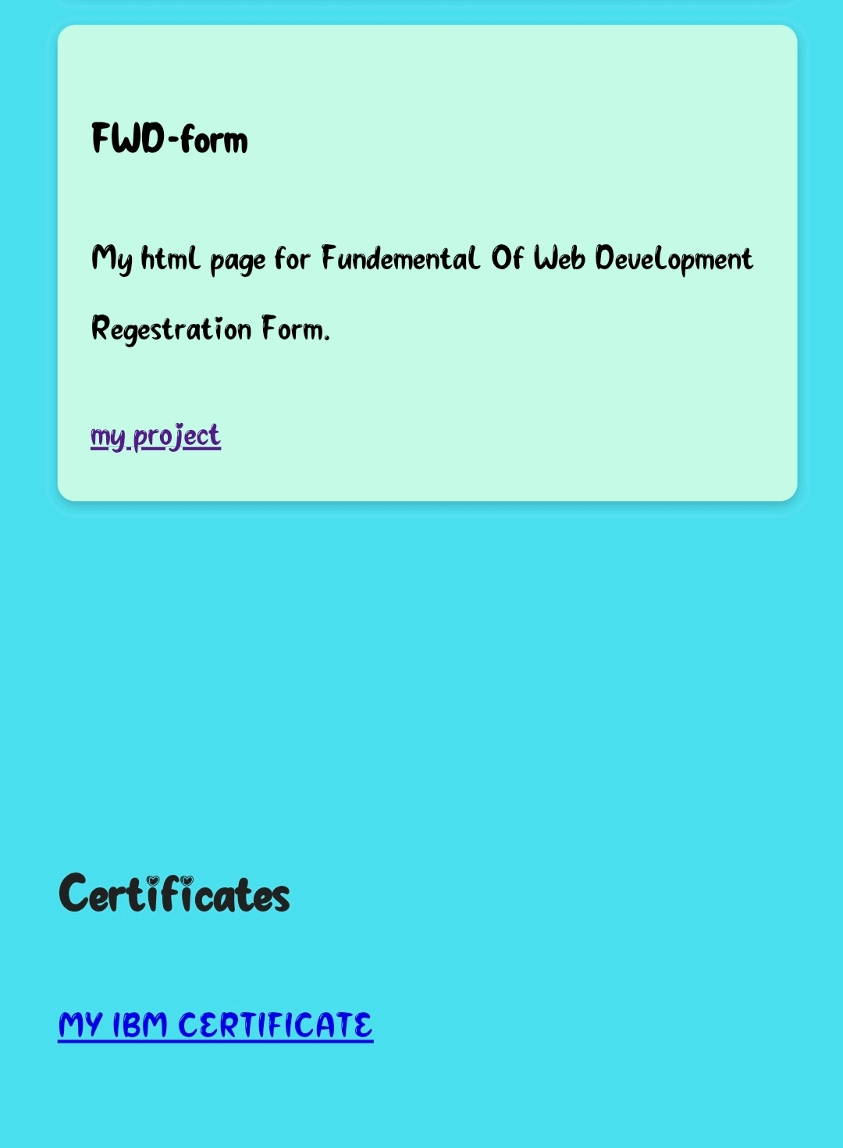


Slide 12
CONCLUSION
Summarize the achievements. Mention challenges faced and how you solved them. Future scope and improvements possible.
12

Slide 13
GitHub Link
https://github.com/vinothvicky845-ship-it?tab=repositories

