Slide 1
Python Parser
Topics to be covered
YAML
CSV
Configparser
XML
python debugging
IDE – Eclipse, Pycharm
Useful Links

Slide 2
YAML
Python Parsing
Overview
YAML (YAML Ain't Markup Language) is a human-readable data serialization language
It is commonly used for configuration files example (Ansible, OpenStack )
Key-value pairs are defined in YAML and separated with a colon.
YAML is an indentation-based markup language which aims to be both easy to read and easy to write.
Filename Extension – (.yaml, .yml)
YAML Syntax
Scalar - Scalars are ordinary values: numbers, strings, booleans.
number-value: 42
floating-point-value: 3.141592
boolean-value: true
string-value: 'Bonjour’ (strings can be both 'single-quoted` and "double-quoted“)
quoted-string: "let me put a colon here: oops"
Generally, you should quote all strings that contain any of the following characters: `[] {} : > |`.
Note that a space after the colon is mandatory.

Slide 3
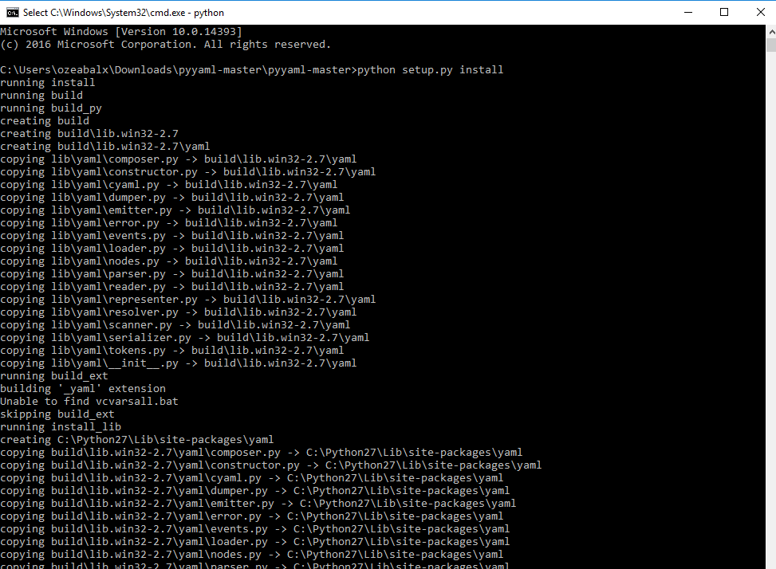

Slide 4
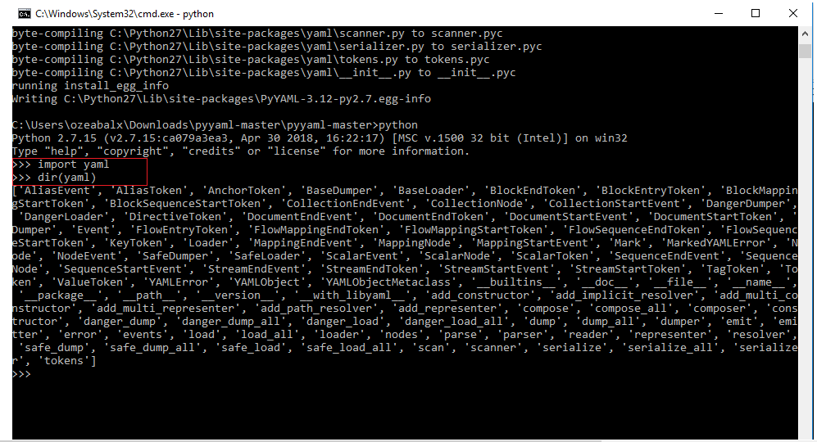

Slide 5
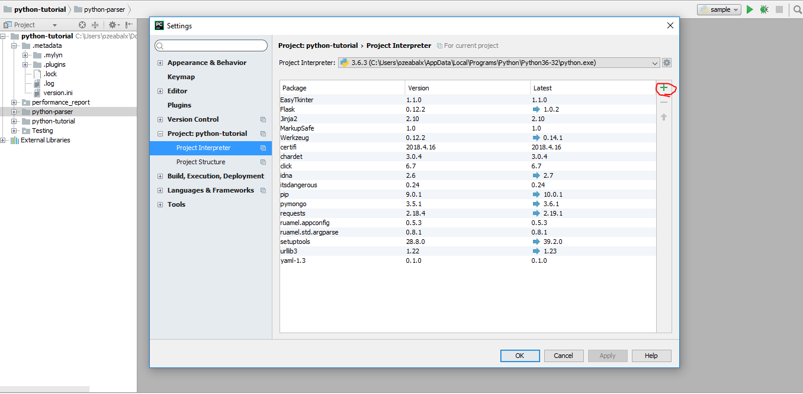
Pycharm- IDE

Slide 6
Lists and Dictionaries
Lists
jedis:
- Yoda
- Qui-Gon Jinn
- Obi-Wan Kenobi
- Luke Skywalker
Dictionaries are collections of key: value mappings.
jedi:
name: Obi-Wan Kenobi
home-planet: Stewjon
species: human
master: Qui-Gon Jinn
height: 1.82m

Slide 7
Inline Syntax
You can also use inline syntax for lists and dictionaries, if you want.
episodes: [1, 2, 3, 4, 5, 6, 7]
best-jedi: {name: Obi-Wan, side: light}
YAML Multi Documents
document: this is document 1
---
document: this is document 2
Reference URL
https://en.wikipedia.org/wiki/YAML
https://www.tutorialspoint.com/grav/grav_yaml_syntax.htm
https://pyyaml.org/wiki/PyYAMLDocumentation
Download https://github.com/yaml/pyyaml

Slide 8
CSV - Comma-separated values
Overview
CSV files are used to store a large number of variables – or data.
CSV module is a built-in function that allows Python to parse these types of files.
CSV Functions
CSV module includes all the necessary functions built in.
csv.reader
csv.writer
csv.register_dialect
csv.unregister_dialect
csv.get_dialect
csv.list_dialects
csv.field_size_limit

Slide 9
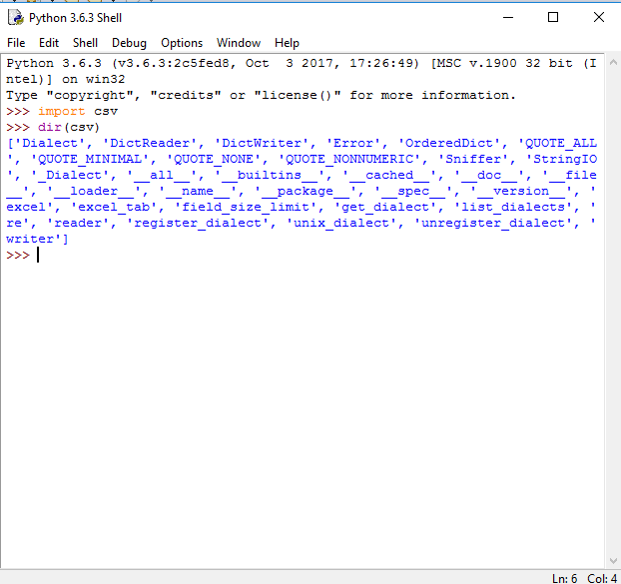

Slide 10
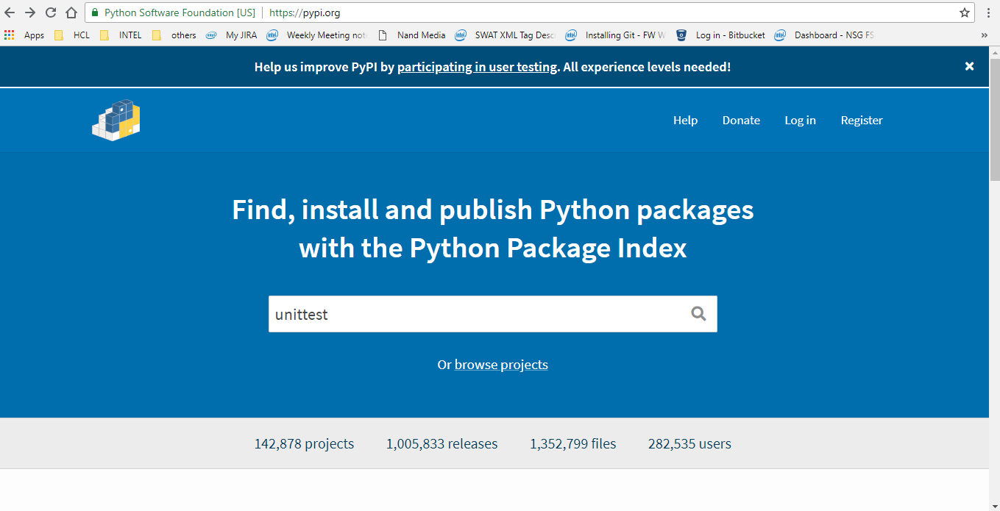

Slide 11
Configparser
ConfigParser class which implements a basic configuration language which provides a structure similar to what’s found in Microsoft Windows INI files.
Reference URL : https://docs.python.org/3/library/configparser.html
[DEFAULT]
ServerAliveInterval = 45
Compression = yes
CompressionLevel = 9
ForwardX11 = yes
[bitbucket.org]
User = hg
[topsecret.server.com]
Port = 50022
ForwardX11 = no

Slide 12
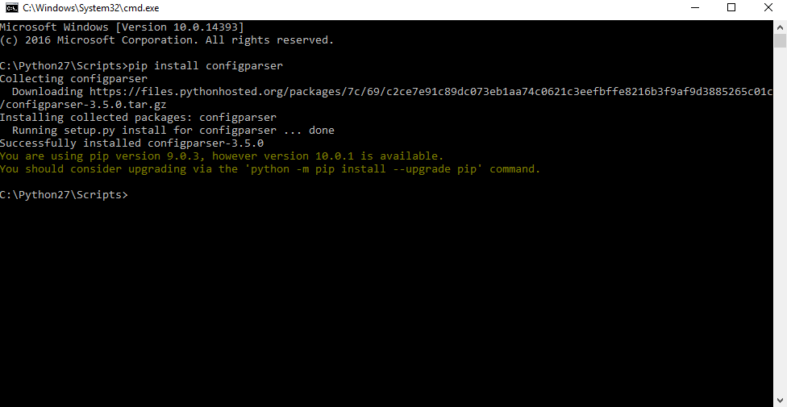

Slide 13
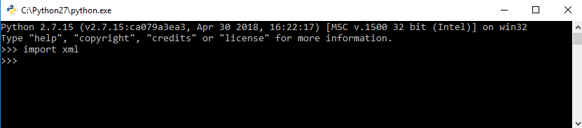
XML - eXtensible Markup Language
Overview
XML stands for eXtensible Markup Language.
It was designed to store and transport data.
It was designed to be both human- and machine-readable
File extension - .xml
CSV module is a built-in function.
Reference URL - https://www.geeksforgeeks.org/xml-parsing-python/
https://www.datacamp.com/community/tutorials/python-xml-elementtree

Slide 14
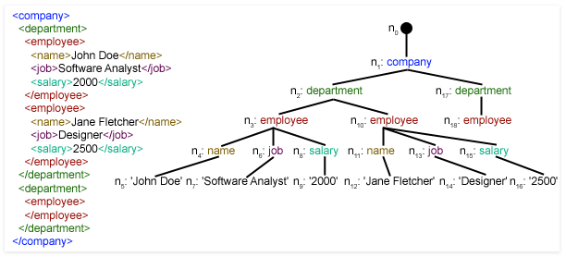

Slide 15
What is XML?
XML creates a tree-like structure that is easy to interpret and supports a hierarchy. Whenever a page follows XML, it can be called an XML document.
XML documents have sections, called elements, defined by a beginning and an ending tag. A tag is a markup construct that begins with < and ends with >.
The characters between the start-tag and end-tag, if there are any, are the element's content. Elements can contain markup, including other elements, which are called "child elements".
The largest, top-level element is called the root, which contains all other elements.
Attributes are name–value pair that exist within a start-tag or empty-element tag.
An XML attribute can only have a single value and each attribute can appear at most once on each element.

Slide 16
Useful links
https://docs.python.org/2/library/pdb.html
https://pypi.org/
https://www.rose-hulman.edu/class/csse/resources/Eclipse/eclipse-python-configuration.htm
http://www.eclipse.org/downloads/eclipse-packages/
https://www.jetbrains.com/pycharm/download/#section=windows
https://www.tutorialspoint.com/python/index.htm
https://www.eclipse.org/community/eclipse_newsletter/2017/june/article1.php

Slide 17


Any queries….
Email – omprakash.z@hcl.com

