Slide 1
MACHINE LEARNING · IT SERVICE DESK
Ticket Support Model
Automatically routing IT support tickets to the right team
with TF-IDF + Logistic Regression
Team presentation — technical overview

Slide 2
OVERVIEW
Agenda
1
The problem — why route tickets automatically
2
The dataset — 1,500 tickets across 10 teams
3
Data quality checks — duplicates, conflicts, leakage
4
Preprocessing & pipeline design
5
Baseline vs. model — is it actually better than guessing?
6
Per-team performance & confusion matrix
7
Live predictions on new tickets
8
Limitations and next steps
Ticket Support Model — routing tickets to the right team
2

Slide 3
THE PROBLEM
Why route tickets automatically?
Every ticket that lands in the help desk queue first has to be
read and manually assigned to one of 10 specialist teams
before anyone can start fixing it.
Slow triage
Inconsistent
Doesn't scale
Manual routing adds delay before work even starts.
Different dispatchers route similar tickets differently.
Ticket volume grows faster than triage staff.
GOAL
Given the free-text description of a ticket, automatically predict the team
that should handle it (assigned_team) — plus a confidence score, so low-
confidence predictions can still be escalated to a human.
Ticket Support Model — routing tickets to the right team
3

Slide 4
THE DATA
Dataset overview
1,500
10
150
~117
tickets total
support teams
tickets per team
avg. characters / ticket
The 10 teams
Applications
Endpoint Management
Security
Email & Collaboration
Identity & Access
Hardware
Telephony
Database
Network
Cloud & Infrastructure
Perfectly balanced classes (150/team): accuracy and macro-averaged metrics can be
compared directly across teams, with no majority class to skew results and no need
for class_weight or resampling.
Ticket Support Model — routing tickets to the right team
4

Slide 5
DATA QUALITY
Checks before training — catching leakage early
Exact duplicates
If left in, the same sentence could land in both train and test — an artificially perfect score.
9 duplicate descriptions found and dropped
Conflicting labels
Same text, different team in different rows — a sign of inconsistent labeling to flag, not silently trust.
5 descriptions had more than one assigned_team
Non-ASCII / HTML noise
Text is re-encoded to ASCII (errors ignored) so stray symbols don't pollute the vocabulary.
Stray encoding artifacts found in free text
“Too good to be true” check
Investigated for leakage first — the real cause is a very distinctive vocabulary (“phone”, “voicemail”, “extension”), confirmed via duplicate/uniqueness checks, not a bug.
Telephony scored a perfect 1.00 precision/recall/F1
Ticket Support Model — routing tickets to the right team
5

Slide 6
ARCHITECTURE
Preprocessing & model pipeline
1
2
3
Clean text
TF-IDF vectorize
Logistic Regression
lowercase · strip digits/punctuation · remove custom stopwords
(incl. ticket filler: “hi”, “new”, “help”)
unigrams + bigrams · max 5,000 features
sublinear term-frequency scaling
C = 5.0 · max_iter = 1,000 · solver = lbfgs
multi-class over 10 teams
All three steps live in a single sklearn.Pipeline
so the exact same cleaning + vectorization is applied consistently at both training and
prediction time — no risk of the two drifting apart, and the whole pipeline is a single
object that can be saved with joblib and reloaded without retraining.
Ticket Support Model — routing tickets to the right team
6

Slide 7
METHODOLOGY
Avoiding data leakage
Two ordering decisions protect the evaluation from being artificially optimistic:
Split before vectorizing
Stratified 75/25 split
train_test_split(..., test_size=0.25, stratify=y) runs first.
The TF-IDF vectorizer is then fit only on X_train — its
vocabulary and IDF weights never see the test set. Test
tickets are transformed using that already-fixed vocabulary.
stratify=y keeps each team's share proportional in both
sets, so no team accidentally ends up entirely in test
(or entirely in train).
Combined with dropping exact duplicate descriptions first,
this keeps train and test genuinely independent.
Ticket Support Model — routing tickets to the right team
7

Slide 8
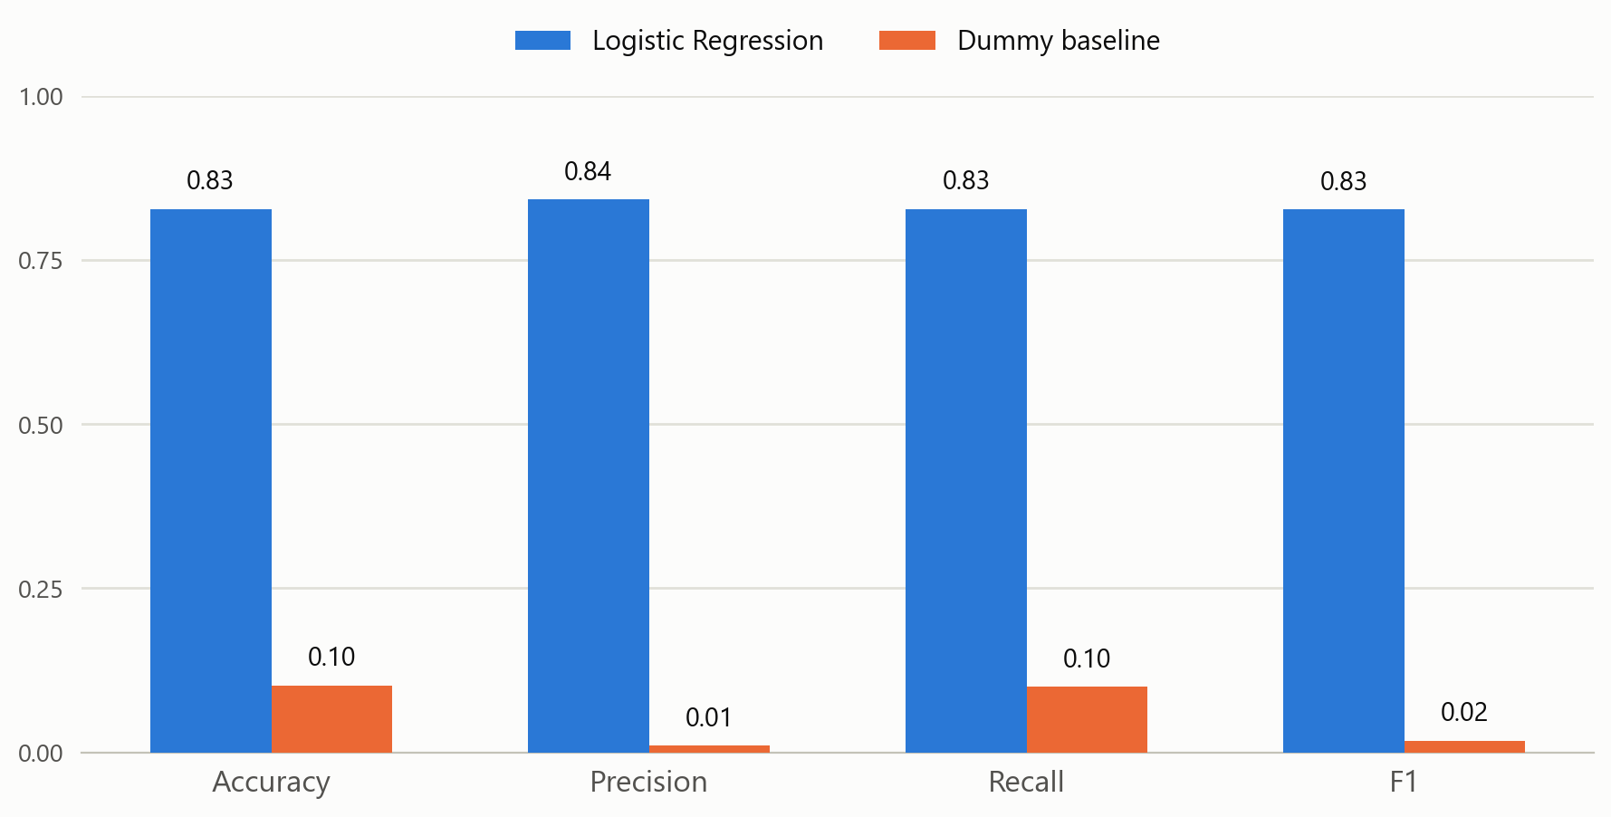
RESULTS
Baseline vs. model
Held-out test set
(25%, 373 tickets)
The Dummy baseline always predicts the most frequent class — on a perfectly balanced dataset that caps out near 10% accuracy.
Logistic Regression reaches 0.83 macro-F1, an 8x improvement over guessing, confirming the ticket text genuinely carries team signal.
Ticket Support Model — routing tickets to the right team
8

Slide 9
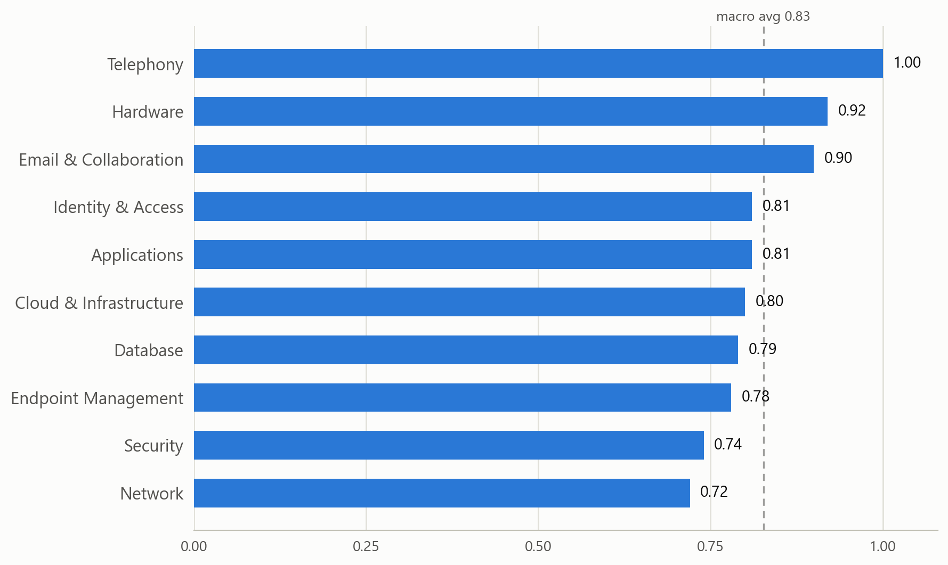
RESULTS
Per-team F1 score
Easy classes
Telephony, Hardware and Email & Collaboration have distinctive vocabulary (“voicemail”, “monitor”, “distribution list”).
Harder classes
Network and Security tickets often describe generic symptoms (“not working”, “getting an error”) that overlap with other teams — see the confusion matrix next.
Ticket Support Model — routing tickets to the right team
9

Slide 10
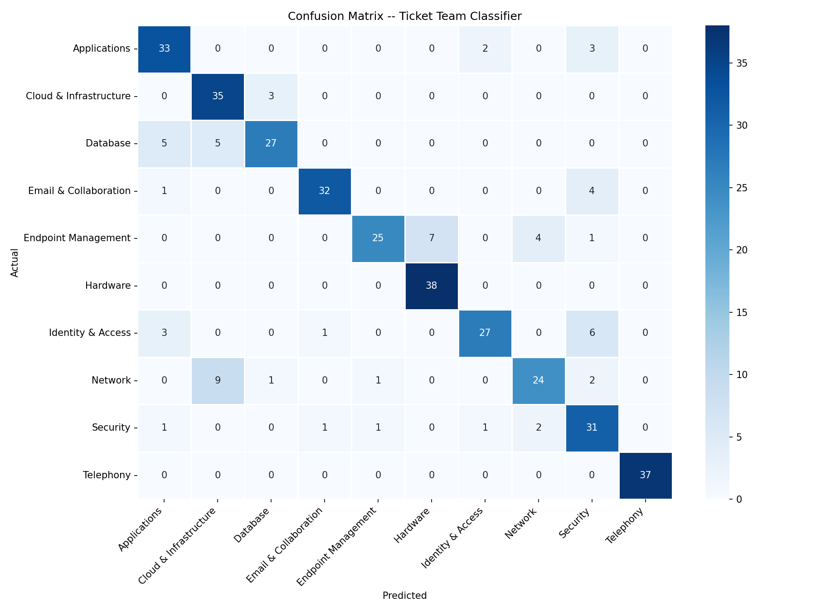
RESULTS
Where the model gets confused
Ticket Support Model — routing tickets to the right team
10

Slide 11
DEMO
Live predictions on new tickets
Ticket (excerpt) | Predicted team | Confidence
“ERP rejects my purchase order with a validation error” | Applications | 0.88
“Windows update stuck installing for two days” | Endpoint Management | 0.87
“Someone signed into my account from Romania at 3am” | Security | 0.83
“Account locked, distribution list lost access” | Email & Collaboration | 0.85
“Need admin rights, can't see files I'm supposed to” | Identity & Access | 0.95
“Laptop won't turn on this morning” | Hardware | 0.54
“Voicemail has terrible audio, call queue no dial tone” | Telephony | 0.94
“Connection pool: too many connections, everything slow” | Database | 0.70
“Internet keeps dropping, can't reach anything internal” | Network | 0.96
“EC2 instance at 100% CPU, autoscaling won't scale up” | Cloud & Infrastructure | 0.95
Ticket Support Model — routing tickets to the right team
11

Slide 12
NEXT STEPS
Limitations & where this goes next
Known limitations
Planned improvements
Short, template-like training text — real-world tickets with more
variety in phrasing may see lower confidence.
Add a second classical model (SVM or Naive Bayes) — or a
transformer baseline (DistilBERT) — on the same test set.
Only one real model trained (Logistic Regression); the only
comparison point today is a naive DummyClassifier baseline.
Pull concrete misclassified examples and discuss why they're
ambiguous (e.g. generic “not working” phrasing).
No systematic review yet of individual misclassified tickets
(y_pred != y_test) beyond the aggregate confusion matrix.
Hyperparameter search already wired up via GridSearchCV +
StratifiedKFold — run it and lock in the best configuration.
Ticket Support Model — routing tickets to the right team
12

Slide 13
Thank you
Questions & discussion
Code: model.py / main.py · Dataset: it_support_tickets.csv

