Slide 1
CMPE 202– Team Inferno
Team Member
Vinit Singh
Pavan Kothawade
Shripal Modani
Amita Mathkar
Pritam Meher

Slide 2
Game Overview

Slide 3
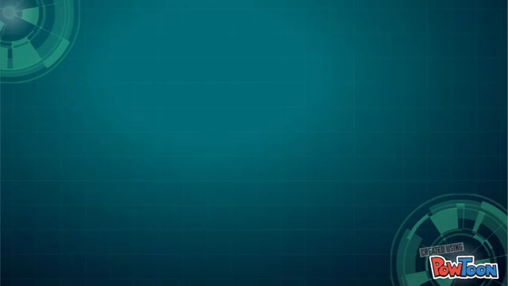

Slide 4
Game Class Diagram

Slide 5
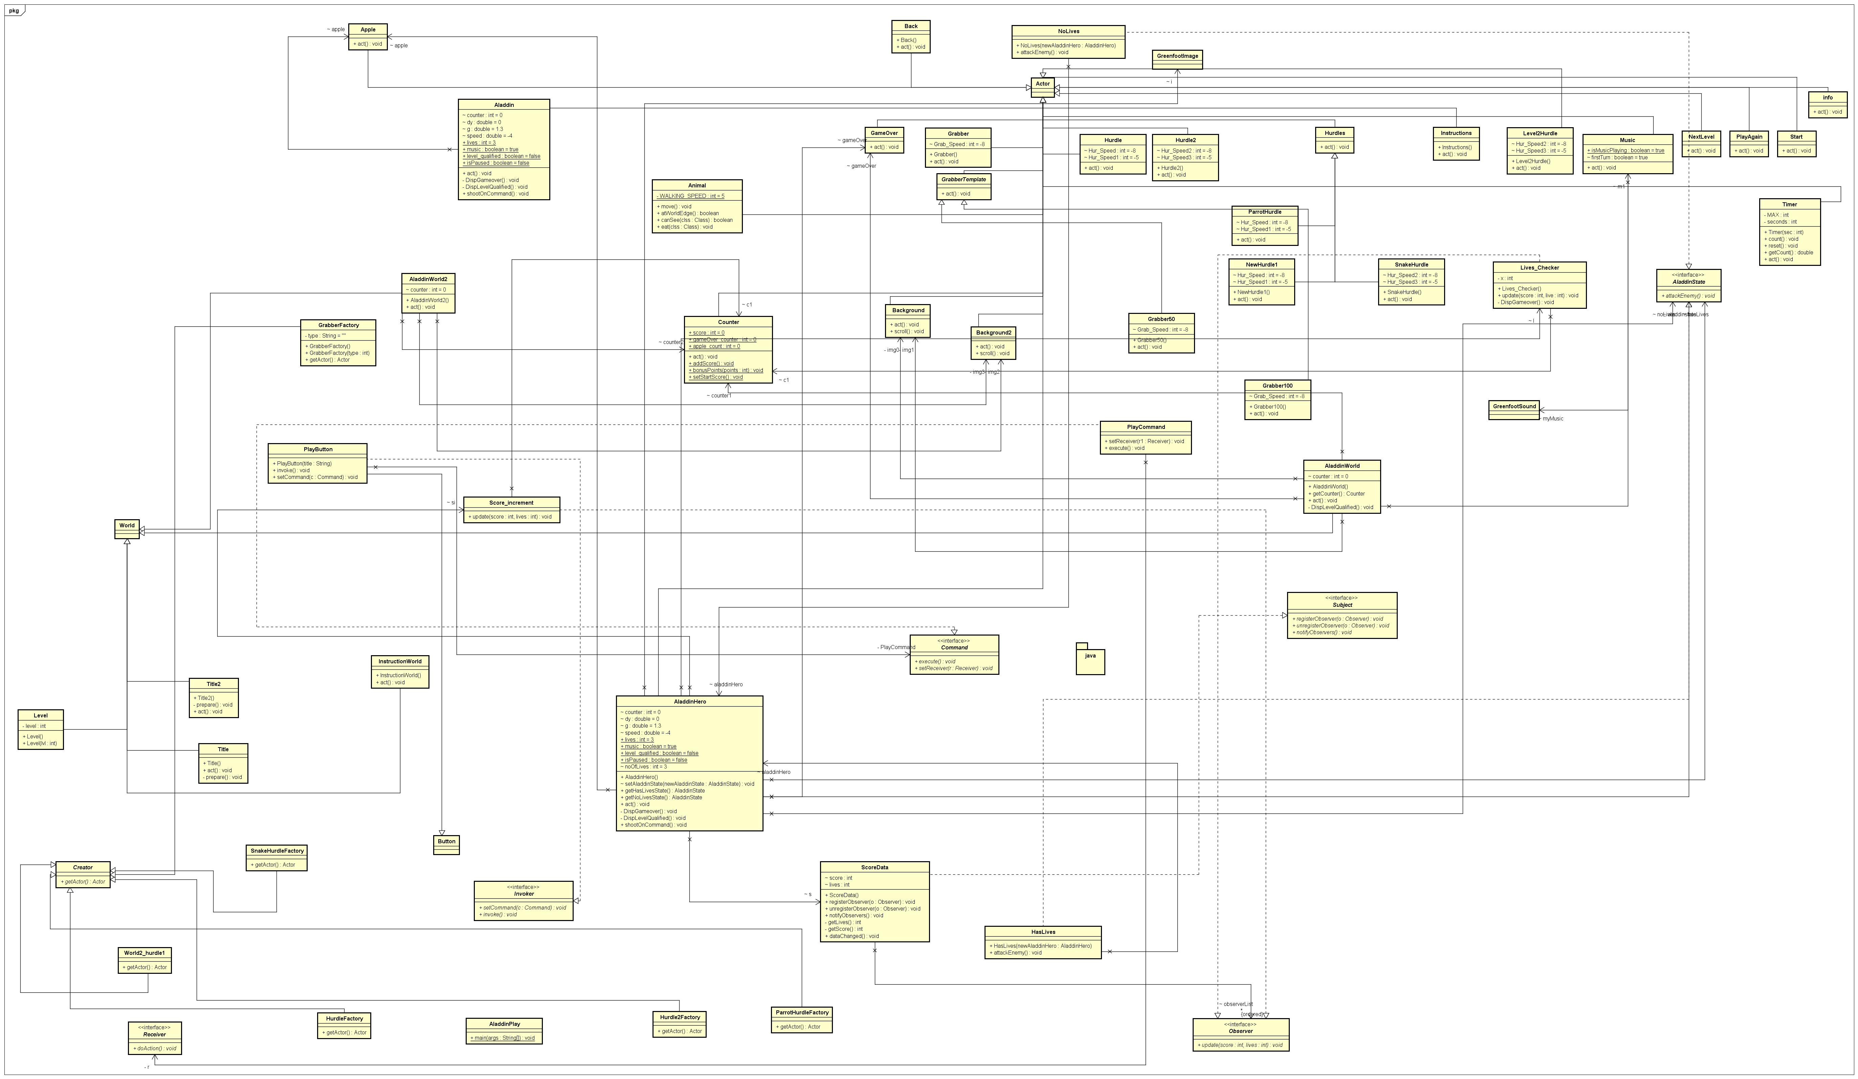

Slide 6
Design Patterns in the Game

Slide 7
Factory Method Design Pattern

Slide 8
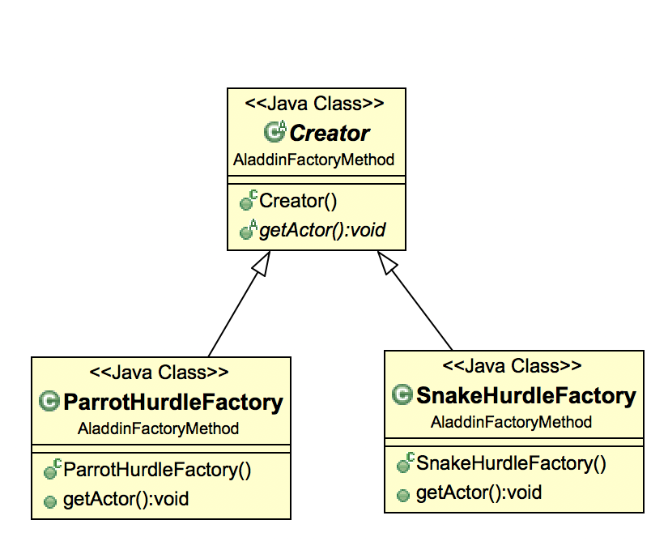
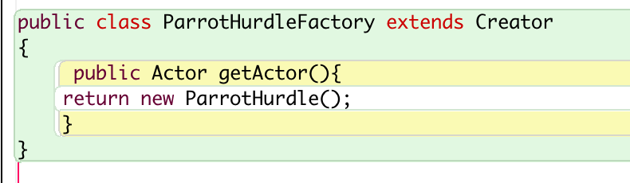
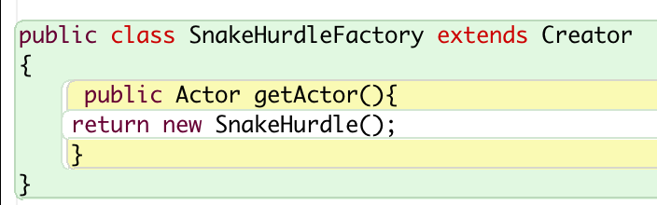
Concrete Classes Implemented
for Object Creation
SnakeHurdle
ParrotHurdle

Slide 9
Template Design Pattern

Slide 10
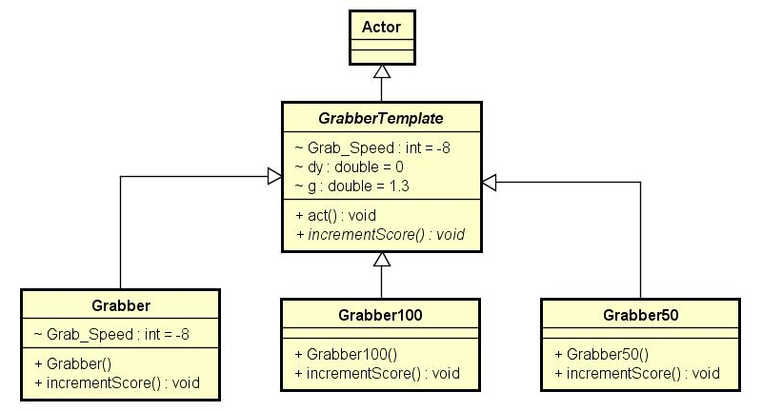
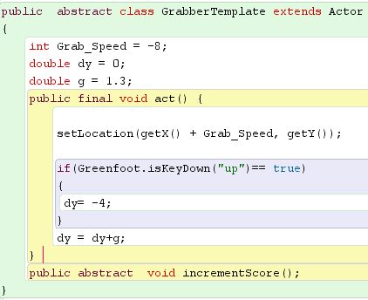
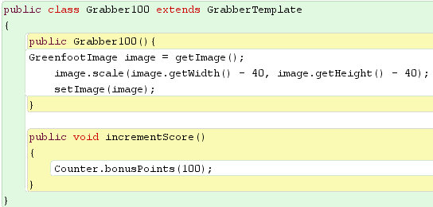
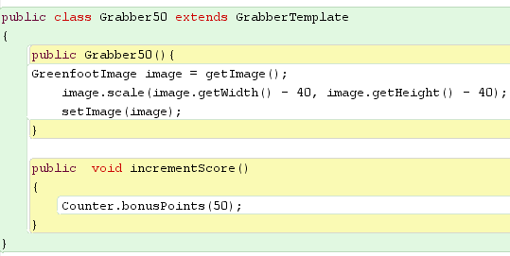
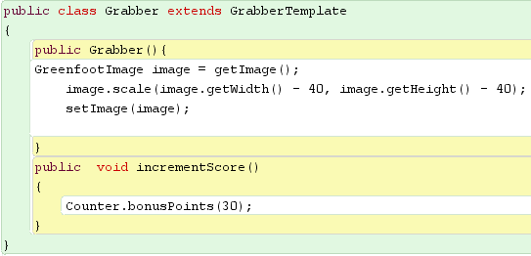

Slide 11
State Design Pattern

Slide 12
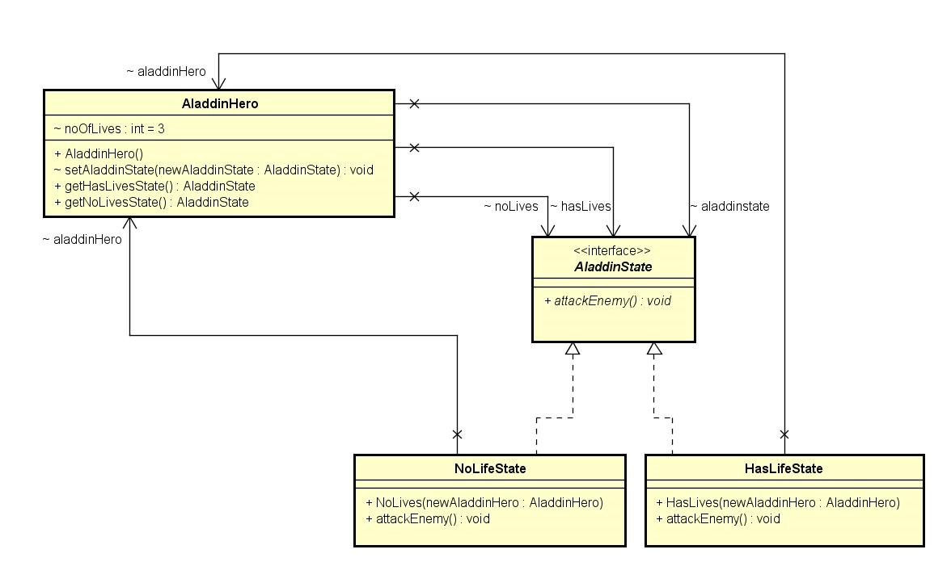
public class AladdinHero
{
AladdinState hasLives;
AladdinState noLives;
AladdinState aladdinstate;
int noOfLives=3;
public AladdinHero(){
hasLives= new HasLives(this);
noLives= new NoLives(this);
aladdinstate= hasLives;
if(noOfLives == 0){
aladdinstate= noLives;
}
}
Void setAladdinState(AladdinState newAladdinState){
aladdinstate= newAladdinState;
}
public AladdinState getHasLivesState(){
System.out.println("In HasLivesState");
return hasLives;
}
public AladdinState getNoLivesState(){
System.out.println("In NoLivesState");
return noLives;
}
}
public interface AladdinState {
void attackEnemy();
}
public class HasLives implements AladdinState {
AladdinHero aladdinHero;
public HasLives(AladdinHero newAladdinHero) {
aladdinHero= newAladdinHero;
}
@Override
public void attackEnemy() {
System.out.println("Aladdin can attack on Hurdles");
}
}
public class NoLives implements AladdinState {
AladdinHero aladdinHero;
public NoLives(AladdinHero newAladdinHero) {
aladdinHero= newAladdinHero;
}
@Override
public void attackEnemy() {
System.out.println("Aladdin can not attack on Hurdles");
}
}

Slide 13
Observer Design Pattern

Slide 14
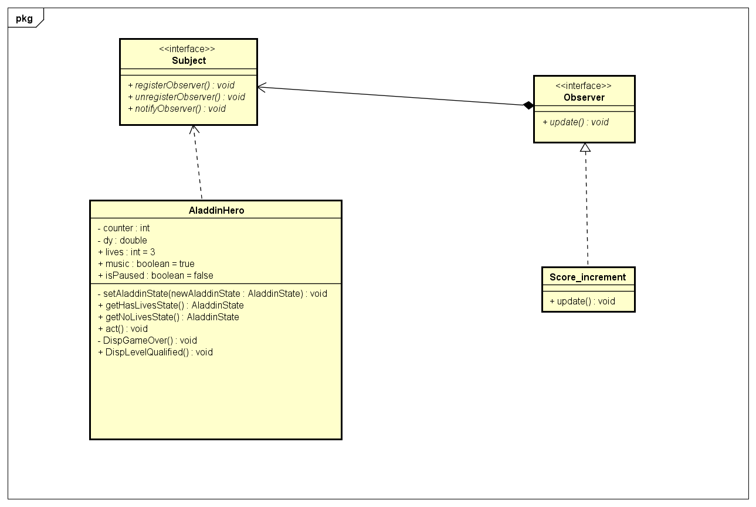
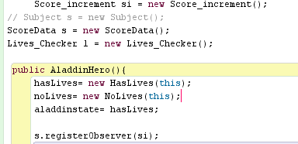
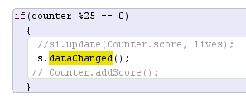
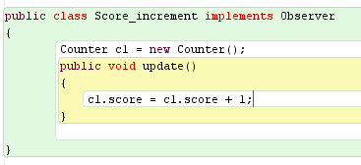

Slide 15
Command Design Pattern

Slide 16
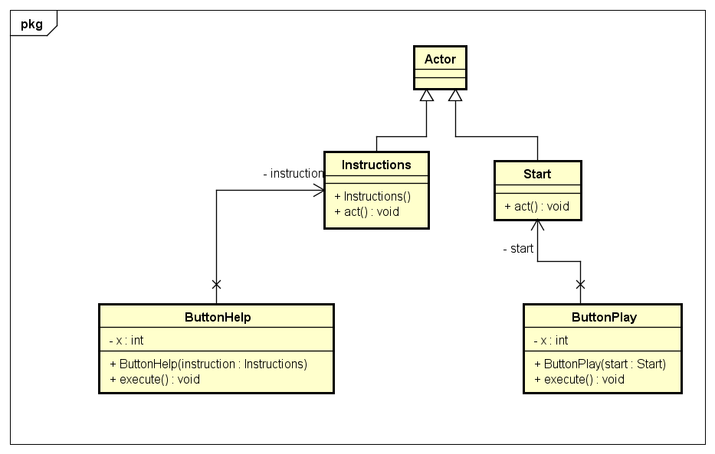
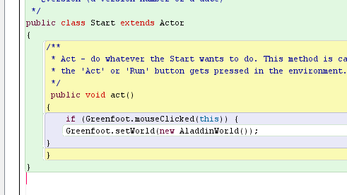
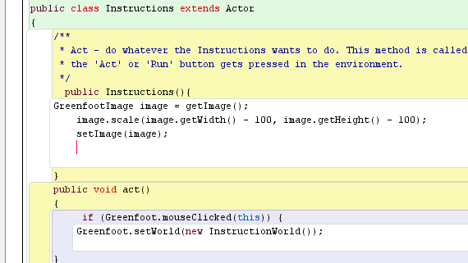
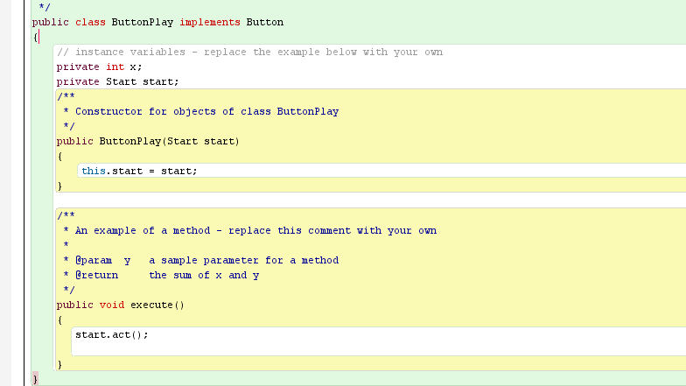
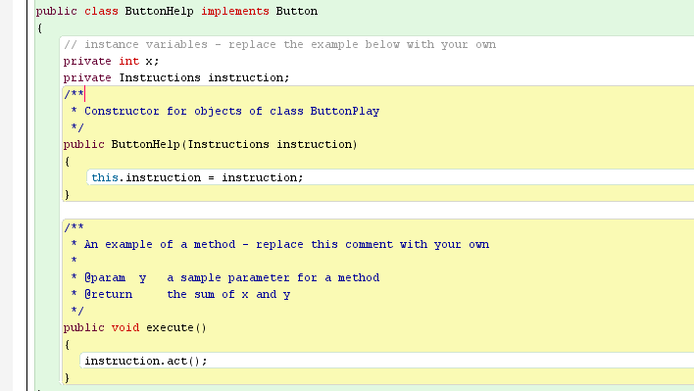
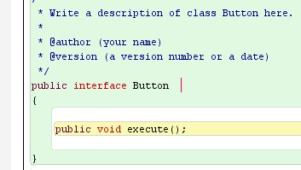

Slide 17
Sprint Planning and Status
Sprint 1
Sprint 2
Sprint 3
Sprint 4
Design Pattern and Level 2 Implementation
Level 1 Prototype
Level 1 Implementation
Integration and Testing
Creation of User Stories
Animation of Game and Actors
Hurdle Creation
UI modification
User story for Music
User story for Score
User story for level 1 completion
Incorporation of Design Pattern
Level 1 Testing
UI refactoring
Level 2 Design and Development
Level 2 implementation
User story for jafar
Testing final game
Code Refactoring
Activities
User Stories for Aladdin, Hurdle created
UI Finalized
Level 1 Prototype Delivered
Implemented User Story for Music
Implemented User Story for Music
Level 1 delivered
5 Design patterns implemented.
Level 1 testing completed
UI refactored
Level 2 implemented
Level integration
Implemented user story for Jafar
Released final version of Game
Outcomes

Slide 18
Sprint Details

Slide 19
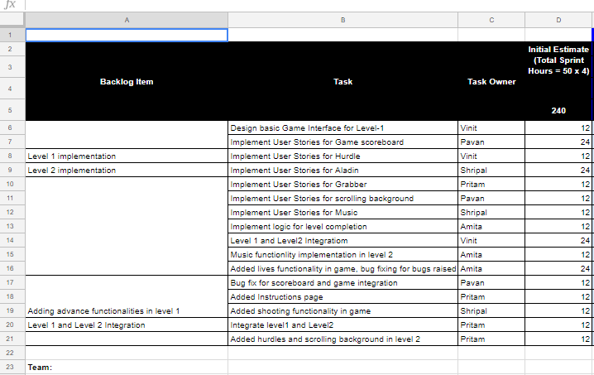

Slide 20
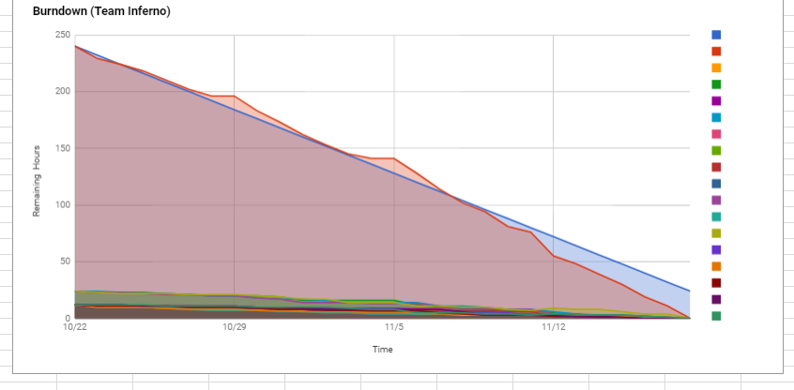
Sprint Burn Down Chart

Slide 21
Team Retrospective
What did we do well?
Finalized the game Design at an early stage
Maintaining product backlog
Weekly Meeting
Team Work
Sprint - Definition of Done
Honesty of Team members
What needs improvement?
Start the coding using Design Patterns
Game play documentation
Managing Team Schedule
Planning schedule by keeping next step in mind.
What should we keep doing?
Work as a Team
Agile helped us understand blockages which later helped us fix the issues.
Weekly Team Meeting
What went wrong during Sprint Cycle?
Achieving Sprint goals as per definition of done
Integration Testing
User Story selection as per Team Schedule

Slide 22
Game Demo

Slide 23
Thank You

