Slide 1


HONG KONG HACK 2026 · Redefining Security
VulnHunterX : LLM-Powered Automated Vulnerability Hunting
Teaching small LLMs to triage like a senior analyst
Tran Chi Thien
Head of Offensive security
10 Jun 2026 - Hong Kong
Notes:
Open on the cost of triage, not detection. Security teams don't drown in MISSED bugs — they
drown in triaging the ones the scanner flagged, most of which are safe. FP rates run 30–80%.
The question for this talk: what if a model that costs zero dollars could do the first triage pass,
and do it well? This builds on CyberArk's Vulnhalla methodology — name it up front for credibility.
State the thesis now and again at the end: reasoning STRUCTURE beats model SIZE.

Slide 2
THE PROBLEM
FP fatigue is a security failure mode
30–80% of SAST findings are false positives.
What if a cheap model could do the first pass — well?
— Thousands of SAST findings → analyst hours → a handful of real bugs
— When ~70% of alerts are noise, analysts stop reading the queue
· …and the real bug rides in with the noise
— Dual-use: defender triage tooling AND an offense recon accelerator
github.com/vinsoc-cyber/VulnHunterX
2 / 33
Notes:
Draw the funnel. The failure isn't a missed detection — it's that humans can't keep up with the
volume, so they tune out, and a genuine vulnerability gets ignored alongside the noise. Frame the
dual-use angle for an HK Hack room: the same triage speed-up helps defenders clear a backlog and
helps offense prioritize attacker-relevant findings fast.

Slide 3
THE PROBLEM
When the scanner is wrong — two real false positives
CodeQL flagged both. The LLM killed both — each with a cited reason. (Verbatim from the committed verdict JSONs.)
vorbis · cpp/alloca-in-loop · lib/vorbisfile.c:2396 · CWE-770
“Although alloca() is used in a loop, both the iteration count (ch1, audio channels) and allocation size (n1, block size) are constrained by the Vorbis format specification. Realistic values will not cause stack exhaustion.”
✗ False Positive confidence High (0.90) · 2 iterations
libjpeg-turbo · cpp/world-writable-file-creation · tjexample.c:320 · CWE-732
“The flagged line (320) is a call to tjTransform with memory buffers, not file operations. The world-writable (mode 0666) finding appears to be misattributed to this code location.”
✗ False Positive confidence Medium (0.75) · 4 iterations
Two failure modes: a real risk neutralised by a domain constraint, and a rule firing on the wrong line.
github.com/vinsoc-cyber/VulnHunterX
3 / 33
Notes:
Two REAL false positives, straight from the committed verdict JSONs — no hand-crafted examples.
Case 1 (vorbis): CodeQL's cpp/alloca-in-loop is a legitimate stack-exhaustion rule, but here the
loop bound (channel count) and the per-iteration size (block size) are both capped by the Ogg
Vorbis format spec, so the stack can't actually be exhausted — High-confidence FP. Case 2
(libjpeg-turbo): the world-writable-file-creation rule fired on line 320, but that line is a
tjTransform() call on in-memory buffers — there's no 0666 file creation there at all; the rule
mis-attributed the location — Medium-confidence FP. Two distinct ways SAST is "wrong": a true rule
defeated by a domain constraint, and a rule firing on the wrong line. Both killed with a cited
reason, on a $0 model. This is the judgment we're automating — and the live demo resolves more of
these later.

Slide 4
THE PROBLEM
Why "just ask GPT if it's a bug" fails
— Free-form prompting pattern-matches the shape, not the data flow
· free(p) … *p → "use-after-free!" — without checking paths overlap or a guard exists
— SecLLMHolmes (IEEE S&P 2024): frontier models cap ~40% on hand-crafted cases
— The gap isn't model IQ — it's METHOD
github.com/vinsoc-cyber/VulnHunterX
4 / 33
Notes:
The naive approach is confidently wrong because it matches a textual pattern instead of reasoning
about reachability and guards. SecLLMHolmes measured frontier models capping around 40% accuracy
on hand-crafted scenarios for precisely this reason. Land the line: the gap is method, not
intelligence — which is what the rest of the talk fixes.

Slide 5
THE METHOD
Guided questions = encoded analyst expertise
py/sql-injection: # real bank — 6 questions
questions:
- "Quote the EXACT sink statement (cursor.execute /
session.execute) and name the variable. Do not paraphrase."
- "List EVERY assignment to that variable on each path that
reaches the sink, with line numbers — and the LAST one."
- "What specific defense sanitises the value before the sink?
Name it concretely. Vague 'sanitisation' is not acceptable."
- "If you cannot point to the tainted value reaching the sink
AND the absence of every defense → verdict False Positive."
additional_context: [caller, callees] min_iterations: 2
evidence-bound cite lines · atomic one fact / question · refusal allowed "not visible" → fetch more
Why: answer ALL questions BEFORE the verdict — this forces step-by-step reasoning instead of pattern-matching.
github.com/vinsoc-cyber/VulnHunterX
7 / 33
Notes:
Instead of "is this a bug?", ask the model the same ordered questions a senior reviewer asks —
these are quoted VERBATIM from config/prompts/python_questions.yaml. Three design rules baked into
how every question is written: evidence-bound — each answer must cite concrete line numbers;
atomic — one fact per question, compound questions get split; refusal allowed — "not visible in the
provided context" is a legal answer, and it's what triggers fetching more context. The WHY, from
the file's own header comment: the LLM must answer ALL questions BEFORE giving a verdict, which
forces step-by-step reasoning instead of pattern matching. Note the last question is the explicit
default-to-FP rule, and min_iterations:2 forces a second pass on taint CWEs in framework languages
(OWASP-Python: 1-iter 57.1% → 2-iter 95.8%). The repo ships these banks across six languages,
routed by rule ID and CWE.

Slide 6
THE METHOD · 2 MIN
Second example — C/C++ use-after-free (CWE-416)
cpp/use-after-free: # lifetime, not taint — 10 questions
questions:
- "ANCHOR FIRST: quote the flagged line; classify it as
pointer USE / free·delete / signature·declaration."
- "List ALL free()/delete reaching the use, with file+line.
If you can't enumerate them, request free_sites:<ptr>."
- "Shortest control-flow path free → use: reachable? NULL-set
or re-allocated in between?"
- "DECISION RULE: mark FP ONLY with POSITIVE evidence of a
defense. Pattern-only reasoning is NOT enough → prefer NMD."
additional_context: [free_sites, caller, all_callers, struct,
callees, destructor, field_writes] min_iterations: 3
Injection asks "where is the taint?" use-after-free asks "who owns the lifetime?"
Why: a lifetime question needs free-site evidence, not a sink match — so the default for an undefended free→use is TP, and FP demands a cited defense.
github.com/vinsoc-cyber/VulnHunterX
8 / 33
Notes:
A deliberately different CWE class to show the method generalizes — these questions are quoted
VERBATIM from config/prompts/cpp_questions.yaml (the bank has 10; four shown). SQL injection is a
taint / data-flow question — does attacker input reach a sink unsanitized? Use-after-free is a
lifetime / ownership question — who owns the memory? Note the moves: ANCHOR and CLASSIFY the flagged
line first (many UAF false positives are just signatures/declarations); enumerate every free site
(it requests free_sites: context); trace the shortest free→use path and check for a NULL-set or
reallocation defense. The DECISION RULE is the key anti-pattern-matching guard: mark FP ONLY with
POSITIVE evidence of a defense — pattern-only reasoning on function names is not enough, prefer
Needs-More-Data. min_iterations is 3 — memory-safety needs the turns. The free_sites / destructor /
field_writes context it asks for is exactly what the next slide shows being extracted.

Slide 7
THE METHOD · 2 MIN
The pipeline
1 prepare
2 analyze
3 verify
4 report
Stages 1–2 ordinary SAST (CodeQL / Semgrep / OpenGrep)
Stage 3 the LLM verification this talk is about
Stages 5–8 optional: PROVE the bug with a crash
github.com/vinsoc-cyber/VulnHunterX
5 / 33
Notes:
One diagram for the whole system. SARIF is the contract that ties it together — remember that for
the extensibility slide. Stages 1–2 are ordinary static analysis; stage 3 is the LLM verification
that is the heart of the talk; stages 5–8 optionally confirm a true positive with an actual crash.
Everything routes through one SARIF interface.

Slide 8
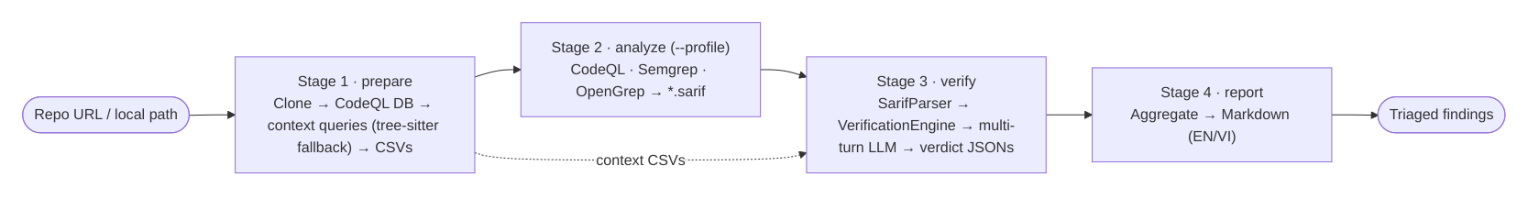
THE METHOD · 1.5 MIN
Stages 1–4 · detection → verified triage
Dotted line = pre-extracted context CSVs feeding multi-turn verification.
github.com/vinsoc-cyber/VulnHunterX
6 / 33
Notes:
The real pipeline figure from the paper. Repo in, triaged findings out. Stage 1 prepares the
CodeQL DB and extracts context CSVs (tree-sitter fallback when the DB build fails); Stage 2 runs
the SAST engines to SARIF; Stage 3 is the multi-turn LLM verification; Stage 4 aggregates a
bilingual report. Point at the dotted line: those pre-extracted context CSVs are what the LLM
draws on in Stage 3 WITHOUT re-running analysis — that's why multi-turn is cheap.

Slide 9
THE METHOD · 2 MIN
Answer-before-verdict — the core trick
{
"answers": [ "sink at L88; var=path", ... ],
"data_flow": "req.args (L10) → join (L15) → open (L88)",
// ^ evidence is generated FIRST
"verdict": "False Positive",
"confidence": "High",
"reasoning": "secure_filename neutralizes traversal (L14)"
}
Verdict token is conditioned on cited evidence. No citation → confidence downgraded.
github.com/vinsoc-cyber/VulnHunterX
9 / 33
Notes:
This is the single most important slide. The response schema forces the model to write its cited
answers and the data-flow trace FIRST; the verdict field is generated last, conditioned on that
evidence. Because generation is left-to-right, autoregression now works FOR us. A post-processor
downgrades any High/Medium verdict whose reasoning is pure pattern-language with no file:line
citation. Evidence first, conclusion last.

Slide 10
THE METHOD · 2 MIN
Context broker + multi-turn
— Need more? Model requests from a FIXED vocabulary:
· caller: · struct: · global: · free_sites: · callees: · destructor: …
— Resolved from pre-extracted CSVs (tree-sitter fallback) — never re-runs SAST
— So multi-turn costs tokens, not another analysis
2.74 mean turns
0.8% forced decisions
github.com/vinsoc-cyber/VulnHunterX
10 / 33
Notes:
When the model says "not visible here," it asks for more context from a fixed vocabulary — caller,
struct, free_sites, and so on. We resolve those from pre-extracted CSVs (or a tree-sitter fallback)
and re-prompt. Crucially we never re-run the SAST engine, so a multi-turn conversation costs a few
thousand extra tokens, not another full analysis. In practice the mean conversation is 2.74 turns
and only 0.8% of findings ever hit a forced decision — source: the 366-entry OWASP-Python run.

Slide 11
THE METHOD · 1.5 MIN
Where context comes from · context_extractor.py
CodeQL
database
→
codeql query run
→ bqrs decode
→
per-type
*.csv
→
multi-turn
broker
Context types extracted per language (QUERIES_BY_LANG)
C / C++ (8)
functions · callers · structs · globals · macros · free_sites · destructors · field_writes
Python / JS / Java / Go / PHP (3)
functions · callers · classes
The use-after-free questions request free_sites / destructors / field_writes — exactly these CSVs.
github.com/vinsoc-cyber/VulnHunterX
11 / 33
Notes:
Pull back the curtain on the context broker. context_extractor.py runs small CodeQL queries
against the database — query run, then bqrs decode — and writes one CSV per context type. C and C++
get eight types, including the memory-safety-specific free_sites, destructors, and field_writes
that the use-after-free questions ask for. The other five languages get three (functions, callers,
classes). When no CodeQL DB exists, a tree-sitter fallback emits the same CSV layout, so the rest
of the pipeline is identical. This is the cheap, pre-computed knowledge the LLM pulls from across
multi-turn — no re-analysis.

Slide 12
INSIDE THE CONVERSATION
FP · conf 0.95 · 2 turns
Real trace #1 — log-injection → False Positive
go/log-injection · merchant_be.go:92 · "depends on a user-provided value"
T1 answer the 6 guided Qs → verdict: Needs More Data (Low, 0.30)
context_needed: [ callees:MaskMerchantKey,
callees:MaskSensitive,
callees:extractContextFields ]
⟶ engine resolves each from pre-extracted CSVs:
callees:MaskSensitive → "[No callees found]" (×3)
T2 re-examine with new context → verdict: False Positive (High, 0.95)
Reasoning user input is logged exclusively as structured zap fields (zap.String) — never interpolated into the message. zap's encoder escapes control characters, so newline injection can't forge log entries.
github.com/vinsoc-cyber/VulnHunterX
32 / 33
Notes:
A real two-turn trace, verbatim from output/go/1216-services/.../go_log-injection_92.json (model
deepseek-v4-flash, $0). Turn 1: the model answers the six log-injection questions, can't see whether
the Mask* helpers sanitise control characters, so it REFUSES — verdict Needs More Data — and asks
for callees:MaskMerchantKey / MaskSensitive / extractContextFields. The engine resolves each from the
pre-extracted CSVs and returns "[No callees found]". Turn 2: with that, the model reasons that the
user input is only ever passed as a STRUCTURED zap field (zap.String), never interpolated into the
message string, and zap's encoder escapes control characters — so log-injection isn't possible.
Verdict flips to False Positive, High confidence. Pair this with the next slide.

Slide 13
INSIDE THE CONVERSATION
TP · conf 0.65 · 2 turns
Real trace #2 — clear-text-logging → True Positive
go/clear-text-logging · logger.go:46 · HTTP headers → cl.logger.Info(…)
T1 answer the 10 guided Qs → verdict: Needs More Data (Medium, 0.60)
context_needed: [ callees:extractContextFields,
code lines 30-31, 41-44 ]
⟶ engine resolves from pre-extracted CSVs:
callees:extractContextFields → "[No callees found]"
T2 re-examine with new context → verdict: True Positive (Medium, 0.65)
Reasoning HTTP-header data reaches cl.logger.Info with no visible sanitization; the only transform, extractContextFields, has no known callees — so no defense can be confirmed. Evidence supports information disclosure.
Same mechanism, same “[No callees found]” — opposite verdicts. The verdict follows the reasoning about the visible defense, not a pattern.
github.com/vinsoc-cyber/VulnHunterX
33 / 33
Notes:
The matched pair. Verbatim from output/go/1216-services/.../go_clear-text-logging_46.json (model
deepseek-v4-flash, $0). SAME mechanism as the previous slide — the model answers the guided
questions, refuses (Needs More Data), and asks for callees:extractContextFields; the engine returns
the identical "[No callees found]". But here the reasoning runs the OTHER way: HTTP-header data
reaches the logger with no visible sanitiser, and since extractContextFields has no known callees we
CAN'T confirm any protection — so the evidence supports a real information-disclosure bug. Verdict:
True Positive. Punchline: identical context outcome, opposite verdicts — the decision tracks the
reasoning about a visible defense, not pattern-matching. (Confidence stays Medium because the helper
body is still unavailable — calibrated honesty.)

Slide 14
THE EVIDENCE · 2.5 MIN
Precision roughly doubles; FP load collapses
Dataset | raw-SAST P / F1 | VulnHunterX P / F1 | FP-reduction
OWASP-Python (300) | 37.7 / 54.7 | 87.3 / 92.4 | 91.4%
OWASP-Java (full) | 90.0 / 94.7 | 97.7 / 96.6 | 80.0%
Juliet C/C++ (full) | 50.0 / 66.7 | 83.8 / 88.5 | 82.2%
SecLLMHolmes (228) | 52.3 / 68.7 | 82.1 / 84.7 | 79.4%
Every cell is quoted from a published run file (vulnhunterx, best model per row).
github.com/vinsoc-cyber/VulnHunterX
12 / 33
Notes:
The headline. Precision roughly doubles and we delete 80–91% of false positives while keeping
>90% of real bugs (TP-preservation stays ~90–96%). Point at the repo: every number here is in a
committed benchmark result file, reproducible with the harness. Numbers are percentages, P/F1.

Slide 15
THE EVIDENCE · 2.5 MIN
Small beats big · cheap beats expensive
Model | OWASP-Python F1 | Cost
DeepSeek-v4-flash ($0 pass-through) | 92.4% | ~$0.40 / 300
gpt-4.1-mini | 89.4% | ~$1.10 / 300
Qwen3-Coder (local) | 78.7% | $0
GPT-5 (SecLLMHolmes) | 82.0% | ~$16.75 / 228
The $0 model wins. GPT-5 costs ~$17 / 228 findings and doesn't lead.
github.com/vinsoc-cyber/VulnHunterX
13 / 33
Notes:
The surprising result. The zero-dollar pass-through model has the best F1, and GPT-5 — at roughly
seventeen dollars for 228 findings — doesn't lead. The lever is the protocol, not the parameter
count. Be honest about latency: this is batch-speed, tens of seconds per finding, not inline on
keystroke.

Slide 16
THE EVIDENCE · 2 MIN
Ablation honesty — where it doesn't dominate
— Biggest jump: raw-SAST → ANY multi-turn LLM (~20 F1 points)
— Zero-shot is already surprisingly strong
— Guided questions add the hard-case tail (~3–5 pts recall)
· On synthetic Juliet, generic questions even edge out specific ones
— Saying where you DON'T win is what earns the room's trust
github.com/vinsoc-cyber/VulnHunterX
14 / 33
Notes:
Don't oversell. The largest single jump is from raw-SAST to any multi-turn LLM — about 20 F1
points. Zero-shot is strong; the guided questions mainly add the hard-case tail, a few points of
recall, and on synthetic Juliet generic questions even nudge ahead. Telling an HK Hack audience the
limits of your own method buys credibility for the numbers that ARE strong.

Slide 17
LIVE DEMO · 1 MIN
Live demo — the setup
— Two targets side-by-side (mirrors examples/pipeline_python.py):
· a benign real-world library
· a deliberately vulnerable app
— Success criteria, stated out loud:
· the real bug SURVIVES as a TP
· a scary-looking benign finding (like the FPs on slide 3) gets KILLED
· both with cited reasoning
github.com/vinsoc-cyber/VulnHunterX
15 / 33
Notes:
Set expectations before touching the keyboard. Two terminals: a benign upstream library and a
deliberately vulnerable app. Say the success criteria aloud so the audience knows what "working"
looks like — the real bug survives, a benign finding (like the real false positives on slide 3)
dies, both with citations.

Slide 18
LIVE DEMO · 6 MIN
Live demo — run · vuln-hunter-x verify
— 1. A benign finding — KILLED as FP, with the cited reason
— 2. A real bug — SURVIVES as TP, with a data-flow trace
— 3. A live multi-turn context request (caller: / struct:) → revised verdict
— 4. Confidence downgrade catching a thin, pattern-matched verdict
BACKUP (rehearse): pre-recorded screencast + cached verdict JSON — floor network WILL flake
github.com/vinsoc-cyber/VulnHunterX
16 / 33
Notes:
Run verify on the pre-staged findings and narrate four moments in order: the false positive dies
with its cited guard; a real bug survives with a data-flow trace; a live multi-turn context
request and the revised verdict; and the confidence downgrade catching a thin verdict. REHEARSE
the fallback: a pre-recorded screencast plus cached verdict JSON. Conference-floor network failure
is a when, not an if. If running long, the fuzz-payoff slide is the safe cut.

Slide 19
LIVE DEMO · 2 MIN
Payoff: from opinion to crashing input
— For a C/C++ true positive, stages 5–8 run automatically:
· generate libFuzzer harness → ASan crash → triaged crashing input
— "The LLM says use-after-free" → "here is the input that crashes it"
— That's the difference between a triage opinion and a filed, reproducible bug
(Pre-recorded — fuzzing live on stage is slow.)
github.com/vinsoc-cyber/VulnHunterX
17 / 33
Notes:
Close the loop. For a memory-unsafe true positive, the fuzz stages generate a harness, build it
with sanitizers, and produce an actual crashing input. That converts an LLM opinion into a filed,
reproducible bug. Use the recording — fuzzing in real time on stage is too slow. This is the bridge
into the real-world results: the next segment shows five such bugs we actually found and confirmed.

Slide 20
RESULTS
manually confirmed · PoC + vendor
Five confirmed real-world vulnerabilities
Library | Vulnerability | CWE | Location | Vendor status
flac | TOCTOU race condition | CWE-367 | file.c:116 | xiph/flac #902
libevent | Compiler-elided memset() | CWE-14 | sha1.c:202 | advance-security triage
vorbis | Stack overflow — alloca() in loop | CWE-770 | vorbisfile.c:2290 | xiph/vorbis MR !43
gradio | Full SSRF via user URL | CWE-918 | image_utils.py:253 | GitHub Security triage
safety | Credential leak — URL sanitization | CWE-295 | uv/command.py:72 | email triage
Memory-safety, crypto-hygiene, DoS, SSRF, and credential-leak — five distinct bug classes across C and Python, each with a manual PoC.
github.com/tuonglnc/VHX-real-bug-confirmed
19 / 33
Notes:
The money slide. Five distinct vulnerability classes — a TOCTOU race, a compiler dead-store that
defeats secret-wiping, an unbounded stack allocation, a server-side request forgery, and a
credential leak from a sloppy URL check — across two languages and five mature, widely-deployed
projects. Every row has a public PoC and a vendor touchpoint. Walk the table, then the next slide
shows the funnel these came out of.

Slide 21
RESULTS
the funnel
175 findings in · 5 real bugs out · $0
Library | Findings | True Pos | False Pos | Scan time
flac | 94 | 12 | 82 | 54.6 min
gradio | 49 | 24 | 12 (+12 err) | 27.0 min
vorbis | 18 | 18 | 0 | 17.1 min
libevent | 7 | 4 | 3 | 5.3 min
safety | 7 | 5 | 1 | 7.2 min
TOTAL | 175 | 63 | 98 | ~1 h 51 m
flac: the real TOCTOU bug was 1 of 94 findings — the LLM filtered 82 false positives to surface it. Model GLM-5.1 · ~2.7K–9.5K tokens/finding · $0.00.
github.com/tuonglnc/VHX-real-bug-confirmed
20 / 33
Notes:
This is why the triage layer matters in the real world. 175 raw findings across the five libraries;
the LLM verdicts narrowed those to a manageable set and, on flac alone, filtered 82 false positives
to leave 12 true positives — one of which was the TOCTOU bug. Note gradio's 12 errors (harness/parse
issues) — be honest about that. The whole campaign ran on GLM-5.1 at zero marginal cost, a few
thousand tokens per finding. Cheap triage, real results.

Slide 22
DEEP DIVE · C
TP · conf 0.72 · 3 turns · xiph/flac #902
flac — TOCTOU race condition (CWE-367)
// grabbag__file_change_stats(filename, ...)
stat(filename, &st); // line 100 — CHECK
... // attacker swaps file → symlink
flac_chmod(filename, mode); // line 116 — USE (no fd held)
Impact Local attacker controlling the parent dir wins the race → chmod arbitrary files as the elevated user (e.g. /etc/shadow). Reachable from 2 production paths. PoC won on attempt 7.
LLM verdict True Positive · confidence 0.72 (Medium) · 3 multi-turn iterations — the engine pulled extra context before committing.
github.com/tuonglnc/VHX-real-bug-confirmed
21 / 33
Notes:
stat() at line 100 and chmod() at line 116 use the same path string with no file descriptor held
between them — the classic check-then-use TOCTOU window. An attacker who controls the parent
directory swaps the file for a symlink in that window, so chmod lands on the symlink target. When
flac/metaflac runs elevated, that's permission changes on arbitrary files. Note the verdict: Medium
confidence, and it took THREE multi-turn iterations — the engine asked for more context before
committing, exactly the behavior the methodology is built for. Vendor issue xiph/flac #902.

Slide 23
DEEP DIVE · C
TP · conf 0.85 · 1 turn · xiph/vorbis MR !43
vorbis — stack overflow via alloca() in loop (CWE-770)
// ov_crosslap() — lib/vorbisfile.c
for (i = 0; i < vi1->channels; i++) // channels from file header
lappcm[i] = alloca(sizeof(**lappcm) * n1); // line 2290
// channels only checked >= 1 (no upper bound); blocksize <= 8192
Impact channels=255 × blocksize=8192 → ~4.17 MB stack on a crafted .ogg → overflows a 1 MB worker thread → DoS. Media players / game engines decode audio on small-stack threads.
LLM verdict True Positive · confidence 0.85 (High) · 1 iteration · ~2.7K tokens · $0.
github.com/tuonglnc/VHX-real-bug-confirmed
22 / 33
Notes:
ov_crosslap allocates with alloca() inside a loop bounded by the channel count, which is parsed
straight from the Ogg header and only checked to be >= 1 — no upper bound. A crafted file with 255
channels and max blocksize forces ~4 MB of stack, overflowing the small worker-thread stacks that
media players and game engines use for audio decode. High-confidence true positive in a single turn.
Vendor merge request !43 on the xiph vorbis GitLab.

Slide 24
DEEP DIVE · C
TP · conf 0.90 · 1 turn · advance-security triage
libevent — compiler-elided memset() (CWE-14)
// sha1.c — clearing sensitive state before return
memset(block, 0, sizeof(block)); // L202 raw SHA1 input
memset(context,0, sizeof(*context)); // L287 hash state
// buffers never read again → Dead Store Elimination removes all 3 at -O1+
Impact SHA1 input blocks, hash state, and counters persist on the stack after return. A memory-read primitive (core dump, /proc/pid/mem, swap) recovers secrets. Elevated in nginx / memcached / Tor.
LLM verdict True Positive · confidence 0.90 (High) · 1 iteration. PoC: objdump shows zero memset in the -O2 binary; stack remnant recovered.
github.com/tuonglnc/VHX-real-bug-confirmed
23 / 33
Notes:
Three memset() calls meant to wipe sensitive SHA1 data are silently removed by the compiler's
dead-store elimination at -O1 and above, because the buffers are never read after the wipe. Raw
input, hash state, and counters survive on the stack. The PoC proves it: objdump shows no memset in
the optimized binary, and the secret block is recovered from the stack. Reachable through the public
SHA1Update API; risk is highest in long-lived servers built on libevent. Triaged by advance-security.

Slide 25
DEEP DIVE · PYTHON
TP · conf 0.92 · 1 turn · GitHub Security triage
gradio — full SSRF via user-controlled URL (CWE-918)
# gradio/image_utils.py — extract_svg_content()
if is_http_url_like(image_file):
response = httpx.get(image_file) # line 253 — no SSRF guard
# sibling processing_utils.py uses safehttpx — this path was overlooked
Impact A user URL ending in .svg passed to a Gallery/Image component → server fetches any address, including internal IPs and cloud-metadata endpoints (169.254.169.254). Confirmed on Gradio 6.9.0.
LLM verdict True Positive · confidence 0.92 (High) · 1 iteration. The LLM noted the sibling module already uses safehttpx — this one didn't.
github.com/tuonglnc/VHX-real-bug-confirmed
24 / 33
Notes:
extract_svg_content fetches a user-controlled URL with httpx.get and no SSRF protection — no scheme
restriction, no host allowlist. The telling detail the LLM surfaced: the sibling processing_utils.py
already routes through safehttpx, so this is an overlooked path, not a missing capability. Impact is
classic SSRF — internal services and cloud metadata. Highest-confidence verdict in the set, single
turn. Triaged privately via GitHub Security.

Slide 26
DEEP DIVE · PYTHON
TP · conf 0.70 · 1 turn · email triage
safety — credential leak via URL sanitization (CWE-295)
# safety/tool/uv/command.py — before() (L72)
if index_value.startswith("https://pkgs.safetycli.com"): # prefix only
self.__index_url = index_value
# bypass: https://pkgs.safetycli.com.attacker.com → JWT injected into netloc
Impact Bypassable prefix check → live JWT embedded into attacker URL → leaked via Authorization header (uv request). CI/CD argument injection harvests ~24 h tokens for the Safety Platform.
LLM verdict True Positive · confidence 0.70 (Medium). Fix: validate urlsplit().hostname == exact host and block userinfo.
github.com/tuonglnc/VHX-real-bug-confirmed
25 / 33
Notes:
The --index-url is validated with startswith() on a domain prefix — which a subdomain like
pkgs.safetycli.com.attacker.com trivially passes. The CLI then embeds the user's JWT into the URL,
and uv ships it in an Authorization header to the attacker's host. The vector is CI/CD argument
injection; tokens are valid ~24 hours. The fix is exact-hostname validation via urlsplit. Medium
confidence — honest about the truncated context. Triaged with the vendor over email.

Slide 27
WHY IT MATTERS
Why a triage layer made the difference
— Needle in a haystack: the flac TOCTOU was 1 real bug among 94 findings (82 FPs). The verdict + reasoning surfaced it.
— Reasoning, not pattern-matching: the LLM noted gradio's sibling module already uses safehttpx, and that vorbis channels lacks an upper bound — facts that separate real from benign.
— Multi-turn earns its keep: flac needed 3 iterations of context expansion before committing to a verdict.
— Calibrated confidence: 0.70–0.92 across the set — Medium where context was truncated (flac, safety), High where the flow was fully visible (gradio, libevent).
— Evidence to act on: each verdict shipped a data-flow trace that fed straight into a working PoC.
github.com/tuonglnc/VHX-real-bug-confirmed
26 / 33
Notes:
Tie it back to the method. These bugs are exactly the cases raw SAST buries: a single real finding
inside dozens of false positives. What surfaced them was the LLM's reasoning — noticing that a
sibling module already had the safe path, that an attacker-controlled count had no upper bound — and
the multi-turn context expansion (flac took three turns). The confidence scores are calibrated:
Medium where the snippet was truncated, High where the data flow was fully visible. And every
verdict carried a data-flow trace the researcher turned into a PoC.

Slide 28
LIMITS & RED-TEAM · 2.5 MIN
Limits & failure modes (be candid)
— Snippet-blind spots — e.g. weak-hash judged from a snippet → low recall on that class
— Context-heavy classes like XXE are inherently hard
— NMD when context is missing — it declines rather than guesses
— Batch latency, not real-time
— Prompt-injection: the analyzed code is untrusted input to the model
github.com/vinsoc-cyber/VulnHunterX
27 / 33
Notes:
Candor is a feature for this audience. Call out the real failure modes: classes that can't be
judged from a snippet (weak-hash recall drops), context-heavy classes like XXE, the Needs-More-Data
outcome when context is missing, batch latency rather than real-time, and prompt-injection risk
because the analyzed source is untrusted input. Naming these makes the strong numbers believable.

Slide 29
WRAP-UP · 1.5 MIN
Extensibility — bring your own
— SARIF is the only contract
— 59 custom CodeQL queries + 89 custom Semgrep rules ship in-repo
— New rules tag a CWE → route through the same verification core
— audit_rule_coverage.py --fail-on-gaps fails CI if a rule isn't wired to a question
— No core changes to add a rule, engine, or language
github.com/vinsoc-cyber/VulnHunterX
29 / 33
Notes:
Because SARIF is the only contract, you bring your own rules, engine, or language. The repo ships
59 custom CodeQL queries and 89 custom Semgrep rules; a new rule just tags a CWE and routes through
the same verification core, and an audit script fails CI when a rule isn't wired to a guided
question. No core code changes required.

Slide 30
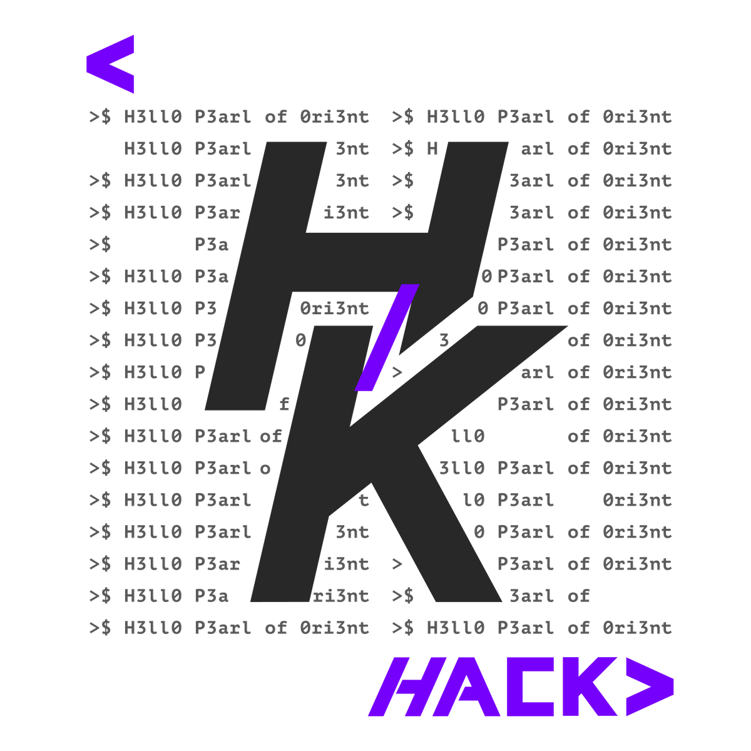
WRAP-UP · 1.5 MIN
Takeaways
1 Reasoning STRUCTURE beats model SIZE
2 FP-reduction is the ROI security teams actually feel
3 Open source (MIT) + full benchmark harness — reproduce every number
4 Validated in the wild — 5 confirmed bugs (flac · libevent · vorbis · gradio · safety), all vendor-engaged, on a $0 model
github.com/vinsoc-cyber/VulnHunterX
github.com/vinsoc-cyber/VulnHunterX
30 / 33
Notes:
Land the takeaways and restate the thesis: structure beats size; FP-reduction is the metric teams
feel; it's open source with a full benchmark harness so every number on the evidence slides is
reproducible; and it holds OUTSIDE the lab — five real, vendor-engaged bugs surfaced on a $0 model.
Two repos on screen: the tool, and the public real-bug confirmations + PoCs. Invite contributions,
then take questions — people screenshot.

